Slide 1

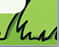
Queensgate’s
‘Raise a SMILE with a Rainbow’
Whole School Project

Slide 2
Section 1:
What are Rainbows?

Slide 3

What Is a Rainbow?
Rainbows are lovely to look at.
A rainbow is an arc made up of seven colours.
A rainbow appears in the sky
when it is raining and sunny
at the same time.
A rainbow will appear
opposite the sun.
Have you ever seen a rainbow?

Slide 4

The Colours of the Rainbow
Do you know the colours of
the rainbow?
Here is a sentence to help you remember the colours of the rainbow:
Richard
red
Of
orange
York
yellow
Richard of York gave battle in vain.
Gave
green
Battle
blue
In
indigo
Vain
violet

Slide 5

Rainbow Symbolism
Rainbows are often seen as signs of hope and peace.
In the Bible, there is a story about Noah building a wooden arc to save himself and his family from a great flood.
God sent a rainbow as a promise that the world would never be destroyed by a flood again.

Slide 6

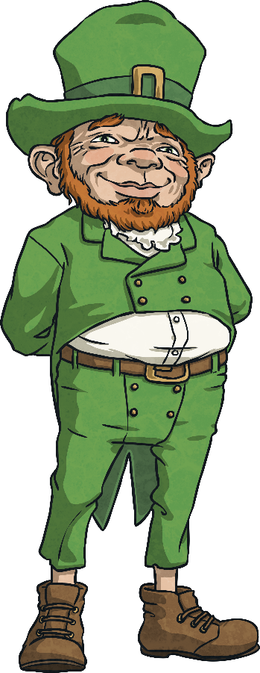
Rainbow Symbolism
Irish folk stories suggest that leprechauns hide their pot of gold at the end of a rainbow and therefore some people believe that rainbows are lucky as there is gold
at the end.

Slide 7
Rainbow Symbolism
Rainbows are a symbol of hope.
Hope is when you wish for something to make yourself or other people happy.
People like to look at pictures of rainbows during difficult times because they make people feel better because happier times aren’t far away.

Slide 8
Section 2:
Why can we see lots of rainbows at the moment?

Slide 9
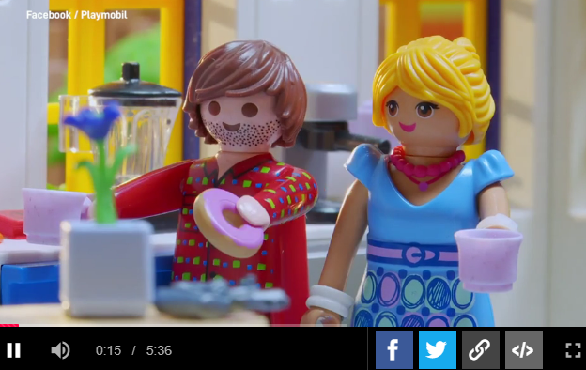
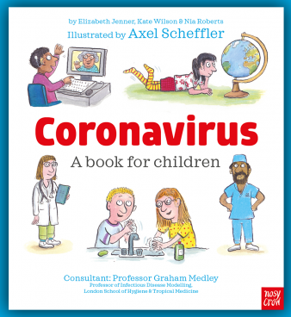
Staying Safe!
At the moment we are all having to stay safe at home.
If you would like to watch a video or read a book to find out why we are having to stay at home, please click on the images which will take you to the weblinks.
Playmobil video
Book by Axel Scheffler

Slide 10
Staying Safe!
Staying at home can be fun but at times it can also make us feel a bit sad because we are all missing our friends and family.
We know this won’t last forever and if we focus on the things that make us happy this will help us feel better.
We have already learnt that rainbows are a sign of hope, they help us to stay positive and look forward to the future.
This is why we are encouraging all the children at Queensgate to ‘Raise a SMILE with a Rainbow’.

Slide 11
Section 3:
Project ‘Raise a SMILE with a Rainbow’

Slide 12
Raise a SMILE with a Rainbow
As part of our ‘Raise a SMILE with a Rainbow’ project, we would like you to…
To design and make something which
can be used by a person who is staying safe at home.

Slide 13
Raise a SMILE with a Rainbow
The thing you make must:
have a rainbow on it – you must have at least one rainbow included in your design.
raise a smile – your product should make the person feel happy when they use it or look at it.
be used at home – your product must be able to be used inside a house or in a garden.
be made from items in your home – you don’t need to buy anything to make your product. Look around your house and see what you can use and recycle.

Slide 14
Raise a SMILE with a Rainbow
As part of our ‘Raise a SMILE with a Rainbow’ DT project, you can choose whether you would like to complete a structure, textile or food and nutrition product.
Structures: Building a structure by joining parts together.
2) Textiles: Joining fabrics together.
3) Food and Nutrition: Creating something you can eat.
You can design and make whatever you would like, however here are some ideas to get you started…

Slide 15
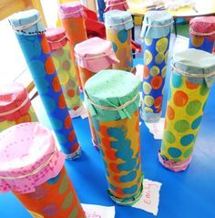
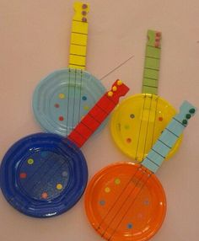
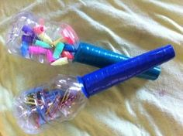
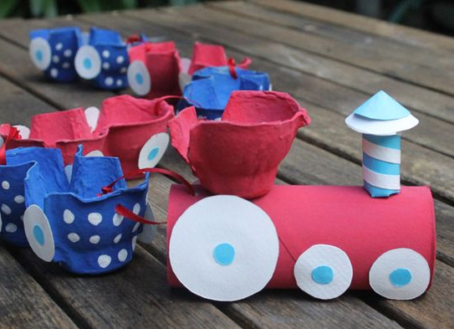
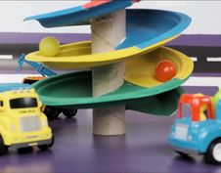
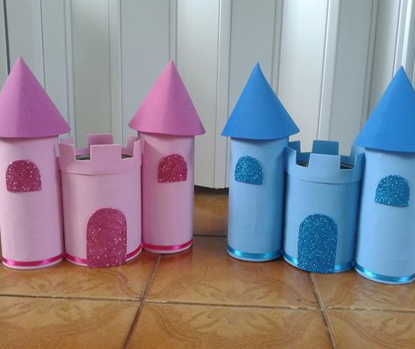
Structure Products
- Toys and musical instrument ideas

Slide 16
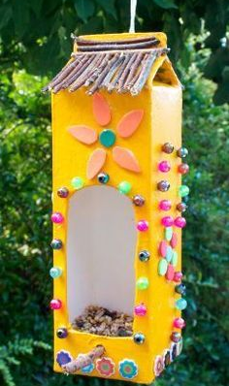
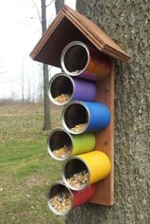
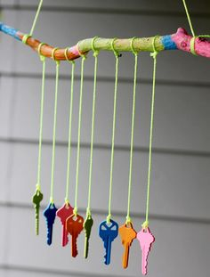
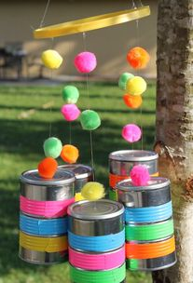
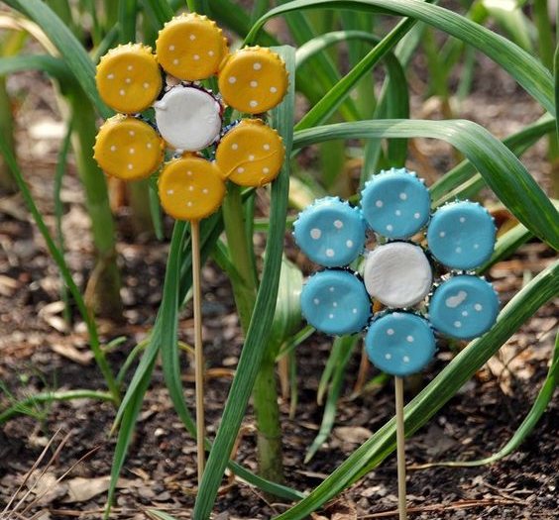
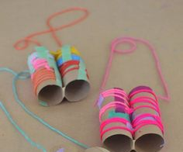
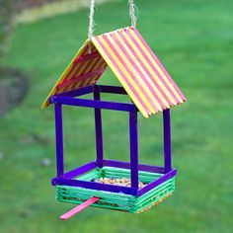
Structure Products
- Outdoor decoration ideas

Slide 17
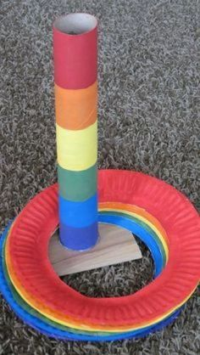
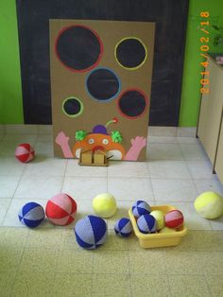
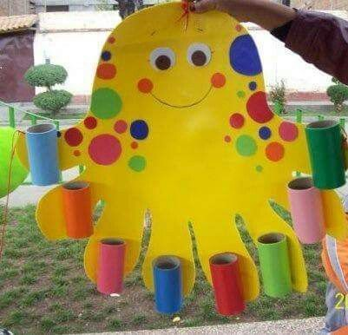
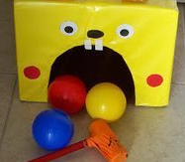
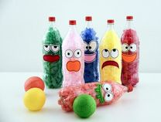
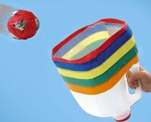
Structure Products
- Outdoor game ideas

Slide 18
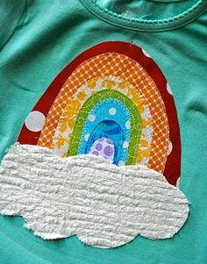
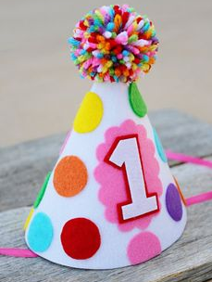
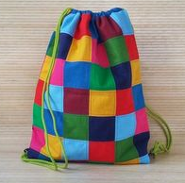
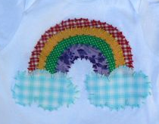
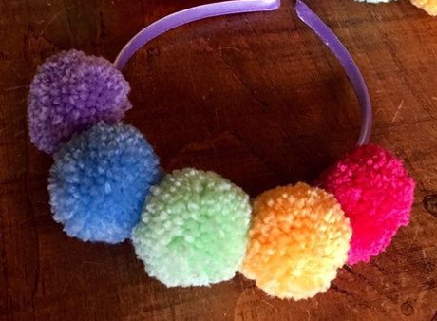
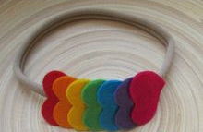
Textile Products
- Wearable clothing/ accessory ideas

Slide 19
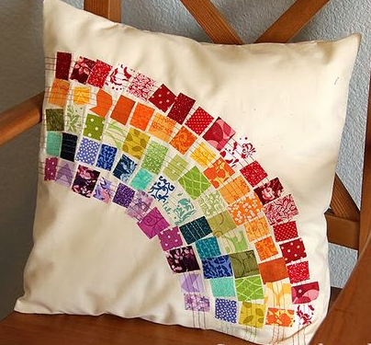
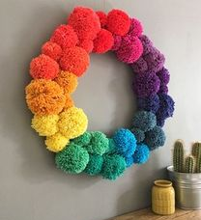
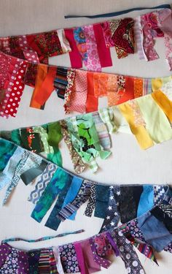
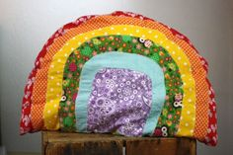
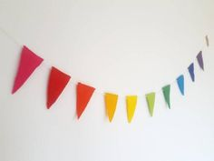
Textile Products
- Soft furnishing ideas

Slide 20
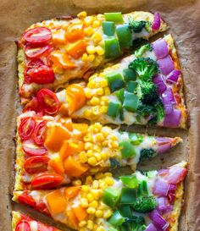
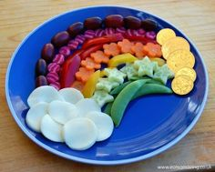
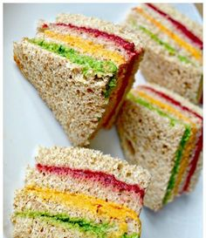
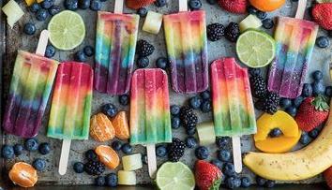
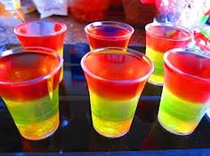
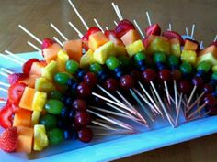
Food Products
- Healthy eating ideas

Slide 21
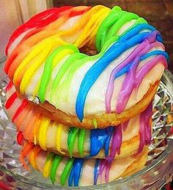
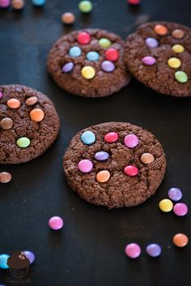
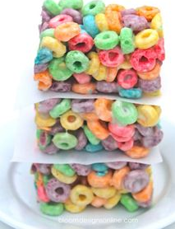
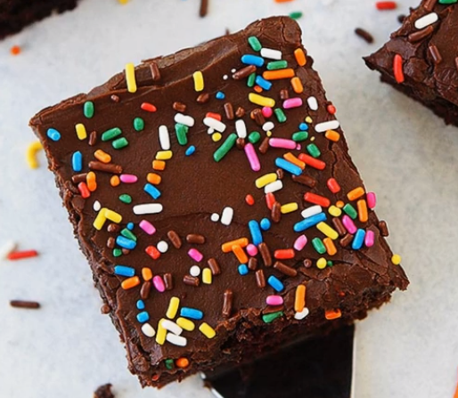
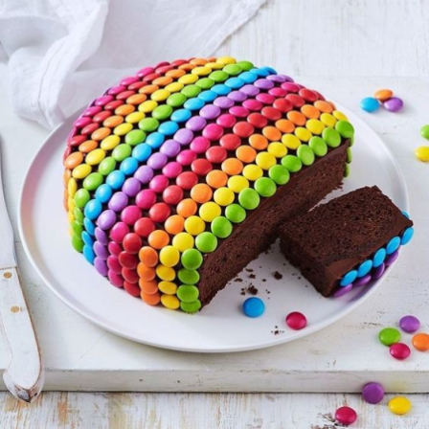
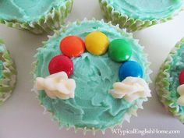
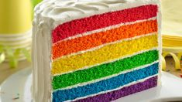
Food Products
- Baking ideas

Slide 22
Section 4:
Design, Make, Evaluate

Slide 23
Design, Make, Evaluate!
Don’t jump straight to the making part of the process. It is important that you follow the ‘Design, Make, Evaluate’ steps in order to create a successful product:
1. Design – Plan your product by asking yourself lots of questions: Who is it for? What resources will you need? What steps do I need to follow?...
2. Make – The fun part, put your plan into action!
3. Evaluate – What went well with the making of your product?
If you were to make it again what would you change to make it even better?

Slide 24
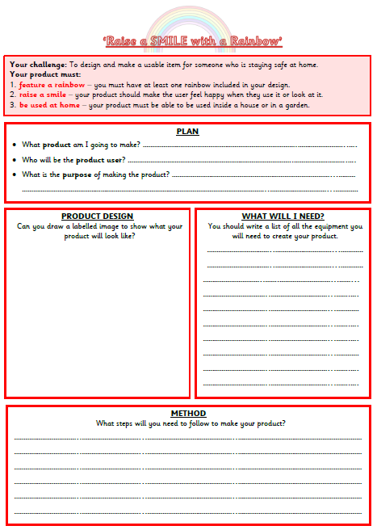
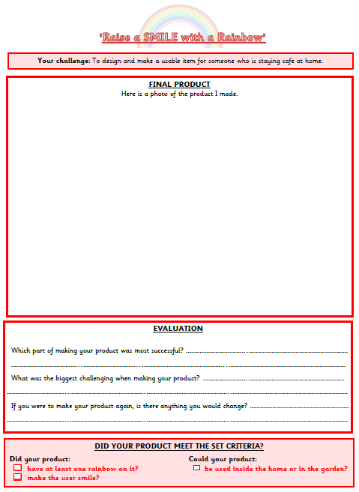
Design, Make, Evaluate!
To help you follow this 3-step process make sure you use the planning and evaluation documents to help!
‘Design, Make, Evaluate’

Slide 25
Section 5:
Let’s raise a SMILE together!

Slide 26
Let’s Raise a SMILE Together!
Once you have finished your project we would love to see what you have created.
It would be great if you could send a photo of your product to admin@queensgate.stockport.sch.uk
To ensure that each email successfully gets to the correct teacher please can you make sure the subject of your email is your year group followed by ‘Raise a SMILE with a Rainbow’ project.
E.G/ Y1C - Raise a SMILE with a Rainbow’ project
‘

Slide 27
Let’s Raise a SMILE Together!
Although we can’t all be together at the moment, we thought it would be lovely to try and share your hard work with all your friends and the Queensgate community.
If you would like to put a photo of your product on the school gates for others to see that would be fantastic!
To do this just print a photo of your product, add your name and year group and laminate it or put it in a plastic wallet (don’t forget to cellotape the edges to seal it).
Then come and attach it to the school fence!
‘

Slide 28
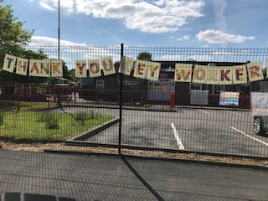
Let’s Raise a SMILE Together!
Creativity is contagious, pass it on!
– Albert Einstein
‘

