Slide 1

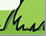
Queensgate’s
‘Raise a SMILE with a Rainbow’
Whole School Project

Slide 2
Contents
Section 1: What are rainbows?
Section 2: Why can we see lots of rainbows at the moment?
Section 3: ‘Raise a SMILE with a Rainbow’ DT Project
Section 4: Design, Make, Evaluate!
Section 5: Let’s SMILE together!

Slide 3
Section 1:
What are Rainbows?

Slide 4

What Is a Rainbow?
What Is a Rainbow?
A rainbow is a formed when light, generally from the Sun, passes through water droplets hanging in the atmosphere. The atmosphere is a layer of gas that surrounds the Earth which enables us to breathe and protects us from harmful radiation from the Sun.
As the waves of light pass through the water droplets, they change direction, resulting in a multicoloured circular arc.
To be able to see a rainbow, you normally need to have your back to the Sun. Rainbows will usually appear in the section of sky directly opposite the Sun.
Did You Know…? Rainbows are actually full circles.

Slide 5

The Colours of the Rainbow
Do you know the colours of the rainbow?
If you don’t, there is a rhyme that can help you remember them:
Richard Of York Gave Battle In Vain.
R for red,
O for orange,
Y for yellow,
G for green,
B for blue,
I for indigo and
V for violet!

Slide 6

What Rainbows Represent
Rainbows have represented good luck and hope for humans throughout history.
In the Bible, the book of Genesis tells the story of Noah and the great flood. At the end of the story, the rainbow represents God’s promise to never destroy life on earth with a global flood again.
Rainbow flags have also been used to represent ideas of freedom and multiculturalism. In the German Peasants' War of the 16th century, it was used as the sign of a new era of hope and social change. In Italy, the rainbow flag was first used in a peace march in 1961 as a symbol of peace. Since 1978, it has been used by gay pride and LGBTQ+ movements to represent diversity.

Slide 7
Section 2:
Why Can We See Lots of Rainbows at the Moment?

Slide 8
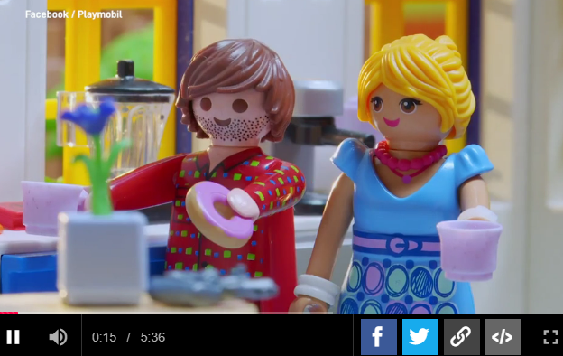
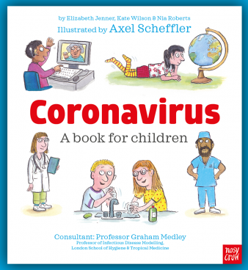

Staying Safe!
At the moment we are all having to stay safe at home.
If you would like to watch a video or read a book to find out why we are having to stay at home, please click on the images which will take you to the weblinks.
Playmobil video
Book by Axel Scheffler

Slide 9
Staying Safe!
Staying at home can be fun but at times it can also make us feel a bit sad because we are all missing our friends and family.
We know this won’t last forever and if we focus on the things that make us happy this will help us feel better.
We have already learnt that rainbows are a sign of hope, they help us to stay positive and look forward to the future.
This is why we are encouraging all the children at Queensgate to ‘Raise a SMILE with a Rainbow’.

Slide 10
Section 3:
Project ‘Raise a SMILE with a Rainbow’

Slide 11
Raise a SMILE with a Rainbow
At school we complete lots of different projects which cover the five areas of DT:
Structures
Mechanisms
Textiles
Food and Nutrition
Electrical Systems
Design and Technology encourages creativity though a process of ‘design, make, evaluate’.
As designers, our aim is always the same:
to make a purposeful product for an intended audience.

Slide 12
Raise a SMILE with a Rainbow
Therefore your mission is…
To design and make a usable item for someone who is staying safe at home.

Slide 13
Raise a SMILE with a Rainbow
Criteria
Your product must:
feature a rainbow – you must have at least one rainbow included in your design.
raise a smile – your product should make the user feel happy when they use it or look at it.
be used at home – your product must be able to be used inside a house or in a garden.
be made from items in your home – you don’t need to buy anything to make your product. Look around your house and see what you can reuse and recycle.

Slide 14
Raise a SMILE with a Rainbow
As part of our ‘Raise a SMILE with a Rainbow’ DT project, you can choose whether you would like to complete a structure, textile or food and nutrition product.
Structures: Building a structure which involves joining parts together to create a finished product.
2) Textiles: Joining fabrics together to create a usable item.
3) Food and Nutrition: Creating an editable dish.
You can design and make whatever you would like, however here are some ideas to get you started…

Slide 15
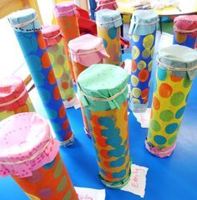
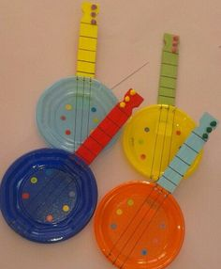
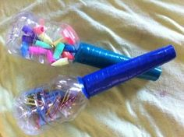
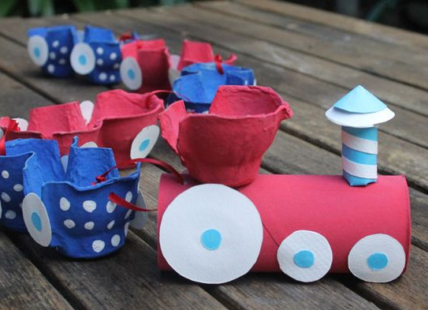
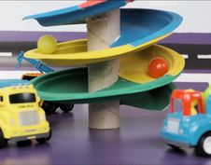
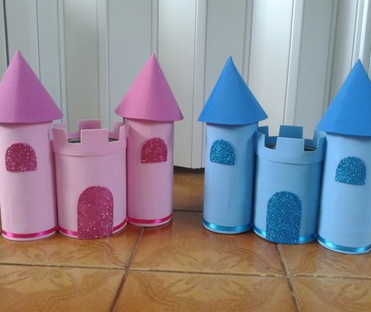
Structure Products
- Toys and musical instrument ideas

Slide 16
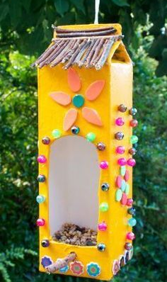
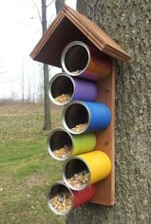
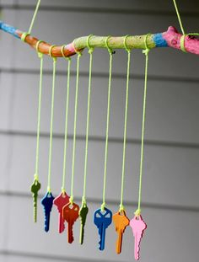
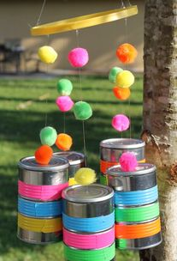
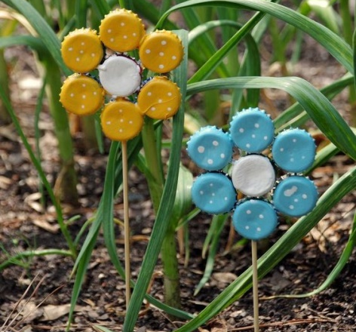
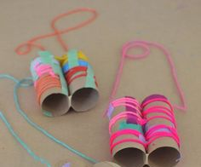
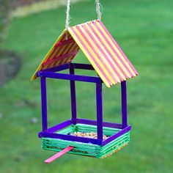
Structure Products
- Outdoor decoration ideas

Slide 17
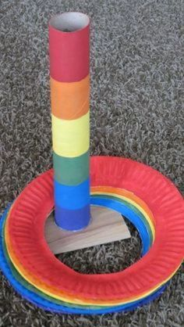
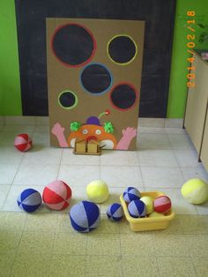
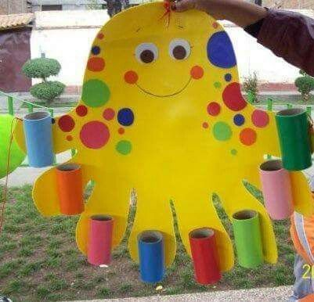
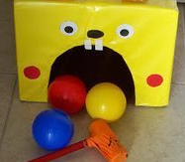
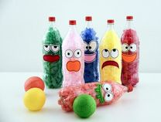
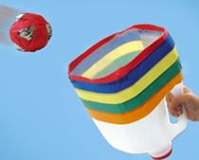
Structure Products
- Outdoor game ideas

Slide 18
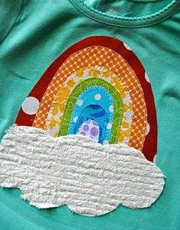
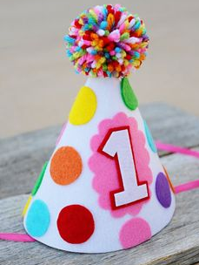
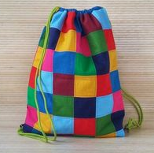
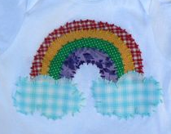
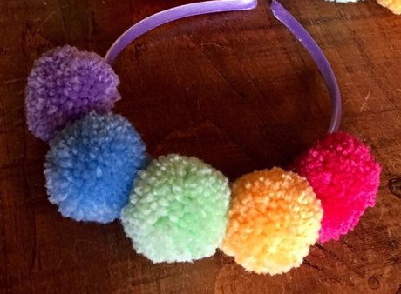
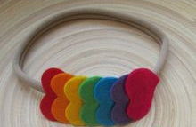
Textile Products
- Wearable clothing/ accessory ideas

Slide 19
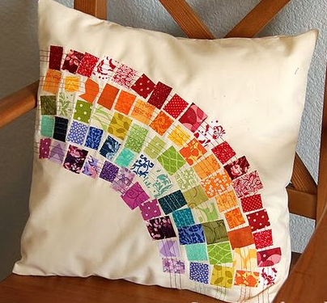

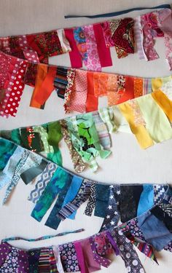
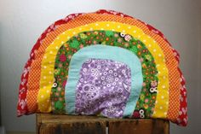
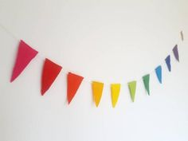
Textile Products
- Soft furnishing ideas

Slide 20
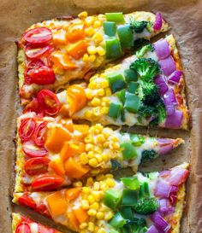
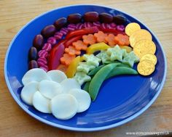
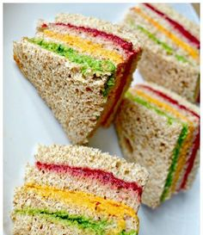
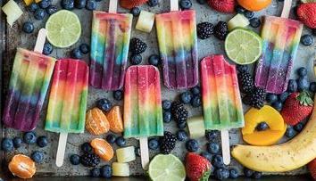
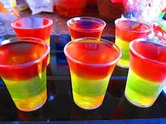
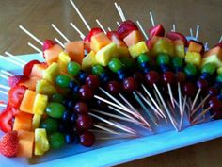
Food Products
- Healthy eating ideas

Slide 21

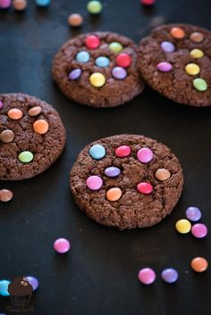
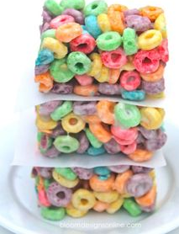
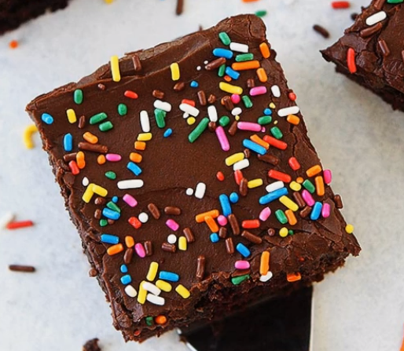
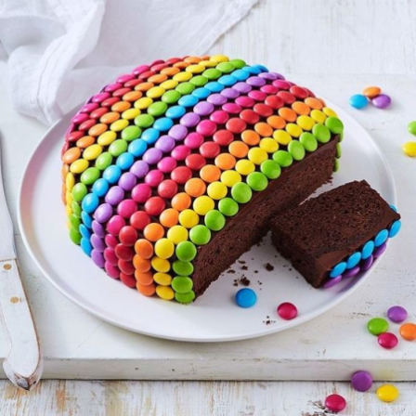
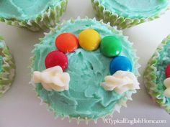

Food Products
- Baking ideas

Slide 22
Section 4:
Design, Make, Evaluate

Slide 23
Design, Make, Evaluate!
Don’t jump straight to the making part of the process. It is important that you follow the ‘Design, Make, Evaluate’ steps in order to create a successful product:
1. Design – Plan your product by asking yourself lots of questions: Who is it for? What resources will you need? What steps do I need to follow?...
2. Make – The fun part, put your plan into action!
3. Evaluate – What went well with the making of your product?
If you were to make it again what would you change to make it even better?

Slide 24
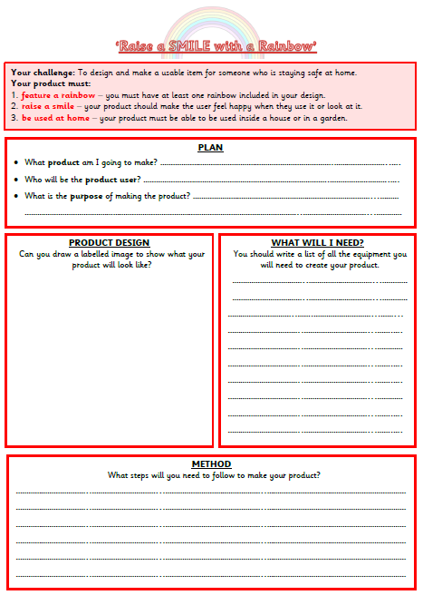
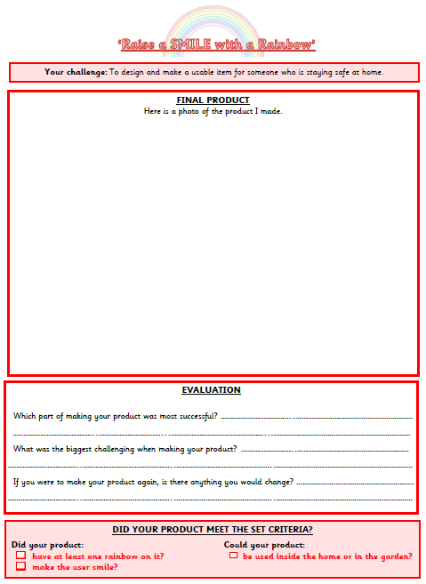
Design, Make, Evaluate!
To help you follow this 3-step process make sure you use the planning and evaluation documents to help!
‘Design, Make, Evaluate’

Slide 25
Section 5:
Let’s raise a SMILE together!

Slide 26
Let’s Raise a SMILE Together!
Once you have finished your project we would love to see what you have created.
It would be great if you could send a photo of your product to admin@queensgate.stockport.sch.uk
To ensure that each email successfully gets to the correct teacher please can you make sure the subject of your email is your year group followed by ‘Raise a SMILE with a Rainbow’ project.
E.G/ Y3 – ‘Raise a SMILE with a Rainbow’ project
‘

Slide 27
Let’s Raise a SMILE Together!
Although we can’t all be together at the moment, we thought it would be lovely to try and share your hard work with all your friends and the Queensgate community.
If you would like to put a photo of your product on the school gates for others to see that would be fantastic!
To do this just print a photo of your product, add your name and year group and laminate it or put it in a plastic wallet (don’t forget to cellotape the edges to seal it).
Then come and attach it to the school fence!
‘

Slide 28
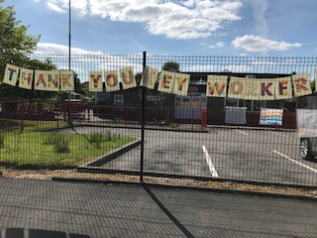
Let’s Raise a SMILE Together!
Creativity is contagious, pass it on!
– Albert Einstein
‘

