Slide 1
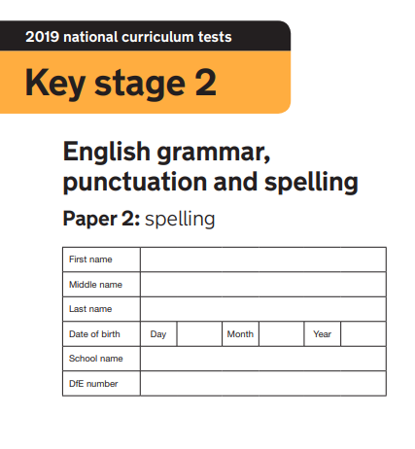
2020
Made by @mrbrownteach

Slide 2

Corey and Lulah-Beau bought a __________ for their mum
Alfie B wanted to be a __________
For lunch, Lyla and Warren ate a __________
Millie’s party was a really good __________!
The shop accepted Alex’s __________ as payment
Jacob went fishing and caught a __________
Joshua E and Frank loved to play __________
Oliver and Amani chased the car with a __________ in hand
Lilly’s gloves were made with natural __________
Katie shouted __________ Joshua H stole his shorts

Slide 3
Grace __________ her homework
To be a real __________, Olivia had to work hard
Effie ate her __________ with Ayaan and Anaya at break
Ava had __________ brothers and one sister
Hunter bought a new dog for James; it was a __________
Alfie R tricked William and Bea __________ they all cried
Serena told Lotta to __________
TJ had not seen her __________ for 3 years
Nancy’s clock would not __________
Mr Knowles’ class are __________

