Slide 2
Notes for parents
The games and activities on these slides reinforce what we have done in previous learning at school. The children do not have to do them all in one go as there are quite a few. Each page could be talked about, written down or a mixture of the two. why not do one activity every day?
Some help with reading might be necessary and that is absolutely fine.
An extension would be to write some of their own sentences about what they have done that day.eg. Today I baked a cake and I played on my swing.

Slide 3
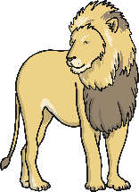

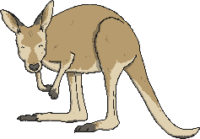



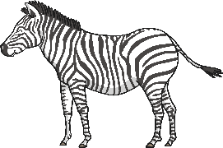

Can you complete the sentences to describe what each child saw at the zoo? Remember to use the word and to join the two animals together.
I went to the zoo and I saw
a lion and a penguin.
I went to the zoo and I saw
a kangaroo and a parrot.
I went to the zoo and I saw
a tiger and a panda.
I went to the zoo and I saw
a zebra and a hippo.
Show answers

Slide 4
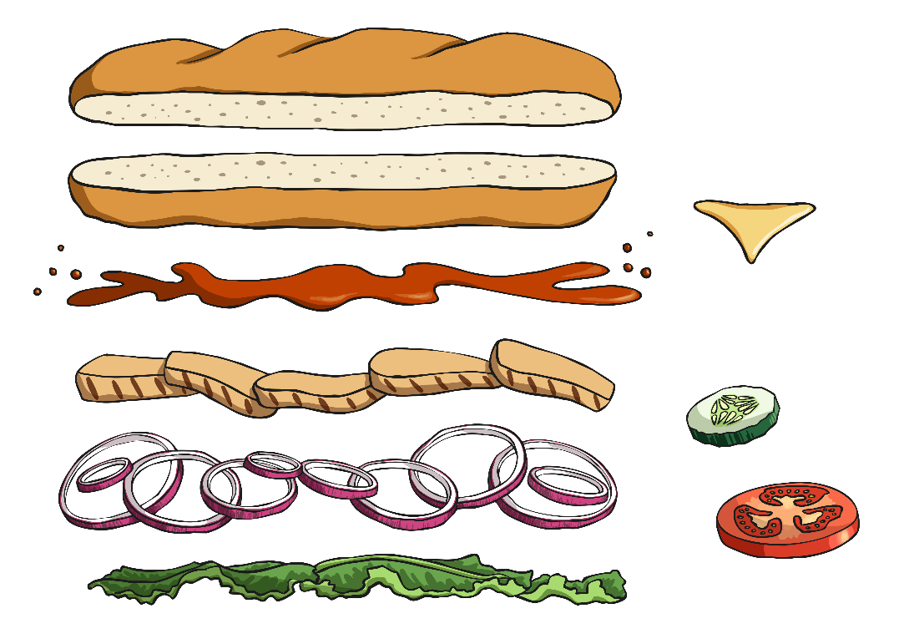




The word and is a bit like the filling of a sandwich that keeps two parts of a sentence together. Can you read the sentences on the bread and then choose which two sentences go together with and as the filling?
The football lesson was long
Finish your broccoli
We played on the slide
Alex wore a smart jacket
and
and
and
and
shiny shoes.
Ali was tired.
the swings at the park.
you can have some ice cream.
Show answers

Slide 5







Can you write a sentence to describe what each of these characters have in their suitcases using the word and to join the parts of your sentence together?
She has _____________.
She has _____________.
a cape and a basket
a crown and a pea
Little Red Riding Hood
The Princess and the Pea
Who do you think each of these suitcases belong to?
Show answers
He has _____________.
boots and a hat
Puss in Boots

Slide 6



Can you put the jigsaw pieces together to make sentences? Remember, each sentence should have the word and in the middle.
At my party we will play games
They worked really hard
and
Her favourite foods were jelly
He has red hair
eat birthday cake.
and
ice cream.
they won the prize.
and
a long nose.
and
Show answers

Slide 7



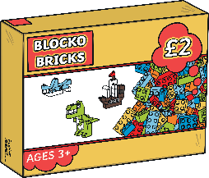
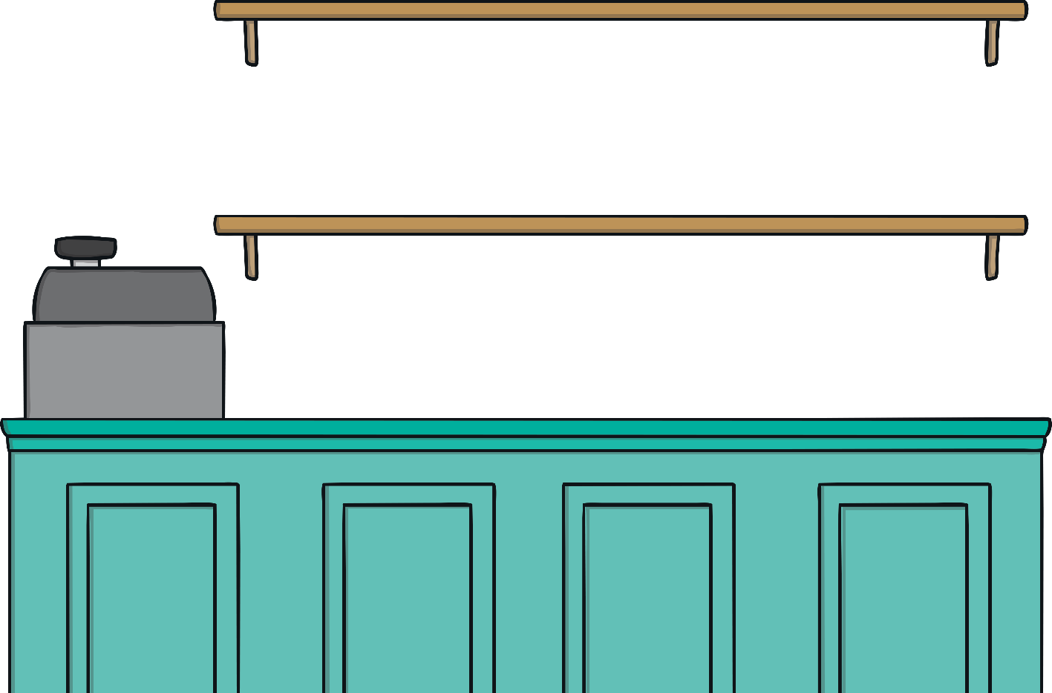


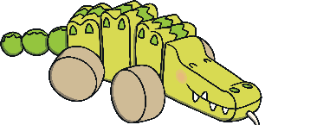

You are allowed to buy two things from the toy shop. Write a sentence to say which two things you want to buy, using the word and to join the different parts of your sentence.
I want to buy...
How many different sentences can you write, saying two toys that you want to buy?

Slide 8
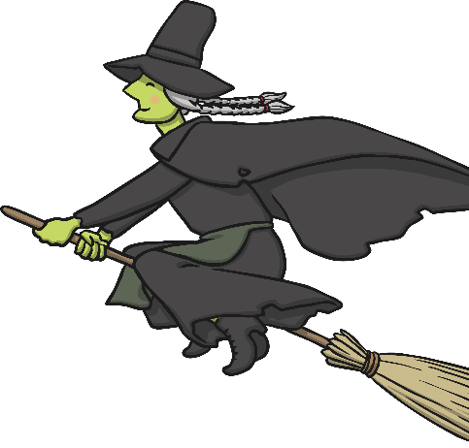


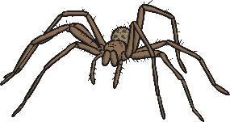

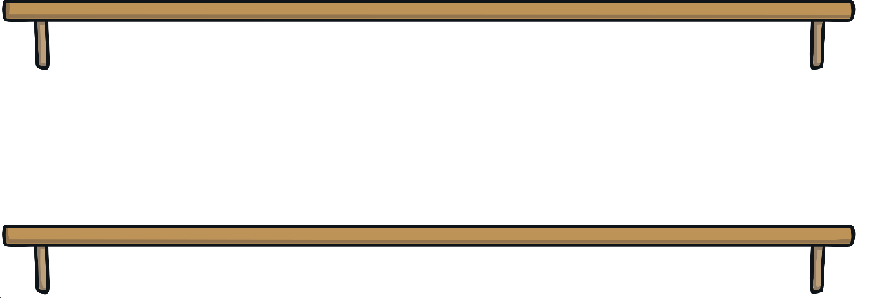




Can you help the witch to make her magic spell? Each spell can only use two ingredients from the witch’s cupboard. Write a sentence to say which two ingredients you would put into the witch’s cauldron, using the word and to join the different parts of your sentence.
How many different sentences can you write, saying two things that you would put in the cauldron?
I put in…

Slide 9
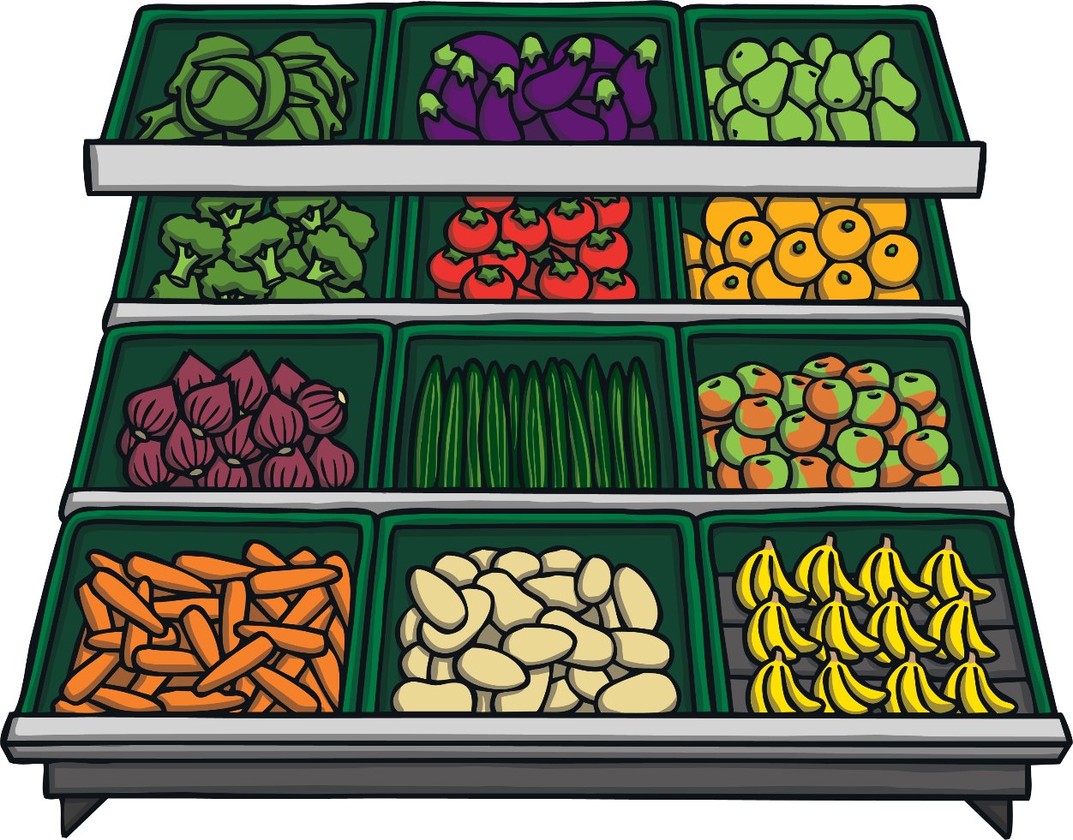
You are allowed to buy two things from the fruit and vegetable shop. Write a sentence to say which two fruits or vegetables you will buy, using the word and to join the different parts of your sentence.
I will buy…
How many different sentences can you write, saying two things that you will buy?

Slide 10

Spin the spinners! Write a silly sentence that includes the words chosen by both spinners and uses the word and to join the different parts of your sentence.
spaghetti
socks
a baby
a granny
a unicorn
an alien
mud
baked beans
spin!
spin again!
and again!
one more time!
Example: The monster ate socks and a granny for breakfast.

