Slide 1
photography
Composition & Expression
Principles of Organization

Slide 2

History of photography
1826- first permanent photographic image
1861- first color photo was taken
1926- first under water photo was taken , color
1991- first still digital camera was used

Slide 3
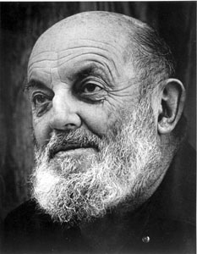
Ansel Adams
born in San Francisco 1902, died in Monterey, California in 1984
photographer and environmentalist
After the major San Francisco earthquake in 1906 he was knocked to the ground and broke his nose which scarred him for life
elderly parents, affluent family history, and the live-in presence of his mother's maiden sister and aged father all combined to create a conservative, Victorian environment
Natural shyness , intensity of genius, and his dramatically "earthquaked" nose-caused Adams to have problems fitting in at school
In later life he noted that he might have been diagnosed as hyperactive.
There is also the distinct possibility that he may have
suffered from dyslexia.

Slide 4
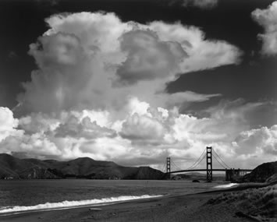
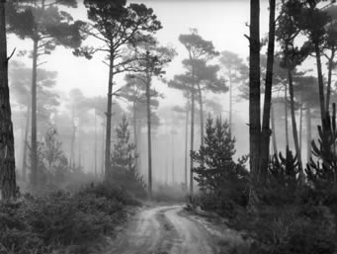
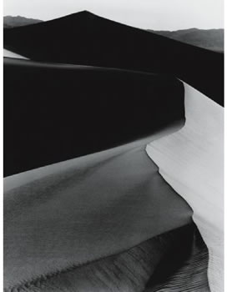
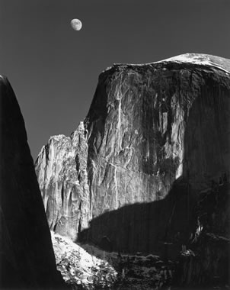

Slide 5
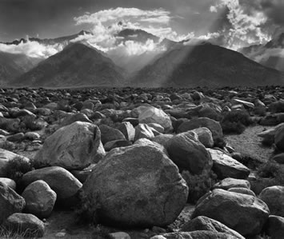
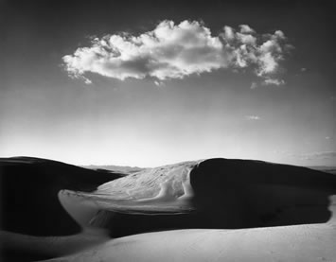
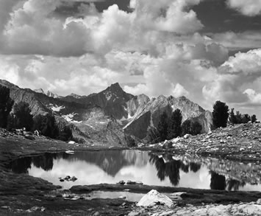
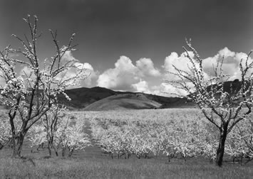

Slide 6
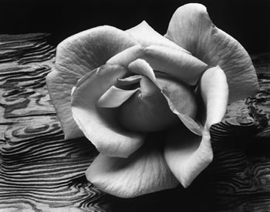
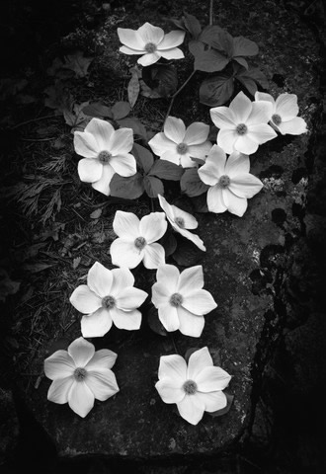
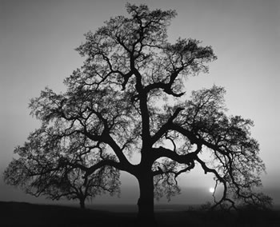

Slide 7
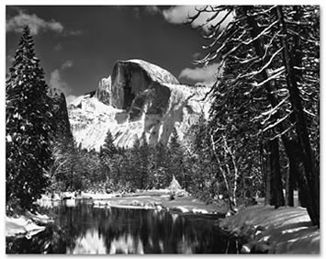
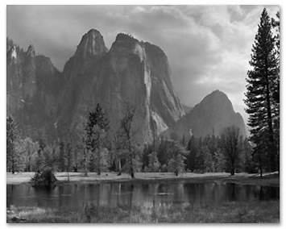
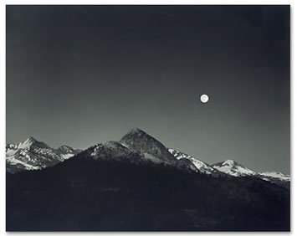
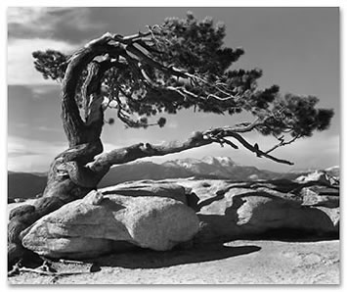

Slide 8




Anne Geddes
Was born in Queensland Australia in 1956
self-taught, her career started until she was 25
Her work has been published in 83 countries- North America, Europe, the United Kingdom, Australia, New Zealand, South America, the Middle East, Africa, and Asia.
Anne’s books have sold more than 18 million copies worldwide

Slide 9


Slide 10
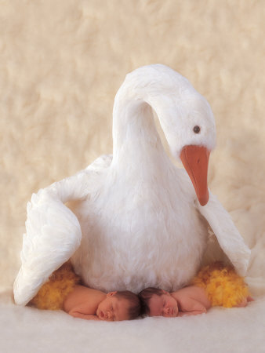
Anne Geddes
deeply held belief that each and every child must be protected, nurtured, and loved
In 1991 she made a company called Next Generations Enterprises Ltd. with money going to preventing child abuse
US $4.5 million have been donated to help prevent child abuse and neglect in Australia, New Zealand, France, the United Kingdom, and the United States.

Slide 11
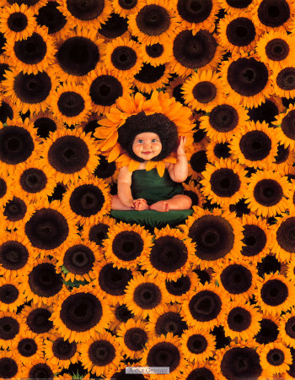
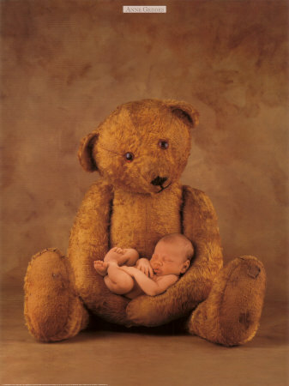
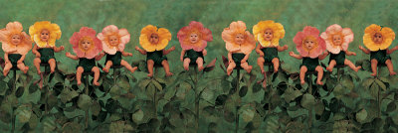

Slide 12
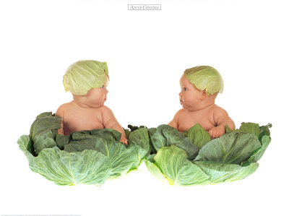
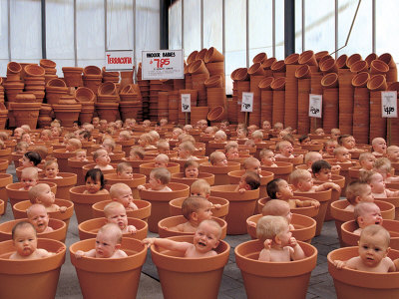

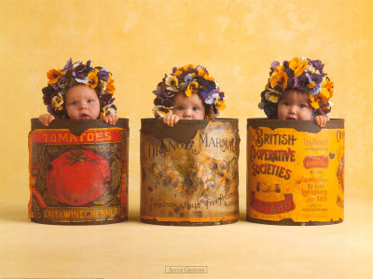

Slide 13

Andy Goldsworthy
Born in Cheshire, England in 1956
Art created in England, Northern Territories of Canada, the North Pole, Japan, the Australian outback, St Louis, and Missouri.
The materials he uses are those to hand in the remote locations he visits: twigs, leaves, stones, snow and ice, reeds and thorns.
The works are recorded as photographs.
Book publication is an important aspect of Andy Goldsworthy's work: each publication is a work of art in its own right.

Slide 14
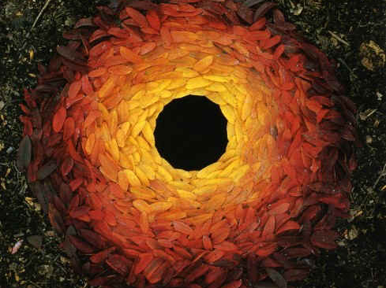
Notes:
What materials did he use? How do you think he made the black circle in the middle?

Slide 15
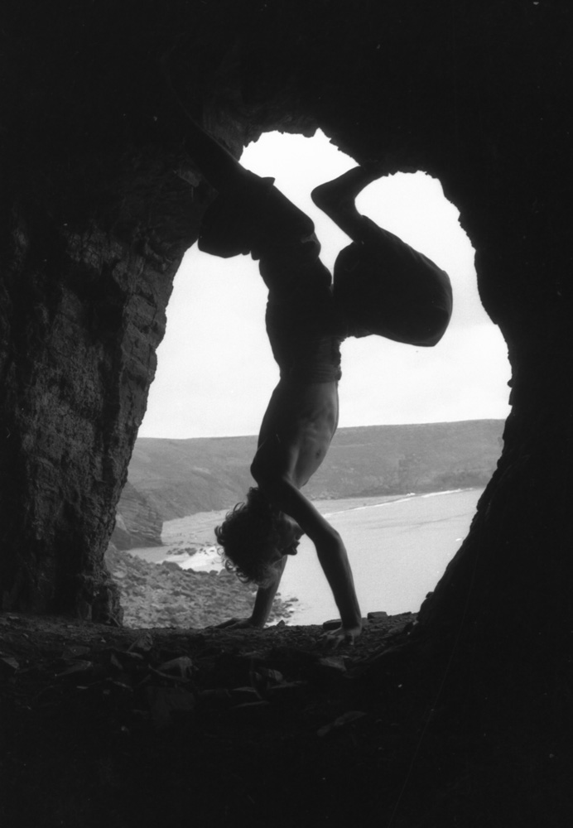
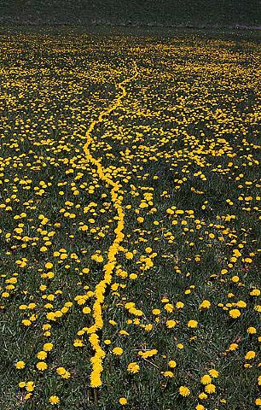
Notes:
What do you notice about this picture?

Slide 16
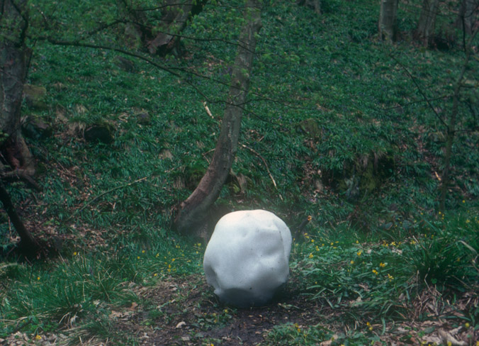
Notes:
What do you think this is made from? How has he made such a pretty effect with the pebbles?

Slide 17
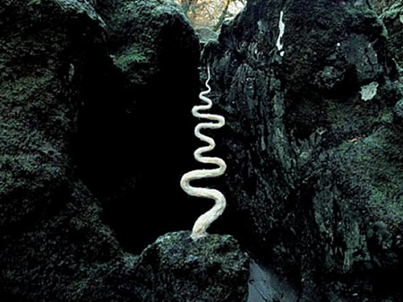
Notes:
Cn you guess what this is made from? Can you guess how he made it?

Slide 18
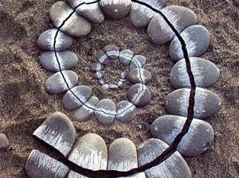

Slide 19
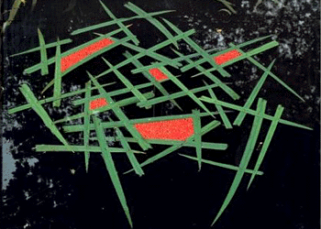

Slide 20
Composition
the act of composing the image in the viewfinder, is a visual process of organizing the elements and individual details of a scene into a balanced and pleasing arrangement.
Because what one person finds pleasing, someone else will not, composition is largely a matter of personal taste
There is no right or wrong composition in photography

Slide 21
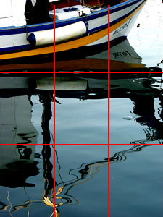
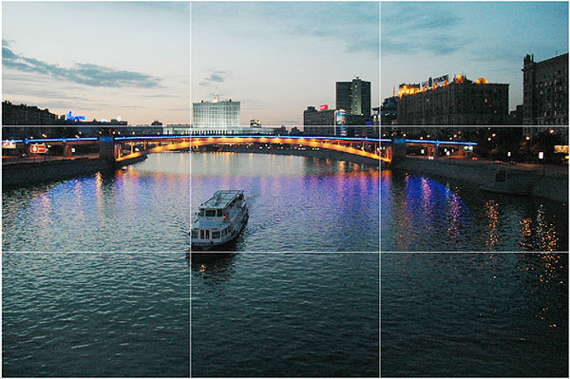
Rule of Thirds
based on the fact that the human eye is naturally drawn to a point about two-thirds up a page.
Crop your photo so that the main subjects are located around one of the intersection points rather than in the center of the image:

Slide 22
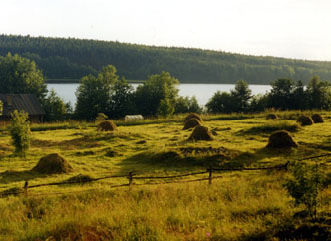
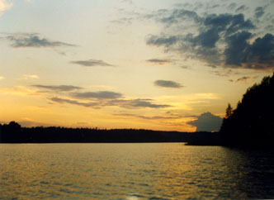
Rule of Thirds
landscapes used Rule of Thirds when you place your horizon line
If the area of interest is land or water, the horizon line will usually be two-thirds up from the bottom
But, if the sky is the area of emphasis, the horizon line may be one-third up from the bottom, leaving the sky to take up the top two-thirds of the picture:

Slide 23
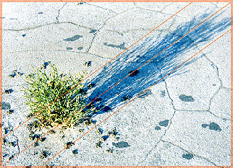
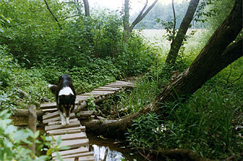
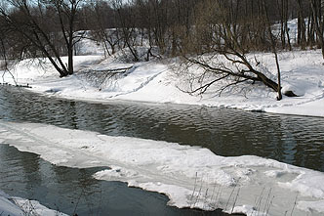
Diagonal Rule
Setting your subject matter on a diagonal will almost always make for a more dynamic picture.
Even if this is an invisible diagonal that draws your eye between two points.
Move around the subject and look for a diagonal.
Linear elements, such as roads, waterways, and fences placed diagonally, are generally perceived as more dynamic than horizontally placed ones:

Slide 24
Your turn!
Demonstrate the Rule of Thirds
Capture a picture showing the Diagonal Rule

