Slide 1
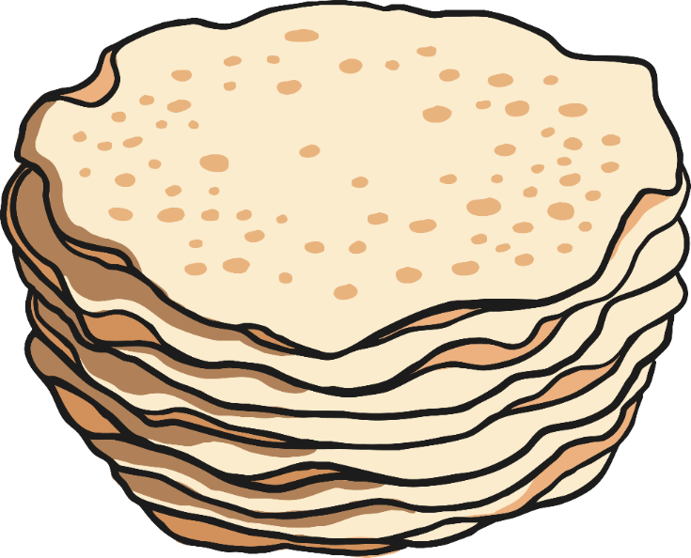
All About
Pancake Day

Slide 2
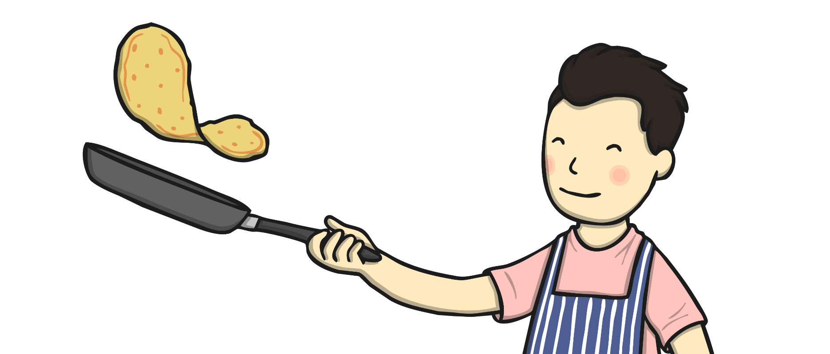

What Is Pancake Day?
Pancake Day
is also called
Shrove Tuesday.
It is celebrated on
the Tuesday before Lent begins.
Lent is a time when Christians are getting ready for Easter.

Slide 3
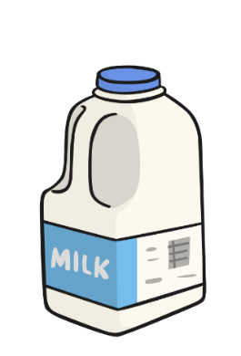
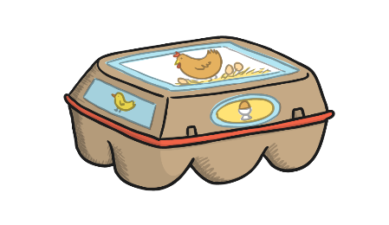
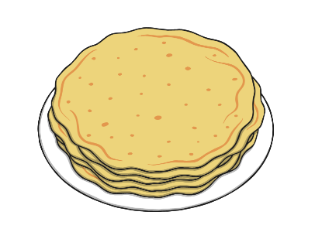
Why Do People Eat Pancakes on Shrove Tuesday?
In the past, people gave up food like eggs, milk and sugar at Lent.
The day before Lent began, they would use up all these foods by making pancakes.
That is why
people eat pancakes on Pancake Day!

Slide 4
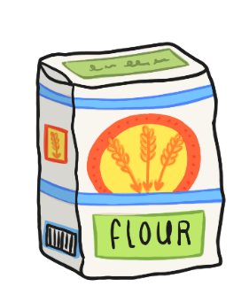

What Are Pancakes Made From?
Pancakes are made from batter. The batter is made using:
flour
eggs
milk

Slide 5
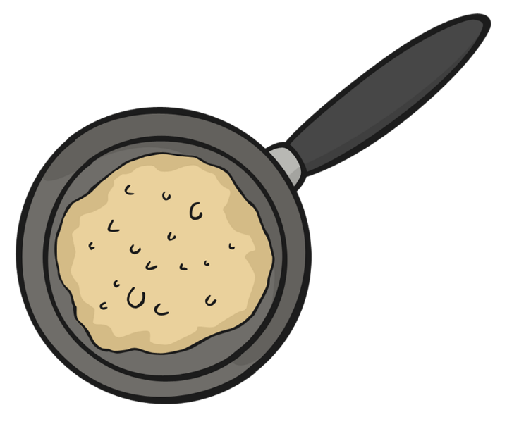
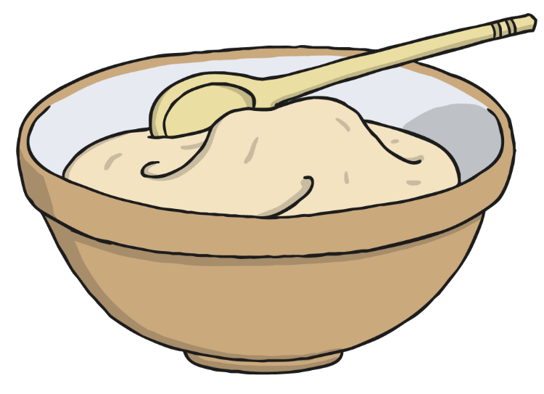
How Do We Make Pancakes?
We mix all these ingredients together.
Then we put the batter in a frying pan and cook it.

Slide 6




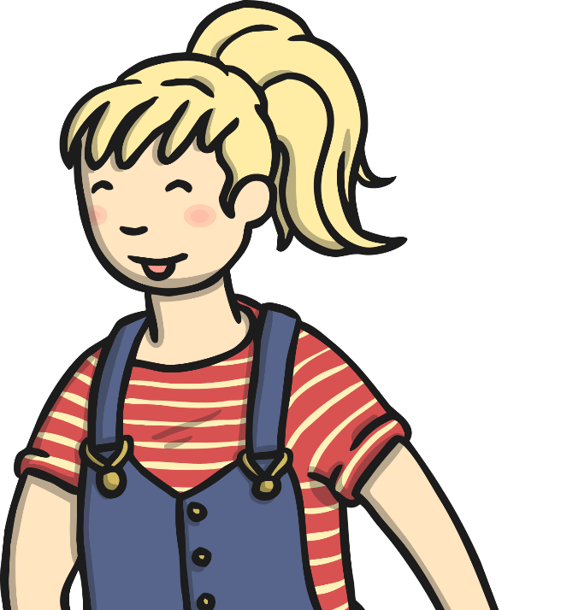


How Do We Eat Pancakes?
When the pancake is cooked, we serve it with our favourite toppings, like lemon juice and sugar.
What is your favourite topping?

Slide 7
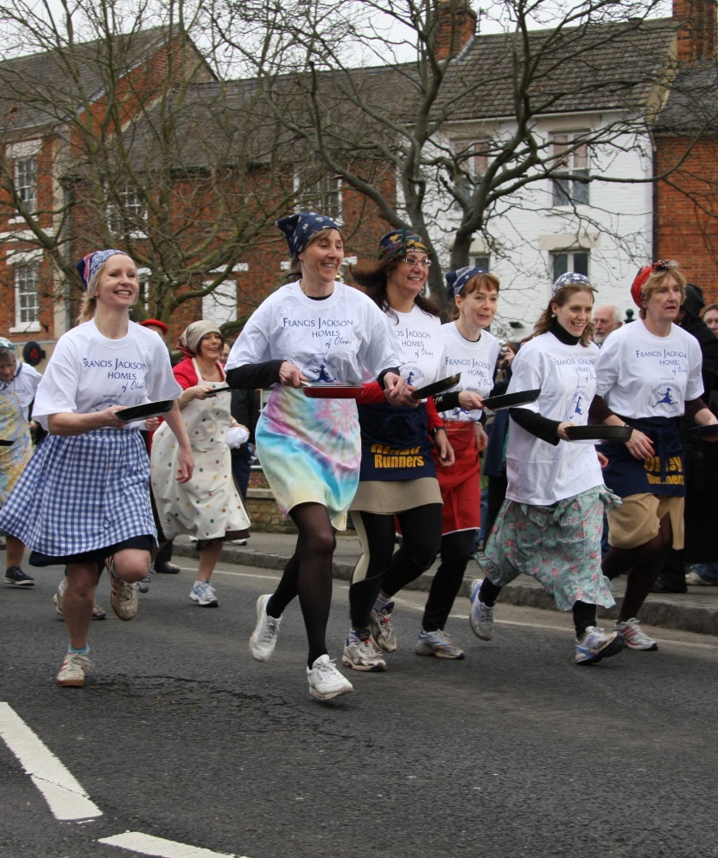

Pancake Racing
People often have pancake races.
They run, sometimes in fancy dress, whilst tossing a cooked pancake in a frying pan at the same time.
The first person to cross the finish line is the winner!
winner
Photo courtesy of robinmyerscough (@flickr.com) - granted under creative commons licence - attribution

Slide 8
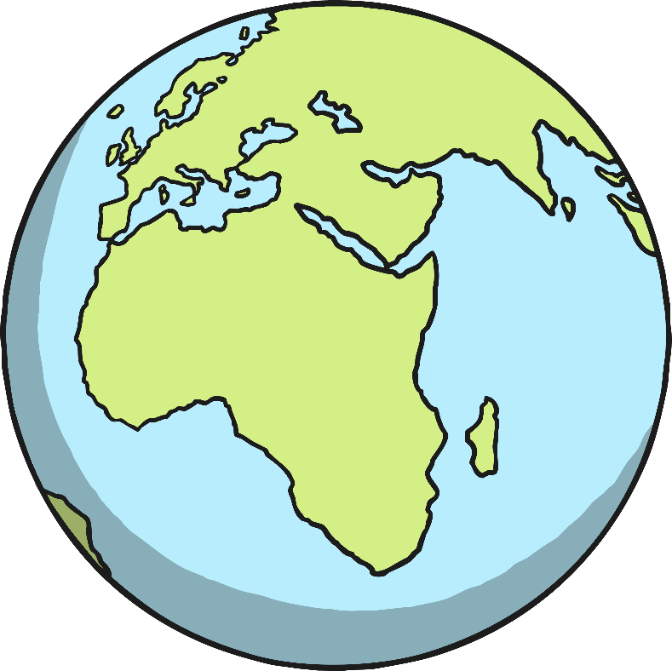
How Do Other Countries
Celebrate Pancake Day?

Slide 9
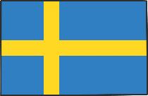
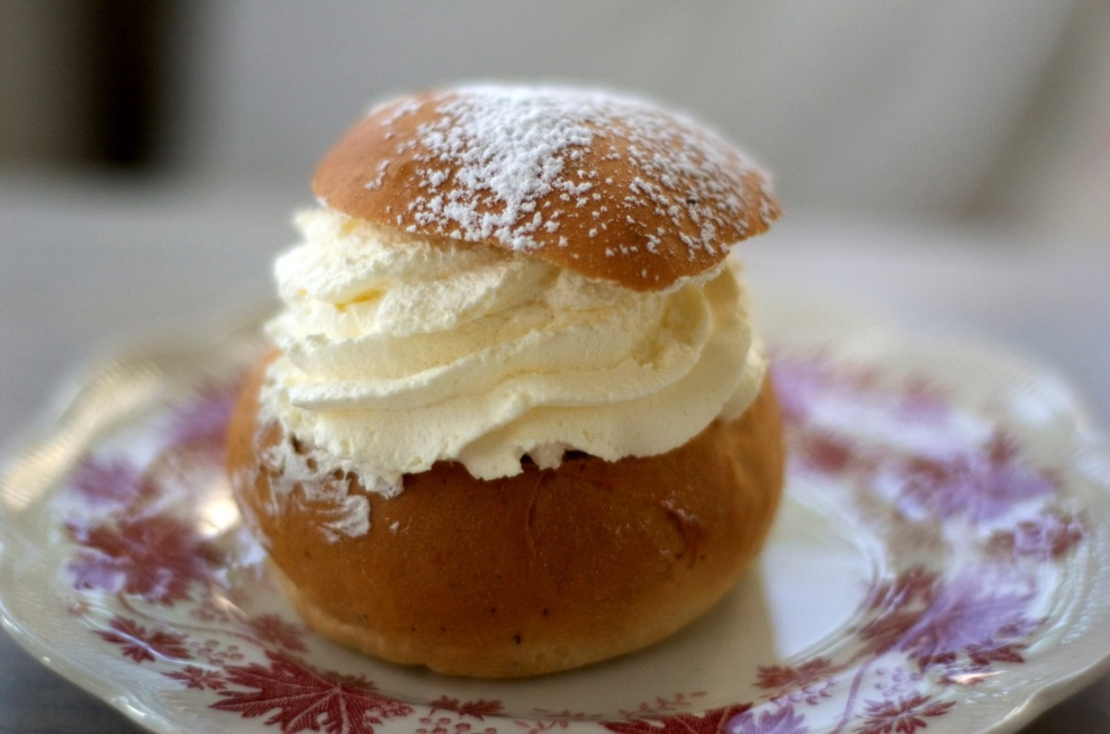
Sweden
The Swedish call Pancake Day ‘Fettsdagen’, which means ‘Fat Tuesday’. They eat a pastry called Semla instead of pancakes.
Photo courtesy of hepp (@flickr.com) - granted under creative commons licence - attribution

Slide 10
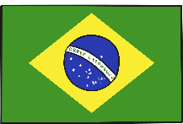
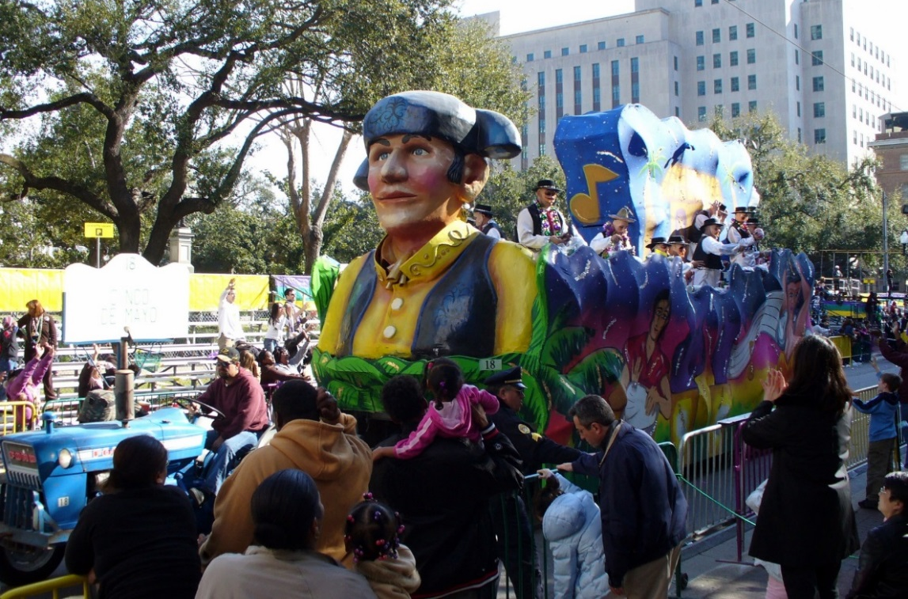
Brazil
Pancake Day is called ‘Mardi Gras’ here as well as many other catholic and Protestant countries.
Photo courtesy of Mr. GunnText4 (@flickr.com) - granted under creative commons licence - attribution

Slide 11

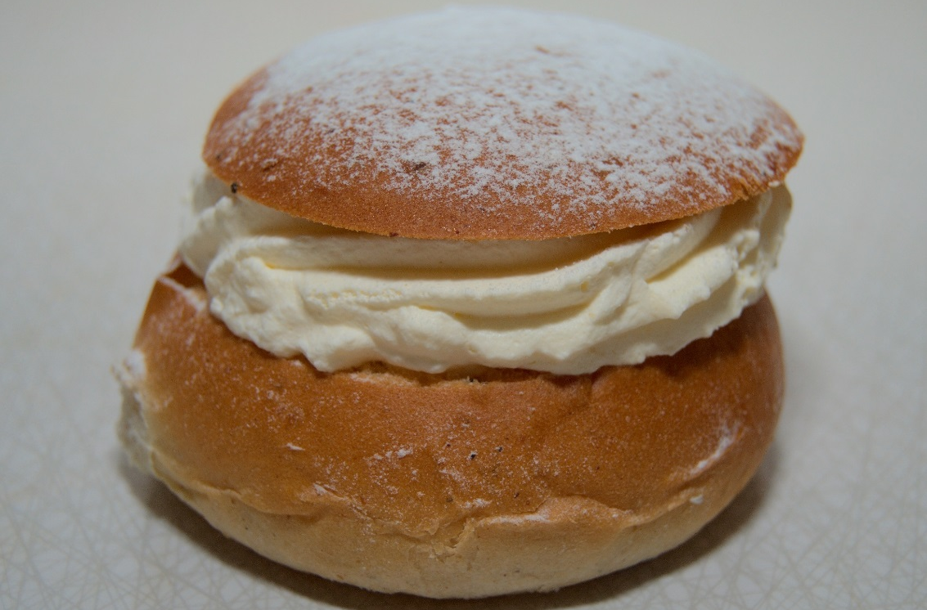
Estonia
Pancake Day is ‘Laskiainen’ in Estonia and they eat pea soup along with cream buns called ‘Vastlakukkel’.
Photo courtesy of awkward.aardwolf (@flickr.com) - granted under creative commons licence - attribution

Slide 12
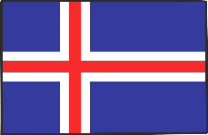
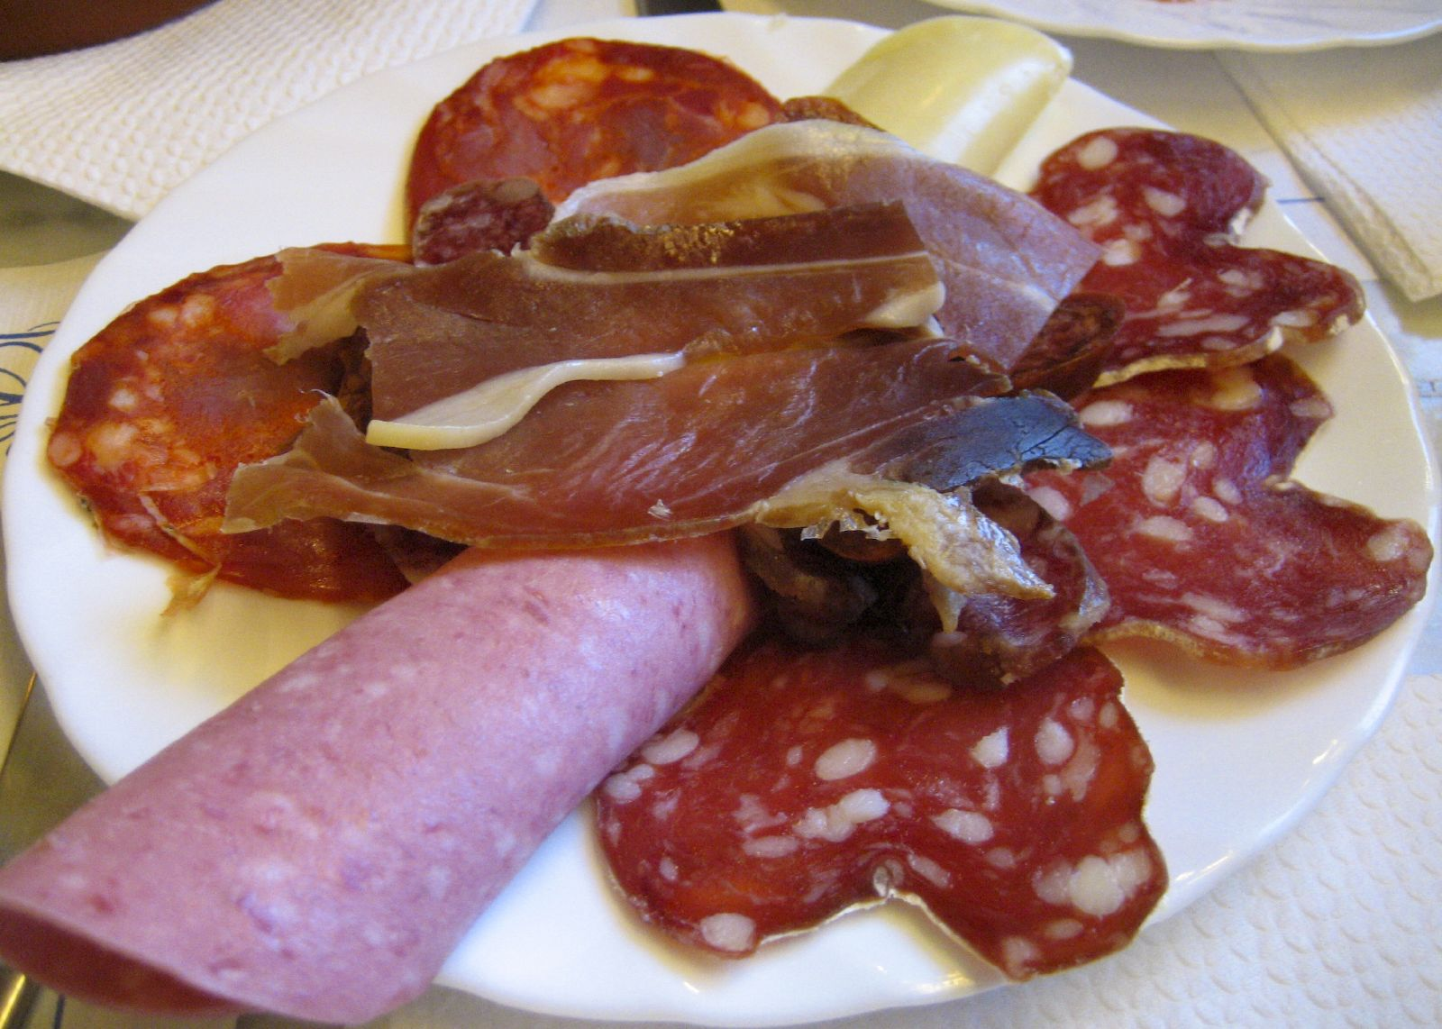
Iceland
Iceland call their Pancake Day ‘Sprengidagur’, which means ‘Bursting Day’. They eat salted meats and peas.
Photo courtesy of subtle_devices (@flickr.com) - granted under creative commons licence - attribution

Slide 13
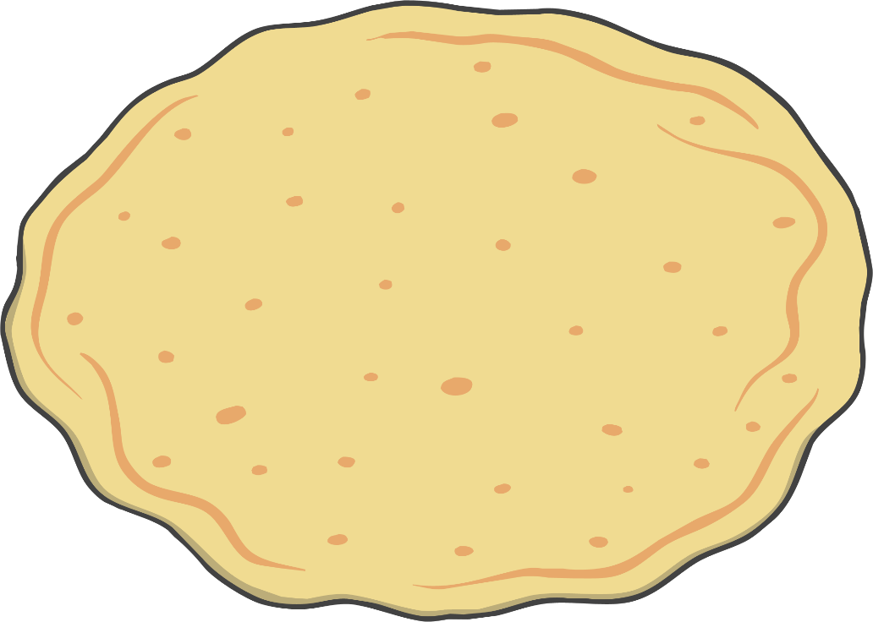
Fun Fact
Did you know...
...the biggest pancake in the world measured over 15 metres long!

