Slide 1



Mount Carmel RC Primary School Award Ceremony
School logo here
Sandwell Wellbeing Charter Mark

Slide 2


For the last year…
The staff and pupils at Mount Carmel have been working very hard on a special project.
The project was about making sure everyone in your school feels listened to, safe and supported.

Slide 3




We collected lots of information about our school…
All the information was very helpful and showed both what people loved about Mount Carmel and what they wanted to make better.
Mount Carmel was already a great school but to earn an award for your school, you had to do lots of work to show you could be even better!!
Grace and Sam assistant psychologists from Catalyst came to school and listened to you, your parents and your teachers about everything you like in your school and some things you might want to change.

Slide 4





Over the last year, we have…

Slide 5
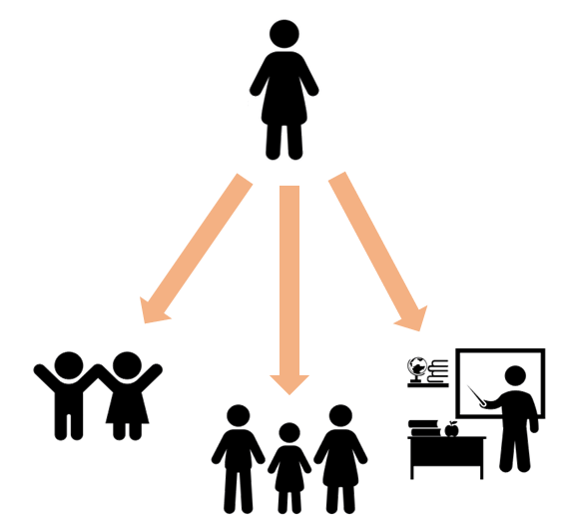
Catalyst then came back…
We listened to everyone again…
Here is what you said!
Some of you even took amazing photos!

Slide 6
KS1 Pupil -
“like the playground because it has a climbing frame which allow me to practise doing new actions”.

Slide 7
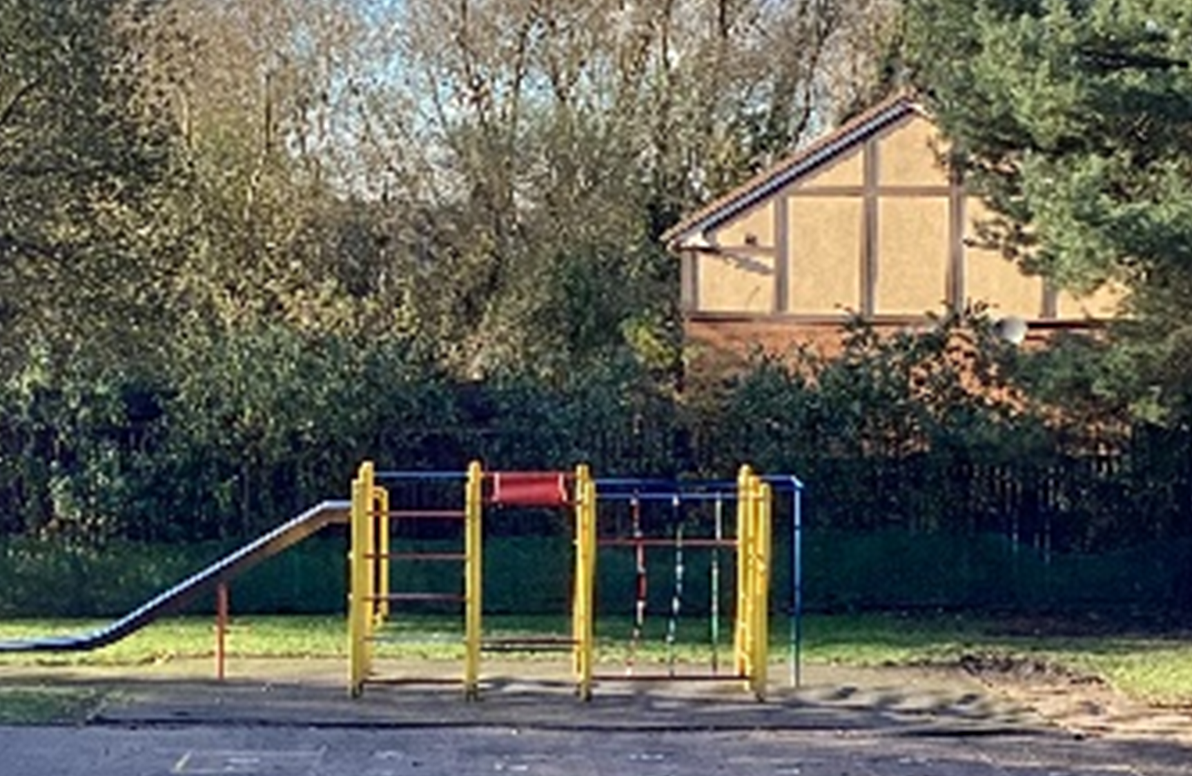

Slide 8
KS1 Pupil -
“They won't just like leave you, they'll like continue helping.”

Slide 9
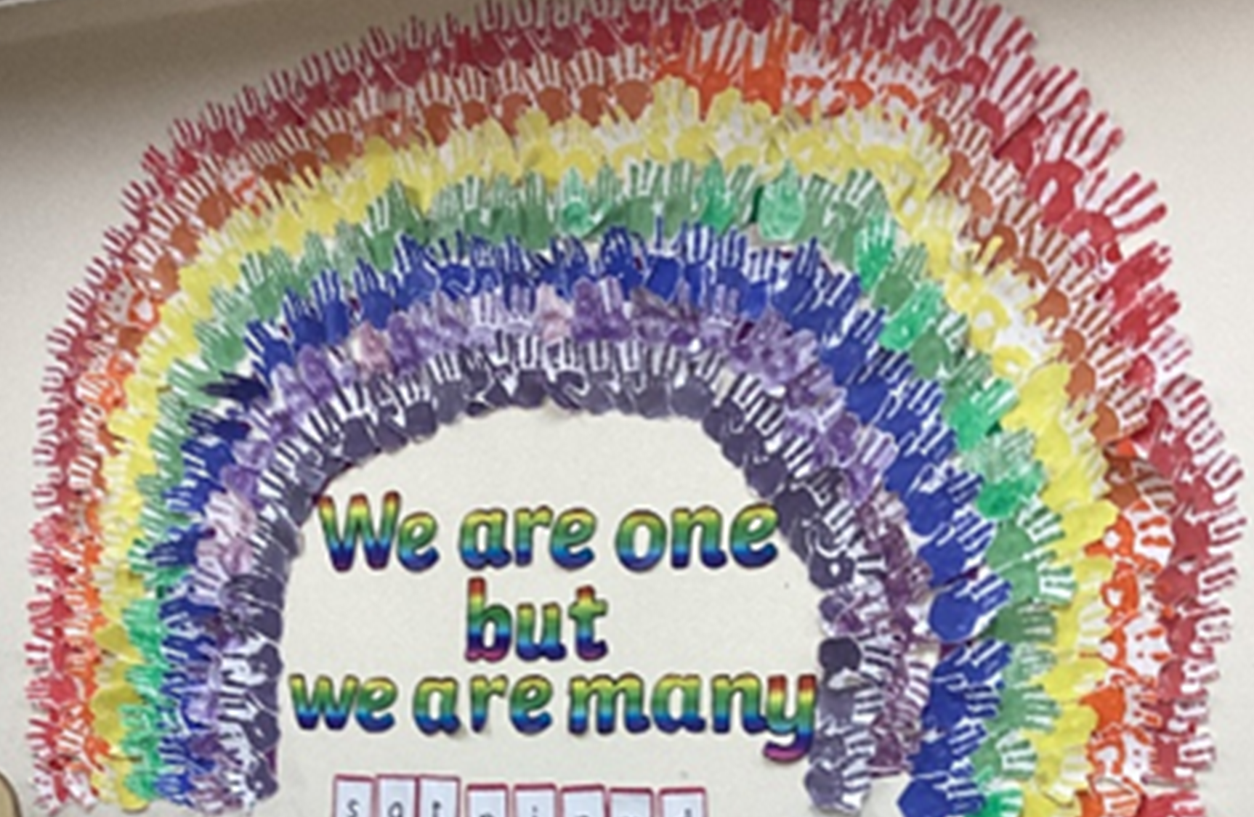

Slide 10
KS2 Pupil -
“like how you've got an open range of different books, so if you don't understand the book, you can just go into the library and get something different”.

Slide 11
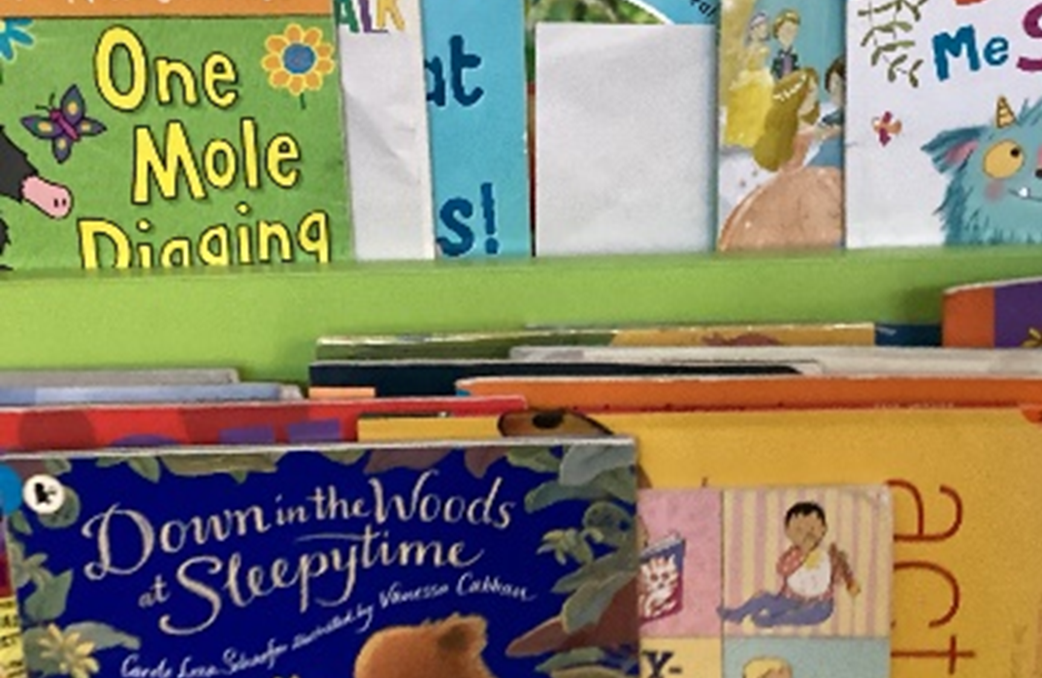

Slide 12
KS2 Pupil -
“Definitely. If you're in an argument or if you want to ever talk to a teacher, they'll listen to you and give you some advice afterward, through an argument, they'll try to solve it”.

Slide 13
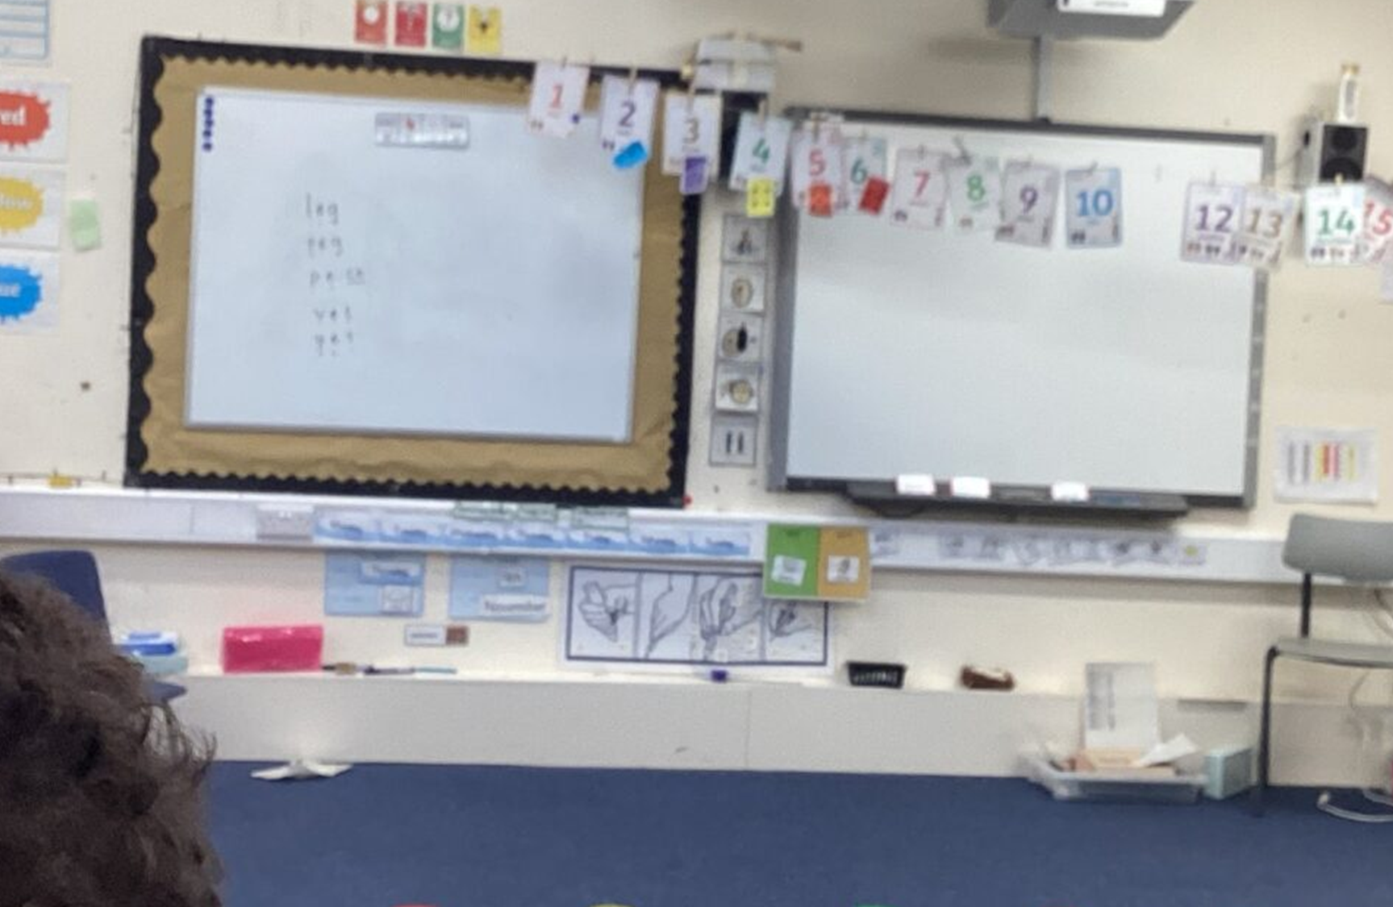

Slide 14
Staff -
“Mount Carmel do a fantastic job making all staff feel valued and appreciated for the work they put in”.

Slide 15
Parent -
“From what my son has told me there is a lot more enrichment at break time in the junior building and he’s enjoyed that”.

Slide 16
Parent -
“All staff are extremely supportive of our children. They know, understand, and love them. Staff will always do their best for them and often go above and beyond.”

Slide 17
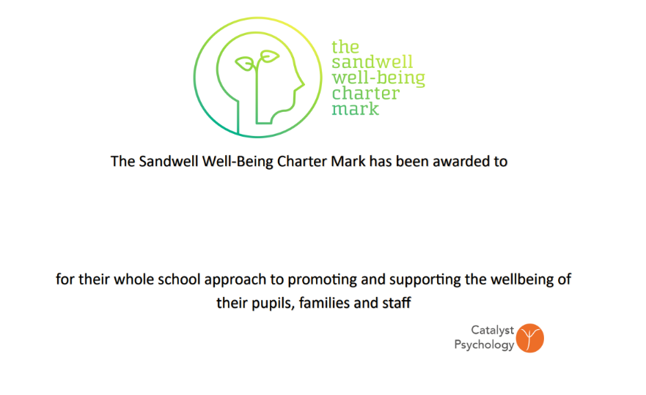
And because Mount Carmel continues to be such a supportive and caring school
You have been awarded a very special Charter Mark, called the Sandwell Well-being Charter Mark, which you can display in your school, and add to all your school communications.
Mount Carmel

Slide 18
CONGRATULATIONS,
Mount Carmel!

