Slide 1


Welcome
to
Mount Carmel Nursery
Follow us on Twitter
@Mount_Carmel1

Slide 2
What is the EYFS?
The Early Years Foundation Stage (E.Y.F.S.) is the stage of education for children from birth to the end of the Reception year.
It is based on the recognition that children learn best through play and active learning.
This is a very important stage as it helps your child get ready for school as well as preparing them for their future learning and successes. From when your child is born up until the age of 5, their early years experience should be happy, active, exciting, fun and secure; and support their development, care and learning needs.

Slide 3
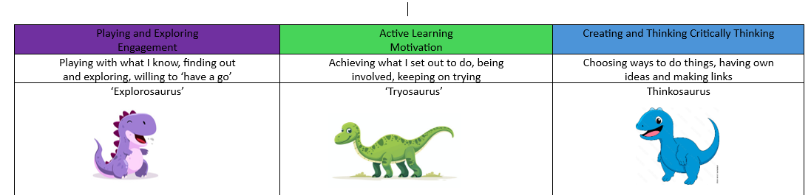
Characteristics of Learning
Playing and Exploring – engagement
Active Learning – motivation
Creating and Thinking Critically - thinking

Slide 4
Early Years Foundation Stage (EYFS)
Prime Areas:
Personal, Social and Emotional Development
-Self regulation
-Building relationships
-Managing self
Communication and Language
-Listening, Attention and Understanding
-Speaking
Physical Development
-Fine motor
-Gross motor

Slide 5
Early Years Foundation Stage (EYFS)
Specific Areas:
Literacy
-Word reading
-Writing
Mathematics
-Number
-Numerical pattern
Understanding the World
-Past and present
-People, Culture and Communities
-The natural world
Expressive Arts and Design
-Creating with materials
-Being Imaginative and Expressive

Slide 6
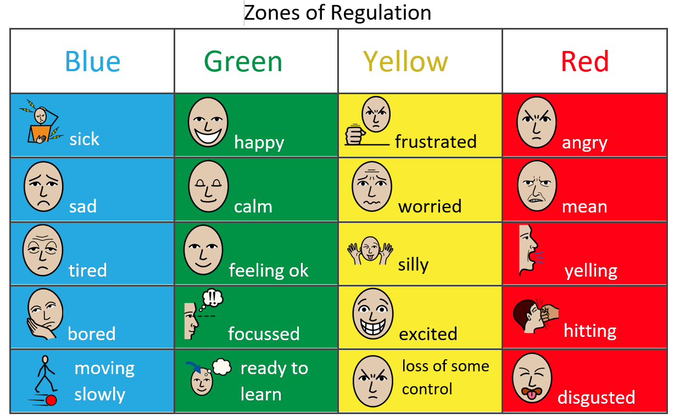

Slide 7

We access our outdoor provision throughout the day which allows children to experience all weather conditions
Please ensure that our child has ‘weather appropriate clothing’ each day
Please supply puddle suits for wet weather that can be left in school.

Slide 8
Organisation
39 place Nursery with a mix of morning and all day places
Two groups- Hedgehog and Foxes
Squirrel group- Children who needs support with speech and language will access a smaller group time at certain points in the day.
(Gates open at 8.40)
Morning sessions- 8.50-11.50 (not including dinner)
Lunchtime- 11.30-12.30
All day sessions- 8.50-3.20

Slide 9

30 Hour Eligibility
If you are a working parent working the equivalent of 16 hours a week you need to apply for the additional 15 hours.
https://www.childcarechoices.gov.uk
Lunchtime provision is not included in your child’s 30 hours free funding. A cost of £5 per week will need to be paid via Arbor.
If you are paying for afternoon slots, the charge is £15 per afternoon. This includes the cost of the lunchtime supervision.

Slide 10
Keeping you informed
Texts
Letters
Seesaw
Class page on school website
Weekly newsletter from Nursery and whole school.

Slide 11

Please do!
If you have a concern/query you can usually speak to a member of staff in the morning or after school. If we can’t resolve your concern there and then we will arrange a meeting at a convenient time.
Please pass messages to the team member(s) in the morning.
Please tell us about any changes at home which may affect your child in school.

Slide 12
Snacks and Lunches
Snacks:
At snack time we offer a variety of snacks including; fruit, seasonal vegetables, a carton of milk or water.
Milk & fruit are free to all children in Nursery
Water is available during the day (no need to send in a water bottle)
School dinners- Cunninghams
Dinner are currently prices around £2.75 per day and children will be given a choice which you can select using an app at home before the school week begins.
Packed Lunches:
Packed lunches need to be labelled and include a drink
We are a NUT FREE school and request that items sent in lunch bags are fee from nuts.

Slide 13
Stay and Play sessions
An opportunity for you and your child to meet the team, their new friends and explore the environment in smaller groups.
Stay and Play session – Monday 13th July
*9.15-10.00
The session is for 45 minutes and we are only able to accomodate one parent per child to stay for the session.
Before you leave this evening please sign up for a stay and play session.

Slide 14
Starting school in September
Home visits will take place from Tuesday 7th July-Thursday 9th July
We stagger the children into Nursery
Your child will begin a part time am or pm session
Children will begin their phased start on Wednesday 2th September
Please prepare for your child to be part time for the first two weeks.
Your child will be invited to stay full time when their class teacher thinks they are ready.

Slide 15

At Mount Carmel we use an online learning journey called Seesaw.
You will need to provide us with your email address so that this can be set up.
This app allows you to see the observations we do in school and also add your own pictures, videos and messages from home.

Slide 16
Medical Matters
Any sickness, diarrhoea, must be followed by 48 hrs absence.
Any absence requires a telephone call explaining why. Without this it will be recorded as unauthorised.
Head lice can occur! Please check regularly and treat as recommended.
Children with asthma need to have an inhaler in school and you will need to complete an Asthma care plan in September.

Slide 17
Uniform – School Trends
Uniform MUST be ordered via the school trends website (Info in pack) – Please allow 21 days for delivery.
Jumper/Cardigan £11.80 / £12.55
Light blue polo shirt
Grey skirt/trousers/pinafore
Blue and white check summer dress

Slide 18

Our main form of communication with parents/carers is via the Arbor app
We will use this platform to communicate school events, class events and contact you in the event of your child having a bump in school that doesn’t require your immediate attention.
*It is vitally important that we have an up to date email for you.
Payments for dinners can be done through Arbor.

Slide 19
Things to do before you start
Get a good sleep routine
If your child has a dummy or a bottle work on removing these
Toilet training your child
Talk, talk and talk some more!

Slide 20
Forms…
Before your child starts with us we will need you to have completed:
Digital permission form
Online free school meal check
Online 30 hours funding check
School uniform order WEBSITE School trends
Confirm your afternoon sessions if applicable

Slide 21
Please remember…
A place in Nursery does not automatically mean a place
in Reception.
You need to apply by 15th January 2027
Apply through Manchester City Council

Slide 22

Welcome to Mount Carmel!

