Slide 1
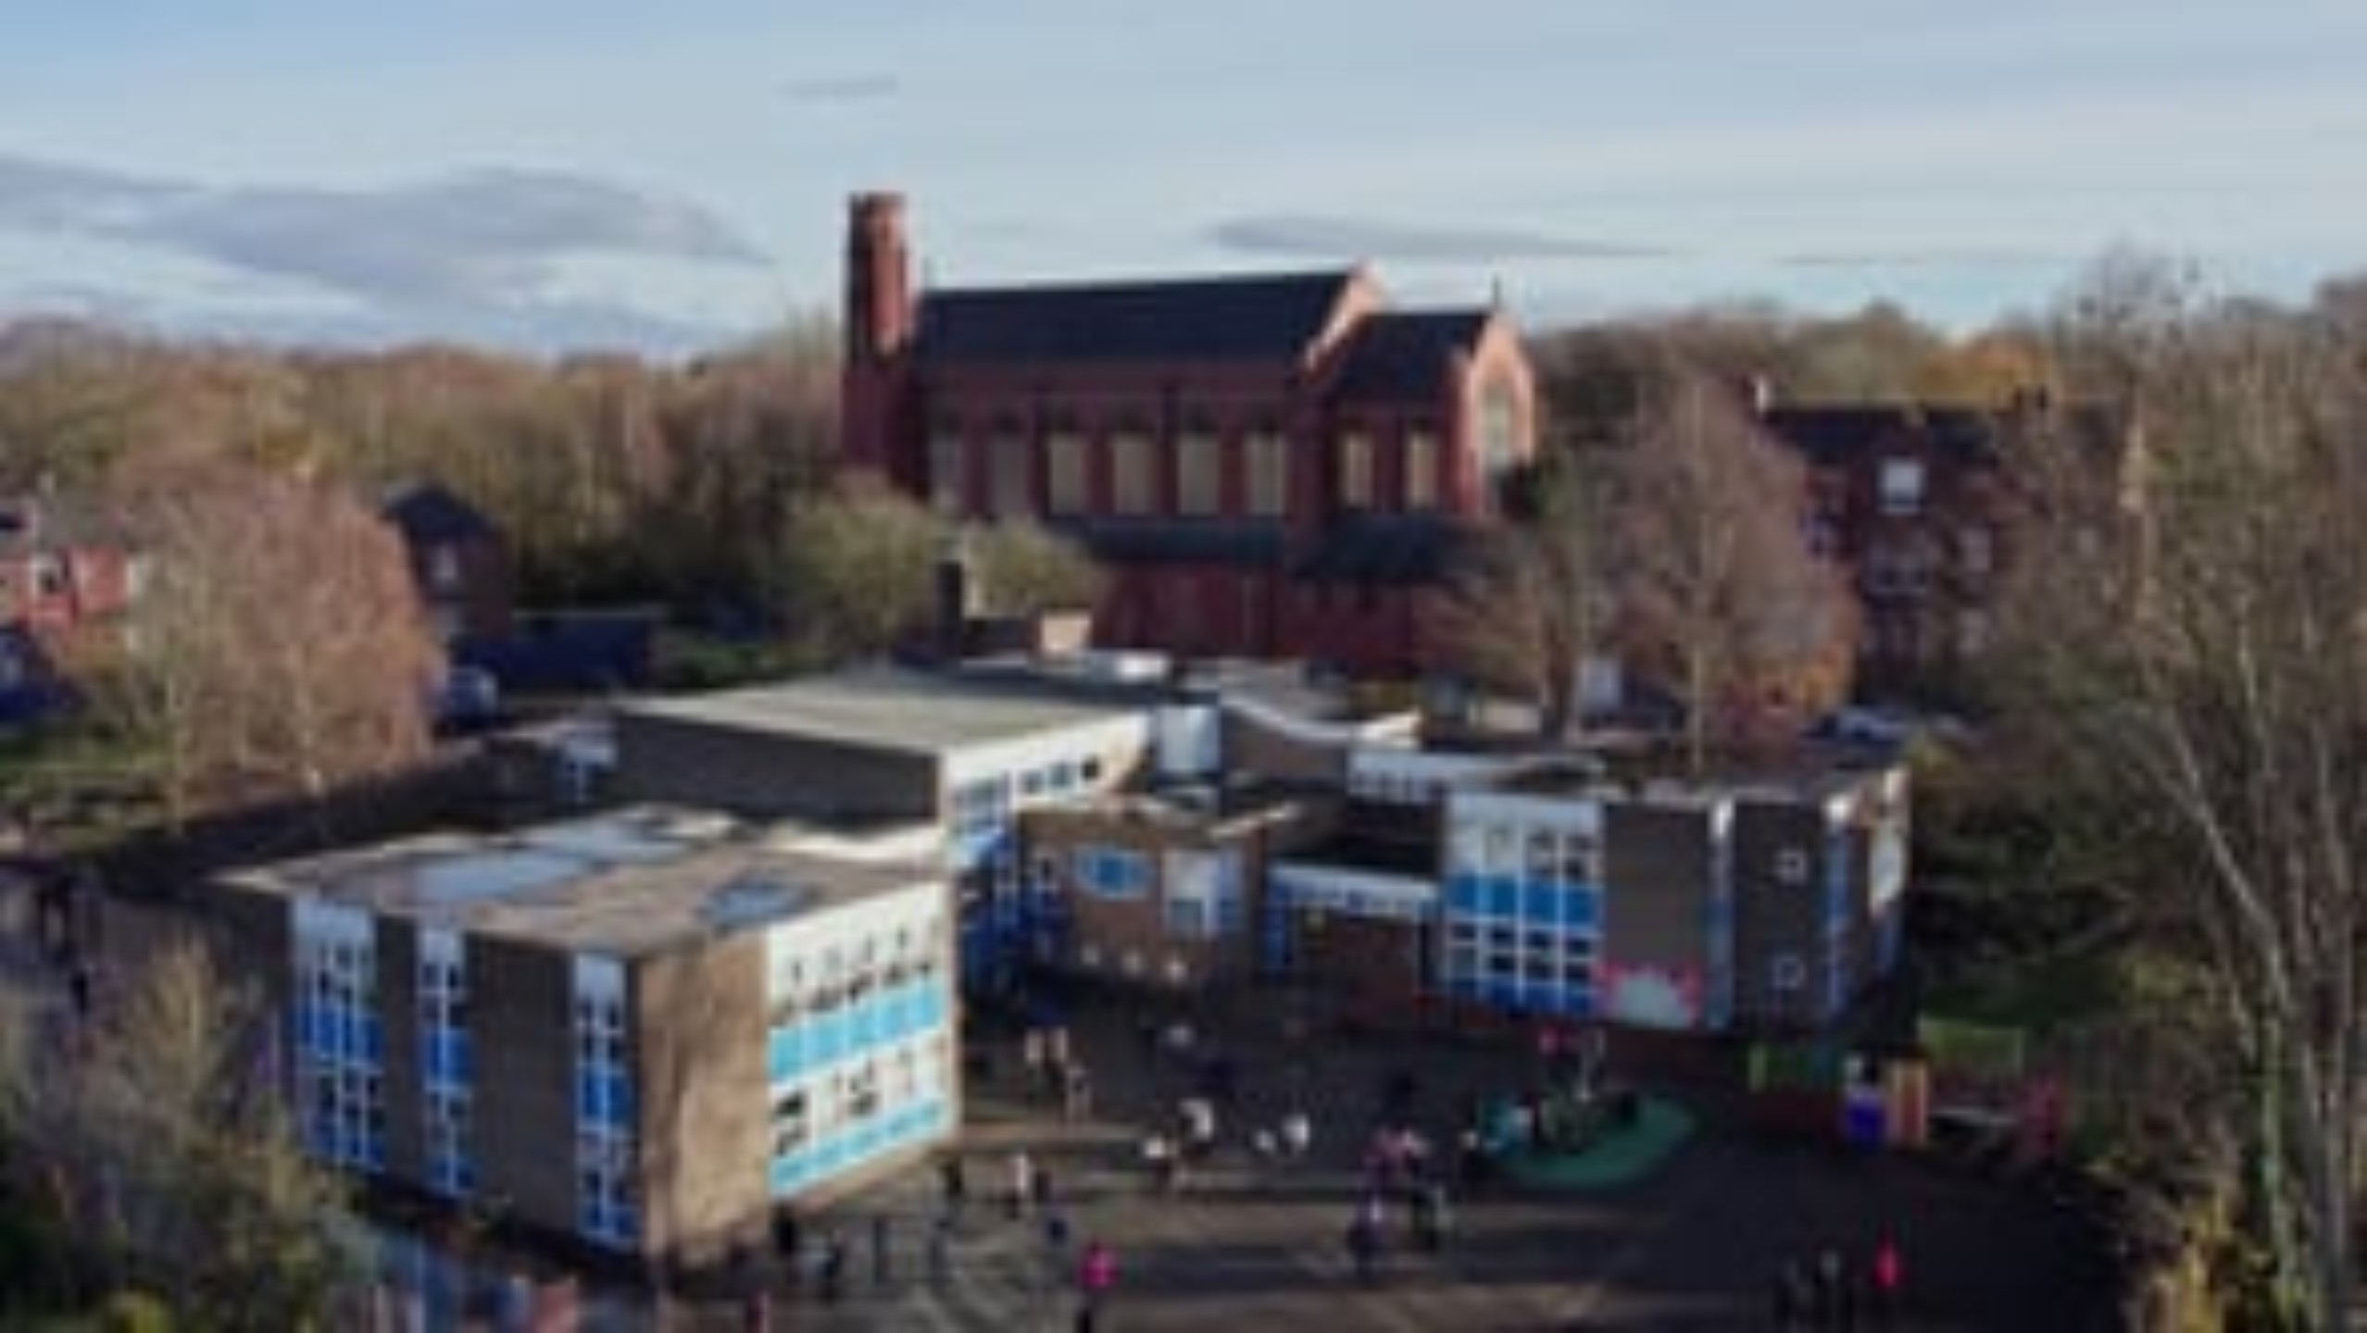

Slide 2

Welcome
to
Mount Carmel Reception

Slide 3
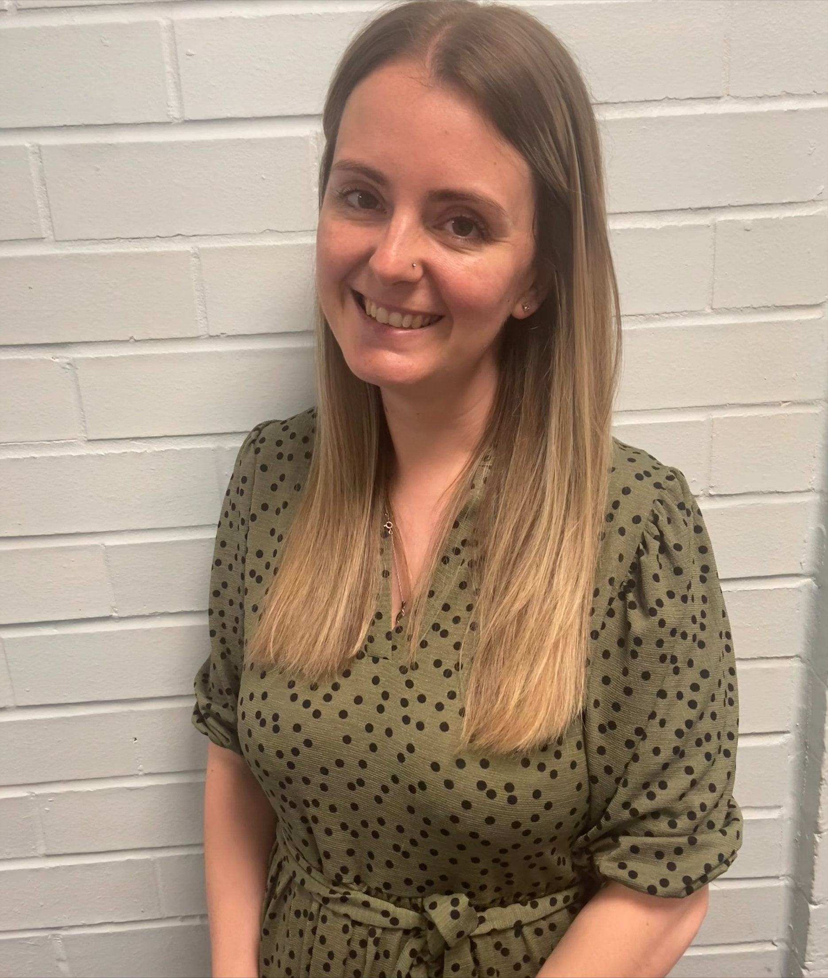
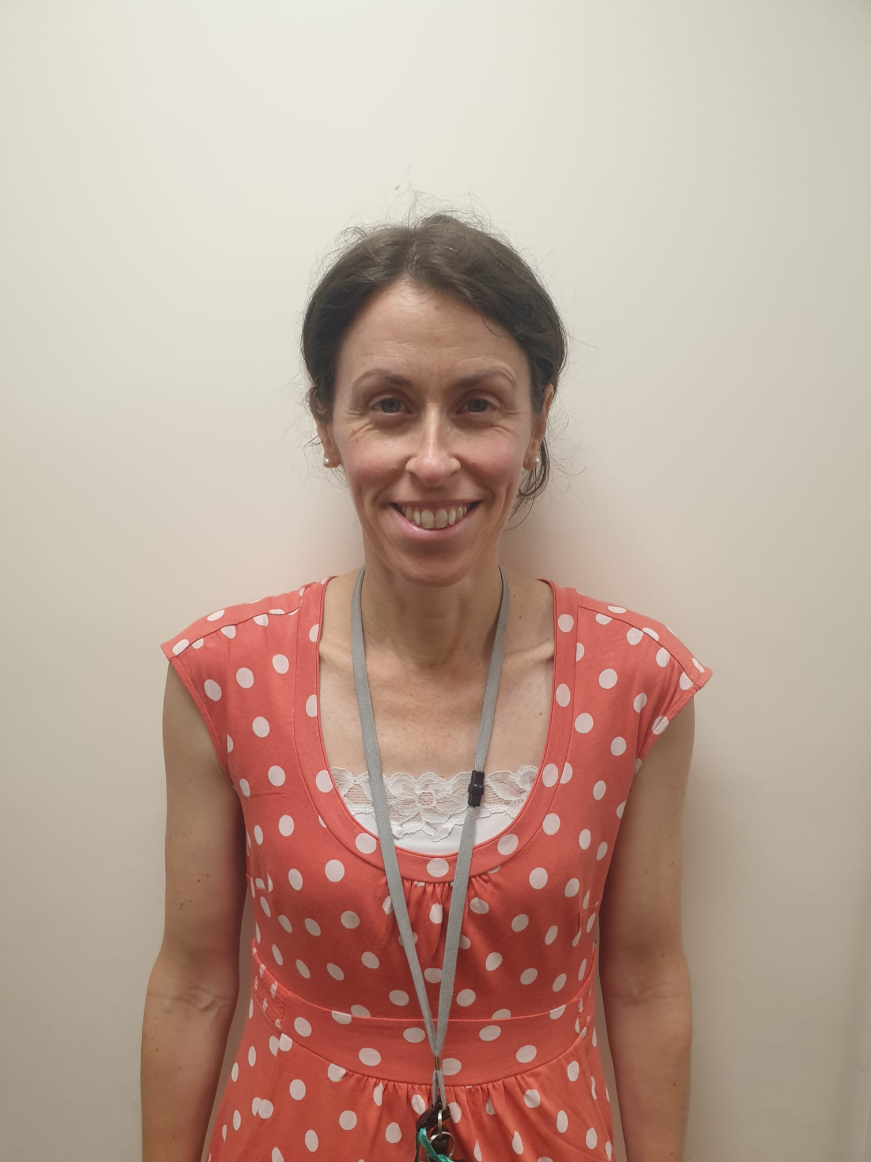
The Reception Teachers
Mrs Lowe
Mrs Coogan

Slide 4
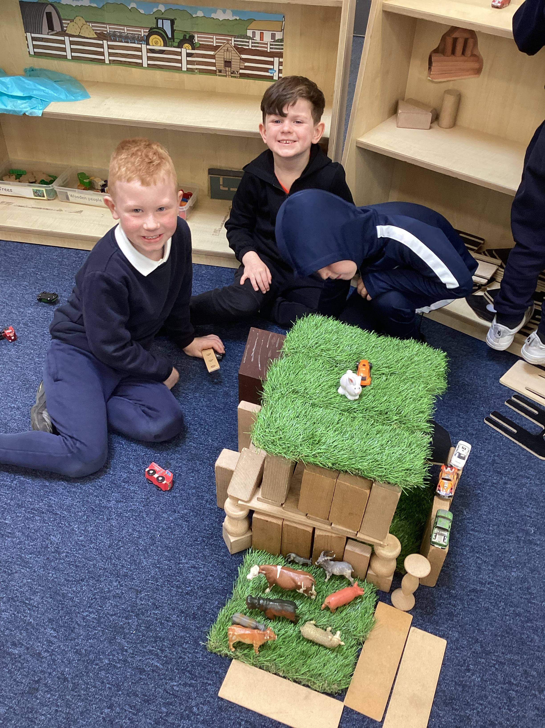
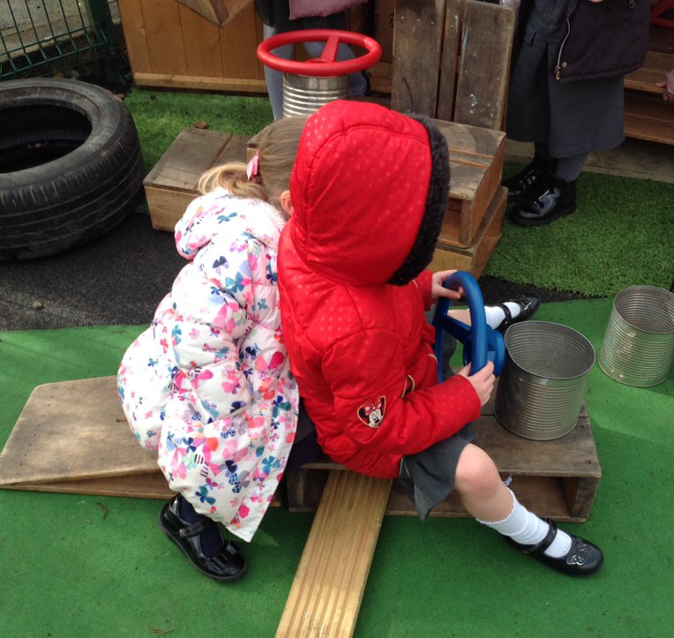
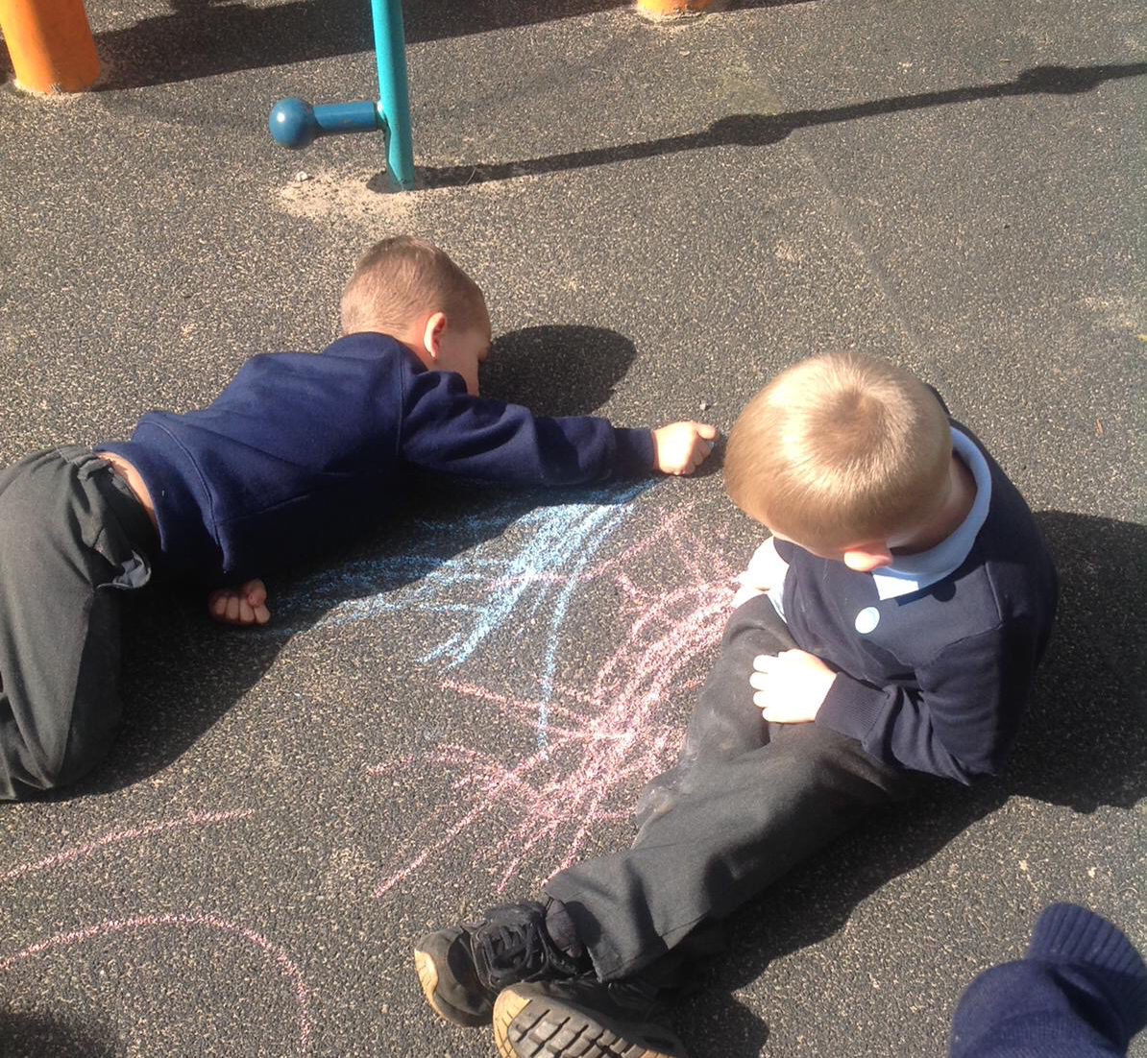
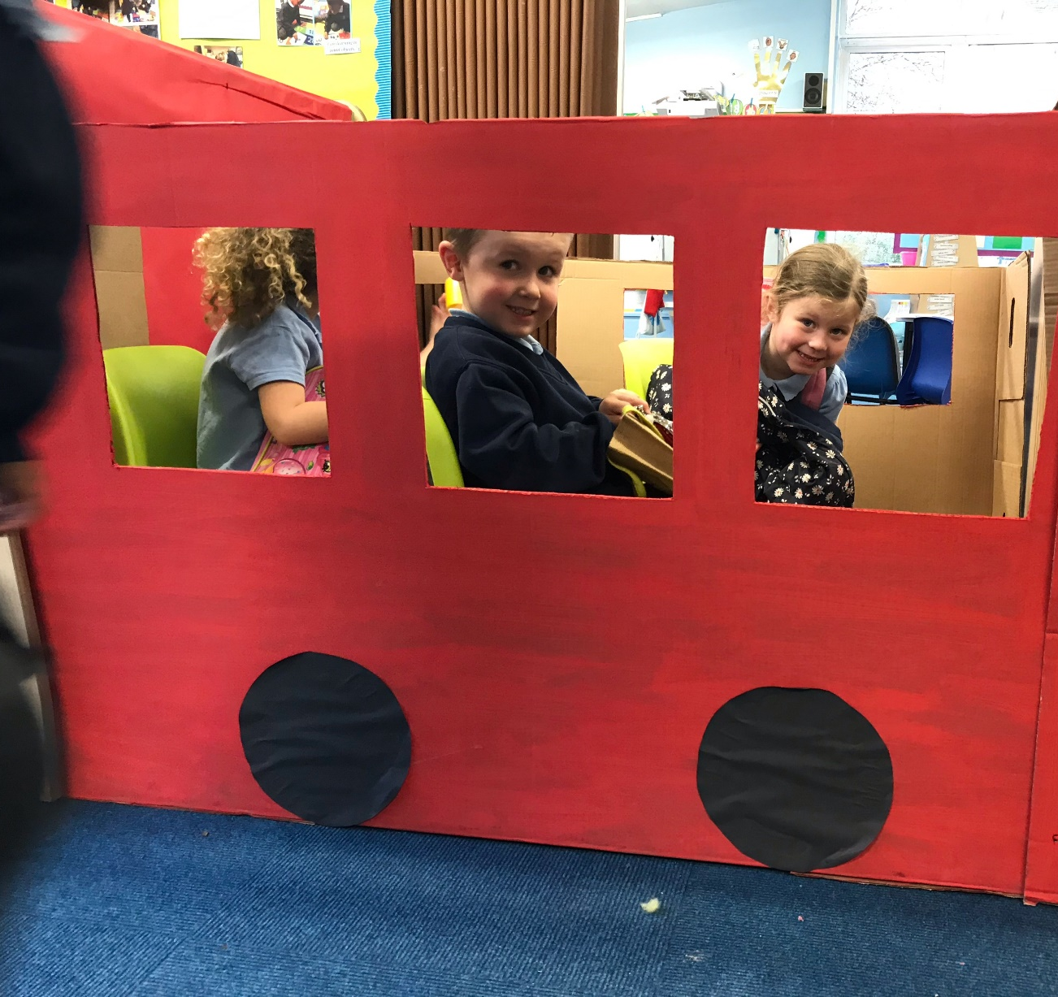
What is the EYFS?
The Early Years Foundation Stage (E.Y.F.S.) is the stage of education for children from birth to the end of the Reception year.
We promote a play-based curriculum which takes place both indoors and outdoors.

Slide 5
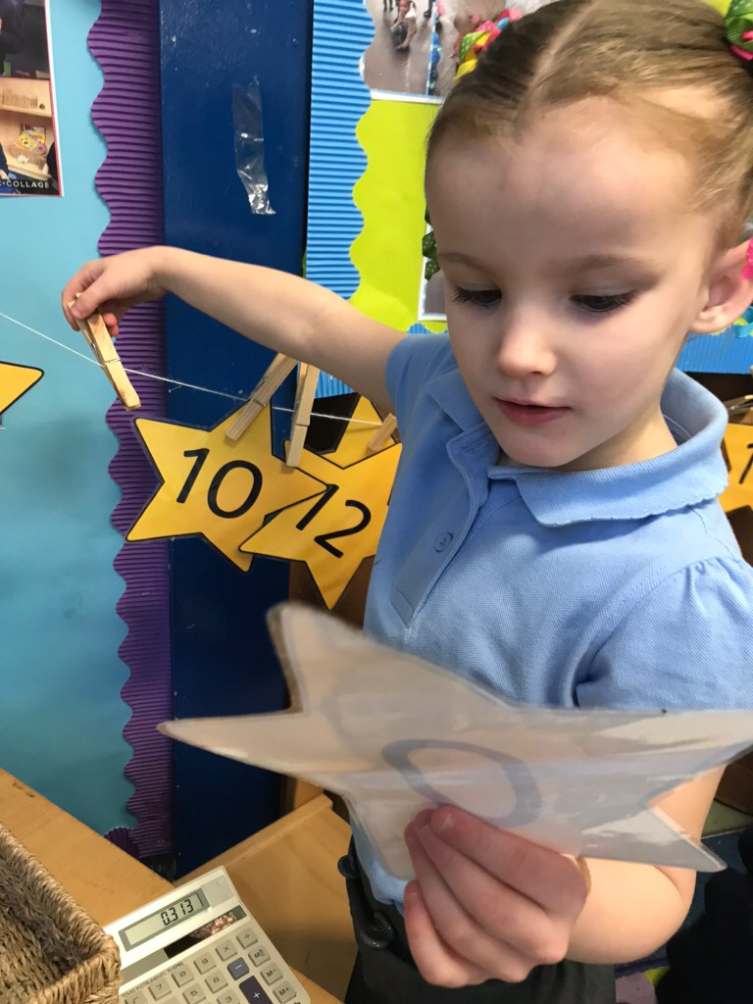
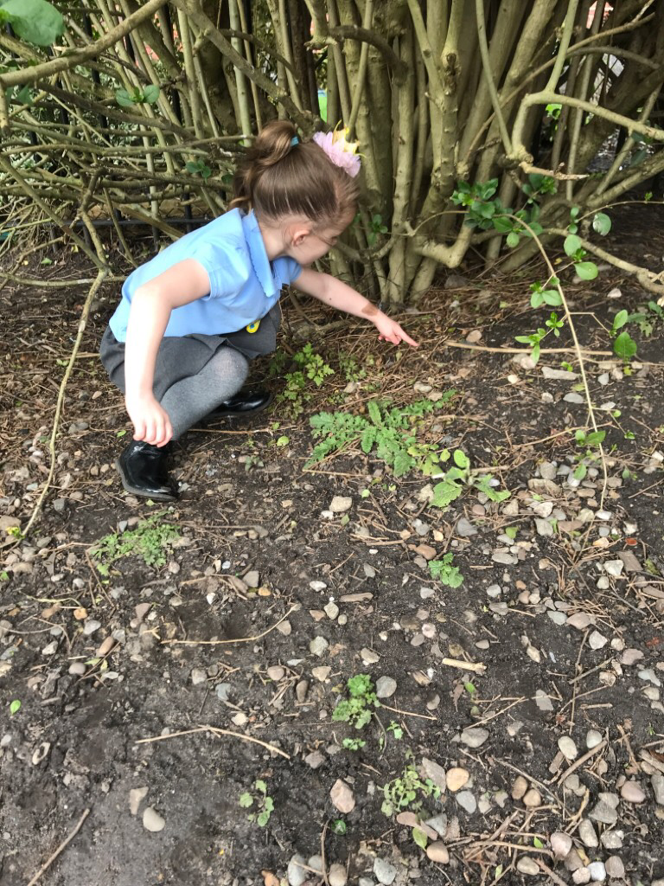
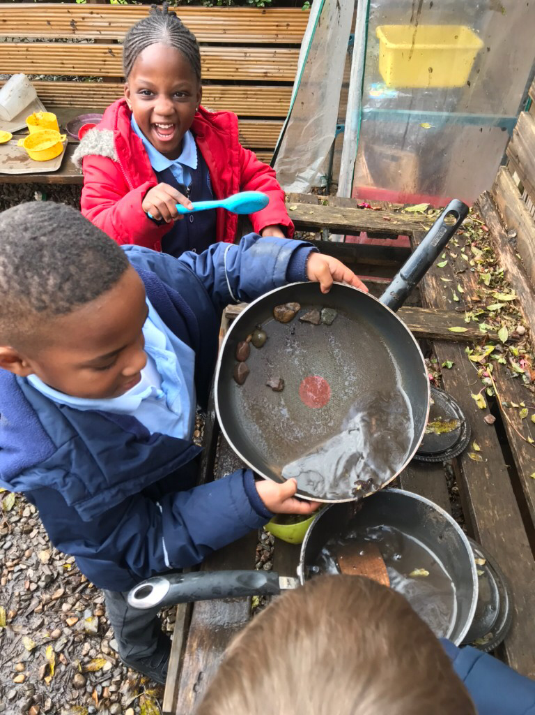
Characteristics of Teaching and Learning
Playing and Exploring – engagement
Active Learning – motivation
Creating and Thinking Critically - thinking

Slide 6
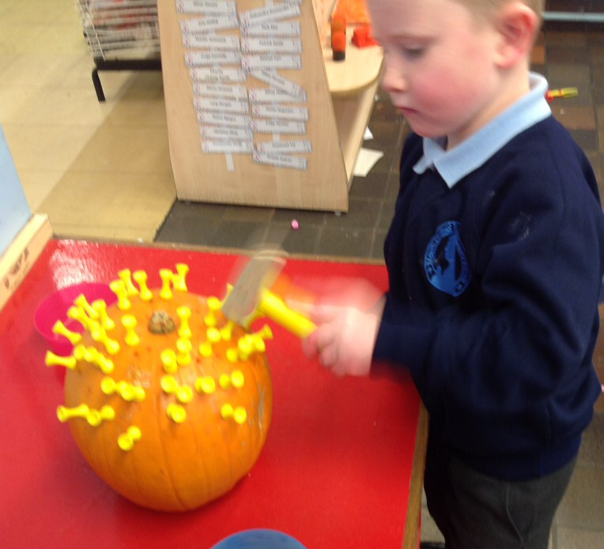
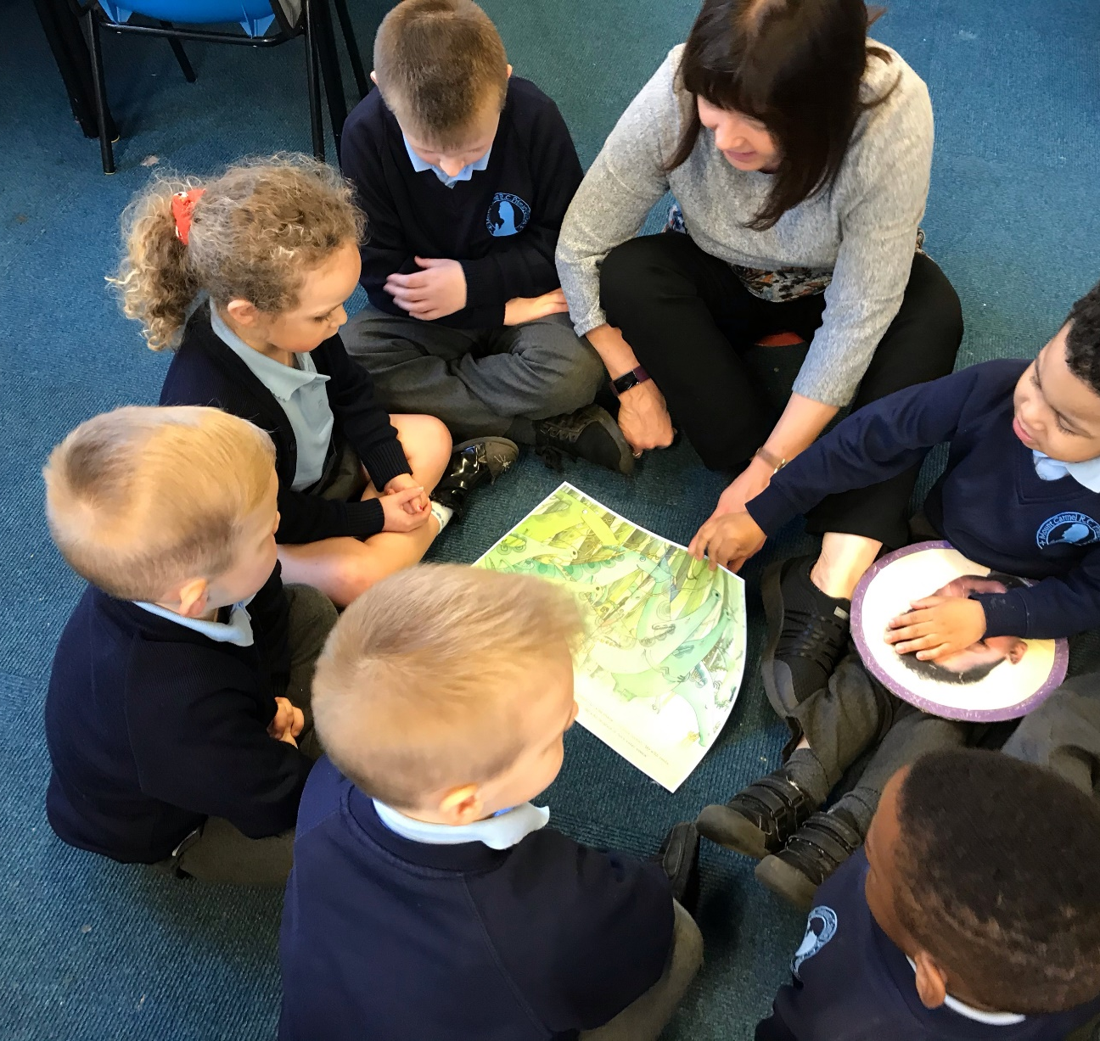
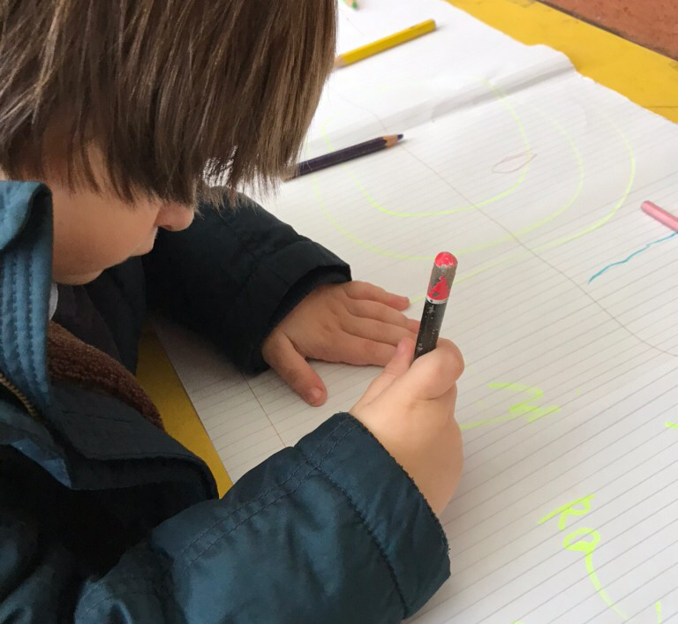
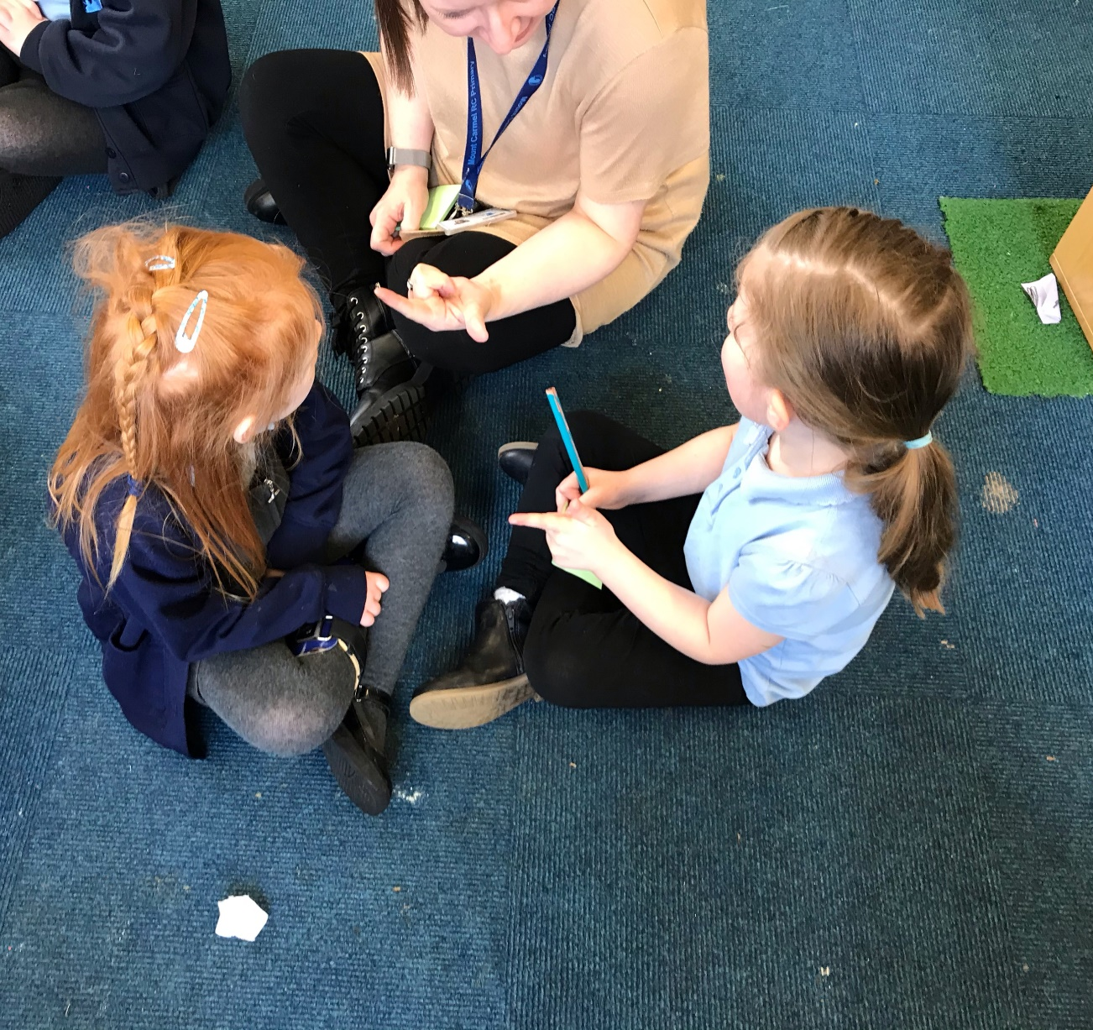
Early Years Foundation Stage (EYFS)
Prime Areas:
Personal, Social and Emotional Development
-Self regulation
-Building relationships
-Managing self
Communication and Language
-Listening, Attention and Understanding
-Speaking
Physical Development
-Fine motor
-Gross motor

Slide 7
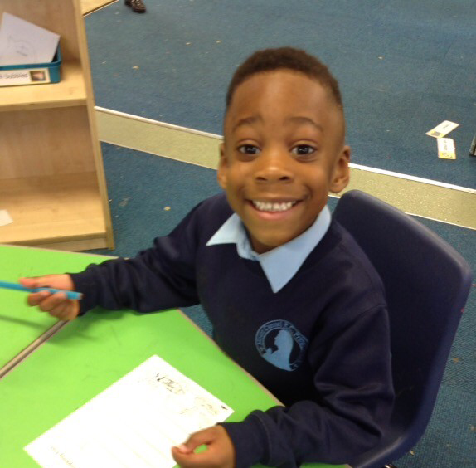
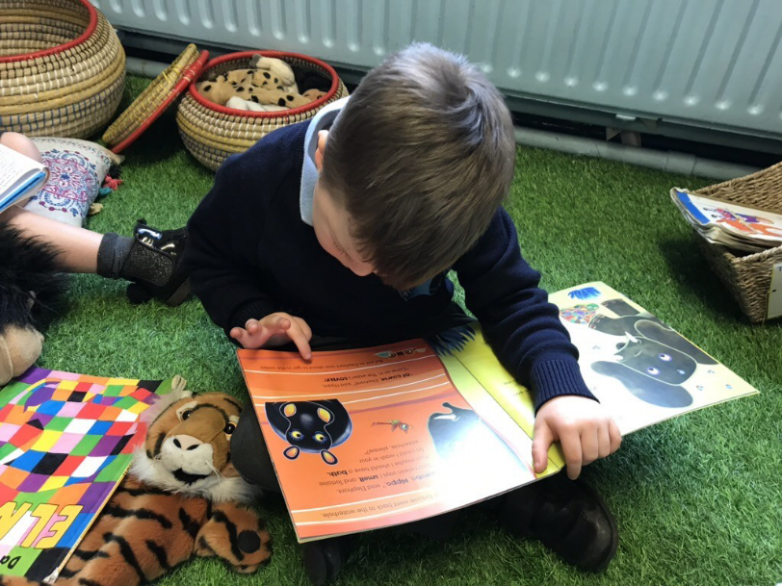
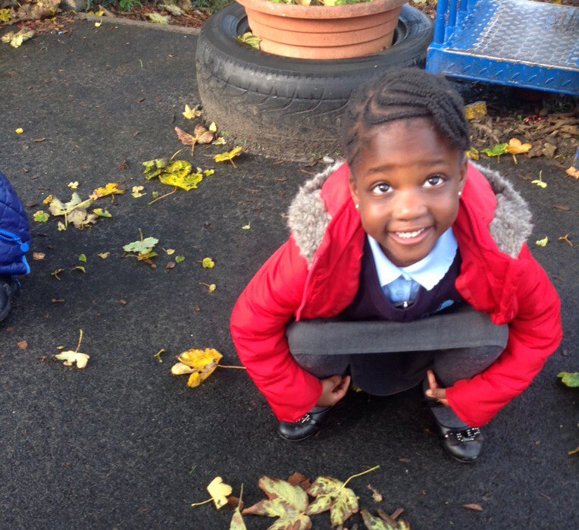
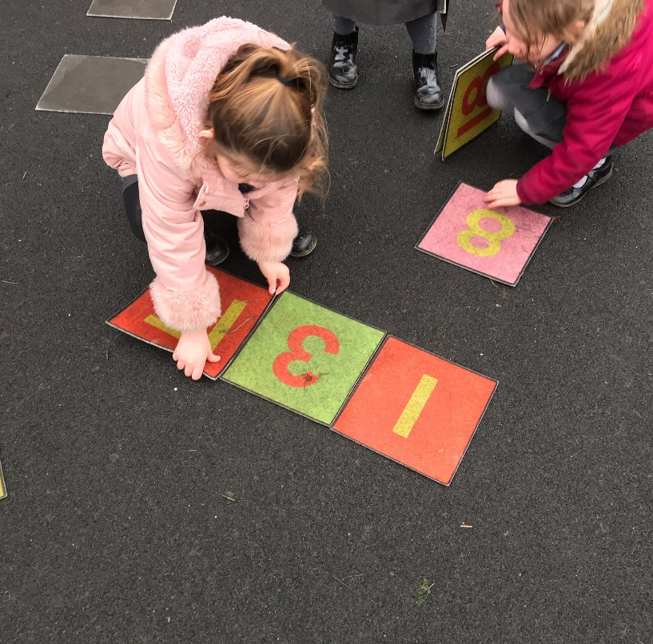
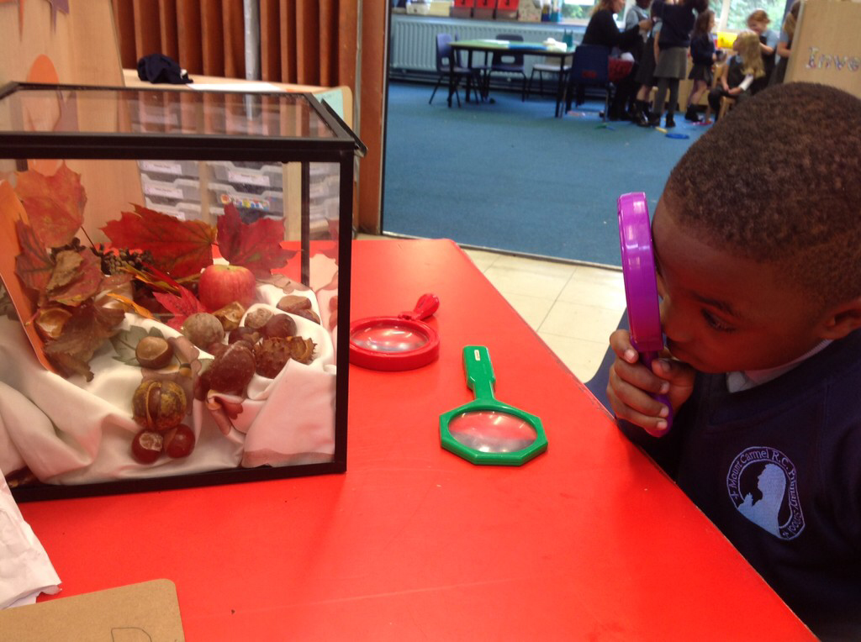
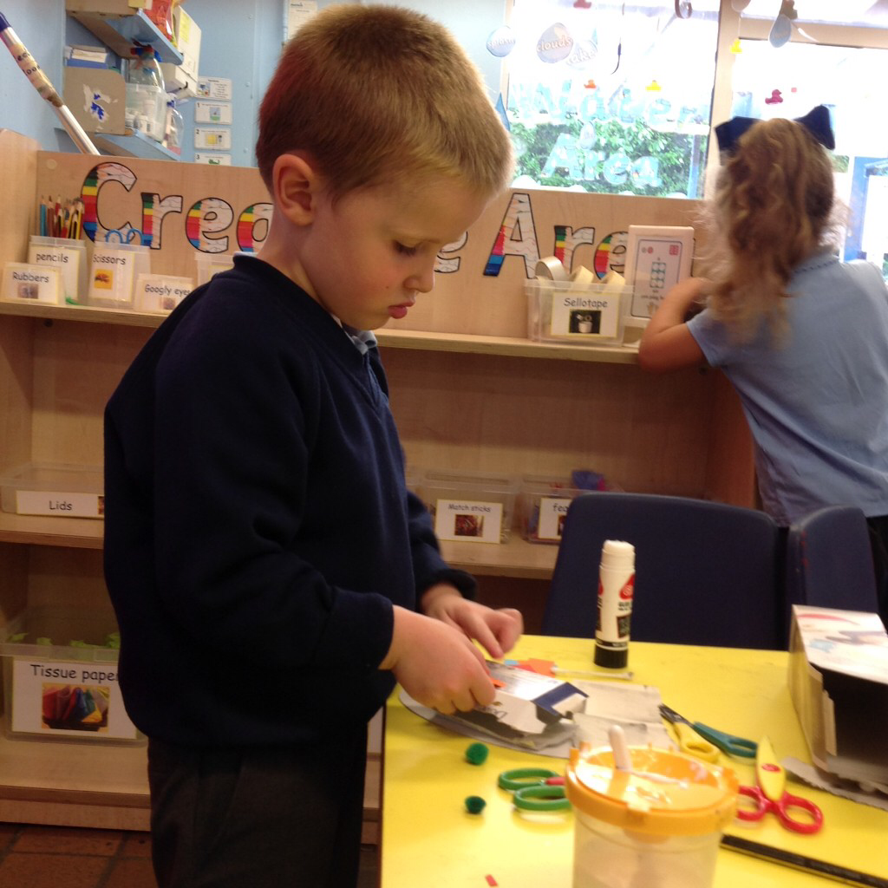
Early Years Foundation Stage (EYFS)
Specific Areas
Literacy
-Word reading
-Writing
Mathematics
-Number
-Numerical pattern
Understanding the World
-Past and present
-People, Culture and Communities
-The natural world
Expressive Arts and Design
-Creating with materials
-Being Imaginative and Expressive

Slide 8
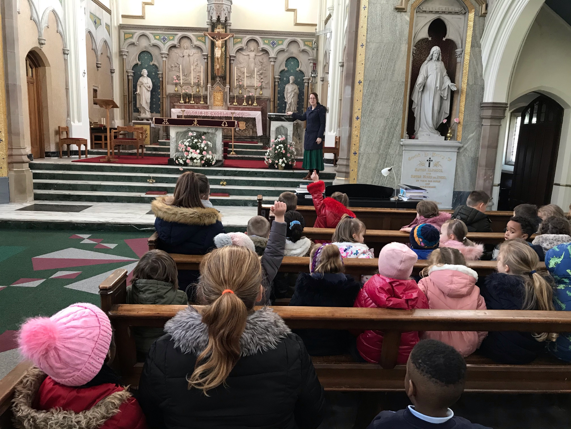
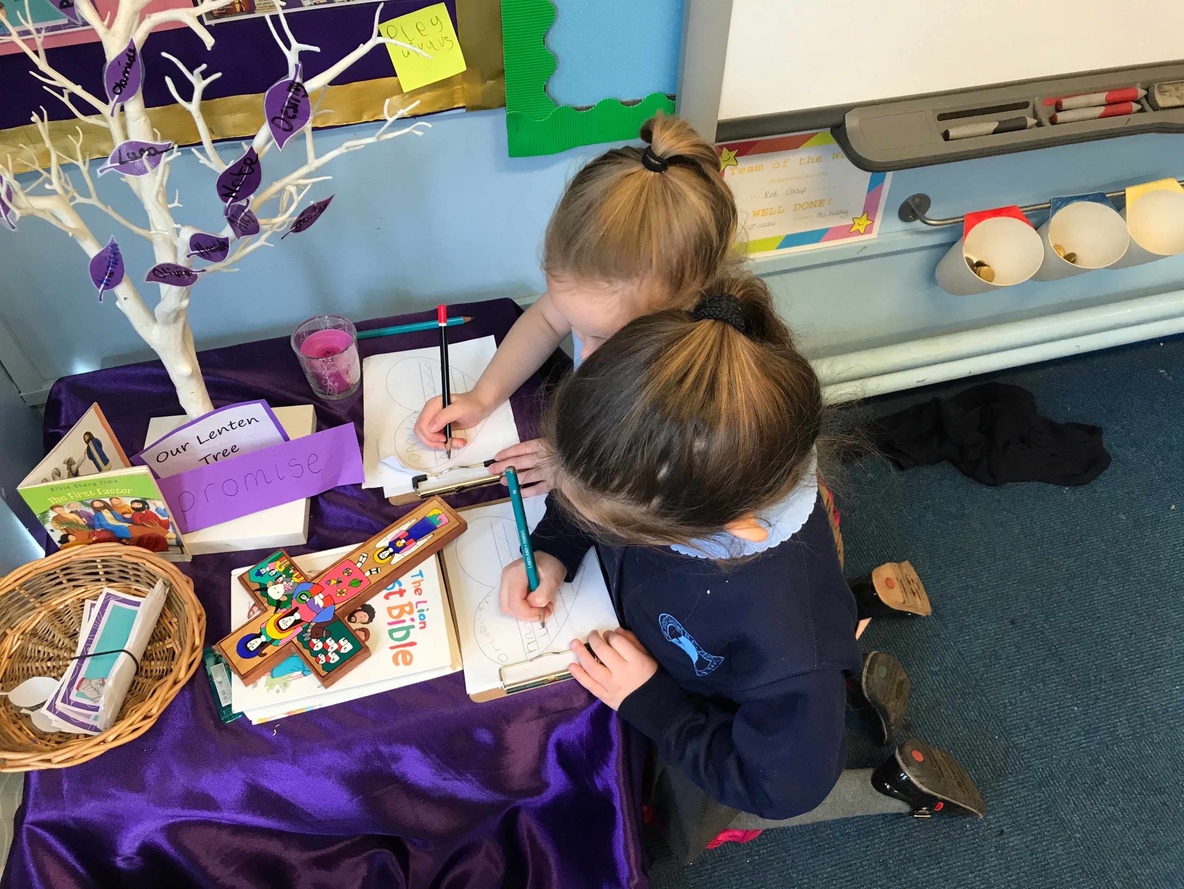
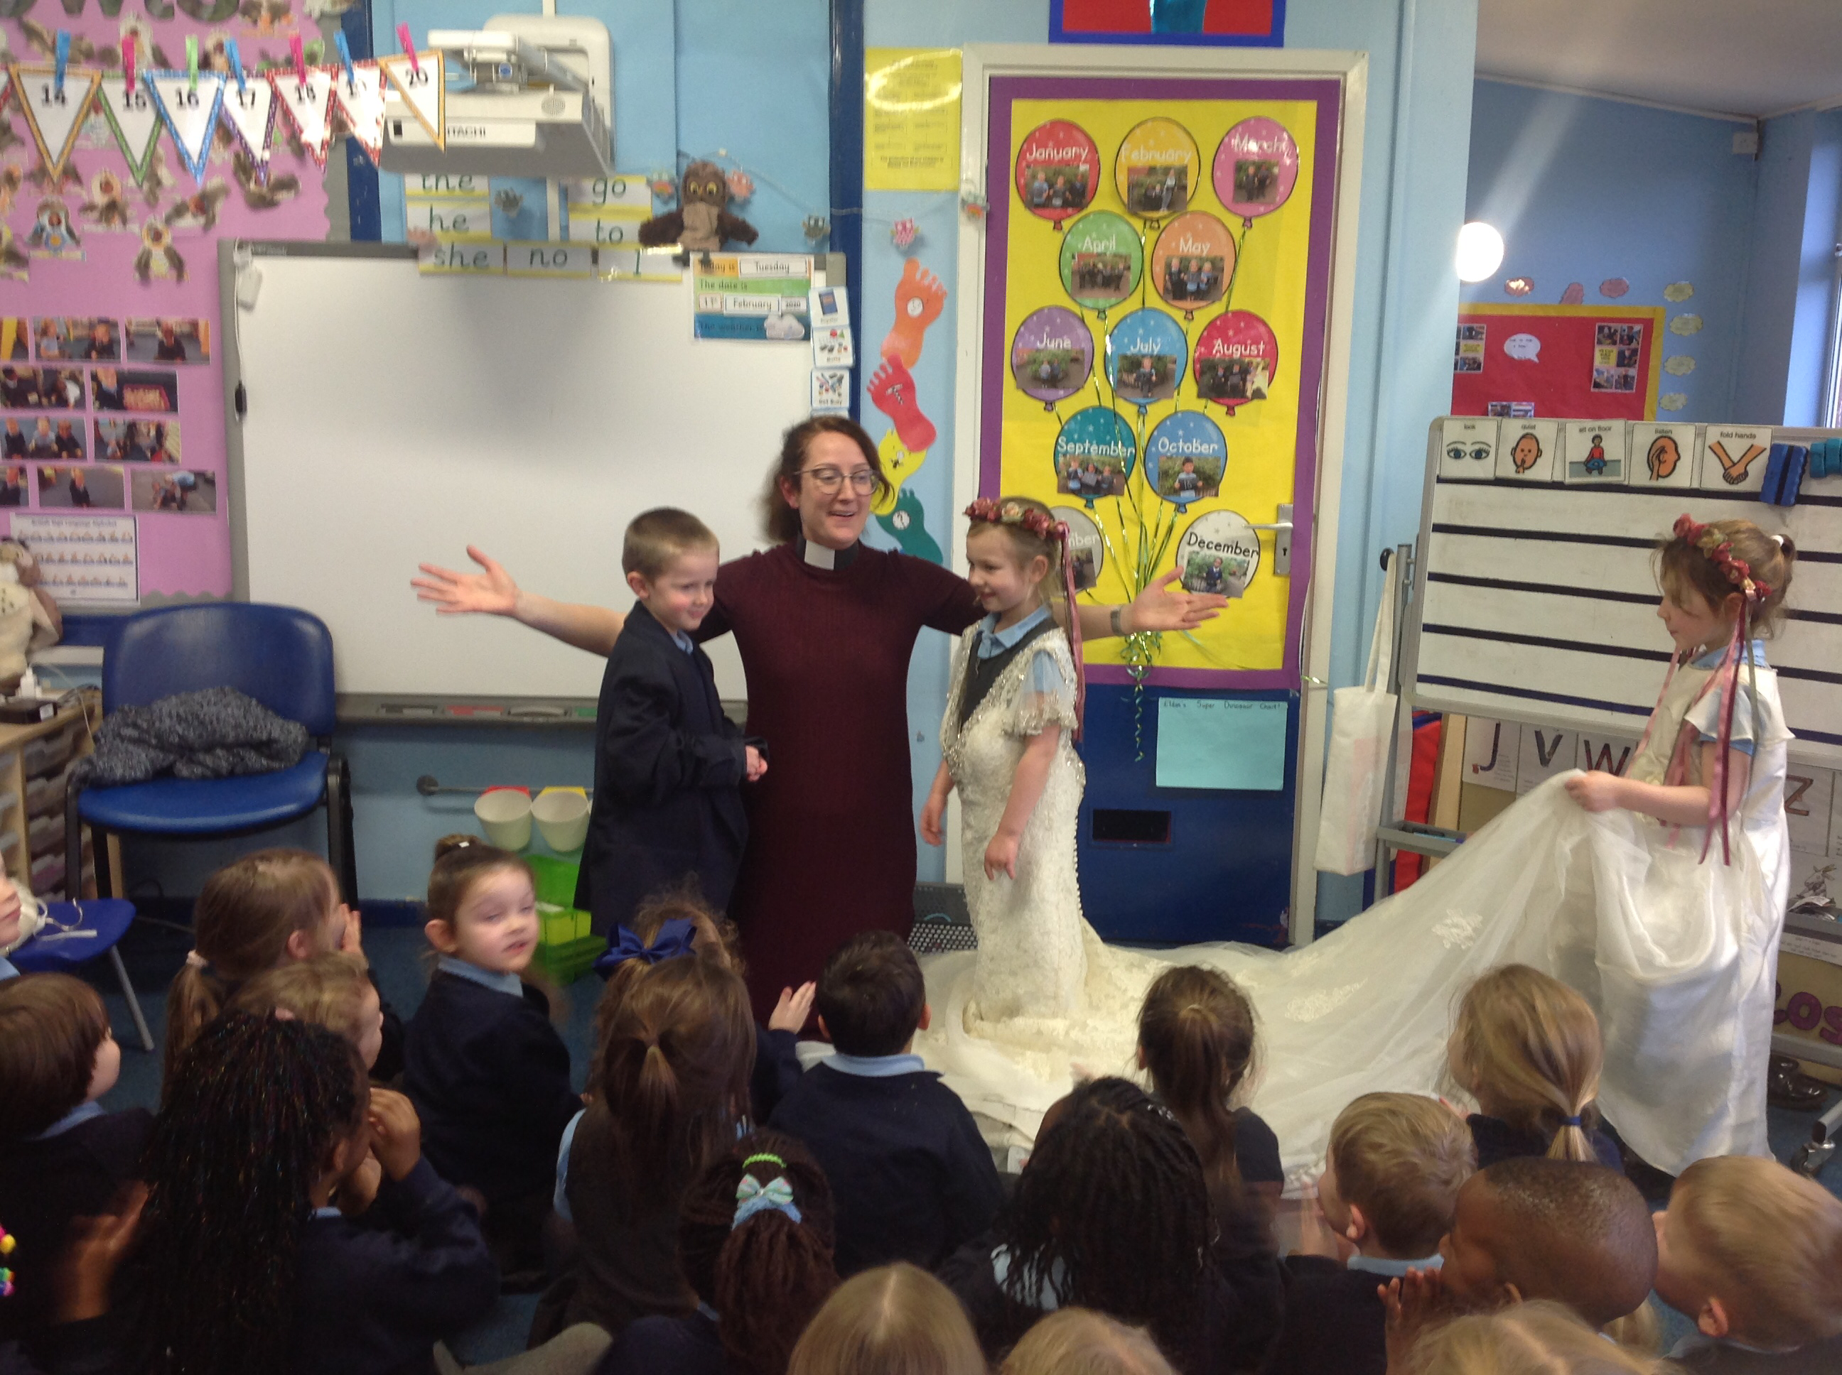
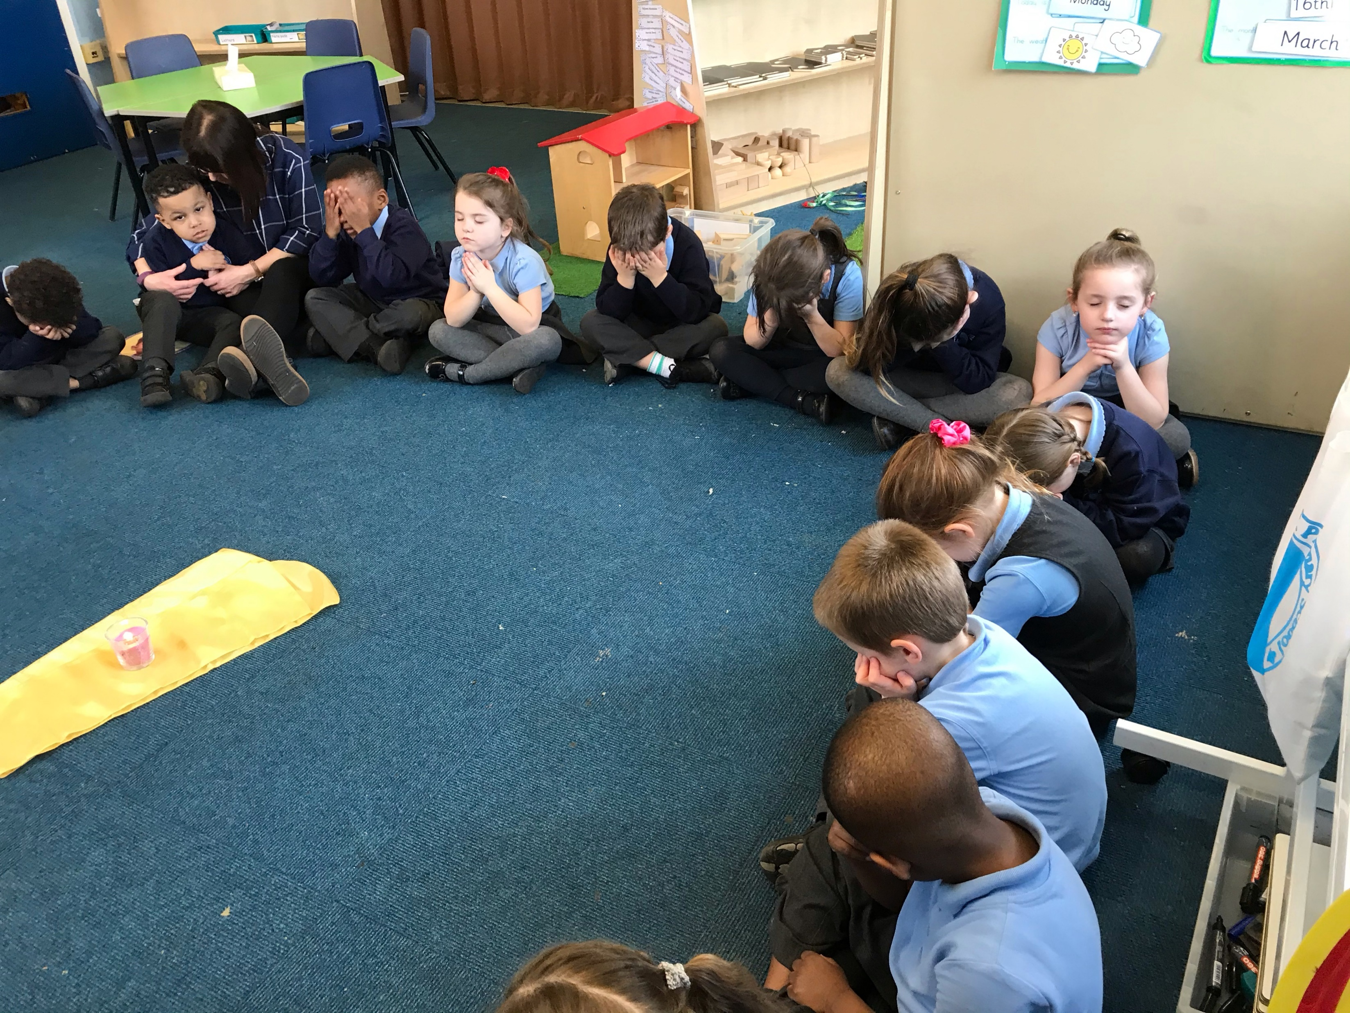
Religious Education
‘
Lighting the
path

Slide 9

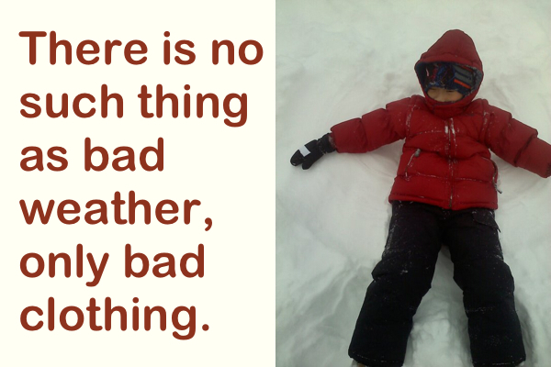
We access our outdoor provision throughout the day which allows children to experience all weather conditions.
Please ensure that your child has weather appropriate clothing each day.

Slide 10
Reading
We follow Little Wandle letters and sounds.
Your child will be heard read twice a week in school.
EBooks are matched to your child’s reading ability.
Two books a week. One paper book and one EBook.
We ask that you read with your child every day and sign their reading record.

Slide 11
Reception Baseline Assessment
This is a short task-based assessment of your child’s early literacy, communication, language and mathematics skills.
It was statutory for all schools from September 2021.
The assessment will form the start of a new measure of how schools are helping their pupils to progress between reception and year six.
Your child does not need to prepare. There is no pass mark or score and your child should not realise they’re doing an assessment.

Slide 12


Organisation
60 place Reception
Rabbit class ~ Mrs Coogan
Owl class ~ Mrs Lowe
Supported by a team of Teaching Assistants

Slide 13

In the EYFS we use an information sharing tool called Seesaw.
This app allows you to keep up to date with what is happening in school.
You will be able to send us pictures and share things that you have been doing at home.
You will receive more information on this in September.

Slide 14
Snacks and Lunchtime
Snacks:
At snack time we offer a variety of snacks including fruit, seasonal vegetables, a carton of milk or water.
There is a charge for milk from the start of the term in which they become five.
Please bring a water bottle every day for your child. It will be sent home each evening.
Lunchtime
School dinners are available to all children in Reception free of charge. You will be able to select your child’s choice at home.
Packed lunches need to be labelled and include a drink.
We are a NUT FREE school and request that items sent in lunch bags are free from nuts.

Slide 15
Keeping you informed
Seesaw
Letters
Weekly newsletter
Class page on school website
X (previously twitter)

Slide 16
Speaking to the Reception Team
Please do!
If you have a concern/query you can usually speak to a member of staff in the morning or after school.
Please pass messages to the team member(s) in the morning.
Do not contact us on seesaw as we may not see this. Always call the office.
Please tell us about any changes at home which may affect your child in school.

Slide 17
Medical Matters
Any sickness, diarrhoea - must be followed by 48 hrs absence.
Any absence requires a telephone call explaining why. Without this it will be recorded as unauthorised.
Head lice can occur! Please check regularly and treat as recommended.
Children with asthma need to have an inhaler in school and you will need to complete an asthma care plan in September.

Slide 18
Uniform
LABEL EVERYTHING!!!!!!!
Jumper/Cardigan with school logo
Light blue polo shirt
Grey skirt/trousers/pinafore
Blue and white check summer dress
Please provide spare clothing in a labelled bag if your child still has accidents (to be kept on your child’s coat peg).
P.E kits- navy shorts and white t-shirt. (After Christmas)
*School Trends ~ www.schooltrends.co.uk

Slide 19
Transition
Monday 15th July 9.15-10.30
Transition morning for children to come and meet their teacher and class.
New children to come to the office.
Date | Event | Times
Tuesday 15th July | Transition morning for Reception children. New children to come in through the office. | 9.15-10.30
Monday 7th July-Thursday 10th July | Stay and play sessions for new children who have not previously attended our nursery. | 3.30-4.00pm
Wednesday 3rd September | Stay and play sessions without parents/carers | Group A 8.50-11.00 Group B 12.20-3.20
Thursday 4th September | Stay and play sessions without parents/carers | Group A 11.00-3.20 (Stay for dinner) Group B 8.50-1.20 (Stay for dinner)
Friday 5th September | Your child will attend full days | 8.50-3.20pm (Doors open at 8.40)

Slide 20
The School day
The school gates open in the morning at 8:40am and are closed at 8:50am
School starts at 8:50am.
School finishes at 3:20pm

Slide 21
Stay and Play sessions for new children to school
Monday 7th July-10th July
Each session is for 30 minutes.
Please sign up for your child's stay and play session before you leave today.

Slide 22
Reception Ready
General independence-willing to have a go
Asking for help when needed
Dressing and undressing, particularly coat and shoes.
Going to the toilet and washing hands
Practise writing their name
Counting objects and using fingers to make numbers

Slide 23
Welcome to the Mount Carmel Family!

Slide 24
