Slide 1

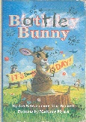

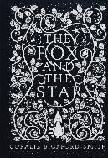
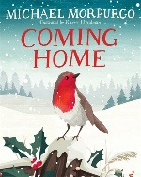
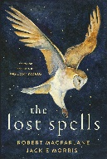


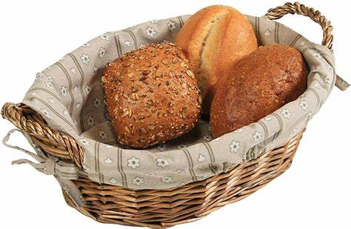
Year 6 – Autumn Term 1
Curriculum Information
2025- 2026
Science: Living Things and Their Habitats
Children will build on their learning about grouping living things by looking at the classification system in more detail. They will be introduced to the idea that broad groupings, such as microorganisms, plants and animals can be subdivided, according to common observable characteristics, based on similarities and differences. Through direct observations, they will classify animals into commonly found invertebrates (such as insects, spiders, snails, worms) and vertebrates (fish, amphibians, reptiles, birds and mammals). They will discuss reasons why living things are placed in one group and not another and be able to give reasons for classifying plants and animals based on specific characteristics. In addition, children will research the significance of the work of scientists such as Carl Linnaeus, a pioneer of classification.
Religious Education
Autumn 1: Branch 1 - Creation and Covenant
English
We will read the following texts and poems :
We will use these texts to write our own poetry, descriptions and informal persuasive texts, and we will revise editing our own work.
PHSE and RSE
Calming the Storm
P.E.
Dance and Fitness
Maths
*Read, write and compare 6-digit numbers and know what each digit represents; read, write and compare 1-, 2- and 3-place decimal numbers; multiply and divide by 10, 100 and 1000; round decimals to nearest tenth and whole number and place on a number line; convert decimals (up to 3 places) to fractions and vice-versa
*Use mental addition strategies to solve additions including decimal numbers; use column addition to add 5-digit numbers, decimal numbers and amounts of money; solve problems involving number up to 3 decimal places, choose an appropriate method to solve decimal addition.
*Express missing number problems algebraically and find pairs of numbers that satisfy equations involving two unknowns; find missing lengths and angles; understand how brackets can be used in calculation problems; use knowledge of the order of operations to carry out calculations involving the four operations, solve addition and subtraction multi-step problems using knowledge of the order of operations.
*Convert between grams and kilograms, millilitres and litres, millimetres and centimetres, centimetres and metres, metres and kilometres, and miles and kilometres; revise reading the 24-hour clock and convert 12-hour times to 24-hour; read and write Roman numerals; find time intervals using the 24-hour clock.
*Use mental addition, column subtraction and Counting up to solve subtractions of amounts of money and word problems; use mathematical reasoning to investigate.
*Use mental multiplication strategies to multiply by numbers such as 4, 8, 5, 25, 19, 29 and 99; revise using short multiplication to multiply 4-digit numbers by 1-digit numbers and use this to multiply amounts of money; solve word problems involving multiplication including two-step problems and finding change; use long multiplication to multiply 3-digit and 4-digit numbers by teens numbers.
Music
We will be creating our own rhythm patterns, listening to music by Benjamin Britten and learning the song Don’t Look Back in Anger.
German-Everyday life
*Revise personal descriptions
*Introduce time
*Daily routine
D&T- Making and Comparing Bread
In this unit children will taste a variety of different breads and think about how bread can contribute to a balanced diet. Children will learn how different ingredients are needed to make bread and how ingredients can be altered and mixed to create different effects. Children will then design, make and evaluate their own breads.
Geography: Natural Resources
Children will learn what natural resources are and about the natural resources in the UK (fossil fuels for energy, crops for food, and livestock for food as well as clothes) and the distribution across the world and understand that natural resources vary in different countries. They will study Russia, including its location, physical features and resources.

Slide 2

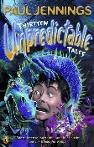


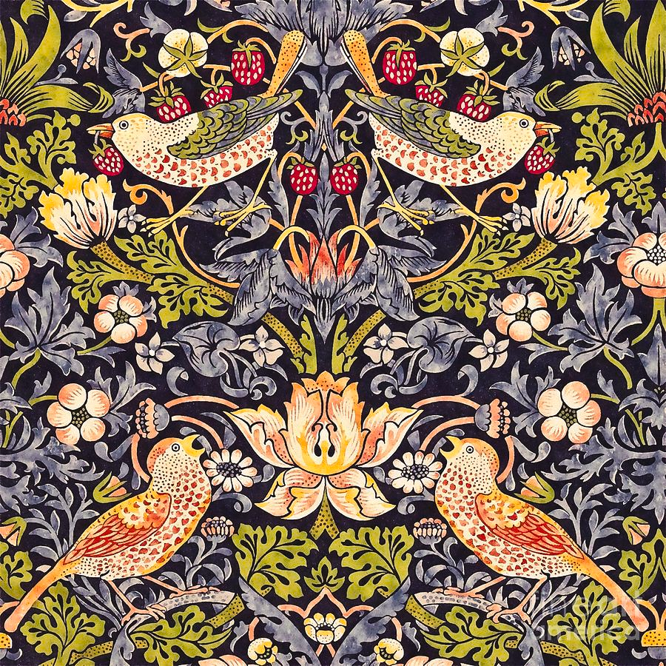
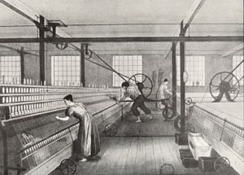
Year 6 – Autumn Term 2
Curriculum Information
2025- 2026
Art- William Morris: Arts and Crafts
Children will research the work of William Morris to understand the arts and craft movement and his approach to the decorative arts. Children will sketch and create own patterns by printing (tracing and transferring).
Science: Animals Including Humans
Children will learn to identify and name the main parts of the human circulatory system, and describe the functions of the heart, blood vessels and blood. They will recognise the impact of diet, exercise, drugs and lifestyle on the way their bodies function. They will be able to describe the ways in which nutrients and water are transported within animals, including humans. In addition, children will learn how to keep their bodies healthy and how their bodies might be damaged – including how some drugs and other substances can be harmful to the human body.
English
We will read the following texts:
Using these texts children will write an atmospheric short story, a non-chronological report and a narrative.
Music
We will be creating pitched melodies, listening to music by Scott Joplin and learning the song Love Shone Down
Computing - Systems and Networks – Communication
Children will learn about the World Wide Web as a communication tool. First, they will learn how we find information on the World Wide Web, through learning how search engines work (including how they select and rank results) and what influences searching, and through comparing different search engines. They will then investigate different methods of communication, before focusing on internet-based communication. Finally, they will evaluate which methods of internet communication to use for particular purposes.
History- The Industrial Revolution In this unit, children will learn about the Industrial Revolution and its impact on Manchester. They will investigate the development of new types of machinery and transport used to improve levels of productivity.
Maths
*Understand negative numbers; calculate small differences between negative numbers and negative and positive numbers; add and subtract negative numbers; compare fractions with unlike, but related, denominators; correctly use the terms fraction, denominator and numerator; understand what improper fractions and mixed numbers are and add fractions with the same denominator, writing the answer as a mixed number
*Calculate the perimeter, area and volume of shapes, and know their units of measurement; understand that shapes can have the same perimeters but different areas and vice versa; calculate the area of a triangle using the formula A = 1/2 b × h; find the area of parallelograms using the formula A = b × h ; name and describe properties of 3D shapes; systematically find and compare nets for different 3D shapes.
*Use mental strategies to divide by 2, 4, 8, 5, 20 and 25; find non-unit fractions of amounts; use short division to divide 3- and 4-digit numbers by 1-digit numbers, including those which leave a remainder; express a remainder as a fraction, simplifying where possible.
*Add and subtract unit fractions with different denominators including mixed numbers; use mental strategies to find simple percentages of amounts, including money.
*Multiply fractions less than 1 by whole numbers, converting improper fractions to whole numbers; use commutativity to efficiently multiply fractions by whole numbers; divide unit and non-unit fractions by whole numbers; solve word problems involving fractions.
P.E.
Gymnastics
Volleyball
Religious Education
Autumn 2: Branch 2 - Prophecy and Promise
PHSE and RSE
*Gifts and Talents
*Girls Bodies
*Boys Bodies
*Spots and Sleep
German- Where I live- Where You Live
*Revise houses and room in a house
*Christmas traditions

Slide 3
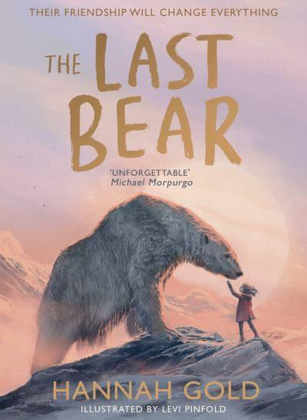
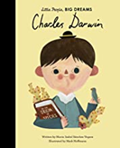

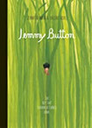
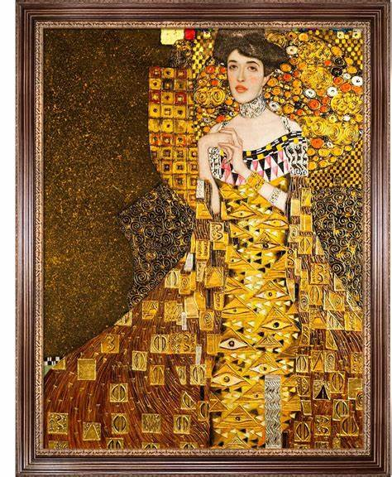
Year 6 – Spring Term 1
Curriculum Information
2025- 2026
P.E.
Yoga & Football
Maths
*Read and write numbers with up to 7-digits, understanding what each digit represents; work systematically to find out how many numbers round to 5000000; solve subtraction of 5- and 6-digit numbers using written column method (decomposition).
*Multiply and divide by 10, 100 and 1000; compare and order numbers with up to three decimal places; know common fraction / decimal equivalents; multiply pairs of unit fractions and multiply unit fractions by non-unit fractions
*Use partitioning to mentally multiply 2-digit numbers with one decimal place by whole 1-digit numbers; multiply numbers with two decimal places; use short multiplication to multiply amounts of money; use estimation to check answers to calculations; use long multiplication to multiply 3-digit and 4-digit numbers by numbers between 10 and 30.
*Name, classify and identify properties of quadrilaterals; explore how diagonal lines can bisect quadrilaterals; understand what an angle is and that it is measured in degrees; know what the angles of triangles, quadrilaterals, pentagons, hexagons and octagons add to and use these facts and mathematical reasoning to calculate missing angles; recognise and identify the properties of circles and name their parts; draw circles using pairs of compasses; draw polygons using a ruler and a protractor.
*Add and subtract numbers using mental strategies; solve addition of 4- to 7-digit numbers using written column addition; identify patterns in the number of steps required to generate palindromic numbers; solve subtraction of 5-, 6- and 7-digit numbers using written column method (decomposition); solve additions and subtractions choosing mental strategies or written procedures as appropriate; read, understand and solve word problems.
*Identity common factors and common multiples; understand that a prime number has exactly two factors and find prime numbers less than 100; understand what a composite (non-prime) number is; use long division to divide 3- and 4-digit numbers by 2-digit numbers, giving remainders as a fraction, simplifying where possible
Music
We will be using dynamics and notation, listening to music by Gabriela Lena Frank and learning the song Saturday Afternoon.
German : Playing and enjoying sport
* New year greetings * Introduce sports * Revise opinions
History- The Peterloo Massacre
Children will identify when the Peterloo Massacre took place. They will review what led to the massacre including the impact of the Corn Laws and representation in Parliament. They will investigate the attitudes and expectations of different groups of people at St. Peter’s Field and detail the sequence of events that led to the massacre. Finally, they will evaluate who was responsible for the Peterloo Massacre.
English
We will read the following texts:
Using these texts we will write narratives including dialogue, biographies and a report about an author.
Science: Evolution and Inheritance
Children will find out more about how living things on earth have changed over time and that fossils provide information about living things that inhabited the Earth millions of years ago. Children will be introduced to the idea that characteristics are passed from parents to their offspring, for instance by considering different breeds of dogs and what happens when, for example, Labradors are crossed with poodles. They will recognise that living things produce offspring of the same kind, but normally offspring vary and are not identical to their parents. They will also learn that variation in offspring over time can make animals more or less able to survive in particular environments, for example, by exploring how giraffes’ necks got longer, or the development of insulating fur on the arctic fox. They will learn to identify how animals and plants are adapted to suit their environment in different ways and that adaptation may lead to evolution. In addition, children will research the work of paleontologists such as Mary Anning and about how Charles Darwin and Alfred Wallace developed their ideas on evolution.
Computing – Spreadsheets
Children will be introduced to spreadsheets. They will be supported in organising data into columns and rows. Children will be taught the importance of formatting data to support calculations, while also being introduced to formulas and will begin to understand how they can be used to produce calculated data. They will be taught how to apply formulas that include a range of cells, and apply formulas to multiple cells by duplicating them. Children will use spreadsheets to plan an event and answer questions. Children will create graphs and charts, and evaluate their results in comparison to questions asked.
Art- Gustav Klimt
Children will learn about the history of key artwork and explore
key elements of Klimt’s style. They will use photographic
portraits of themselves to create a portrait inspired by ‘Adele
Bloch Bauer’.
Religious Education
Spring 1: Branch 3 - Galilee to Jerusalem
PHSE and RSE
*Body Image
*Funny Feelings and Emotional Changes
*Seeing stuff online

Slide 4
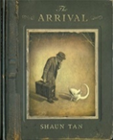



Year 6 – Spring Term 2
Curriculum Information
2025- 2026
English
We will read the following texts:
Using these texts we will write letters, persuasive formal letters and a narrative with a flashback.
Music
We will be exploring timbre and tempo, listening to music by Sona Jobarteh and learning songs for The Stations of the Cross.
P.E.
OAA and Athletics
Maths
*Solve addition and subtraction multi-step problems in shopping contexts, and add and subtract money using column addition and counting up; add and subtract decimal numbers choosing an appropriate strategy, and add decimal numbers with different numbers of places using column addition; use mathematical reasoning to investigate and solve problems, and solve subtractions of decimal numbers with different numbers of places (2-places) using counting up
*Calculate and understand the mean average; construct and interpret distance/time line graphs where intermediate points have meaning, including conversion line graphs; understand pie charts are a way of representing data using percentages, interpret and construct pie charts.
*Read and plot coordinates in all four quadrants, draw and translate simple polygons using coordinates and find missing coordinates for a vertex on a polygon; draw and reflect simple polygons in both the x-axis and y-axis using coordinates; find unknown angles around a point, on a line, in a triangle or vertically opposite and in polygons where diagonals intersect.
*Multiply 4-digit numbers including those with two decimal places by 1-digit numbers; use long multiplication to multiply 4-digit numbers by numbers between 10 and 30, including those with two decimal places; revise using short division to divide 4-digit by 1-digit and 2-digit numbers including those which leave a remainder, and divide the remainder by the divisor to give a fraction, simplifying where possible, and make approximations; use long division to divide 4-digit by 2-digit numbers, and use a systematic approach to solve problems
*Generalise a relationship between pairs of numbers, express simple formulae in words, then using letters; describe and continue sequences, generalise to predict the tenth term, begin to generalise a term in a sequence using n to stand for the number of the term in a sequence; describe ratio and use ratio to solve problems; find fractions and simplify ratios
Science: Electricity
Children will construct simple series circuits, to help them to answer questions about what happens when they try different components, for example, switches, bulbs, buzzers and motors. They will learn to associate the brightness of a lamp or the volume of a buzzer with the number and voltage of cells used in the circuit. They will be able to compare and give reasons for variations in how components function, including the brightness of bulbs, the loudness of buzzers and the on/off position of switches. They will also learn how to represent a simple circuit in a diagram using recognised symbols.
Geography: Energy and Sustainability
In this unit, the children will learn how energy is produced (including renewable and non-renewable energy. Additionally, the children will learn about what it means to be sustainable and practices that can be used to improve sustainability such as a circular economy. Through case studies of Curitiba (Brazil) and Freiburg (Germany), children will learn about the impact sustainable practice can have on an area. Children will identify ways in which they can make more sustainable decisions and respond to Pope Francis’ message of Laudato Si.
English
.
PHSE and RSE
Making Babies
Menstruation
German– This is me, hobbies and fun
*Revise sports
*Introduce hobbies
*Lieblings Sachen
Religious Education
Spring 2: Branch 4 - Desert to Garden

Slide 5




Year 6 – Summer Term 1
Curriculum Information
2025- 2026
PHSE/ SRE
Hope Beyond Death
Coping with Change
Build Others Up
Science- Light
Children will build on the previous learning exploring the way that light behaves, including light sources, reflection and shadows. Children will recognise that light appears to travel in straight lines. They will be able to use the idea that light travels in straight lines to explain that objects are seen because they give out or reflect light into the eye. They will learn to explain that we see things because light travels from light sources to our eyes or from light sources to objects and then to our eyes. They will discuss what happens and make predictions. They will be able to use the idea that light travels in straight lines to explain why shadows have the same shape as the objects that cast them.
Religious Education
Summer 1: To the Ends of the Earth
P.E. Handball and Rounders
Geography: Local Fieldwork
Children will learn how to locate landmarks (including those in the local area) using 6-figure grid references. They will learn about the location of Blackley in the UK. Children will learn how Blackley has changed over time. Finally, pupils will complete a local fieldwork walk which will be used to design a fieldwork questionnaire.
Maths
*Revise reading, writing, comparing and ordering numbers with up to seven digits and decimal numbers with up to three decimal places; revise rounding decimal numbers to the nearest tenth and whole number; revise rounding big numbers to the nearest thousand, ten thousand, hundred thousand and million; revise locating a number on a number line marking numbers it lies between; revise comparing and ordering negative numbers including calculating differences between negative numbers and positive and negative numbers
*Revise adding and subtracting whole numbers and decimal numbers using mental and written methods; revise finding percentages of numbers, converting fractions, decimals and percentages and making comparisons using percentages; revise how brackets can be used in calculation problems, revise the order of operations for calculations involving the four operations; revise solving missing number problems using inverse operations; revise using trial and improvement to solve equations involving one or two unknowns, and find missing lengths and angles
*Revise scaling, using mental strategies for multiplying and dividing; revise solving problems involving rate; revise multiplying pairs of 2-digit numbers and finding factors of 2-digit numbers; multiply 3-digit and 4-digit numbers including decimals by whole 1-digit numbers and solve word problems involving multiplication of money and measures; use a systematic approach to solve problems involving multiplication and division, including long multiplication of 3-digit and 4-digit numbers and decimals.
*Revise using short division to find unit fractions of amounts, including decimals, and round answers to money problems according to the context; revise using long division to divide 4-digit by 2-digit numbers, giving remainders as a fraction, simplifying where possible; revise using long division to divide 3-digit and 4-digit numbers by numbers between 10 and 30, writing the fractional part of the answer as a decimal where equivalents are known; revise calculating the mean average; revise reading and marking coordinates in all four quadrants, draw simple polygons and find missing coordinates on a polygon or line
English
We will be reading the following texts:
Using these texts we will write a new chapter, we will rewrite a chapter from the perspective of a character using flashbacks and we will write letters.
D&T-Making a Leavers Cushion
In this unit the children will think about the user’s needs/wants and aesthetics when choosing textiles to make a memory/leavers cushion. Children will use a range of joining techniques to make a patchwork leavers cushion and begin to use cross stitch to add detail. Children will think carefully about what would improve their product.
Music
We will be creating compositions with structure and texture, listening to Hans Zimmer and learning the song Feel the Light.
German– Café Culture and Restaurants
*Revise and practice food items and phrases from previous units.

Slide 6



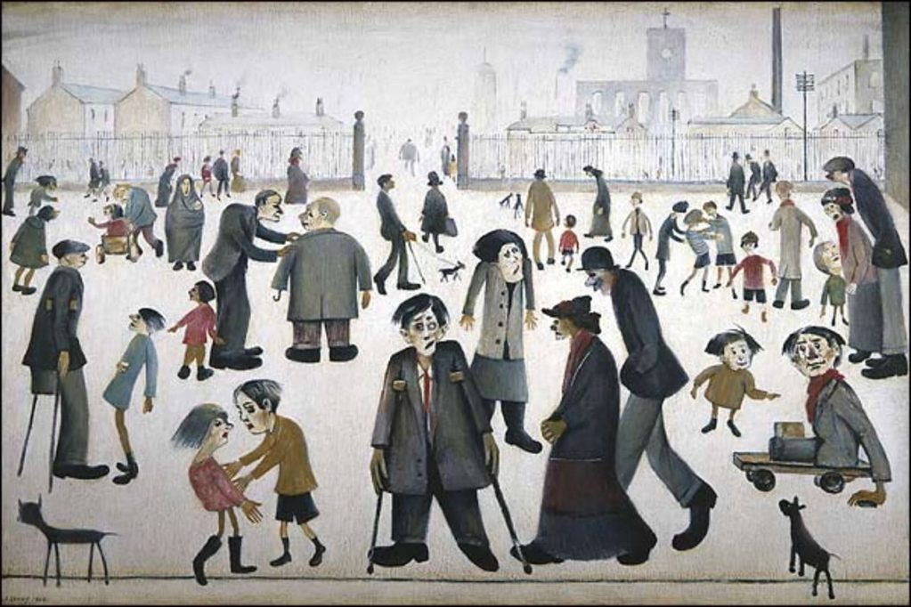

Year 6 – Summer Term 2 Curriculum Information
2025-2026
Music
We will be using all our knowledge and skills in our final performances, listening to Elton John and learning the song We are Unstoppable.
English
We will read the following texts:
We will use these texts to write from different character perspectives. We will write a guide for starting secondary school and letters to our form tutors.
PHSE and RSE
The Trinity
Catholic Social Teaching
Reaching Out
Money and Me
Religious Education
Summer 2: Dialogue and Encounter
German- Performance Time
*Create and perform simple sketches
P.E.
Golf and Tennis
Art- Artist Study- Lowry
Through the work of LS Lowry children will learn how artists make people look as they are moving. They will explore the concept of a ‘vanishing point’ and produce their own playtime Lowry piece of artwork.
Maths
*Revise equivalence simplifying fractions and changing improper fractions into mixed numbers and vice versa; revise adding and subtracting fractions with different denominators, including those which give answers greater than 1; revise multiplying pairs of fractions and multiplying and dividing fractions by whole numbers; solving problems involving ratios; read intermediate points off scales.
*Revise properties and classification of 2D shapes, drawing 2D shapes using ruler, protractor and compasses, parts of a circle and angles in polygons; revise calculating missing angles by knowing angle facts; use a protractor to measure and draw angles in degrees; identify and name acute, right, obtuse and reflex angles; understand perimeter, area and volume; find the perimeter of rectangles, find the area of rectangles, parallelograms and triangles, and find the volumes of cubes and cuboids; revise reading and interpreting different types of data display.
*Use Mathematical reasoning to investigate and solve problems, and to estimate and predict; solve problems using doubling, solve calculations with enormous numbers; find out about famous mathematicians including Brahmagupta and John Napier and use their different methods to multiply; use lattice multiplication to solve multiplications of 2-, 3- and 4-digit numbers; begin to compare historical multiplication methods
*Explore binary numbers; solve mathematical puzzles; including using multiplication facts, find digital roots and look for patterns; explore Fibonacci sequences and Pythagoras' theorem
History: The Victorians
Children will identify when the Victorian era was and highlight key features of this period in time. They will review the political reforms which occurred as a result of the Chartist Movement and the impact of the Education Act. They will investigate how leisure time changed and the importance of the Great Exhibition.
Computing - Programming – Raspberry Pi HTML and CSS
Children will learn a different programming language to help in their programming journey. Learners will learn how to use HTML (Hypertext Markup Language) to create web pages to achieve specific web development goals. Learners will make an online birthday card, create webpages to tell stories and write letters and create an end of year webpage project.
Science: Sound and Hearing and Revision
Children will revisit how sounds are made, associating some of them with something vibrating. They will revise those vibrations from sounds travel through a medium to the ear. They will revise patterns between the pitch of a sound and features of the object that produced it. They will revise patterns between the volume of a sound and the strength of the vibrations that produced it. They will revise that sounds get fainter as the distance from the sound source increases.
Children will also revise and identify the way sound is made through vibration in a range of different musical instruments from around the world, investigating how the pitch and volume of sounds can be changed in a variety of ways.

