Slide 1


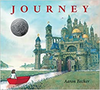

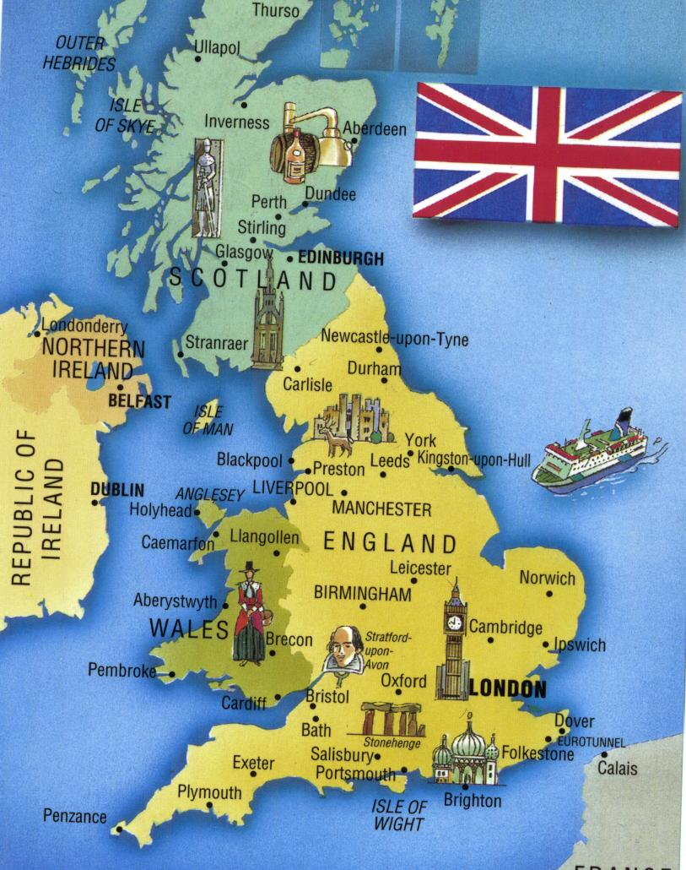

Year 3 – Autumn Term 1
Curriculum Information
2025- 2026
Religious Education
Branch 1
Creation and Covenant
English
We will be reading the following texts:
We will use these texts to write dialogue, letters and our own version of a story.
P.E.
Dance & Fundamentals
Art- Drawing and Painting famous landmarks.
Children will be introduced to the work of Fernand Leger- ‘The City’. Children will make sketches of key points of the local area. Children will take a selection of their own drawings to create their own abstract art based on the local area using and mixing similar colours to Fernard Leger.
Maths
*Use multiple of 5 and 10 bonds to 100 to solve additions and subtractions; add and subtract 1-digit numbers to and from 2-digit numbers
*Compare and order 2- and 3- digit numbers; count on and back in 10s and 1s; add and subtract 2-digit numbers; solve problems using place value
*Know multiplication and division facts for the 5, 10, 2, 4 and 3 times-tables; doubling and halving
*Know and understand the calendar, including days, weeks, months, years; tell the time to the nearest 5 minutes on analogue and digital clocks; know the properties of 3D shapes
*Comparing, ordering and understanding place value of 2- and 3-digit numbers; subtracting from 2-digit numbers; using prediction to estimate calculations
Geography- The UK and its features
Children will learn about the physical and human geography of the UK. Children will learn about hills, mountains and the location of rivers within the UK. Children will learn about counties and cities in the UK and use maps, atlases and aerial photographs.
Computing –
Connecting computers
Children will develop their understanding of digital devices, with an initial focus on inputs, processes, and outputs. They will compare digital and non-digital devices, before learning about computer networks that include network infrastructure devices like routers and switches.
Music
We will be learning to play the recorder in Whole Class Ensemble Training sessions
Science: Animals Including Humans
Children will learn about the importance of nutrition and will be introduced to the main body parts associated with the skeleton and muscles, finding out how different parts of the body have special functions. Children will learn to identify that animals, including humans, need the right types and amount of nutrition and that they cannot make their own food; they get nutrition from what they eat. They will learn to identify that humans and some other animals have skeletons and muscles for support, protection and movement.
German- A New Start
Children will learn:
*Greetings
*Nos 1-10
*Colours
PHSE and RSE
Get Up
The Sacraments
Jesus My Friend

Slide 2

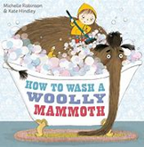
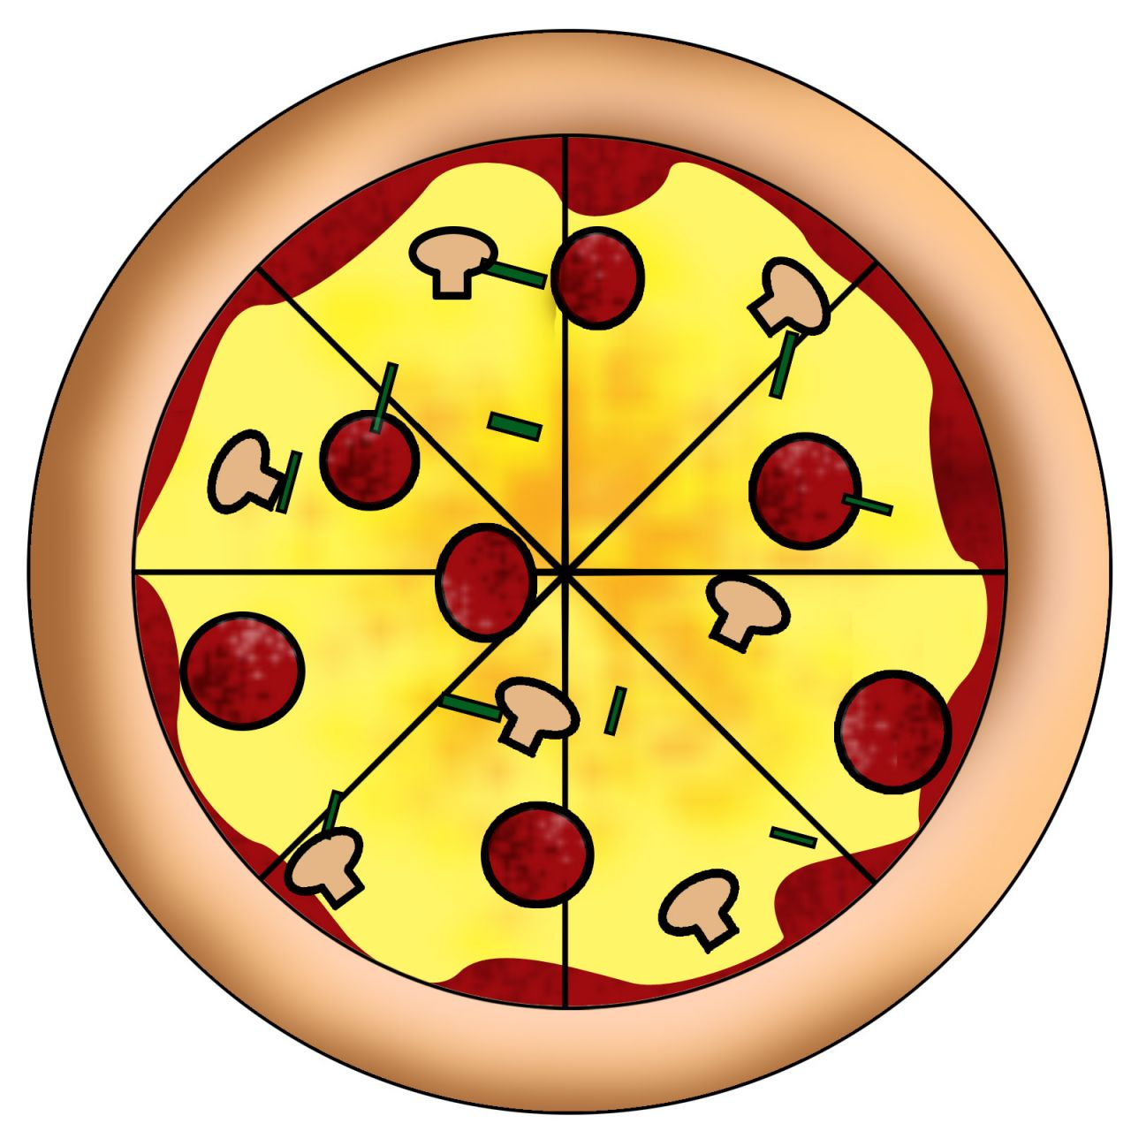
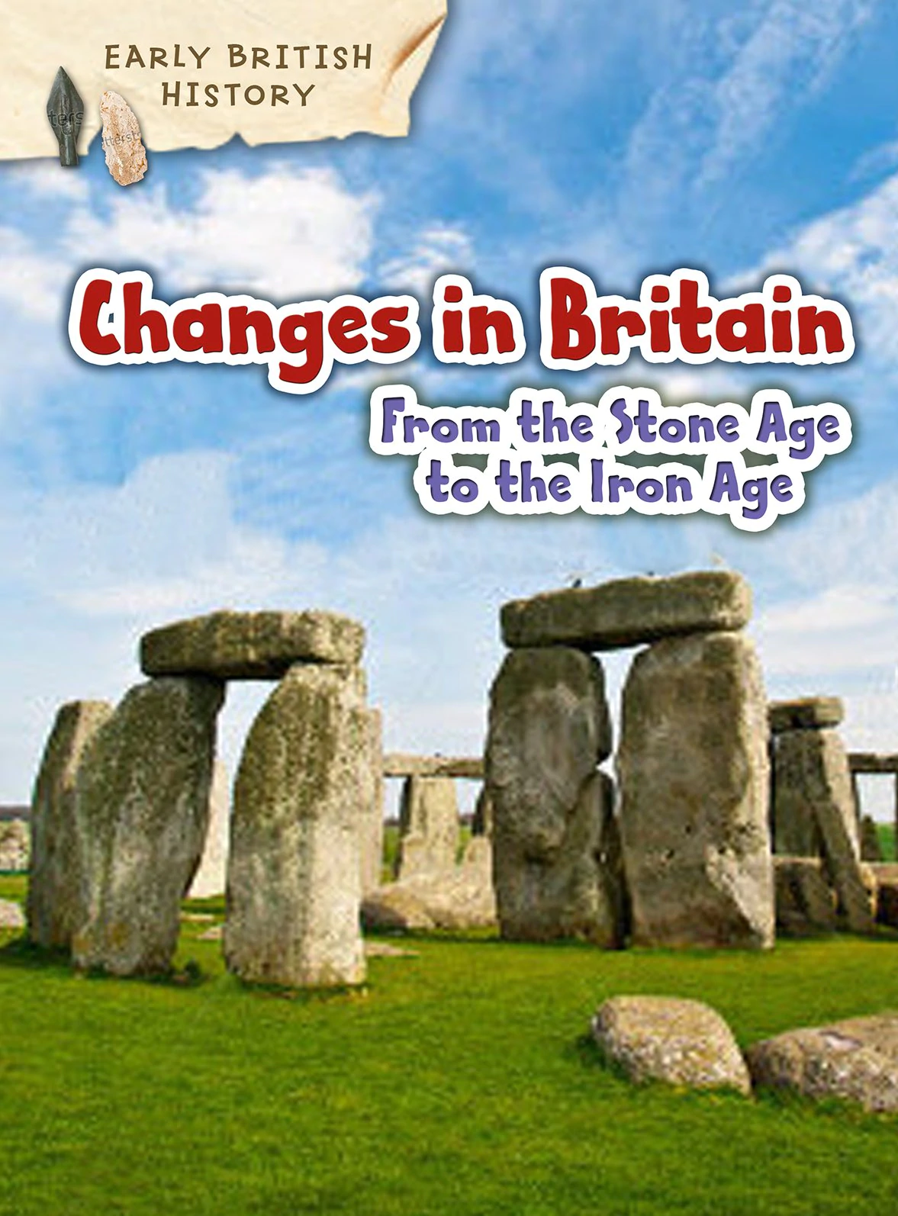
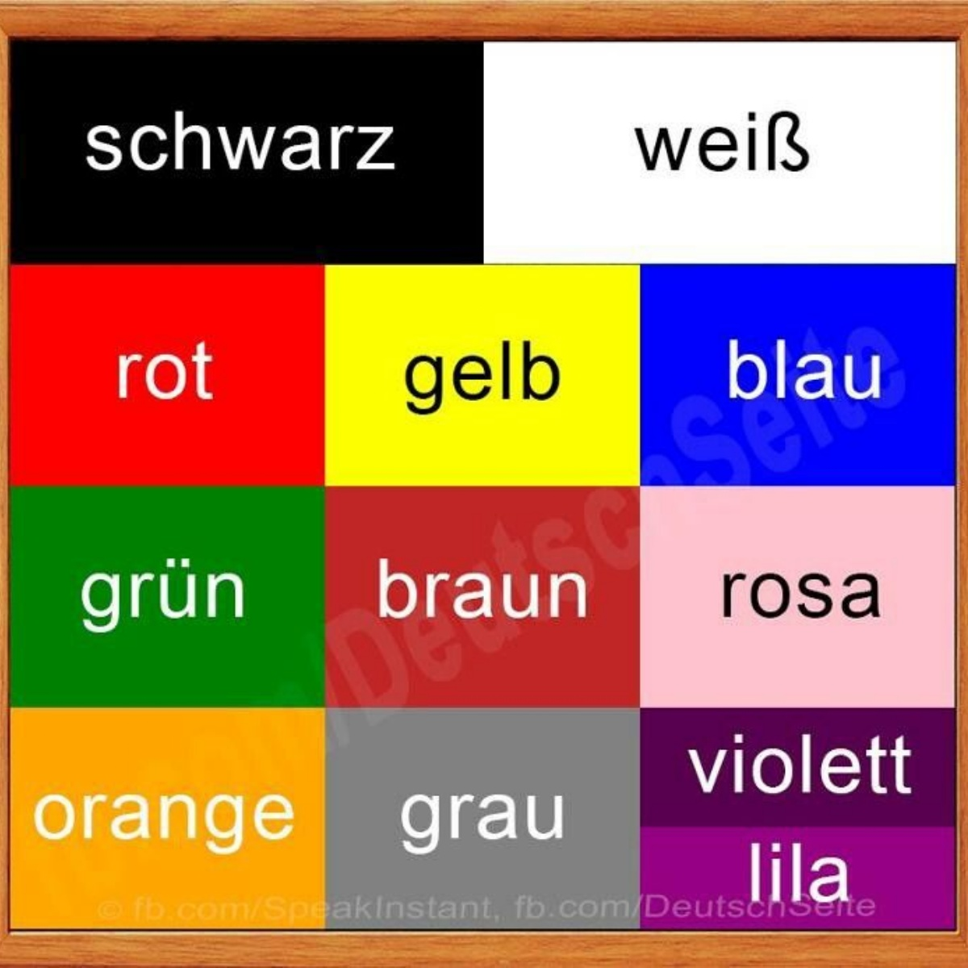
Year 3 – Autumn Term 2
Curriculum Information
2025- 2026
PHSE and RSE
Friends, Family and Others
When Things Feel Bad
Science- Rocks
Children will explore different kinds of rocks and soils, including those in the local environment. They will compare and group together different kinds of rocks based on their appearance and simple physical properties. They will describe in simple terms how fossils are formed when things that have lived are trapped within rock. They will recognise that soils are made from rocks and organic matter.
Music
We will be learning to play the recorder in Whole Class Ensemble Training sessions
English
We will be reading the following texts:
We will use these texts to write diaries, travel journals and instructions.
Religious Education
Branch 2
Prophecy and Promise
D&T- Making Pizzas
Children will research what makes a good pizza. Children will learn where the ingredients come from to make a pizza (including herbs such as basil and oregano). Children will look at the seasonality of these ingredients. They will learn how to create their own simple pizza base from dough and use a variety of skills such as chopping, grating, kneading and stretching to make a pizza. Children will learn how to work hygienically and safely.
Maths
*Doubling and halving numbers up to 100 using partitioning; understanding fractions and fractions of numbers
*Use money to add and subtract and record using the correct notation and place value; add and subtract 2-digit numbers using partitioning; add three 2-digit numbers by partitioning and recombining.
*Choose an appropriate instrument to measure a length and use a ruler to estimate, measure and draw to the nearest centimetre; know 1 litre = 1000 ml; estimate and measure capacity in millilitres
*Place 2- and 3-digit numbers on a number line; round 3-digit numbers to nearest 100; use counting up to do mental subtractions with answers between 10 and 20, 10 and 30, and either side of 100
*Revise times-tables learned and derive division facts; perform division with remainders; choose a mental strategy to solve additions and subtractions; solve word problems
P.E.
Gymnastics
Fitness
History- The Stone Age
Children will learn about the important aspects of the Stone Age. They will find out what historians discovered about the Stone Age including: understanding how hunter gathers lived, why settlements were formed,
why stone circles were important
and the daily life for people living
at Scara Brae.
German- The calendar and celebrations
Children will learn
*Classroom commands
*Colours
*Days of the week
*Story of St Nikolaus

Slide 3


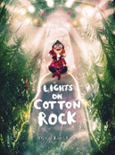
Year 3 – Spring Term 1
Curriculum Information
2025- 2026
Religious Education
Branch 3
Galilee to Jerusalem
Science – Forces and Magnets
Children will compare how things move on different surfaces. They will observe that most forces need direct contact between two objects (for example, opening a door, pushing a swing) but magnetic forces can act at a distance, without direct contact. Children will observe how magnets attract or repel each other and attract some materials and not others. They will compare and group together a variety of everyday materials based on whether they are attracted to a magnet and identify some magnetic materials. describe magnets as having two poles and predict whether two magnets will attract or repel each other, depending on which poles are facing. In addition, they will explore the behaviour and everyday uses of different magnets (for example, bar, ring, button and horseshoe).
Geography- Earthquakes
Children will learn about the structure of the Earth. They will learn what causes earthquakes. Through an introduction into latitude and longitude children will locate the world’s largest earthquakes.
Maths
*Rehearse place value in 3-digit numbers, order them on a number line and find a number in between; compare number sentences; solve additions and subtractions using place value; multiply and divide by 10 (whole number answers); count in steps of 10, 50 and 10O.
*Add pairs of 2-digit numbers using partitioning (crossing 10s, 100 or both) and then extend to add two 3-digit numbers (not crossing 1000); recognise and sort multiples of 2, 3, 4, 5, and 10; double the 4 times-table to find the 8 times-table; derive division facts for the 8 times-table; multiply and divide by 4 by doubling or halving twice.
*Identify 1/2s, 1/3s, 1/4,s 1/6s, and 1/8s; realise how many of each make a whole; find equivalent fractions; place fractions on a 0 to 1 line; find fractions of amounts.
*Recognise right angles and know they are 90°; understand angles are measured in degrees; recognise ° as the symbol for the measurement of degrees; name and list simple properties of 2D shapes; begin to understand and use the term perimeter to mean the length/distance around the edge (border) of a 2D shape; begin to calculate using a ruler; know a right angle is a quarter turn; know 360° is a full turn; begin to understand angles and identify size of angles in relation to 90°
*Place 3-digit numbers on empty 100 number lines; begin to place 3-digit numbers on 0-1000 landmarked and empty number lines; round 3-digit numbers to the nearest ten and to the nearest hundred; use counting up as a strategy to perform mental subtraction (Frog); subtract pounds and pence from five pounds; use counting up (Frog) as a strategy to perform mental subtraction of amounts of money; subtract pounds and pence from ten pounds
Music
We will be notating rhythms and using dynamics, listening to music by Kerry Andrew and learning How Far I’ll Go.
English
We will be reading the following texts:
Using these texts we will write letters, our own stories and learning how to punctuate speech.
German- Animals I like and don’t like
Children will learn
*Pets
*Colours
*Easter
*Fashing
Computing- Creating media – Desktop
Children will become familiar with the terms ‘text’ and ‘images’ They will use desktop publishing software and consider careful choices of font size, colour and type to edit and improve pre-made documents. Children will be introduced to the terms ‘templates’, ‘orientation’, and ‘placeholders’ and begin to understand how these can support them in making their own template for a magazine front cover.
Art-Paper Sculptures
Children will learn about paper sculptures created by Richard Sweeney. Children will learn how to make paper sculptures and use papier mache to make monster faces
PHSE and RSE
Sharing Online
Chatting Online
Critical Thinking
P.E.
Yoga
Ball Skills

Slide 4


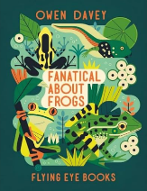
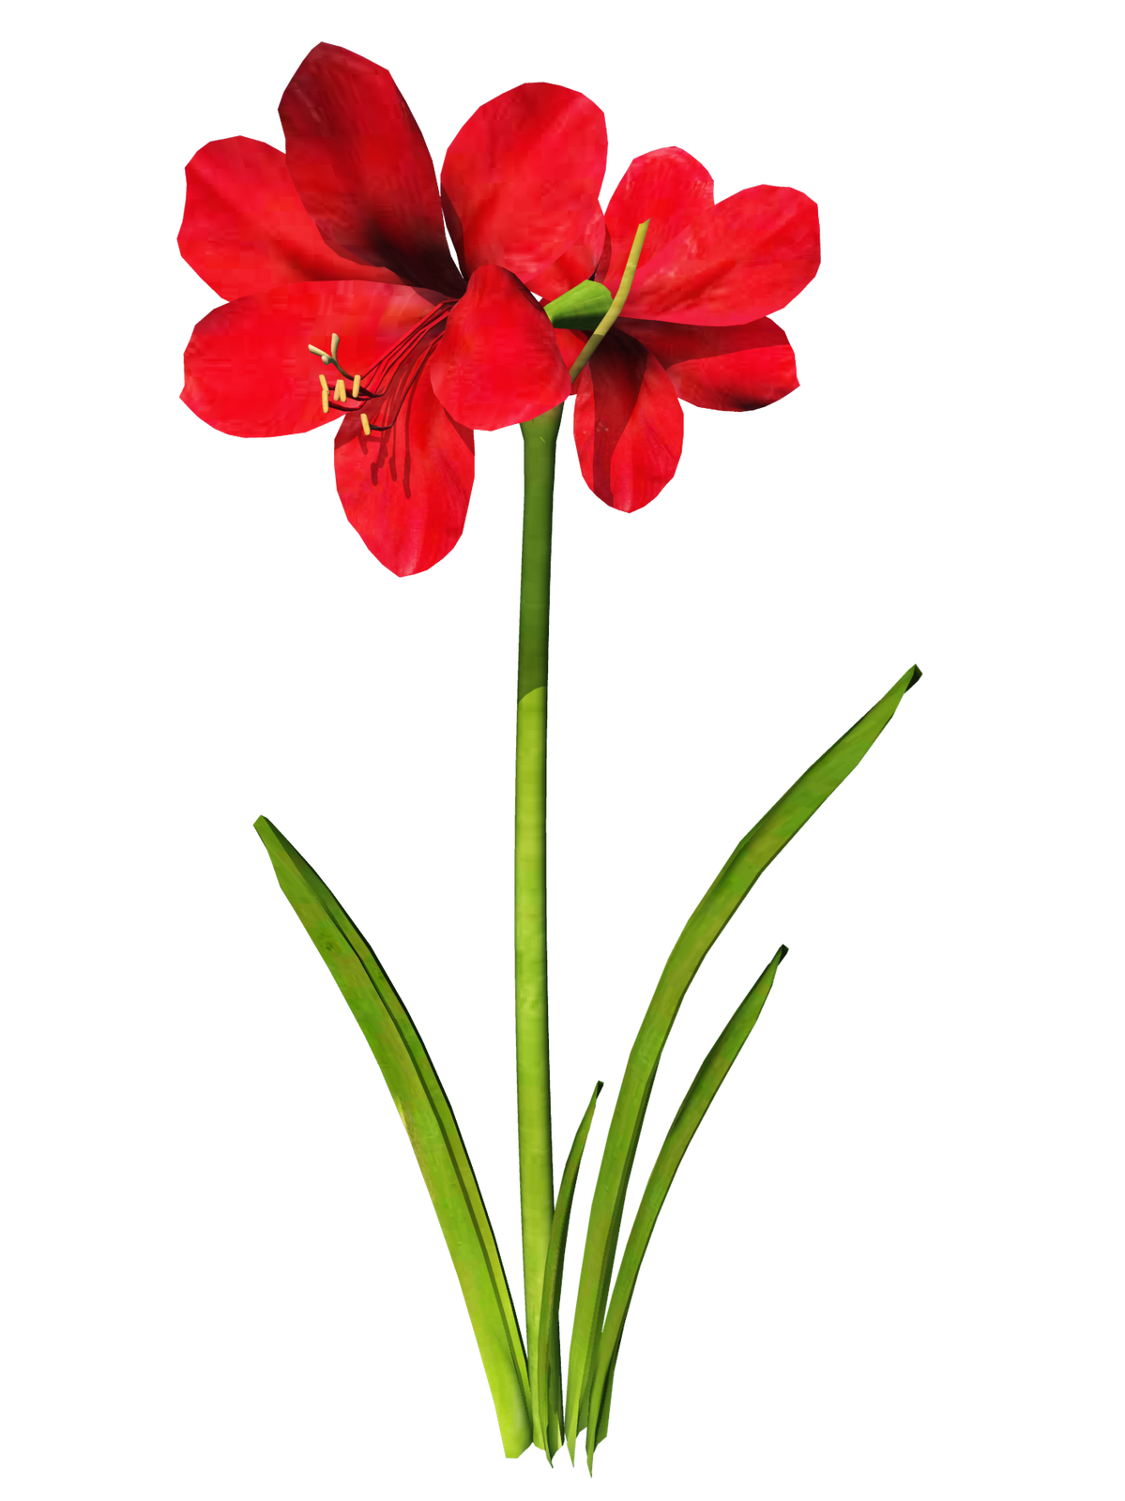
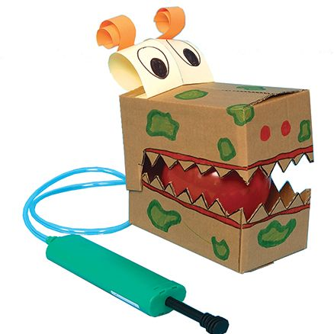
Religious Education
Branch 4
Desert to Garden
Science – Plants
Children will be introduced to the relationship between structure and function: the idea that every part of the plant has a job to do. Children will be able to identify and describe the functions of different parts of flowering plants: roots, stem/trunk, leaves and flowers. They will explore questions that focus on the role of the roots and stem in nutrition and support, leaves for nutrition and flowers for reproduction. They will examine the requirements of plants for life and growth (air, light, water, nutrients from soil and room to grow), how this varies from plant to plant and they will be introduced to the idea that plants can make their own food. They will investigate the way in which water is transported within plants. They will also investigate the part that
flowers play in the life cycle of flowering plants,
including pollination, seed formation and seed
dispersal.
Year 3 – Spring Term 2
Curriculum Information
2025 - 2026
English
We will be reading the following texts:
Using these texts children will write poetry, letters and an information text.
Music
We will be using instruments to create different sounds, thinking about tempo, listening to music from Argentina and learning The Plant Song.
P.E.
OAA
Tag Rugby
Maths
*Understand place-value in 3-digit numbers; separate 3-digit numbers into hundreds, tens, and ones; add two 3-digit numbers using vertical written addition (expanded); add 2- and 3- digit numbers using vertical written addition (expanded)
*Add two 2-digit numbers mentally; add 2-digit to 3-digit numbers mentally using place value and rounding; add two 3-digit numbers using expanded written method (answers under 1000); begin to move tens and hundreds moving towards formal written addition; add two 3-digit numbers using expanded column addition
*Tell the time to the nearest minute on analogue and digital clocks (minutes past and minutes to); time events in minutes and seconds; find a time after a given interval (not crossing the hour); calculate time intervals; solve word problems involving time
*Order 3-digit numbers and find numbers between; solve subtractions of 3-digit - 3-digit numbers using counting up (Frog); use counting up and counting back as strategies to perform mental subtractions; choose to solve a given subtraction by counting up or counting back
*Double and halve numbers up to 100 by partitioning; solve word problems involving doubling and halving; multiply numbers between 10 and 25 by 1-digit numbers using the grid method; divide multiples of 10 by 1-digit numbers using known tables facts; see the relation between multiplication and division
D&T- Moving Monsters
Children will learn and explore pneumatic systems before designing, making and evaluating their own monster
with moving parts. Children will evaluate their
finished product.
German-Karneval and playground games
*Revision of colours
*Look in depth at Austrian artist Hundertwasser.
*Revise personal information
History- The Bronze Age and Iron Age
Children will be build on the knowledge taught in the Stone Age unit by learning about the changes that occurred during the Bronze and Iron Age, including what an iron age fort was like and what life was like. They will understand how historians found out about life millions of year ago and make comparisons between the different ages, using evidence to support their statements.
PHSE and RSE
Safe in My Body
Out and About
Drugs, Alcohol and Tobacco

Slide 5


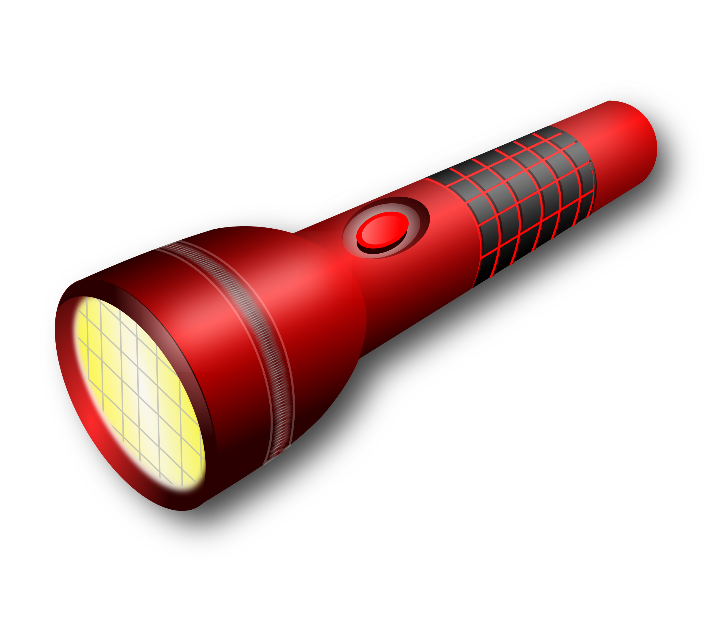

Year 3 – Summer Term 1
Curriculum Information
2025 - 2026
Religious Education
To the Ends of the Earth.
English
We will be reading the following texts:
Using these texts we will write diaries, letters, description, dialogue and our own adventure story.
P.E.
Hockey
Tennis
Music
We will be using structure and texture in compositions, listening to music by Alan Menken and learning Believe in Me.
Maths
*Add 3-digit and 1-digit numbers mentally, using number facts; subtract 1-digit numbers from 3-digit numbers mentally using number facts; add and subtract multiples of 10 by counting on and back in 10s and using number facts to cross 100s; compare and order fractions with the same denominator; begin to recognise equivalences of 1/2; add and subtract fractions with the same denominator
*Use function machines to multiply by 2, 3, 4, 5 and 8 and understand the inverse; use scaling to multiply heights and weights by 2, 4, 8, 5 and 10; use known facts to multiply multiples of 10 by 2, 3, 4 and 5; multiply numbers between 10 and 30 by 3, 4 and 5 using the grid method; multiply 2-digit numbers by 3, 4, 5 and 8 using the grid method
*Divide without remainders, just beyond the 12th multiple; division using chunking, with remainders; use the grid method to multiply 2-digit numbers by 3, 4 ,5 and 8; begin to estimate products
*Draw and interpret bar charts and pictograms where one square/symbol represents two units; compare and measure weights in multiples of 100g; know how many grams are in a kilogram; estimate and weigh objects to the nearest 100g; draw and interpret bar charts where one square represents one hundred units
*Add 3-digit and 2-digit numbers using mental strategies; add two 3-digit numbers using mental strategies or by using column addition; use reasoning, trial and improvement to solve problems involving more complex addition.
German-Breakfast, fruit nouns, the Hungry Giant
Fruit and vegetables
Requesting food
Computing- Programming – code.org Course C
Course C builds uses word based code to develop problem-solving skills, encourage persistence and promote creativity. These lessons highlight key coding concepts including sequencing and loops and learners will create interactive games they can share.
Geography- Volcanoes
Children will learn how volcanoes are formed and know what happens when a volcano erupts. They will look at the location of volcanoes using a world map and investigate why people would live near a volcano.
Art: Mosaic: Pompeii
Children will look at the mosaics preserved in the House of Faun. Children will learn how mosaics are made up of an assemblage of small pieces of marble, ceramics etc. Children will learn mosaics come in different styles, such as opus regulatum and opus palladianum. Children will draw and paint their own sea creatures, then cut and reassemble to make a mosaic
Science – Light
Children will learn that we need light in order to see things and that dark is the absence of light. They will notice that light is reflected from surfaces. Children will explore what happens when light reflects off a mirror or other reflective surfaces, including playing mirror games to help them to answer questions about how light behaves. They will learn that there are ways to protect their eyes and about why it is important to protect their eyes from bright lights. They will recognise that shadows are formed when a solid object blocks the light from a light source. In addition, they will look for, and measure, shadows, and find out how they are formed and what might cause the shadows to change.
PHSE and RSE
First Aid Heroes
Rights and Responsibilities

Slide 6
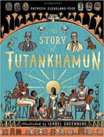
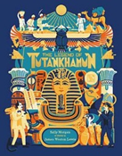
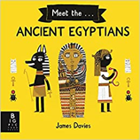
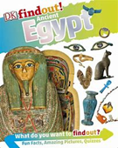
Year 3 – Summer Term 2
Curriculum Information
2025 - 2026
Science – Revision
Children will revise units covered throughout the year
Religious Education
Dialogue and Encounter
D&T- Making a Garden Obelisk
children will look at different structures used to make a garden obelisk. Children will then design and make their own garden obelisk to use when growing sweet peas. Children will assemble, join and combine materials and components with some accuracy and investigate and analyse why materials have been chosen.
Art - Artist Study- Alma Thomas
Children will learn about the work of Alma Thomas and her use of colour in her paintings. Children will use abstract pointillism and collaging to create their own landscape pieces inspired by Alma Thomas
History-Early Civilisation/Ancient Egypt
Children will learn about the ancient civilisation of Egypt. They will learn about trade, art and religion in Egyptian times. They will learn how the ancient civilisation of Egypt came to an end.
Maths
*Use column addition to add three 2- and 3-digit numbers together and four 2- and 3-digit numbers together; subtract 3-digit numbers using counting up; solve word problems choosing an appropriate method
*Add 3-digit numbers using column addition; solve problems involving measures; solve subtractions of 3-digit numbers using counting up on a line and work systematically to find possibilities; choose an appropriate strategy to solve addition or subtraction
*Identify, name and draw horizontal, vertical, perpendicular, parallel and diagonal lines, angles and symmetry in 2D shapes; measure the perimeter of 2D shapes by counting and measuring with a ruler; tell the time on analogue and digital clocks to the minute, begin to tell the time 5, 10, 20 minutes later, recognise am and pm and 24-hour clock times
*Use the grid method to multiply 2-digit numbers by 3, 4, 5, 6 and 8; estimate products; divide using chunking, with and without remainders; decide whether to use multiplication or division to solve word problems; recognise tenths and equivalent fractions; find one-tenth and several tenths of multiples of 10 and begin to find one-tenth of single-digit numbers
*Revise column addition for adding three 3-digit numbers; revise mental strategies for addition; subtract 3-digit numbers using written and mental methods; find change using counting up; check subtraction using addition; multiply numbers between 10 and 40 by 1-digit numbers using grid method; solve division problems just beyond the known tables facts
English
We will be reading the following texts:
Using these texts we will write instructions, non -chronological report, diaries and newspaper reports.
German Going on a picknick
*German towns and cities
*Revise food items and saying what you would like.
Computing Creating Media – Stop Frame Animation Learners will use a range of techniques to create a stop-frame animation using iPads. Next, they will apply those skills to create a story-based animation. This unit will conclude with learners adding other types of media to their animation, such as music and text.
P.E.
Cricket
Athletics
PHSE and RSE
A Community of Love
What is the Church
How Do I Love Others?
Working Together
Music
We will be using all our knowledge and skills in our final performances, listening to music by Tim Minchin and learning the song Tutankhamen.

