Slide 1


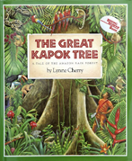


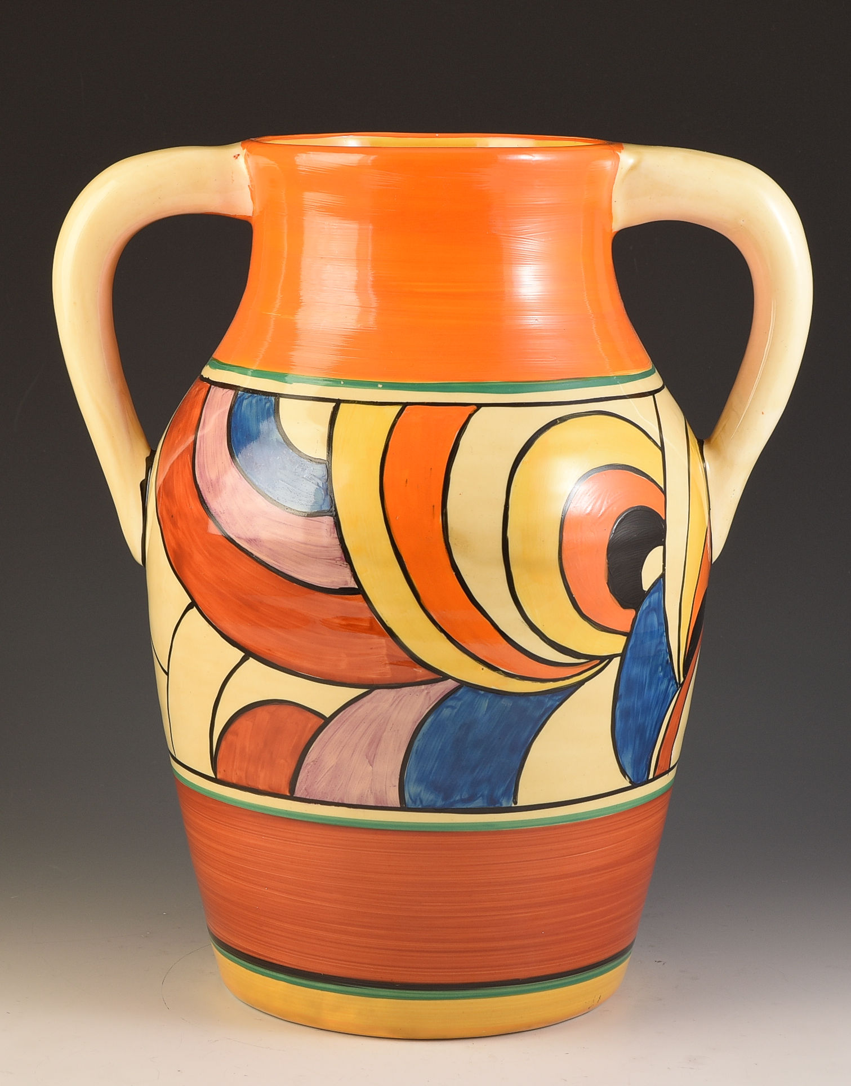
Year 5 – Autumn Term 1
Curriculum Information
2025- 2026
Religious Education
Branch 1: Creation and Covenant
We will be learning about Abraham, Moses and the Commandments.
Science: Living Things and Their Habitat
Children will study and raise questions about their local environment throughout the year. They will observe life-cycle changes in a variety of living things, for example, plants in the vegetable garden or flower border, and animals in the local environment. Children will be able to describe the differences in the life cycles of a mammal, an amphibian, an insect and a bird. They will learn to describe the life process of reproduction in some plants and animals. They will research the work of naturalists and animal behaviourists, for example, David Attenborough and Jane Goodall.
PHSE and RSE
*Calming the storm
*God is calling you.
Music
We will be creating our own rhythm patterns, listening to music by Florence Price and learning the song Hey Dumbo.
Maths
*Read, write, compare and order 5-digit numbers, understanding the place value and using < and >signs; add and subtract multiples of 10, 100 and 1000 to and from 5-digit numbers; use written addition to add two 4-digit numbers; work systematically to spot patterns.
*Add and subtract 2- 3- and 4-digit numbers mentally; choose a strategy for solving mental additions or subtractions; solve word problems
*Understand place value in decimal numbers; multiply and divide numbers with up to two decimal places by 10 and 100; multiply and divide by 0 and 100; add and subtract 0·1 and 0·01; multiply and divide by 4 by doubling or halving twice; use mental multiplication strategies to multiply by 20, 25 and 9
*Revise converting 12-hour clock times to 24-hour clock times; find a time a given number of minutes or hours and minutes later; calculate time intervals using 24-hour clock format; measure lengths in mm and convert to cm; find perimeters in cm and convert cm to m
*Solve subtraction using a written method for 3-digit − 3-digit numbers and for 4-digit numbers; use counting up (Frog) as a strategy to perform mental subtraction; find change from a multiple of ten pounds using counting up
English
We will be reading the following texts:
We will use these texts to write persuasive letters, dialogue, postcards and an adventure story.
Geography- Brazil
Children will learn about the physical and human geography of Brazil. Children will learn about urbanization and explore Rio de Janerio as a tourist destination and explore the culture of Brazil and compare it to the UK.
Art- Pottery- Clarice Cliff and Josiah Wedgwood
Children will learn about Clarice Cliff and Josiah Wedgwood. Children will design and make their own piece of pottery inspired by these famous potters.
German- My school, my subject
*Revise feelings, say how they are feeling
*Introduce school subjects
*Look at word order when giving reasons
P.E.
Dance & Fitness

Slide 2
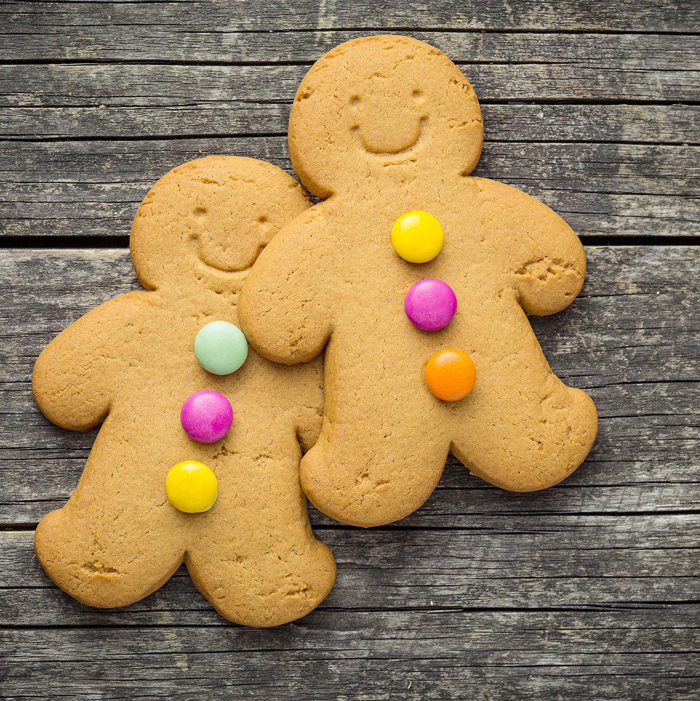

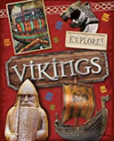
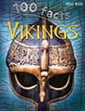
Year 5 – Autumn Term 2
Curriculum Information
2025- 2026
Music
We will be creating pitched melodies, listening to music by Samuel Coleridge-Taylor and learning Christmas Comes to Town.
D&T - Making Gingerbread Christmas Biscuits
In this unit children will explore different kinds of biscuits including their flavours, textures and appearances. Children will find out which biscuits are most and least popular, as well as designing, making, their own gingerbread Christmas themed biscuits and packaging. Children will suggest ways in which their recipe/design may be improved.
P.E.
Gymnastics and Hockey
Computing : Systems and networks – Sharing information
In this unit, children will develop their understanding of computer systems and how information is transferred between systems and devices. Learners will consider small-scale systems as well as large-scale systems. They will explain the input, output, and process aspects of a variety of different real-world systems. Learners will also take part in a collaborative online project with other class members and develop their skills in working together online.
Maths
*Recognise which numbers are divisible by 2, 3, 4, 5, 6, 9 and 25 and identify multiples; find factors; recording results systematically and finding all factors of a given number; compare and place fractions on a line; find equivalent fractions and reduce them to their simplest form
*Use mental strategies to multiply and divide multiples of 10 and 100; use a written method to multiply 3-digit and 4-digit numbers by 1-digit numbers and estimate answers, divide 3-digit numbers by 1-digit numbers using a written method and express remainders as a fraction and solve division word problems
*Use a protractor to measure and draw angles in degrees; recognise, use terms and classify angles as obtuse, acute and reflex; recognise that angles on a line total 180° and angles round a point total 360°; identify and name parts of a circle including diameter, radius and circumference; draw circles to a given radius using a pair of compasses; relate angles to turns, and recognise that a 360° angle is a complete turn; use angle facts to solve problems related to turn
*Place numbers to 100 000 and decimals up to two places on a line, round numbers to the nearest 10, 100 and 1000 and decimals up to two places to the nearest whole number; compare and order numbers with up to two decimal places; reduce fractions to their simplest form; know and recognise equivalent fractions and decimals to half, tenths and fifths
*Revise mental and written addition and subtraction strategies, choose to use a mental strategy or written method to solve addition and subtraction, choose to solve word problems involving multiplication and division questions including 2- and 3-digit by 1-digit and 2-digit by 2-digit using a mental or a written method, use mathematical reasoning to work out a function, identify the operation being used on numbers, understand that addition and subtraction are inverse operations multiplication and division, use function machines
History- Anglo Saxon, Viking and Scots
In this unit children will learn where the Angles, Saxons, Jutes, Frisians came from. They will learn why they came to Britain, what their lives were like, the challenges they faced whilst establishing settlements and recognise the fear caused by Vikings.
Science: Properties and Changes of Materials
Children will compare and group together everyday materials based on their properties, including hardness, solubility, transparency, conductivity (electrical and thermal), and response to magnets. They will use knowledge of solids, liquids and gases from Year 4 to decide how mixtures might be separated, including through filtering, sieving and evaporating. They will know that some materials will dissolve in liquid to form a solution, and describe how to recover a substance from a solution. They will explore reversible and irrevisible changes. In addition, they will research how chemists create new materials.
English
We will read the following texts:
Using these texts we will write non- chronological page and write our own myth.
German: Time in the city
*Revise German towns and cities
*Revise and extend places in a town
*Christmas traditions
PHSE and RSE
Under Pressure
Do you want a piece of cake?
Self Talk
Religious Education
Branch 2: Prophecy and Promise

Slide 3
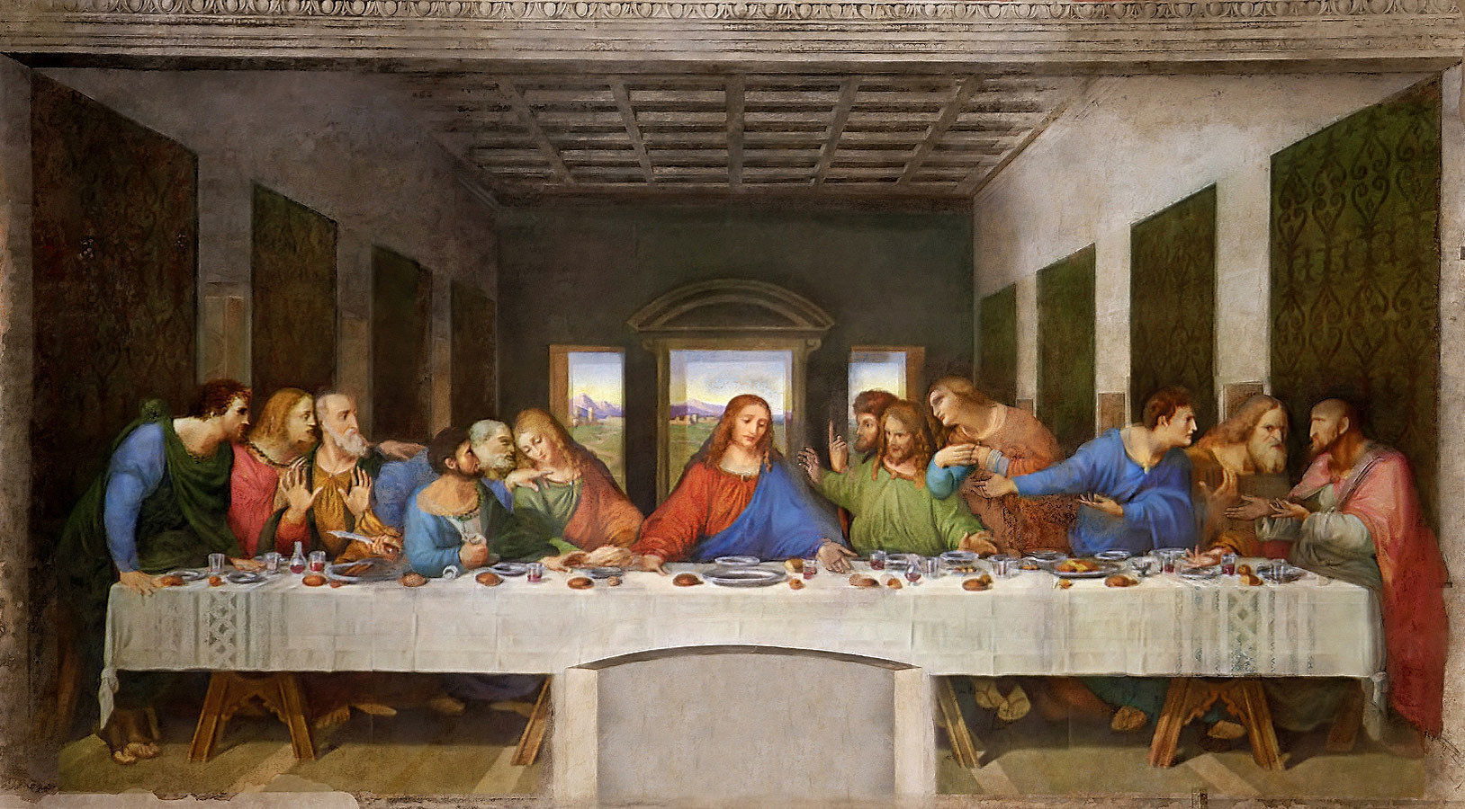

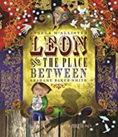
Year 5 – Spring 1
Curriculum Information
2025- 2026
Religious Education
Branch 3: Galilee to Jerusalem
Art- Perspective
Children will use line drawings to explore perspective before looking at the work ‘The Scream’ by Edvard Munch and
Da Vinci’s ‘Last Supper’. Children will use their understanding of perspective to create their own pictures.
P.E.
Yoga and Tag Rugby
Maths
*Read, write and order numbers with up to 6 digits and understand the place value of each digit; place 6-digit numbers on a number line and find numbers between; solve place-value additions and subtractions with 6-digit numbers; understand place value in decimal numbers as tenths and hundredths; multiply and divide by 10/100/1000 using a place-value grid; understand place value in decimal numbers to 2-decimal places; place decimal numbers on a line; round two-place decimal numbers to nearest tenth and whole number; say the number a tenth or a hundredth more
*Rehearse mental addition strategies for decimals and whole numbers; use counting on as a strategy to perform mental addition of 2-place decimals to the next whole number; solve missing number sentences; use mental strategies to solve multi-step word problems; use counting up as a strategy to perform written subtraction
*Use rules of divisibility to find if numbers are divisible by 2, 3, 4, 5, 9 and 10; identity prime numbers; revise finding factors of numbers; find squares and square roots of square numbers; finding patterns and making and testing rules; use mental multiplication and division strategies; relate mental division strategies to multiples of ten of the divisor
*Know properties of equilateral, isosceles, scalene and right-angled triangles; find that angles in a triangle have a total of 180°; sort triangles according to their properties; use scales to weigh amounts to the nearest half interval; convert from grams to kilograms and vice versa, from millilitres to litres and vice versa, and from metres to kilometres and vice versa; read scales to the nearest half division; understand that we measure distance in kilometres and miles; use ready reckoning to give approximate values of miles in kilometres and vice versa; draw line conversion graphs
*Use a written column method to add amounts of money in pounds and pence; add 2-place decimals using written column addition; subtract decimal numbers using counting
Science: Forces
Children will explore falling objects and be able to explain that unsupported objects fall towards the Earth because of the force of gravity acting between the Earth and the falling object. They will raise questions and identify the effects of air resistance, water resistance and friction that act between moving surfaces. They will investigate the effects of air resistance by observing how different objects such as parachutes and sycamore seeds fall. They will experience forces that make things begin to move, get faster or slow down. They will explore the effects of friction on movement and find out how it slows or stops moving objects. They will study the effects of levers, pulleys and gears on movement, recognising that some mechanisms allow a smaller force to have a greater effect. In addition, children will research how scientists, for example, Galileo Galilei and Isaac Newton helped to develop the theory of gravitation.
German: Healthy eating/Going to market
*Revise fruits and commands
*Read and compare Hans und der *Bohnenranke – identify *Similarities/differences between German & English version – language links cognates
*Easter
English
We will be reading the following texts:
Using these texts we will be writing poetry, descriptions, dialogue and our own narratives.
PHSE and RSE
Sharing isn’t always caring
Cyberbullying
Content Consumers
Music
We will be using dynamics and notation, listening to music by Wynton Marsalis and learning the song Forces
History- Anglo Saxons, Vikings and Scots (Part 2)
In the second part of this unit, children will learn about the effects of Anglo- Saxons, Viking and Scots settlement in Britain. Children will consider the question: ‘Did the Anglo Saxon and Viking struggle for England lead to anything positive?’

Slide 4
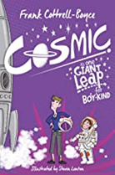



Year 5 – Spring 2
Curriculum Information
2025- 2026
Religious Education
Branch 4: Desert to Garden
D&T- Making a model rocket
In this unit children will learn about the Saturn and Soyuz rockets. Children will design and make a model rocket that can be launched from the playground.
PHSE and RSE
*Types of Abuse
* Against the law
*Impacted Lifestyles
P.E. OAA and Athletics
Music
We will be exploring timbre and tempo, listening to music by Kaija Saariaho and learning the song Earth, Space and All That Jazz.
English
We will be reading the following texts:
We will use these texts to write explanations and a space adventure narrative.
Maths
*Use a written method (grid) to multiply pairs of 2-digit numbers; use short division to divide 3-digit numbers by 1-digit numbers, including those which leave a remainder
*Find unit fractions and non-unit fractions of 3-digit numbers; use short multiplication to multiply 3-digit numbers by 1-digit numbers; begin to use short multiplication to multiply 4-digit numbers by 1-digit numbers
*Understand what a polygon is; draw polygons using dotted square and isometric paper; revise terms obtuse, acute and reflex angles, perpendicular and parallel sides; recognise quadrilaterals as polygons and identify their properties; classify quadrilaterals; draw regular polygons and explore their properties; revise metric units of weight, capacity and length; understand that we can measure in imperial units and relate these to their instances in daily life
*Place mixed numbers on lines; count up in fractions using equivalence; convert improper fractions to mixed numbers and vice versa; write improper fractions as mixed numbers and vice versa; multiply proper fractions by whole numbers
* Solve subtraction of 4-digit numbers using written column subtraction (decomposition); add several numbers using written column addition; use column to solve problems
Science: Earth and Space
Children will be introduced to a model of the sun and Earth that enables them to explain day and night. They will be able to describe the movement of the Earth and other planets relative to the sun .They will learn that the sun is a star at the centre of our solar system and that it has eight planets. They will learn to describe the movement of the moon relative to the Earth and they will understand that a moon is a celestial body that orbits a planet. They will be able to use the idea of the Earth’s rotation to explain day and night and the apparent movement of the sun across the sky. In addition, children will research about the way that ideas about the solar system have developed.
Computing –Creating media – Video editing
This unit gives learners the opportunity to learn how to create short videos in groups. As they progress through this unit, they will be exposed to topic-based language and develop the skills of capturing, editing, and manipulating video. Active learning is encouraged through guided questions and by working in small groups to investigate the use of devices and software. Learners are guided with step-by-step support to take their idea from conception to completion. At the teacher’s discretion, the use of green screen can be incorporated into this unit. At the conclusion of the unit, learners have the opportunity to reflect on and assess their progress in creating a video.
Geography- The Rainforest
Children will learn about the earth’s biomes and their location. They will look at time zones and the positions of tropic of Cancer and Capricorn. Children will learn about the rainforest and its structure. They will learn about indigenous tribes. Children will learn about product from the rainforest and the effects of urbanisation.
German – Clothes, colours and fashion
*Introduce clothes
*Revise colours

Slide 5
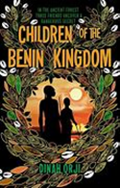




Year 5 – Summer 1
Curriculum Information
2025- 2026
PHSE/ SRE
*Making Good Choices
*Giving Assistance
English
We will read the following texts:
We will use these texts to write biographies and narratives.
Science: Animals including Humans
Children will be able to describe the changes as humans develop to old age. Children will draw a timeline to indicate stages in the growth and development of humans. They will learn about the changes experienced in puberty.
German – Out of this world
*Introduce Planets
*Describe planets.
*Revise physical descriptions
*Introduce personal characteristics
Religious Education
To the Ends of the Earth
Art- Portraits in a Cubism Style
Children will study Picasso and be introduced to Cubism. Children will produce portraits in a Picasso style using mix media and paints.
Maths
*Add mentally 2-place decimal numbers in the context of money using rounding; add several small amounts of money using mental methods; mentally subtract amounts of money including giving change; calculate the difference between two amounts using counting up; solve word problems, including 2-step problems, choosing an appropriate method
*Multiply fractions less than 1 by whole numbers, convert improper fractions to whole numbers; use short multiplication to multiply 3-digit and 4-digit numbers by 1-digit numbers; use long multiplication to multiply 2-digit and 3-digit numbers by teens numbers
*Read, write and compare decimals to three decimal places, understanding that the third decimal place represents thousandths; multiply and divide numbers by 10, 100 and 1000 using 3-place decimal numbers in the calculations; place 2-place decimals on a number line and round them to the nearest tenth and whole number; read, write, order and compare 3-place decimal numbers; understand and use negative numbers in the context of temperature
*Read and and mark co-ordinates in the first two quadrants; draw simple polygons using co-ordinates; translate simple polygons by adding to and subtracting from the co-ordinates; reflect simple shapes in the y axis or in a line, noting the effect on the co-ordinates; translate simple shapes and note what happens to the co-ordinates; draw regular and irregular 2D shapes using given dimensions and angles; use the properties of 2D shapes, including rectangles, to derive related facts; identify 3D shapes from 2D representations; create 3D shapes using 2D nets and draw 3D shapes
*Add 5-digit numbers using written column addition; subtract 5-digit numbers using written method (decomposition); check answers to subtractions using written column addition; solve subtractions of 4- and 5-digit numbers using written column subtraction or number line counting up.
History-The Kingdom of Benin
In this unit, children will learn how the Kingdom of Benin developed. They will learn about the religious beliefs and look at evidence and sources to consider what the culture was like. Children will learn how the Kingdom of Benin became successful and how and why the empire came to an end.
Computing-Creating Media –Slideshows (Laptops) This unit gives children the opportunity to develop their knowledge of Microsoft PowerPoint. It focuses on intermediate skills, beyond simple word processing, including organising a PPT, choosing a visual style, presenting information clearly, adding and editing images, adding transitions and animations, adding Hyperlinks and finding and collecting information and digital media from an online source safely
Music
We will be learning to play the ukuleles in Whole Class Ensemble Training sessions.
P.E. Netball and Dodgeball

Slide 6


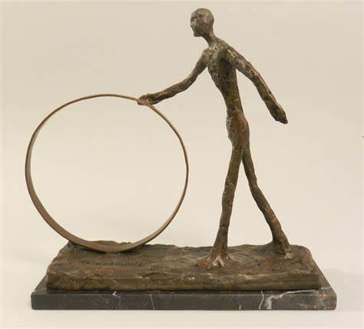
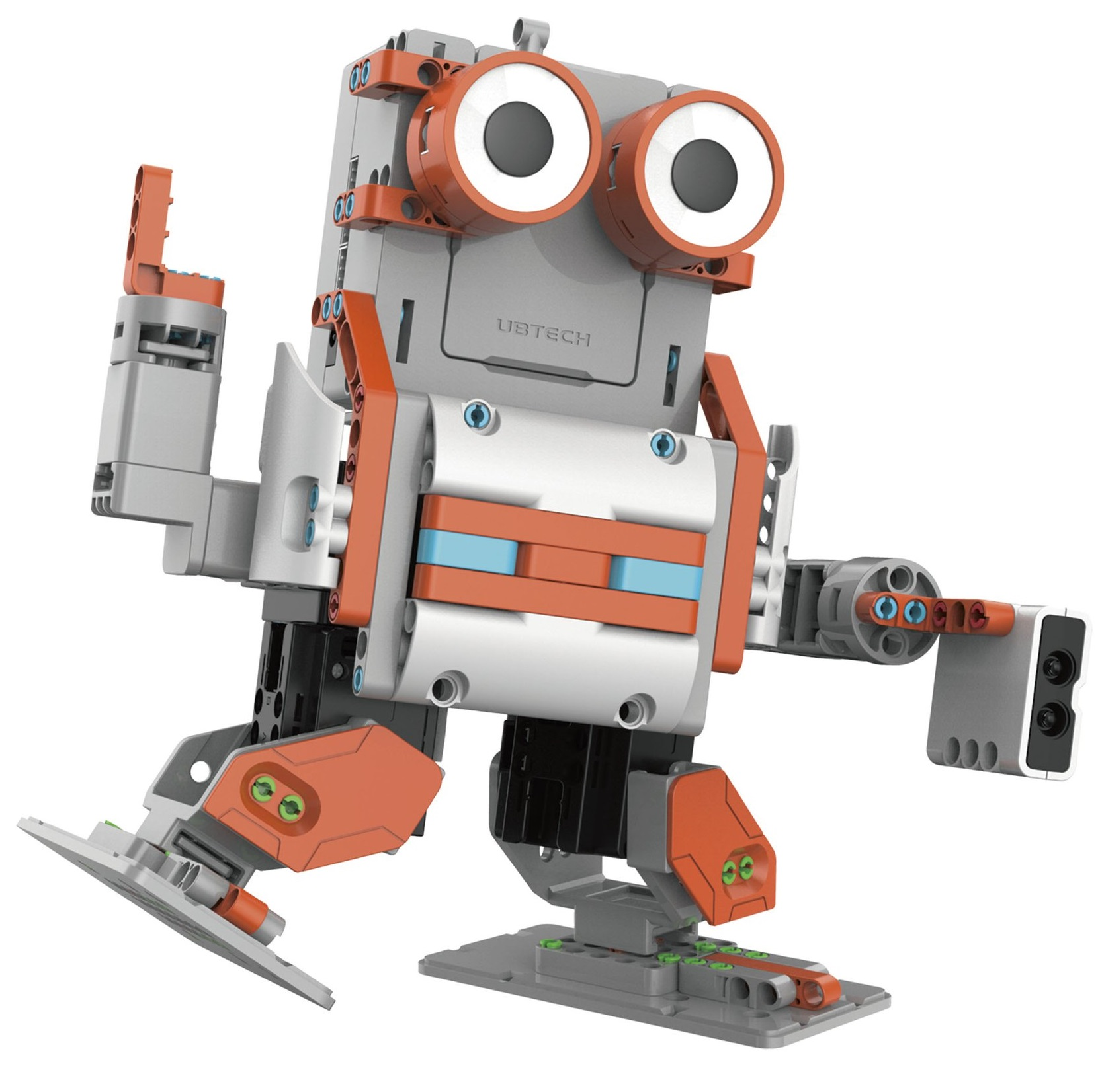

Year 5 – Summer 2
Curriculum Information
2025- 2026
English
We will be reading the following texts:
We will use these texts to write recounts, formal letters and diaries.
Religious Education
Dialogue and Encounter
Art: Artist Study- Giacometti Sculpture
Children will learn about the artist and sculptor Alberto Giacometti. Children will thing about figurative compositions before creating sculptures in his distinctive style.
Maths
*Identify factors and multiples, find factor pairs; revise equivalent fractions; compare and order fractions with related denominators; add fractions with same or related denominators, then convert answer into a mixed number; subtract fractions with same and related denominators, revise multiplying fractions by whole numbers
*Use short division to divide 3-digit numbers by 1-digit numbers and 4-digit numbers by 1-digit numbers, including those which leave a remainder; express a remainder as a fraction; use long multiplication to multiply 3-digit and 4-digit numbers by teens numbers
*Find the area and perimeter of squares and rectangles by calculation and pursue a line of enquiry; estimate and find the area of irregular shapes; calculate the perimeter and area of composite shapes; use the relations of area and perimeter to find unknown lengths; begin to understand the concept of volume; find the volume of a cube or cuboid by counting cubes; understand volume as measurement in three dimensions; relate volume to capacity; recognise and estimate volumes
*Understand what percentages are, relating them to hundredths; know key equivalences between percentages and fractions, finding percentages of amounts of money; find equivalent fractions, decimals and percentages; solve problems involving fraction and percentage equivalents; write dates using Roman numerals
*Find cubes of numbers to 10; draw and interpret line graphs showing change in temperature over time; begin to understand rate; use timetables using the 24-hour clock and use counting up to find time intervals of several hours and minutes; solve problems involving scaling by simple fractions; use factors to multiply; solve scaling problems involving measure
Geography- Migration
Children will learn about migration and the reasons people migrate. They will learn how migration effects people and place. Children will learn about economic migration and refugees. They will learn how climate change will contribute to migration.
PHSE and RSE
The Trinity
Catholic Social Teaching
Reaching Out
The World of Work
D&T- Making an interactive football robot
In this unit children will build and programme their own JIMU robots using engineering skills.
Music
We will be learning to play the ukuleles in Whole Class Ensemble Training sessions.
Computing - Programming – UBTech Jimu Robots
This term, children will build and program their own robots to follow instructions. To start, children will follow video and textual instructions to build their own robot. Over the next few weeks, learners will use code to program their robot to follow simple instructions to achieve given tasks, such as moving and dancing. Lastly, the students will follow instructions in dismantling their robots.
German : Going to the seaside
*Things you can do at the beach
*Design a deckchair
Science: Revision
Children will revise the units covered so far
P.E.
Cricket & Tennis

