Slide 1



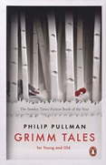
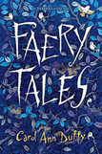


Year 4 – Autumn Term 1
Curriculum Information
2024- 2025
English
We will be reading the following texts:
We will be using these texts to write dialogue, settings, character descriptions ,alternative endings and persuasive writing.
Religious Education
Branch 1:
Creation and Covenant
Music
We will be learning about rhythms in music, listening to music by William Grant Still and learning the Electricity Song.
Maths
*Finding pairs with a total of 100; adding to the next multiple of 100 and subtracting to the previous multiple of 100; subtract by counting up to find a difference; adding several numbers
*Read, write 4-digit numbers and know what each digit represents; compare 4-digit numbers using < and > and place on a number line; add 2-digit numbers mentally; subtract 2-digit and 3-digit numbers
*Learn × and ÷ facts for the 6 and 9 times-table and identify patterns; multiply multiples of 10 by single-digit numbers; multiply 2-digit numbers by single-digit numbers (the grid method); find fractions of amounts
*Tell and write the time to the minute on analogue and digital clocks; calculate time intervals; measure in metres, centimetres and millimetres; convert lengths between units; record using decimal notation
*Add two 3-digit numbers using column addition; subtract a 3-digit number from a 3-digit number using an expanded column method (decomposing only in one column)
Science: Electricity
Children will identify common appliances that run on electricity. They will construct simple series electrical circuits, trying different components, identifying and naming basic parts, including cells, wires, bulbs, buzzers, switches and motors. They will use their circuits to create simple devices. They will learn to identify whether or not a lamp will light in a simple series circuit, based on whether or not the lamp is part of a complete loop with a battery. They will recognise that a switch opens and closes a circuit and associate this with whether or not a lamp lights in a simple series circuit. They will recognise some common conductors and insulators, and associate metals with being good conductors. Children will learn to draw the circuit as a pictorial representation.
Geography- Mountains
Children will learn about the world’s major mountain ranges and their key features. They will learn how fold mountains are formed and research the climate of a mountain environment. They will use 4 figure map references and latitude and longitude to locate famous mountains.
Computing –
Programming – code.org Course D
Technology has a
language and it is called code. code.org Course C continues the learning of key coding concepts including sequencing and loops before students develop their understanding of algorithms, nested loops, while loops, conditionals and more.
PHSE/ SRE
Get Up
D&T- Making a model house with electrics
In this unit children will use their knowledge of circuits to make a model house with electrics. Children will produce a labelled plan naming the components and explain how it will work to others. Children will integrate the circuit into their design of a model house
German-Welcome to School
* Numbers
* Days of the week/months of the year
*Compare German &English schools.
* Classroom items
PHSE and RSE
Get Up
P.E.
Swimming & Fitness

Slide 2

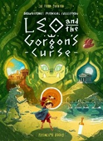
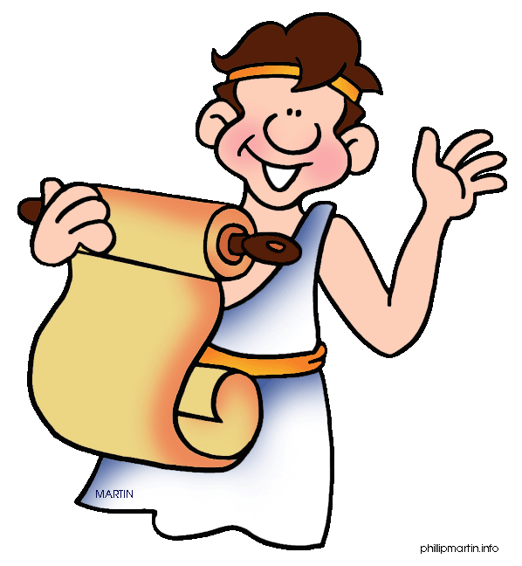



Year 4 – Autumn Term 2
Curriculum Information
2024- 2025
History- Ancient Greece (Part 1)
Children will learn about life in Ancient Greece. They will learn who were the Ancient Greeks and how we know about the Ancient Greeks through artefacts and archeological sites . Children will learn about myths and legends and will study the achievements of Alexander the Great.
Science- Sound
Children will identify how sounds are made, associating some of them with something vibrating. They will recognise that vibrations from sounds travel through a medium to the ear. They will find patterns between the pitch of a sound and features of the object that produced it. They will find patterns between the volume of a sound and the strength of the vibrations that produced it. They will recognise that sounds get fainter as the distance from the sound source increases. Children will also explore and identify the way sound is made through vibration in a range of different musical instruments from around the world, investigating how the pitch and volume of sounds can be changed in a variety of ways.
English
We will be reading the following texts:
We will use these texts to write non chronological reports, instructions, recounts, persuasive letters and dialogue.
Religious Education
Branch 2:
Prophecy and Promise
Maths
*Double 3-digit numbers and halve even 3-digit numbers; revise unit fractions; identify equivalent fractions; reduce a fraction to its simplest form; count in fractions (each fraction in its simplest form)
*Look at place value in decimals and the relationship between tenths and decimals; add two 4-digit numbers; practise written and mental addition methods; use vertical addition to investigate patterns
*Convert multiples of 100 g into kilograms; convert multiples of 100 ml into litres; read scales to the nearest 100 ml; estimate capacities; draw bar charts, record and interpret information
*Round 4-digit numbers to the nearest: 10, 100 and 1000; subtract 3-digit numbers using the expanded written version and the counting up mental strategy and decide which to use
*Use the grid method to multiply 3-digit by single-digit numbers and introduce the vertical algorithm; begin to estimate products; divide numbers (up to 2 digits) by single-digit numbers with no remainder, then with a remainder
Art -Logos : Negative space
Children will study artwork in the style of negative space. Children will create a logo using negative space designs and will sketch their ideas. Children will create a collage using negative space and use digital painting tools.
P.E.
Swimming
Dance
Music
We will be learning about pitch, listening to Tchaikovsky’s music and learning Santa’s Coming for Us.
PHSE and RSE
We Don’t Have To Be The Same
Respecting Our Bodies
What is Puberty?
Changing Bodies
German: My local area/ your local area
*Places in a town
*Directions
*Christmas traditions, story and puzzles

Slide 3



Year 4 – Spring Term 1
Curriculum Information
2024- 2025
PHSE and RSE
What am I Feeling?
What am I Looking at?
I am Thankful
Science – States of Matter
Children will explore a variety of everyday materials and develop simple descriptions of the states of matter (solids hold their shape; liquids form a pool not a pile; gases escape from an unsealed container). Children will observe water as a solid, a liquid and a gas and should note the changes to water when it is heated or cooled. Children will be able to compare and group materials together, according to whether they are solids, liquids or gases. They will observe that some materials change state when they are heated or cooled and measure or research the temperature at which this happens in degrees Celsius (ºC). They will be able to identify the part played by evaporation and condensation in the water cycle and associate the rate of evaporation with temperature.
Music
We will be learning to play the steel pans in Whole Class Ensemble Training sessions.
Maths
*Place 4-digit numbers on landmarked lines; 0–10 000 and 1000–2000; round 4-digit numbers to the nearest 10, 100 and 1000; mentally add and subtract to/from 4-digit and 3-digit numbers using place-value; count on and back in multiples of 10, 100 and 1000; count on in multiples of 25 and 50; add and subtract multiples of 10 and 100 to/from 4-digit numbers
*Use expanded written subtraction and compact written subtraction to subtract pairs of 3-digit numbers (one ʻexchangeʼ); use expanded column subtraction and compact column subtraction to subtract pairs of 3-digit and 2-digit numbers from 3-digit numbers (one ʻcarryʼ); learn the 7× table and ʻtrickyʼ facts; use the vertical algorithm to multiply 3-digit numbers by 1-digit numbers; solve simple money problems with decimals to two decimal places
*Use mental multiplication and division strategies; find non-unit fractions of 2-digit and 3-digit numbers; find equivalent fractions and use them to simplify fractions (halves, thirds, quarters)
*Recognise and compare acute, right and obtuse angles; draw lines of a given length; identify perpendicular and parallel lines; recognise and draw line symmetry in shapes; sort 2D shapes according to their properties; draw shapes with given properties and explain reasoning; draw the other half of symmetrical shapes
*Understand how to divide 2-digit and 3-digit numbers by 1-digit numbers using place value and mental strategies; divide numbers by 1-digit numbers to give answers between 10 and 25, with remainders; identify factor pairs and use these to solve multiplications and divisions with larger numbers; use Frog to find complements to multiples of 1000; use Frog to find change from £10, £20 and £50
History- Ancient Greece Part 2
Children will build on their knowledge from the Autumn term and will look at how the Ancient Greeks were governed. They will look at how the Olympic games have changed over time and consider similarities and difference between our lives and Ancient Greeks, including schools, language, buildings.
Computing- Computing systems and networks – The Internet
Learners will apply their knowledge and understanding of networks, to appreciate the internet as a network of networks which need to be kept secure. They will learn that the World Wide Web is part of the internet, and will be given opportunities to explore the World Wide Web for themselves in order to learn about who owns content and what they can access, add, and create. Finally, they will evaluate online content to decide how honest, accurate, or reliable it is, and understand the consequences of false information.
German- Family Tree
*Introduce family members
D&T Making a purse/ wallet
In this unit children will investigate a range of purses/wallets and their features. Children will design their own purse/ wallet using design criteria. They will develop and practice their sewing skills (blanket stitch) before following their design to make a purse or wallet with compartments. Children will evaluate their final product.
English
We will read these texts:
We will use these texts to write non-chronological reports, information texts, postcards, leaflets.
Religious Education
Branch 3:
Galilee to Jerusalem
P.E.
Swimming
Yoga

Slide 4



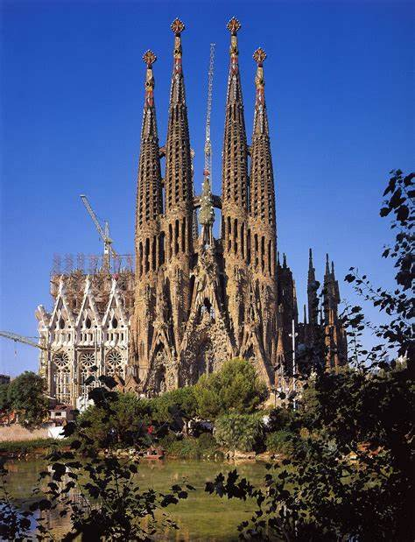

Year 4 – Spring Term 2
Curriculum Information
2024- 2025
Science –Living Things and their Habitats
Children will use the local environment throughout the year to raise and answer questions that help them to identify and study plants and animals in their habitat. They will identify how the habitat changes throughout the year. Children will recognise that living things can be grouped in a variety of ways. They will explore and use classification keys to help group, identify and name a variety of living things in their local and wider environment. Children will also explore possible ways of grouping a wide selection of living things that include animals, flowering plants (including grasses) and non-flowering plants (ferns and mosses). Children will begin to put vertebrate animals into groups, for example: fish, amphibians, reptiles, birds, and mammals; and invertebrates into snails and slugs, worms, spiders, and insects. Children will recognise that environments can change and that this can sometimes pose dangers to living things. They will also explore examples of human impact (both positive and negative) on environments, for example, the positive effects of nature reserves, ecologically planned parks, or garden ponds, and the negative effects of population and development, litter or deforestation.
Religious Education
Branch 4:
Desert to Garden
English
We will read the following texts:
We will use these texts to write explanations, poems and stories with an alternative ending.
German-
*Celebrating Karneval
*Introduce body parts
*Revise animals and family members
*Easter traditions
Maths
*Recognise, use, compare and order decimal numbers; understand place value in decimal numbers; recognise that decimals are tenths; round decimals numbers to the nearest whole number; divide 2-digit numbers by 10 to get decimal numbers; multiply decimal numbers by 10 to get 2-digit numbers; divide 3-digit multiples of ten by 100 to get decimal numbers; multiply decimal numbers by 100 to get 3-digit multiples of ten; add four digit numbers using written method with answers greater than 10 000
*Add amounts of money using written methods and mentally using place value and number facts; choose to add using the appropriate strategy: mental or written; subtract, choosing appropriate mental strategies: counting up or taking away (using counting back, place value or number facts); solve subtractions using a suitable written method (column subtraction)
*Tell the time on a 24 hour clock, using am and pm correctly; convert pm times to 24 hour clock and vice versa; use 24 hour clock in calculating intervals of time; measure and calculate perimeters of rectilinear shapes where each side is labelled in cm and m; find missing lengths in rectilinear composite shapes; find the perimeters of rectilinear shapes with some lengths not marked; convert from one unit of length to another; solve word problems involving lengths including those involving perimeters
*Understand place value in 4-digit numbers; partition 4-digit numbers; solve subtraction of 4-digit numbers using column subtraction (decomposition); choose an appropriate method to solve subtractions, either mental or written, and either column or counting up
*Use the vertical algorithm to multiply 3-digit numbers by 1-digit numbers; explore patterns; use mental strategies and tables facts to divide 2-digit and 3-digit numbers by 1-digit numbers to give answers between 10 and 35, without remainders; solve word problems
P.E.
Swimming
Football
Art- Antoni Gaudi- Architecture and design
Children will look at the architecture of Gaudi in Barcelona and learn how he was inspired by natural forms. Children will sketch natural forms and then redesign the school church to look like one of Gaudi’s buildings.
Music
We will be learning to play the steel pans in Whole Class Ensemble Training sessions.
Geography- Spain and Catalonia.
Children will learn about the countries of Europe and capital cities and locate them on a map. Children will learn about some of the physical features of Europe. Children will learn about Spain. They will learn about similarities between the UK and Spain. They will learn about how the climate affects the way people live.
PHSE and RSE
Life Cycles
A Time For Everything
Big Changes, Little Changes

Slide 5


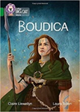
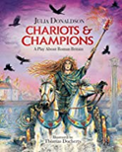
Year 4– Summer Term 1
Curriculum Information
2024- 2025
Music
We will be using structure and texture in compositions, listening to John Williams and learning the song Just Like a Roman.
English
We will read the following texts:
We will use these texts to write poems, advertisements, speech and diaries.
History- Roman Empire.
Children will learn about the Roman Empire and its impact on Britain. Children will learn about the similarities and differences between the Romans and Celtic tribes. They will learn about Boudicca and why we remember her.
Art- Textiles and Design
Children will experiment with wax resist and create a wax resist picture. Children will create the different patterns using tie-dye techniques and flour resit Batik to design a handkerchief.
Maths
*Read, write and compare 4-digit numbers and place on a line; find 1000 more or less than any given number; read, write and compare 5-digit numbers; recognise what each digit represents in a 5-digit number; read, use and compare negative numbers in the context of temperature
*Multiply and divide numbers by 10 and 100 including decimals (tenths and hundredths); read and write decimals (to 1 and 2 places), understanding that these represent parts (tenths and hundredths) of numbers; mark 1- and 2- place decimals on a line; count in tenths (0.1s) and hundredths (0.01s); multiply numbers with up to 2 decimal places by 10 and 100, and divide numbers by 10 and 100; say the number one tenth and one hundredth more or less than a given number; round decimal numbers to the nearest whole number
*Learn 11 and 12× tables; develop and use effective mental multiplication strategies; use a vertical written method to multiply 3-digit numbers by 1-digit numbers; use rounding to estimate answers; use a written method to multiply 3-digit numbers, including amounts of money by 1-digit numbers; multiply 2-digit and 3-digit numbers by 1-digit numbers; understand how division ʻundoesʼ multiplication and vice versa; divide above the tables facts using multiples of 10
*Recognise and read Roman numerals to 100; begin to know the history of our number system including 0; calculate area and perimeter of rectilinear shapes using multiplication and addition, or counting; recognise, name and classify 2D shapes identifying regular and irregular polygons; sort 2D shapes according to properties including types of quadrilaterals and triangles; revise 3D shapes, consider 2D-shaped sides on 3D shapes, and sort shapes
*Understand, read and write 2-place decimals; compare 2-place decimals in the context of lengths; add and subtract 0·1 and 0·01 and say a number one-tenth (0·1) or one-hundredth (0·01) more or less than a given number; revise equivalent fractions; write fractions with different denominators with a total of 1; recognise decimal and fraction equivalents
Science – Animals Including Humans
Children will be introduced to the main body parts associated with the digestive system in humans, for example: mouth, tongue, teeth, oesophagus, stomach, and small and large intestine, and explore questions that help them to understand and describe their special functions. They will learn to identify the different types of teeth in humans and their simple functions. They will be able to construct and interpret a variety of food chains, identifying producers, predators and prey.
PHSE and RSE Community of Love
What is the church?
P.E.
Swimming
Rounders
German
*Feeling unwell
*Jungle animals
*Revision of body parts
Religious Education
Branch 5:
To the Ends of the Earth
Computing- Data and information – Data logging
In this unit, children will consider how and why data is collected over time. Children will consider the senses that humans use to experience the environment and how computers can use special input devices called sensors to monitor the environment. Children will collect data as well as access data captured over long periods of time. They will look at data points, data sets, and logging intervals. Pupils will spend time using a computer to review and analyse data. Towards the end of the unit, pupils will pose questions and then use data loggers to automatically collect the data needed to answer those questions.

Slide 6


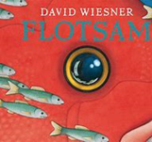
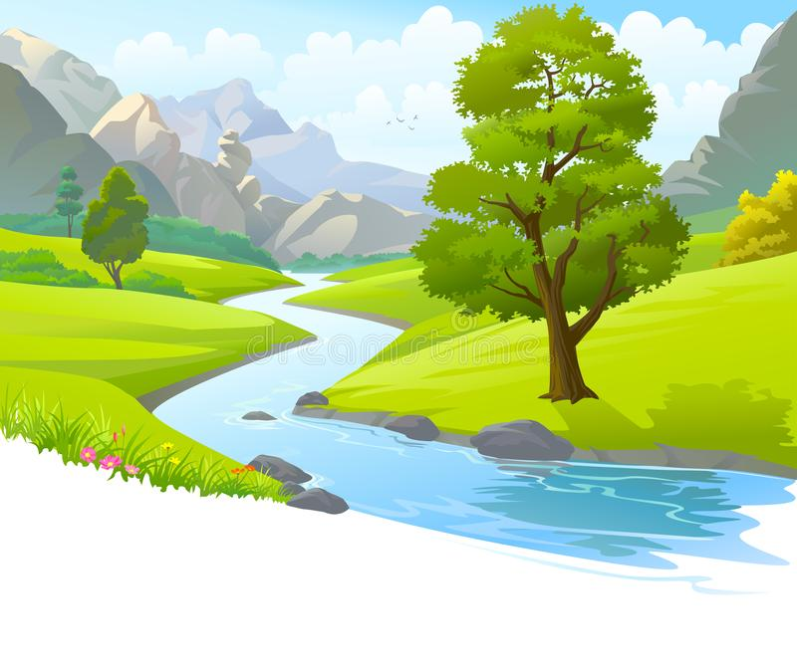
Year 4 – Summer Term 2
Curriculum Information
2024- 2025
German: Summertime
*Revise and extend food & drink items.
*Introduce weather
D&T Seasonal Food- Making a seasonal dish.
In this unit children will learn why certain British foods are seasonal and consider some pros and cons of food being available from other parts of the world. Children will learn how seasonal fruits and vegetables are grown in Britain. Children will learn how fish and meat are reared and can form part of a healthy diet. Children will use their knowledge to design and make a seasonal spring dish.
Art -Artist Study -Frida Kahlo- Still life
Children will learn about still life painting through the study of artwork by Frida Kahlo. They will create their own still life compositions using a layered watercolour painting.
Music
We will be using all our knowledge and skills in our final performances, listening to music by Leonard Bernstein and learning the song River Journey.
English
We will read the following texts:
We will use these texts to write newspaper articles, information leaflets, balanced arguments and persuasive letters.
Religious Education
Branch 6:
Dialogue and Encounter
P.E.
Swimming
Athletics
Science – Revision
Revision of the units covered so far
Maths
*Add two 2-digit numbers or a 2-digit number to a 3- or 4-digit number mentally; subtract 2-, 3- and 4-digit numbers using counting up; derive factors of 2-digit numbers and use factors and doubling to solve multiplication mentally; solve integer scaling problems using mental strategies and spot a relationship between products; solve correspondence problems, using a systematic approach and calculate using mental multiplication strategies
*Solve written addition of two 4-digit numbers; add amounts of money (pounds and pence) using column addition; solve 4-digit minus 4-digit and 4-digit minute 3-digit subtractions using written column method (decomposition) and check subtraction with addition; solve word problems choosing an appropriate method
*Use coordinates to draw polygons; find the coordinates of shapes after translation; draw and interpret bar charts and pictograms; draw line graphs and understand that intermediate points have meaning
*Use the vertical algorithm (ladder) to multiply 3-digit numbers by 1-digit numbers; find non-unit fraction of amounts, using ʻchunkingʼ; add fractions with like denominators, including totals greater than 1; divide by 10 and 100 (to give answers with 1 and 2 decimal places)
*Multiply 2-digit numbers by 11 and 12; look for patterns and write rules; multiply 2-digit numbers by numbers between 10 and 20 using the grid method; begin to use the grid method to multiply pairs of 2-digit numbers; use mental strategies and tables facts to divide 2-digit and 3-digit numbers by 1-digit numbers to give answers between 20 and 50, with and without remainders; find non-unit fractions of amounts
Geography- Rivers and The Water Cycle
Children will learn about the distribution of water across the world and will compare the availability of water. Children will learn about the water cycle. They will learn about the formation of a river and its journey to the sea. Children will learn about the landforms rivers create. Children will locate some world rivers and learn why rivers are important and what happens when rivers flood. Children will conduct a local river study.
PHSE and RSE
How Do I Love Others?
Money Matters

