Slide 1




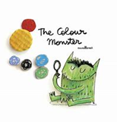
Year 2 – Autumn Term 1
Curriculum Information
2025 - 2026
Religious Education
Branch 1:
Creation and Covenant
Science - Living Things and Their Habitats
Children will be introduced to the idea that all living things have certain characteristics that are essential for keeping them alive and healthy. Children will explore and compare the differences between things that are living, dead and things that have never been alive. Children will be introduced to the terms ‘habitat and ‘microhabitat’. They will learn to identify that most living things live in habitats to which they are suited and describe how different habitats provide for the basic needs of different kinds of animals and plants and how they depend on each other. They will describe how animals obtain their food from plants and other animals, using the idea of a simple food chain and identify and name different sources of food.
English
We will be reading the following texts:
We will use these texts to write character descriptions, letters, poems and stories with an alternative ending.
P.E.
Fundamentals
Team Building
PSHE and RSE
Let the Children Come
Geography- Continents and Oceans
Children will learn about the continents and oceans of the world and locate them on a map. They will explore each of the seven continents. They will look at hot and cold places of the world in relation to the equator. Children will study the South Pole. Children will learn about animals in the ocean and how we can protect the oceans.
Maths
*Estimate and count a number of objects up to 100; locate numbers on 0−100 beaded lines and 1−100 squares; compare pairs of numbers and find a number in between; order three numbers, order 2-digit numbers.
*Revise number bonds to 6, 7, 8, 9 and 10; know number bonds to 10 and begin to learn related subtraction facts; know multiple of 10 number bonds to 100, learn bonds to 20, rehearse number bonds to 10 and 20 using stories
*Double numbers to double 15, use patterns in number bonds, use number bonds to solve more difficult additions, to subtract and to solve additions bridging 10
*Sort 2D shapes according to symmetry properties using Venn diagrams, identify right angles and sort shapes using Venn diagrams, recognise squares, rectangles, circles, triangles, ovals and hexagons, investigate which tessellate, sort shapes and objects using a two-way Carroll diagram
*Begin to mark numbers on a landmarked line, compare and order numbers, using < and > signs, work systematically to find all possible inequalities, find 1 and 10 more or less using the 100-square, find 10 more and 10 less than any 2-digit number
Computing– IT around us
Children will learn how information technology (IT) is being used for good in our lives. With an initial focus on IT in the home, children will explore how IT benefits society in places such as shops, libraries, and hospitals. Whilst discussing the responsible use of technology, and how to make smart choices when using it.
Art- Portraits
Children will learn what a portrait is. Children will learn how to draw eyes, ears, noses and mouths. Children will look at portraits of the Queen and say what they like about it and other famous portraits. Children will draw and paint a portrait using watercolours.
Music
We will be finding the pulse and creating rhythm patterns, listening to music by Ravel and learning Harvest Songs.

Slide 2


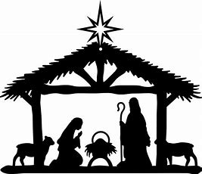

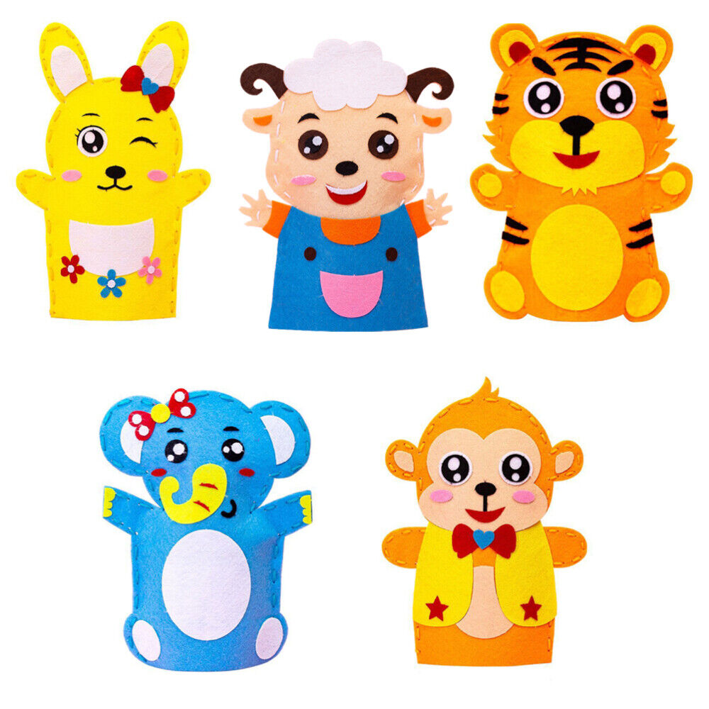
Year 2 – Autumn Term 2
Curriculum Information
2025 - 2026
P.E.
Dance
Fitness
Science- Uses of Everyday Materials
Children will identify and discuss the uses of different everyday materials so that they become familiar with how some materials are used for more than one thing. Children will identify and compare the suitability of a variety of everyday materials, including wood, metal, plastic, glass, brick, rock, paper and cardboard for particular uses. They will find out how the shapes of solid objects made from some materials can be changed by squashing, bending, twisting and stretching. Children will compare and group together a variety of everyday materials based on their properties. In addition, they will learn to think about the properties of materials that make them suitable or unsuitable for particular purposes. Children will also find out about John McAdam.
English
We will be reading the following texts:
We will use these texts to write letters, recounts, instructions, diaries and information texts.
Music
We will be creating high and low patterns, listening to music by Vaughan Williams and learning Advent Songs.
Religious Education
Branch 2:
Prophecy and Promise
History- Remembrance
Children will learn who we remember on remembrance day and why. Children will learn about what happens on Remembrance day. Children will learn about the significance of the poppy.
Maths
*Know and use ordinal numbers; understand that 2-digit numbers are made from some 10s and some 1s; Understand place value using 10p and 1p coins; find and record all possible amounts using 10p and 1p coins; find 10p more and 10p less; Find 10 more and 10 less
*Add and subtract 10, 20 and 30 to any 2-digit number; Add and subtract 11, 21, 12 and 22 to any 2-digit number; Solve addition and subtractions by counting on and back in 10s then in 1s; solve addition and subtraction problems using concrete and pictorial representations
*Understand and use terms and vocabulary associated with position, direction and movement; Measure lengths using uniform units; Begin to measure in centimetres and metres
*Add and subtract 2-digit numbers; Solve addition and subtraction problems using concrete and pictorial representations; Add near doubles to double 15; Add several small numbers spotting near doubles or pairs to 10, etc.
*Count in 2s, 5s and 10s from zero; Count in multiples of 2p, 5p and 10p; Number sequences of 2s, 5s and 10s; Find the totals of coins and ways to make an amount; Use coins to make given amounts of money
D&T- Puppets
Children will investigate a range of puppets and their features. Children will design their own puppet using design criteria. They will develop and practice their sewing skills (running stitch/ or over stitch) before following their design to make a puppet.
PSHE and RSE
I am Unique
Girls and Boys
Clean and Healthy (My Body)

Slide 3
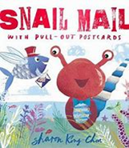



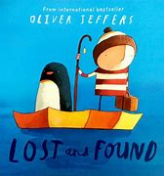
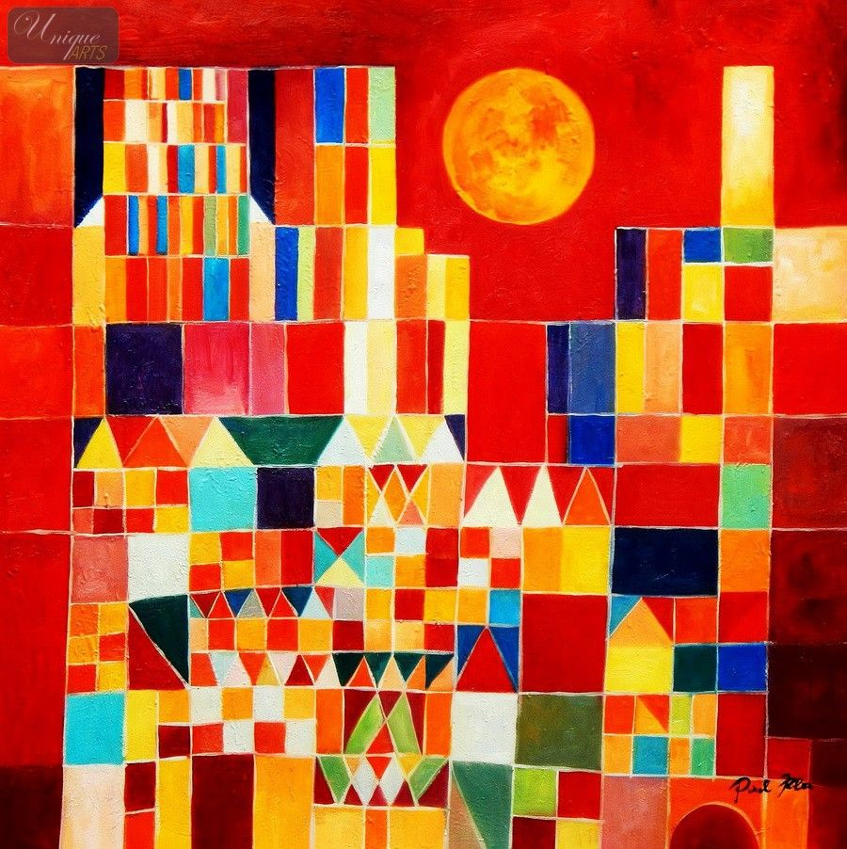
Year 2 – Spring Term 1
Curriculum Information
2025 - 2026
P.E.
Gymnastics
Yoga
English
We will be reading the following texts:
We will use these texts to write postcards, non chronological reports, postcards, letters , persuasive letters and our own stories.
Music
We will be starting to notate music and thinking about loud and quiet sounds, listening to music by Duke Ellington Orchestra and learning songs about animals.
Art- Collage
Children will study the painting ‘Castle and Sun’ by the artist Paul Klee. Children will learn how Klee used simple shapes to make his painting. Children will make their own artwork inspired by a place/ building and then simplify their idea into basic shapes and colours using the collage technique. Children will use printing techniques to make their own painting in Klee’s style.
PSHE and RSE
Feelings: Likes and Dislikes
Feelings: Inside Out
Super Suzie Gets Angry
Science- Animals including humans
Children will learn about the basic needs of animals for survival; they will find out about and describe the basic needs of animals, including humans, for survival (water, food and air). They will also learn to describe the importance of exercise and nutrition for humans, as well as eating the right amounts of different types of food and hygiene. Children will also be introduced to the processes of reproduction and growth in animals. They will learn that animals, including humans, have offspring, which grow into adults. The focus at this stage will be on questions that help children to recognise growth. The following examples will be used: egg, chick, chicken; egg, caterpillar, pupa, butterfly; spawn, tadpole, frog; lamb, sheep. Growing into adults will include reference to baby, toddler, child, teenager and adult.
Maths
*Place value and ordering 2-digit numbers; place value additions and subtractions; add and begin to subtract 9, 10 and 11
*Revise number bonds to 10; begin to bridge 10; subtract from 10 and 20; use number facts to find the complement to ten; find a difference between two numbers by counting on
*Rehearse complements to multiples of 10; find differences using a number line; find change from 10p and 20p, and from £10 to £20 by counting up and using bonds to 10 and 20; add two 2-digit numbers by counting on
*Recognise and identify properties (including faces and vertices) of 3D shapes; sort according to properties including number of faces; name the 2D shapes of faces of 3D shapes; tell the time to the nearest quarter on analogue and digital clocks
*Order 2-digit numbers and revise the < and > signs; locate 2-digit numbers on a landmarked line and grid; round 2-digit numbers to nearest 10; estimate a quantity <100 within a range
Religious Education
Branch 3:
Galilee to Jerusalem
Geography- Hot and Cold Places
Children will learn about hot and cold places in relation to the equator. They will be introduced to biomes and climate zones. Children will learn about the weather associated with these areas and they will begin to describe places.

Slide 4


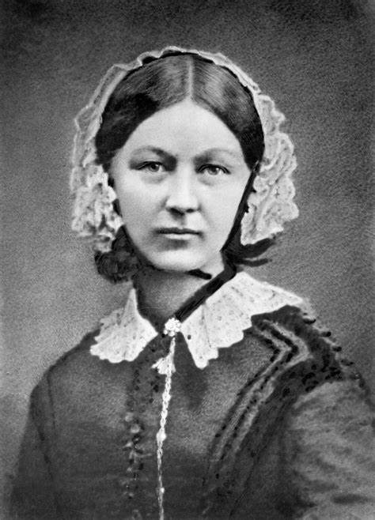
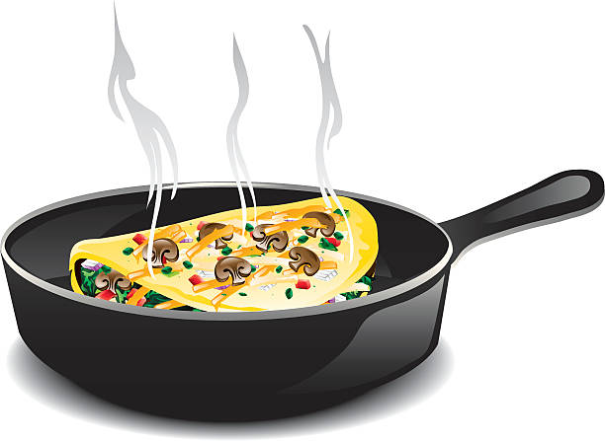

Year 2 – Spring Term 2
Curriculum Information
2025 - 2026
Religious Education
Branch 4:
Desert to Garden
English
We will be reading the following texts:
We will use these texts to write letters, instructions and explanations.
P.E.
Ball Skills
Sending and Receiving
Maths
*Revise doubles and corresponding halves to 15; find half of odd and even numbers to 30; Revise and recognise 1/2s, 1/4s, 1/3s and 2/3s of shapes; place 1/2s on a number line; count in 1/2s and 1/4s; understand and write mixed numbers
*Count in 2s, 5s and 10s to solve multiplication problems and find specified multiples; introduce the × sign; record the 2, 5 and 10 times-tables; investigate multiplications with the same answer; write multiplications to go with arrays, rotate arrays to show they are commutative
*Tell the time to the nearest quarter of an hour using analogue and digital clocks; understand the relationship between seconds, minutes and hours and use a tally chart; interpret and complete a pictogram or block graph where one block or symbol represents one or two things
*Revise 2, 5 and 10 times-tables; revise arrays and hops on the number line; multiply by 2, 3, 4, 5 and 10; arrange objects into arrays and write the corresponding multiplications; make links between grouping and multiplication to begin to show division; write divisions as multiplications with holes in and use the ÷ sign
*Recognise all coins, know their value, and use them to make amounts; recognise £5, £10, £20 notes; make amounts using coins and £10 note; write amounts using £.p notation; order coins 1p – £2 and notes £5 – £20; add several coins writing totals in £.p notation (no zeros in 10p place); add two amounts of pence, using counting on in 10s and 1s; add two amounts of money, beginning to cross into £s
PSHE and RSE
The Cycle of Life
Beginnings and Endings
Change is All Around
History- Florence Nightingale and Mary Seacole
We will be learning about Mary Seacole and Florence Nightingale and their achievements. We will be making and using timelines and will compare their lives.
Computing-Programming – code.org Course A
Course A first teaches learners how to use the basic skills of code writing including dragging and dropping. It then teaches learners to write basic instructional code using visual-based code to develop problem-solving skills, encourage persistence and promote creativity.
D&T- Making an Omelette
Children will find out about where food comes from in the world, from plants or animals. They will know how to use techniques such as cutting, peeling and whisking. With adult support children will use the appropriate heat source.
Science- Plants (part 1)
Children will use the local environment to observe and describe how seeds and bulbs grow into mature plants. They will find out and describe how plants need water, light and a suitable temperature to grow and stay healthy.
Music
We will be creating different sounds, using fast and slow patterns, listening to music from Nigeria and learning Easter Songs.

Slide 5
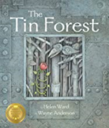

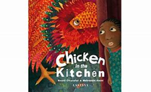

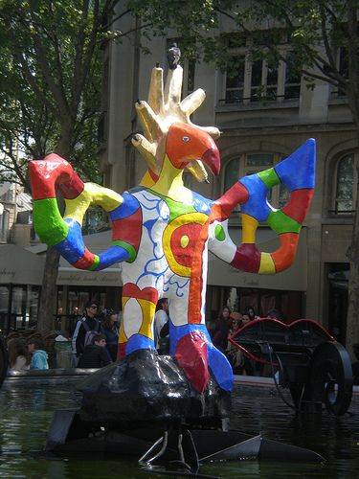
Year 2 – Summer Term 1
Curriculum Information
2025 - 2026
Religious Education
Branch 5:
To the ends of the Earth
English
We will be reading the following texts:
We will use these texts to write diaries, letters of persuasion and alternative endings.
P.E.
Athletics
Striking and Fielding
Music
We will be thinking about and creating musical structures, listening to music by Kristen Anderson-Lopez and learning songs about fairy tales.
Maths
*Locate, order and compare 2-digit numbers on 0-100 landmarked lines and on the 1-100 square; use < and > signs; locate numbers on an empty 0-100 line; introduce numbers 101 to 200 and count in 100s to 1000; add 2-digit numbers by counting on in 10s and 1s; subtract 2-digit numbers by counting back in 10s and 1s
*Use doubles and number bonds to add three 1-digit numbers; use number facts to 10 and 20 in number stories; find complements to multiples of 10; understand subtraction as difference and find this by counting up; find small differences either side of a multiple of 10
*Add and subtract 1-digit numbers to and from 2-digit numbers; subtract 2-digit numbers by counting back in tens and ones; add two 2-digit numbers by counting in 10s, then adding 1s; add 2-digit numbers using 10p and 1p coins (partitioning, answers less than 100); add 2-digit numbers using place-value cards (partitioning, answers more than 100)
*Measure weight using standard or uniform non-standard units; draw a block graph where one square represents two units; weigh items using 100g weights using scales marked in multiples of 1kg or 100g; measure capacity using uniform non-standard units; measure capacity in litres and in multiples of 100ml
*Double multiples of 10 and 5 (answers less than 100); double 2-digit numbers ending in 1, 2, 3 or 4 (answers less than 100); find a quarter of numbers up to 40 by halving twice; begin to find 3/4 of numbers; find 1/2 1/4 and 1/3 of amounts (sharing); spot patterns and make predictions when finding a third of numbers
Geography- Nigeria in Africa
Children will revise their knowledge of continents and oceans. They will locate Nigeria on a world map and use an atlas to find the capital city and rivers in Nigeria. They will look at the capital city, Abuja, and compare it to our capital city in London. Children will learn about the weather in Nigeria and compare life in Nigeria to life in the UK.
PSHE and RSE
Three in One
Who is My Neighbour?
Science- Plants (part 2)
Children will learn about the requirements of plants for germination, growth and survival, as well as the processes of reproduction and growth in plants. Children will also learn that seeds and bulbs need water to grow but most do not need light; seeds and bulbs have a store of food inside them.
Art- Sculpture – Fairy Tale Animals
Children will look at a piece of public sculpture BY Niki de Saint Phalle (Firebird) and learn how the inspiration for it was a Russian story. Children will visit Clifton Park (Salford) and visit the fairy tale sculptures. Children will create their own fairy tale animals out of clay.
Computing -Creating media/Digital photography
Children will learn to recognise that different devices can be used to capture photographs and will gain experience capturing, editing, and improving photos. Finally, they will use this knowledge to recognise that images they see may not be real.

Slide 6

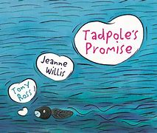
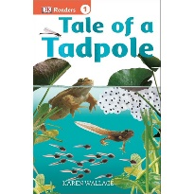

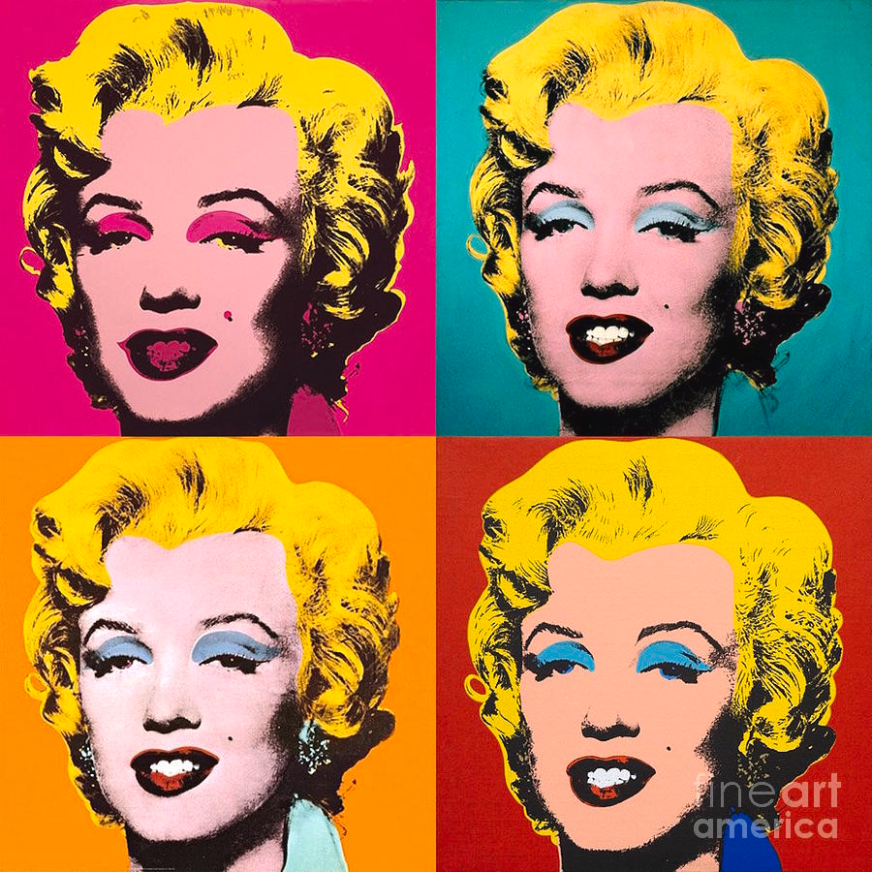
Year 2 – Summer Term 2
Curriculum Information
2025 - 2026
Religious Education
Branch 6:
Dialogue and Encounter
English
We will be reading the following texts:
We will use these texts to write letters, diaries and our own stories.
History- Significant Local Events and People
Children will learn about significant local events and why they are significant to the people of Manchester (Pope John Paul’s visit to Heaton Park). Children will learn about Alan Turing and find out information using different sources.
PSHE and RSE
The community we live in
Needs and Wants
Managing Money
Maths
*Count back in 10s and 1s to solve subtraction (not crossing 10s) and check subtraction using addition, beginning to understand that addition undoes subtraction and vice versa; add three or more small numbers using number facts; record amounts of money using £·p notation including amounts with no 10s or 1s; find more than one way to solve a money problem
*Count in 3s, recognising numbers in the 3 times-table; write multiplications to go with arrays and use arrays to solve multiplication problems; understand that multiplication is commutative and that division and multiplication are inverse operations; solve divisions as multiplications with a missing number; count in 2s, 3s, 5s and 10s to solve divisions and solve division problems in contexts
*Measure and estimate lengths in centimetres; tell the time involving multiples of 5 minutes past the hour and 5 minutes to the hour; tell time to 5 minutes; begin to say the time 10 minutes later
*Partition to add two 2-digit numbers; find the difference between two 2-digit numbers; multiply two numbers using counting in steps of 2, 3, 5 and 10; solve division problems by counting in steps of 2, 3, 5 and 10
*Compare two 2-digit numbers and find bonds to 100 using thermometers; revise place value in 2-digit numbers, numbers between 100 and 200, and 3-digit numbers (including zeros in the 10s and 1s places)
P.E.
Target & Invasion Games
D&T- Making a vehicle
Children will investigate a variety of different vehicles before designing, making and evaluating their own vehicle. They will learn all about wheels, axles and chassis.
Science- Revision.
Children will revise units covered throughout the year.
Art- Artist Study/ Andy Warhol
Children will study the art of Andy Warhol reflect on his style and revise the previous learning on colour. Children will explore how an artist can use repeating lines to create an optical effect for the view. Children will create their own art work using oil pastels.
Computing
Children will be introduced to using laptops to create content. They will develop their understanding of the various aspects of using a computer. They will begin to familiarise themselves with how to use laptops to create and store content. They will become more familiar with using a keyboard and mouse to enter and remove text, change the look of their text, and consider the differences between using a computer to create text, and writing text on paper.
Music
We will be using all our knowledge and skills in our final performance, listening to music by Dolly Parton and learning songs about the being special.

