Slide 1




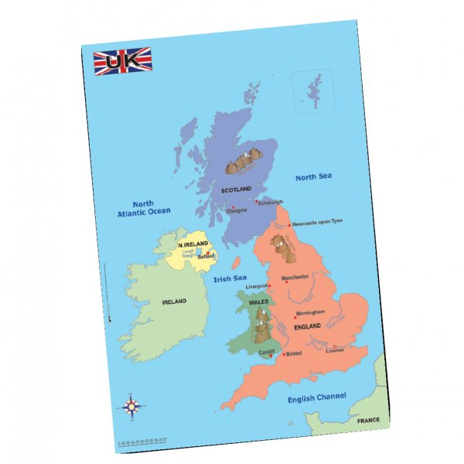
Science- Animals Including Humans
Using the local environment, we will explore and answer questions about animals in their habitat. We will learn how to take care of animals taken from their local environment and the need to return them safely after study. We will learn to identify and name a variety of common animals that are carnivores, herbivores and omnivores including fish, amphibians, reptiles, birds and mammals, including those that are kept as pets. They will be able to describe and compare the structure of these animals.
Maths
We will be learning to
*Count up to 20 objects (match number to object); estimate and count up to 30 objects; count on and back and order numbers to 10; recognise domino/dice arrays without counting; identify a number 1 more (next number in count)
*Find pairs that make 5; subitise to 5; find pairs that make 6; subitise to 6; find pairs that make 10; subitise fingers to 10; match pairs to 5, 6 and 10 to number sentences; find missing numbers in number sentences
*Double numbers 1 to 5; find 1 and 2 more; count back 1 and begin to find 1 less
*Recognise, name and describe squares, rectangles, circles and triangles; recognise basic line symmetry; sort 2D shapes according to their properties, using Venn diagrams and Carroll diagrams
*Read and write numbers and number-names to 20; compare and order numbers to 20; identify 1 more and 1 less; estimate sets of objects, count to check and order sets according to size
Year 1 – Autumn Term 1
Curriculum Information
2025- 2026
Phonics
We will be learning
*Review Phase 3 GPCs- ai ee igh oa oo ar or ur oo ow oi ear
* air er /z/ s –es
* Read CVCC CCVC CCVCC CCCVC
* Teach Phase 5
/ai/ ay play
/ow/ ou cloud
/oi/ oy toy
/ee/ ea each
*Review longer words
Religious Education
Branch 1: Creation and Covenant
P.E.
Fundamentals
Team Building
Music
We will be finding the pulse and creating rhythm patterns, listening to music by Mussorgsky and learning Harvest Songs.
English
We will be reading the following texts:
Using these texts we will be labelling, sequencing, making lists, writing simple sentences , writing recounts and writing simple poems.
Geography- Where do I Live?
We will learn about the countries and capital cities of the UK. We will identify features of countries of the UK (England/London, Northern Ireland/ Belfast, Scotland /Edinburgh, Wales/ Cardiff.) We will then explore Blackley the town where we live and will take part in some local field work.
PSHE and RSE
Let the Children Come
God Loves You
Art- Andy Goldsworthy
We will learn about sculpture as an art form and become familiar with the work of Andy Goldsworthy. We will make temporary sculptures using natural forms. We will learn how to sketch natural objects and leaves found in their local environment.

Slide 2



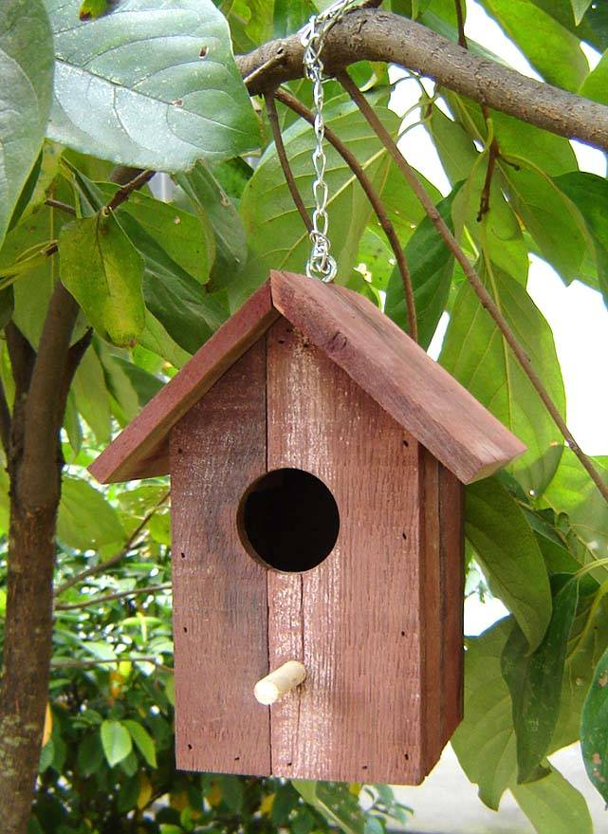
History- How has the high street changed since the 1950s?
Children will look at how our local high street has changed since the 1950s. They will learn about the different types of products on sale the high street throughout the decades and how people paid in the past.
PSHE and RSE
Special People
Treat Others Well
Say Sorry
Maths
*Understand and then make teen numbers (10 and some 1s); compare and order numbers to 20, then 30; find the number between two numbers with a difference of 2; understand and use ordinal numbers
*Revise bonds to 5, 6 and 10; find pairs which make 7; use addition facts for 5, 6 and 10 to solve subtractions; use number facts for 5, 6 and 10 to solve word problems
*Describe position and direction using common words (including half turns); compare lengths and heights; estimate, compare and measure lengths using uniform non-standard and standard units
* Add 1, 2 and 3 by counting on; subtract 1, 2, 3 or more by counting back; begin to add three small numbers by spotting bonds to 10 or doubles (1-6)
* Compare and order numbers to 20; recognise coins and know values (up to £2); begin to make amounts in pence; understand teen numbers are 10 and some 1s
Year 1 – Autumn Term 2 Curriculum Information
2025- 2026
Religious Education
Branch 2: Prophecy and Promise
Phonics
We will be learning
Week 1 /ur/ ir bird igh/ ie pie
/oo/ /oo/ ue blue rescue
u unicorn
their people oh your
Week 2 /oa/ o go igh/ i tiger
ai/ a paper ee/ e he
Mr Mrs Ms ask
Week 3 /ai/ a-e shake
/igh/ i-e time oa/ o-e home
oo/ /yoo/ u-e rude cute
could would should our
Week 4 /ee/ e-e these
/oo/ /yoo/ ew chew new
/ee/ ie shield /or/ aw claw
house mouse water want
Week 5 Grow the code:
igh/ ie i i-e
ai/ ay a a-e
oa/ oa o o-e
ee/ e ie e-e ea
oo/ ew u-e u ue
Science-Seasonal Change
Children will observe and talk about changes in the weather and across the four seasons. They will observe and describe weather associated with seasons and how day length varies. They will learn that it is not safe to look directly at the sun, even when wearing dark glasses.
English
We will be reading the following texts:
Using these texts we will be writing simple sentences, character descriptions, instructions (how to make a treasure chest/ bird house), letters.
Computing- Computing systems and networks – Technology around us
Children will develop their understanding of technology and how it can help them. They will become more familiar with the different components of a computer by developing their keyboard and mouse skills, and also start to consider how to use technology responsibly.
P.E
Dance
Fitness
Music
We will be creating high and low patterns, listening to music by Wolfgang Amadeus Mozart and learning Advent Songs.
Design and Technology – Designing and Making a Birdhouse
Children will design a bird house following a design criteria and research similar existing products.
They will learn how to assemble and join materials using a simple construction kit.

Slide 3




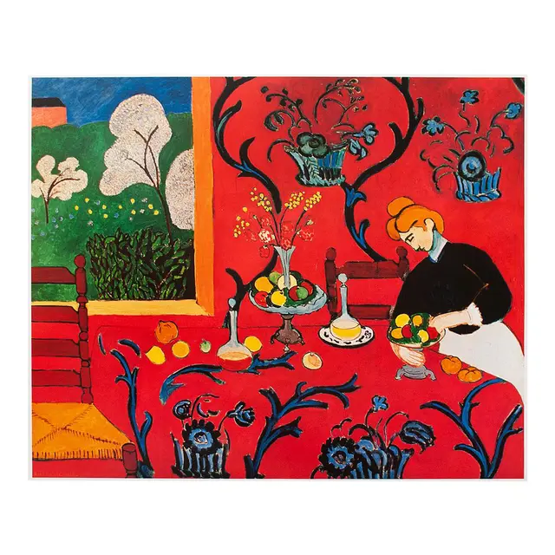
Geography - The Four Seasons and Weather in the UK
Children will learn about the four seasons and identify what the typical weather is like in the seasons. Children will describe daily weather patterns .
PSHE and RSE
Being Safe
Physical Contact
Harmful Substances
Maths
*Say the number one more or less and two more or less using a number line or a 100 grid; locate 2-digit numbers on a 100 grid and a 1-100 bead string; read, write and say 2-digit numbers and understand them as some tens and some ones
*Revise pairs to 5, 6, 7, 10 and doubles to double 6; derive subtraction facts; understand a symbol being used for an unknown; use number facts to solve simple addition and subtraction word problems; find pairs of numbers with a total of 8
*Add by putting the larger number first and counting on (numbers up to 100), spotting unit patterns; count on from 2-digit numbers; add a 1-digit number to a 2-digit number
*Name, recognise and know the properties of 3D shapes: cube, cuboid, cone, cylinder and sphere; begin to sort 3D shapes according to properties; order and name the days of the week and months of the year; recognise and name the season
*Count on and back in tens from any number; begin to count in 5s and 2s recognising multiples of 5 end in 5 and 0; children begin to count in 2s; estimate a number of objects within a range and count by grouping into 10s or 5s
P.E
Gymnastics
Yoga
D&T- Making a Hat
Children will design and make a hat out of recyclable materials/ junk.
Year 1 – Spring Term 1 Curriculum Information
2025- 2026
Music
We will be starting to notate music and thinking about loud and quiet sounds, listening to Elvis Presley and learning songs about the weather and seasons.
Phonics
Week 1 /ee/ y funny
/e/ ea head /w/ wh wheel
/oa/ oe ou toe shoulder
any many again
Week 2 /igh/ y fly /oa/ ow snow
/j/ g giant /f/ ph phone
who whole where two
Week 3 /l/ le al apple metal
/s/ c ice /v/ ve give
school call different
Week 4 /u/ o-e o ou some mother young /z/ se cheese
/s/ se ce mouse fence e
e/ ey donkey
thought through friend work
Week 5 Grow the code:
/oo/ u ew ue u-e ui ou oo fruit soup
/ee/ ea e e-e ie ey y ee
/s/ c se ce ss
/z/ se s zz
/oa/ ow oe ou o-e o oa
Science- Everyday Materials
Children will explore, name, discuss, raise, and answer questions about everyday materials so that they become familiar with the names of materials and properties. Children will learn to distinguish between an object and the material from which it is made. They will identify and name a variety of everyday materials, including wood, plastic, glass, metal, water and rock. They will be able to describe the simple physical properties of a variety of everyday materials. They will learn to compare and group together a variety of everyday materials based on their simple, physical properties. In addition, children will further explore and experiment with other materials, including: brick, paper, fabrics, elastic and foil.
Religious Education
Branch 3: Galilee to Jerusalem
English
We will be reading the following texts:
Using these texts we will be writing invitations, information texts, speech bubbles, character descriptions and retelling stories.
Art- Colours and Painting
Children will learn about primary and secondary colours and warm and
cool colours. Children will learn how to mix primary colours. Children
will look at Henrie Matisse; Harmony in red to explore colour and
create their own work in the style of Matisse’s work using colour.

Slide 4





History- George Stephenson and the developments of the railway.
Children will learn about George Stephenson and the development of the railway . They will learn about his life and the impact he had locally, nationally and globally.
Phonics
Week 1 /ur/ or word
/oo/ u oul awful would
/air/ are share
/or/ au aur oor al author dinosaur floor walk
once laugh
Week 2 /ch/ tch match
/ch/ ture adventure
/ar/ al half*
/ar/ a father*
because eye
Week 3 /or/ a water
Schwa in longer words: different
/o/ a want
/air/ ear ere bear there
Week 4 /ur/ ear learn
/r/ wr wrist
/s/ st sc whistle science
Schwa at the end of words: actor
Week 5 /c/ ch school
/sh/ ch chef
/z/ /s/ ce se ze freeze
Maths
*Recognise odd and even numbers; count objects in 5s and 10s and begin to say 5 lots and 10 lots; find half, quarter and three quarters of shapes; begin to know that two halves and four quarters are a whole and that two quarters is a half
*Find and begin to know doubles to double 10; revise pairs to 5, 6, 7, 8, 9 and 10 and derive related subtraction facts; use knowledge of pairs of 10 to make pairs to 20; use number facts to solve word problems
*Relate units of time weeks, days, hours; divide the days up into parts; read and write times to the hour; begin to have a notion of how long an hour is and how long a minute is; tell the time (oʼclock and half past) on analogue and digital clocks; measure using uniform units (cubes and rulers)
*Add a 1-digit number by counting on from a 2-digit number, not crossing 10s at first, then beginning to cross 10s; subtract a 1-digit number by counting back initially from numbers up to 30 (not crossing 10s) and then generally from a 2-digit number (not crossing 10s) and from multiples of 10
*Locate 2-digit numbers on a 100-square; begin to recognise 2-digit numbers as some 10s and 1s; make 2-digit numbers using 10p and smaller coins; find 1 more or 1 less than any number to 100; find 10 more than any number to 90; find 10 less than any number to 100
Year 1 – Spring Term 2 Curriculum Information
2025- 2026
D&T- Making a Sandwich
Children will learn that food can be
divided into different groups .Children will learn where sandwich fillings come from and will taste a variety of sandwich ingredients before designing and making their own sandwich. Children will use techniques such as spreading, cutting and grating.
Science- Animals Including Humans
They will be able to identify, name, draw and label the basic parts of the human body and know which part of the body is associated with each sense.
Religious Education
Branch 4: Desert to Garden
English
We will be reading these texts:
Using these texts we will write poetry, instructions, descriptions, letters, diaries, comic strips.
Music
We will be creating different sounds, using fast and slow patterns, listening to Calypso music from Trinidad and learning songs about Spring and Easter.
Computing- Creating media/Digital painting
Children will explore the world of digital art and its exciting range of creative tools. Children will create their own paintings, while getting inspiration from a range of other artists. Children will consider their preferences when painting with, and without, the use of digital devices.
PSHE and RSE
Can You Help Me?
P.E
Ball Skills & Sending and Receiving

Slide 5


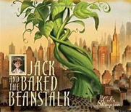


Geography- The Seaside
Children will learn about seaside destinations in the four
countries of the UK. Children will learn about the human
and physical features of the seaside. Children will learn
that daily weather patterns may be different in coastal areas.
Art - Van Gough
Children will become familiar with the work of Van Gogh. Children will use pencil to make an observational drawing of sunflowers and other flowers. Children will learn how to use pastels and blend colours together to create a picture in Van Gough sunflower style.
Phonics
Week 1 ay play
a-e shake
ea each
e he
Week 2 ie pie
i-e time
o go
o-e home
Week 3 ue blue rescue
ew chew new
u-e rude cute
aw claw
Week 4 ea head
ir bird
ou cloud
oy toy
Week 5 i tiger
a paper
ow snow
u unicorn
Week 6 ph phone
wh wheel
ie shield
g giant
Year 1 – Summer Term 1 Curriculum Information
2025- 2026
Maths
*Find 1 more, 1 less, 10 more, 10 less than any 2-digit number; explore patterns on the 100-square; understand place value in 2-digit numbers and identify 10s and 1s
*Use number facts to add and subtract 1-digit numbers to/from 2-digit numbers; add pairs of 1-digit numbers with totals above 10; sort out additions into those you ʻjust knowʼ and those you need to work out.
*Add three small numbers, spotting pairs to 10 and doubles; add and subtract 10 to and from 2-digit numbers
*Compare weights and capacities using direct comparison; measure weight and capacity using uniform non-standard units; complete tables and block graphs, recording results and information; make and use a measuring vessel for capacity.
Find half of all numbers to 10 and then to 20; identify even numbers and begin to learn halves; recognise halves and quarters of shapes and begin to know 2/2=1, 4/4=1 and 2/4=1/2; recognise, name and know value of coins 1p–£2 and £5 and £10 notes; solve repeated addition problems using coins; make equivalent amounts using coins.
Music
We will be thinking about and creating musical structures, listening to music by Michael Giacchino and learning songs about plants and growing.
English
We will be reading these texts:
Using these texts we will be writing letters, poems, retelling stories, instructions, and alternative stories.
Religious Education
Branch 5: To the Ends of the Earth
P.E
Athletics and Striking & Fielding
Science- Plants
Using the local environment, children will explore and answer questions about plants growing in their habitat. They will be able to identify and name a variety of common wild and garden plants and flowers, including deciduous and evergreen trees. They will also learn to identify and describe the basic structure of a variety of common flowering plants, including trees (leaves, flowers, blossom, petals, fruit, roots, bulb, seed, trunk, branches, and stem).
PSHE and RSE
Three in One
Who Is My Neighbour?
Computing- Programming /Moving a robot
Children will be introduced to early programming concepts. Children will explore using individual commands, both with other learners and as part of a computer program. They will identify what each floor robot command does and use that knowledge to start predicting the outcome of programs. Learners are also introduced to the early stages of program design through the introduction of algorithms.

Slide 6




History- The Seaside (Victorians)
Children will learn about holidays in the past. They will learn how holidays have changed over time.
Art- Artist Study- Seaside pictures inspired by Renoir
Children will learn how to draw water, sea, beach and boats. Children will create their own seaside artwork using chalk.
Phonics
Week 1 /ai/ eigh aigh ey ea eight straight grey break
/n/ kn gn knee gnaw
/m/ mb thumb
/ear/ ere eer here deer
busy beautiful pretty
hour
Week 2 /zh/ su si treasure vision
/j/ dge bridge
/i/ y crystal
/j/ ge large
move improve parents
shoe
Week 3 /sh/ ti ssi si ci potion mission mansion delicious
Week 4 /or/ augh our oar ore daughter pour oar more
review
Week 5 review
Year 1 – Summer Term 2 Curriculum Information
2025- 2026
Maths
*Locate 2-digit numbers on a beaded line and 100-square; compare and order 2-digit numbers up to 100 and say a number between two numbers; identify 10s and 1s in 2-digit numbers and solve place-value additions
*Recognise odd and even numbers; count in 2s, 5s and 10s, look for patterns; multiply by 2, 5, 10 by counting in groups/sets; find doubles to double 10 and related halves; halve odd numbers up to 10
*Tell the time to the half hour and quarter hour on analogue clocks and begin to read these times on digital clocks; revise months of the year; read, interpret and create a pictogram; begin to recognise and read block graphs; measure lengths using non-standard, uniform units; recognise and name simple 2D shapes and continue repeating patterns
*Use number facts to add and subtract 1-digit numbers to and from 2-digit numbers; find change from 10p and from 20p
*Locate 2-digit numbers on a bead string and a 1-100 square; order numbers to 100; identify 10s and 1s in 2-digit numbers; say or write 1 more and 1 less and 10 more and 10 less than any number to 100; explore patterns in 10s, 5s and 2s on a 9×9 grid; count in tens from any given number
English
We will be reading these texts:
Using these texts we will be writing postcards, letters and poems.
PSHE and RSE
The communities we live in
Who Will I Be?
Gifts, talents, jobs and vocations.
Music
We will be using all our knowledge and skills in our final performance, listening to music by Stephen Sondheim and learning songs about the seaside.
P.E
Target Games and Invasion Games
D&T- Moving Pictures
Children will explore and learn about inventive ways to bring their pictures to life through a variety of moving mechanisms. They will explore sliders, levers, pivots and wheel mechanisms and how they can be used to make different parts of a picture move.
Religious Education
Branch 6: Dialogue and Encounter
Science
Revision of the units covered this year

