Slide 1

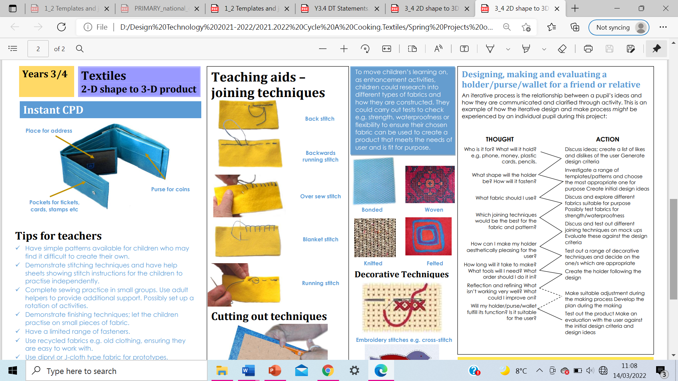
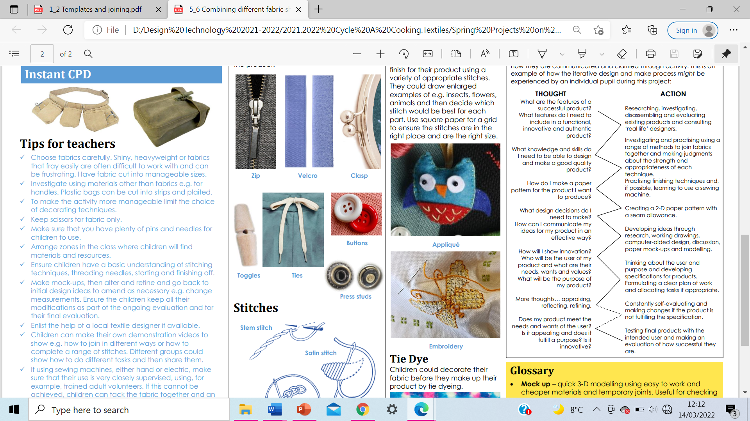
St Anne's Catholic Primary School - Design Technology
Aspect: Textiles | Phase: UKS 2 | Focus: Combining different fabric shapes
What should I already know…
Experience of basic stitching, joining textiles and finishing techniques. Experience of making and using simple pattern pieces.
Essential knowledge 2:
Use research into famous designers and inventors to inform the design of own innovative products. Generate, develop, model and communicate ideas through discussion, annotated sketches, cross-sectional and exploded diagrams, prototypes, pattern pieces and computer-aided design. Apply knowledge of materials and techniques to refine and rework his/her product to improve its functional properties and aesthetic qualities. Use technical knowledge accurate skills to problem solve during the making process. Use knowledge of famous designs to further explain the effectiveness of existing products and products made.
Sample
 | Vocabulary
Mock-up | quick 3-D modelling using easy to work and cheaper materials. Useful for checking proportions and scale.
Pattern or template | a shape drawn to exact shape and size, used to assist in cutting out
Seam allowance | extra fabric allowed for joining together - 15mm for domestic patterns
specification | describes what a product has to do
tacking | large running stitches to hold pieces of fabric together temporarily
Working drawing | detailed drawing contains all information needed to make a product but is updated as changes are made.
Technical knowledge and understanding: Stitches

