Slide 1
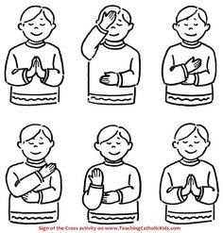

Please join me in making the sign of the cross:
In the name of the Father,
And of the Son,
And of the,
Holy Spirit,
Amen.

Slide 2
EYFS Morning Prayer
Good morning Lord,
We praise your Holy name,
And thank you for giving us,
This lovely new day,
Amen

Slide 3
Thank you for…
What would you like to thank God for this morning?
Perhaps it’s the weather? Something beautiful that you have seen? Somebody you know who has been poorly has got better.
God knows us and loves us so much, he loves to hear us say thank you for the wonderful gifts he has given to us.
Draw a picture or take a photograph to send to us on Dojo to show us what you are thankful for.

