Slide 1
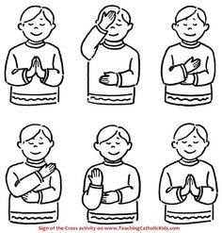

Please join me in making the sign of the cross:
In the name of the Father,
And of the Son,
And of the,
Holy Spirit,
Amen.

Slide 2
EYFS Lunch time Prayer
Thank you for the world so sweet,
Thank you for the food we eat,
Thank you for the birds that sing,
Thank you Lord for everything,
Amen

Slide 3
How lucky we are…
We have shops that we can visit safely, we have grown ups to make us delicious food.
Let us think about children who aren’t as lucky as we are.
We ask God to help them, so they are never hungry or thirsty.

