Slide 1
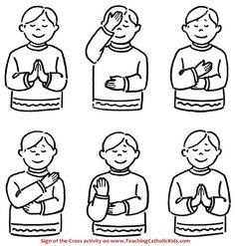

Please join me in making the sign of the cross:
In the name of the Father,
And of the Son,
And of the,
Holy Spirit,
Amen.

Slide 2
EYFS Evening Prayer
God our Father,
I come to say,
Thank you for your love today.
Thank you for my family and all the friends you give to me.
Guard me in the dark of night and in the morning send your light,
Amen

Slide 3
How was your day?
What went well today? Was their something you did really well that you could say thank you for?
Did you find something very difficult and you need God’s prayers to help you reach your goal?
Draw a picture or take a photograph to add to Dojo of something that was good today and something you need a little help with.

