Slide 1
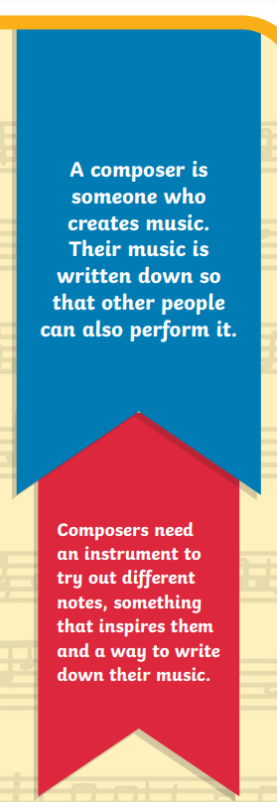



Music Composers

Slide 2
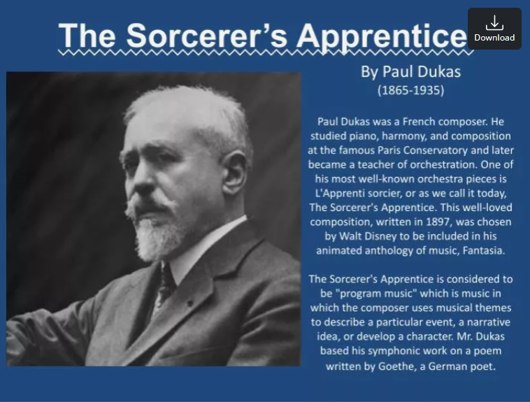
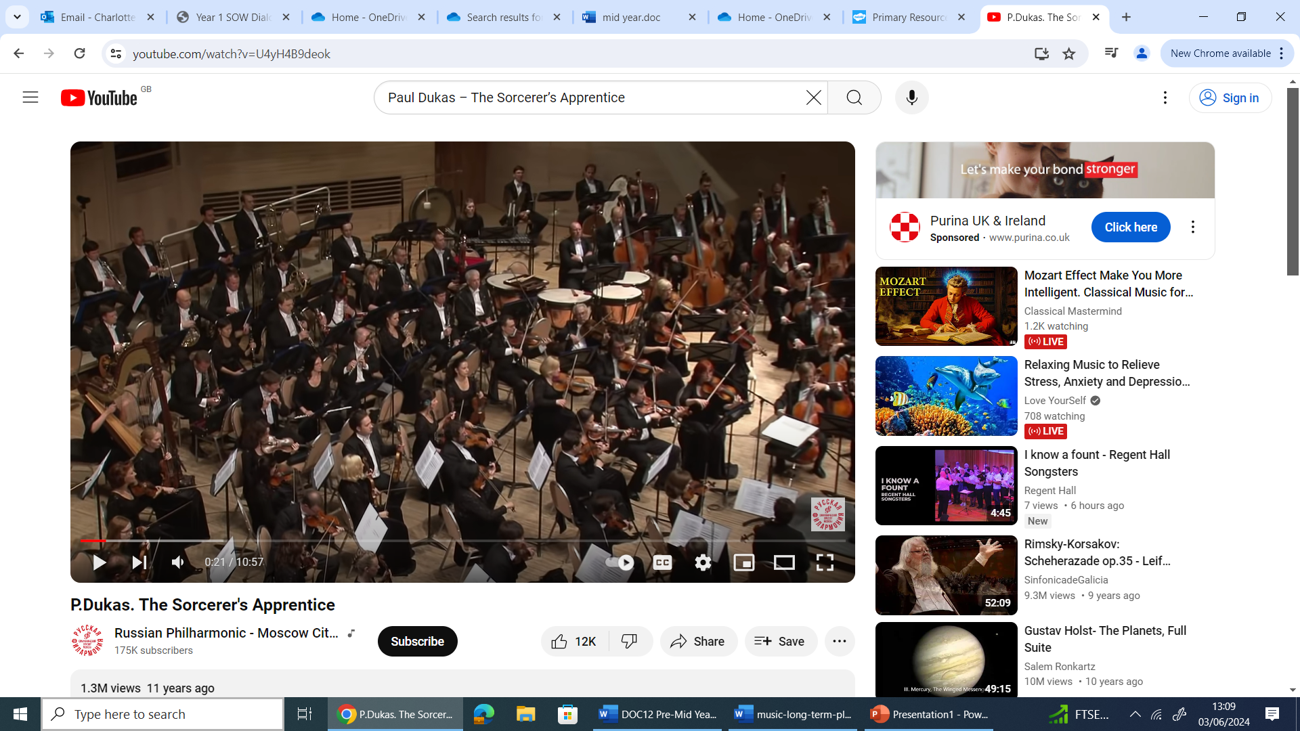

KS1 – E1 - Autumn
Paul Dukas – The Sorcerer’s Apprentice
Notes:
https://www.youtube.com/watch?v=U4yH4B9deok

Slide 3
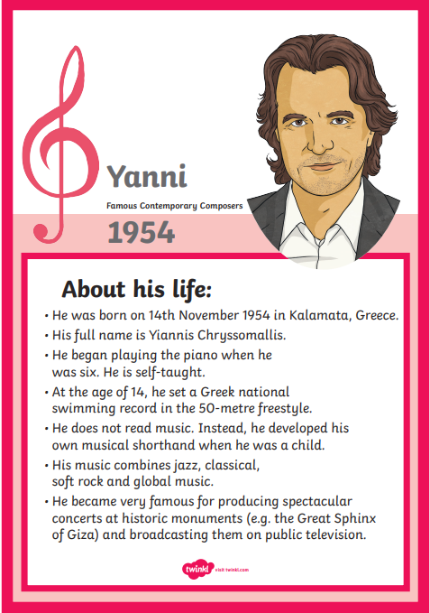
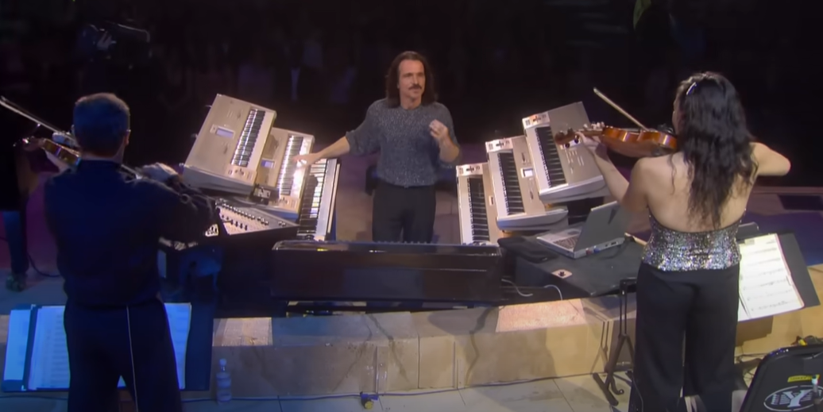
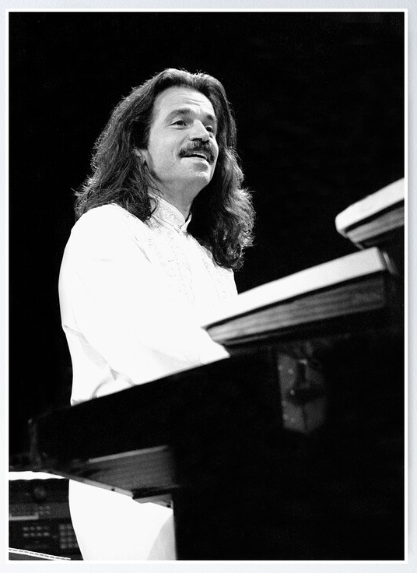
KS1 – E2 - Autumn
Yanni
Notes:
https://www.youtube.com/watch?v=BNi9fOjXx-Y (The storm)

Slide 4
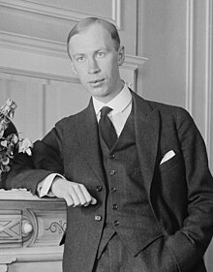

KS1 – E1 - Spring
Prokofiev – Peter and the Wolf
Sergei Sergeyevich Prokofiev (1891-1953) was a Russian composer, pianist, and conductor who later worked in the Soviet Union. As the creator of acknowledged masterpieces across numerous music genres, he is regarded as one of the major composers of the 20th century.
Notes:
Peter and the Wolf (youtube.com)

Slide 5
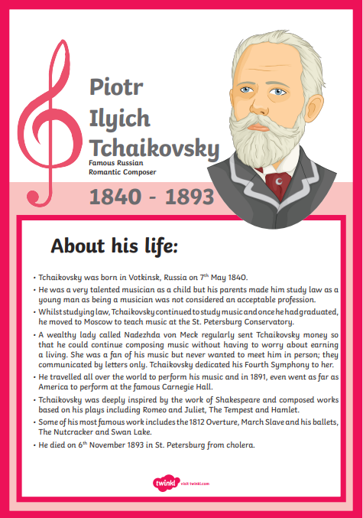
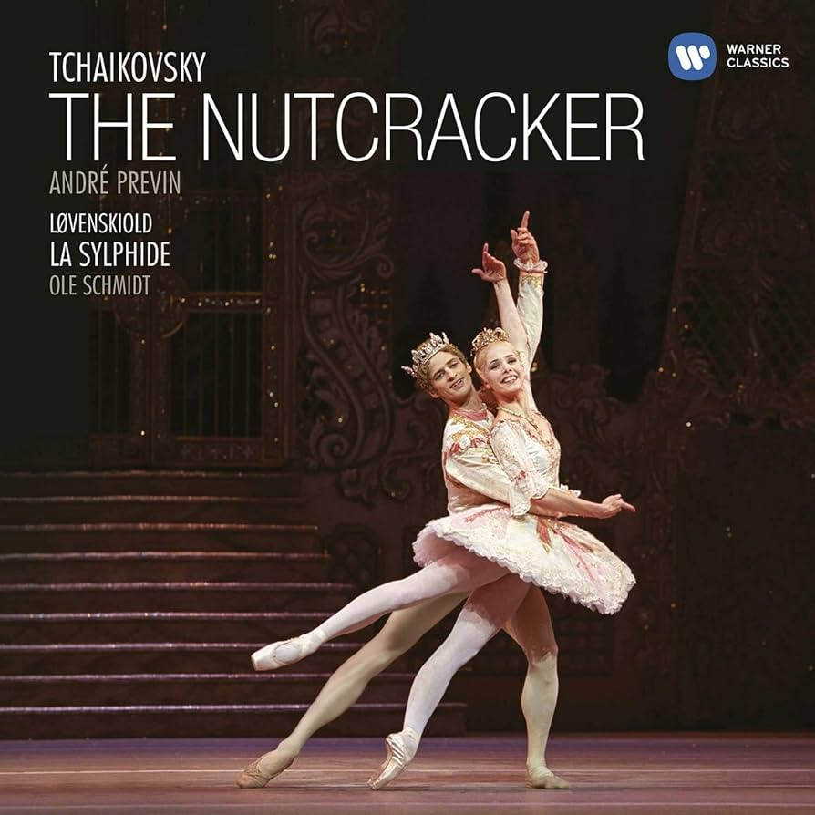
KS1 – E2 - Spring
Tchaikovsky – The Nutcracker
Notes:
https://www.youtube.com/watch?v=Zp1aDnVySf8

Slide 6
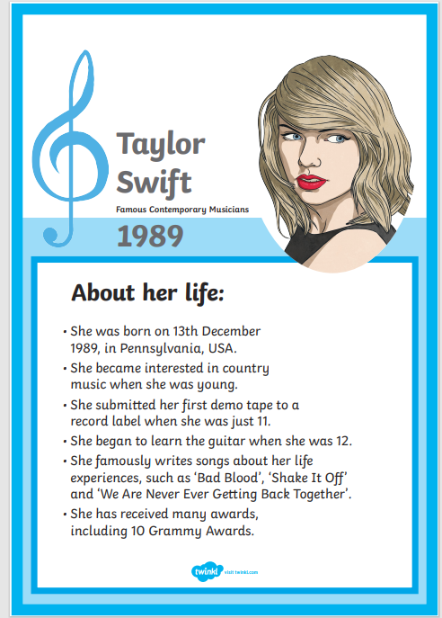
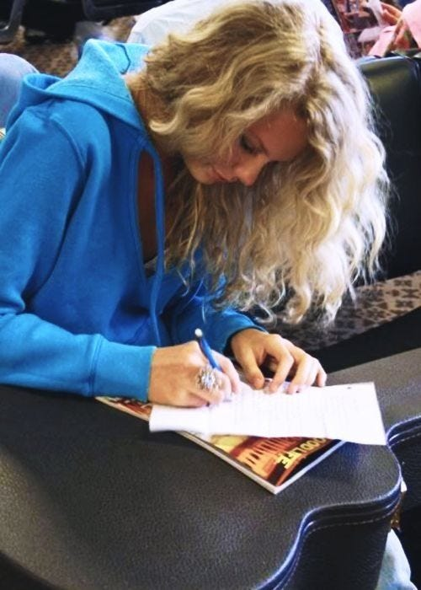
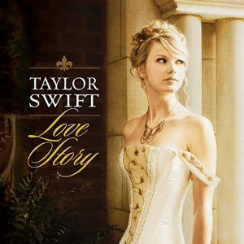
KS1 – E1 - Summer
Taylor Swift
Notes:
https://www.youtube.com/watch?v=LApbr6Pa4co (love story)

Slide 7
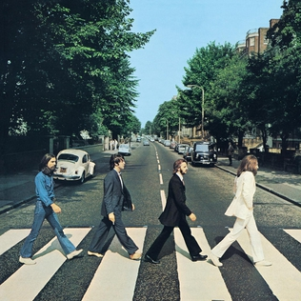
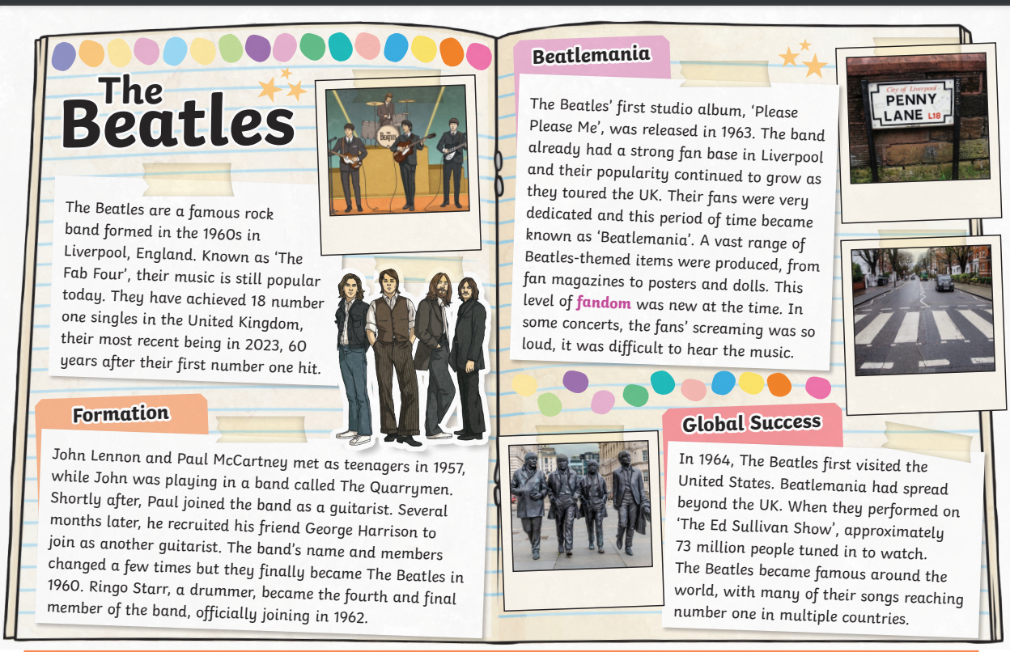
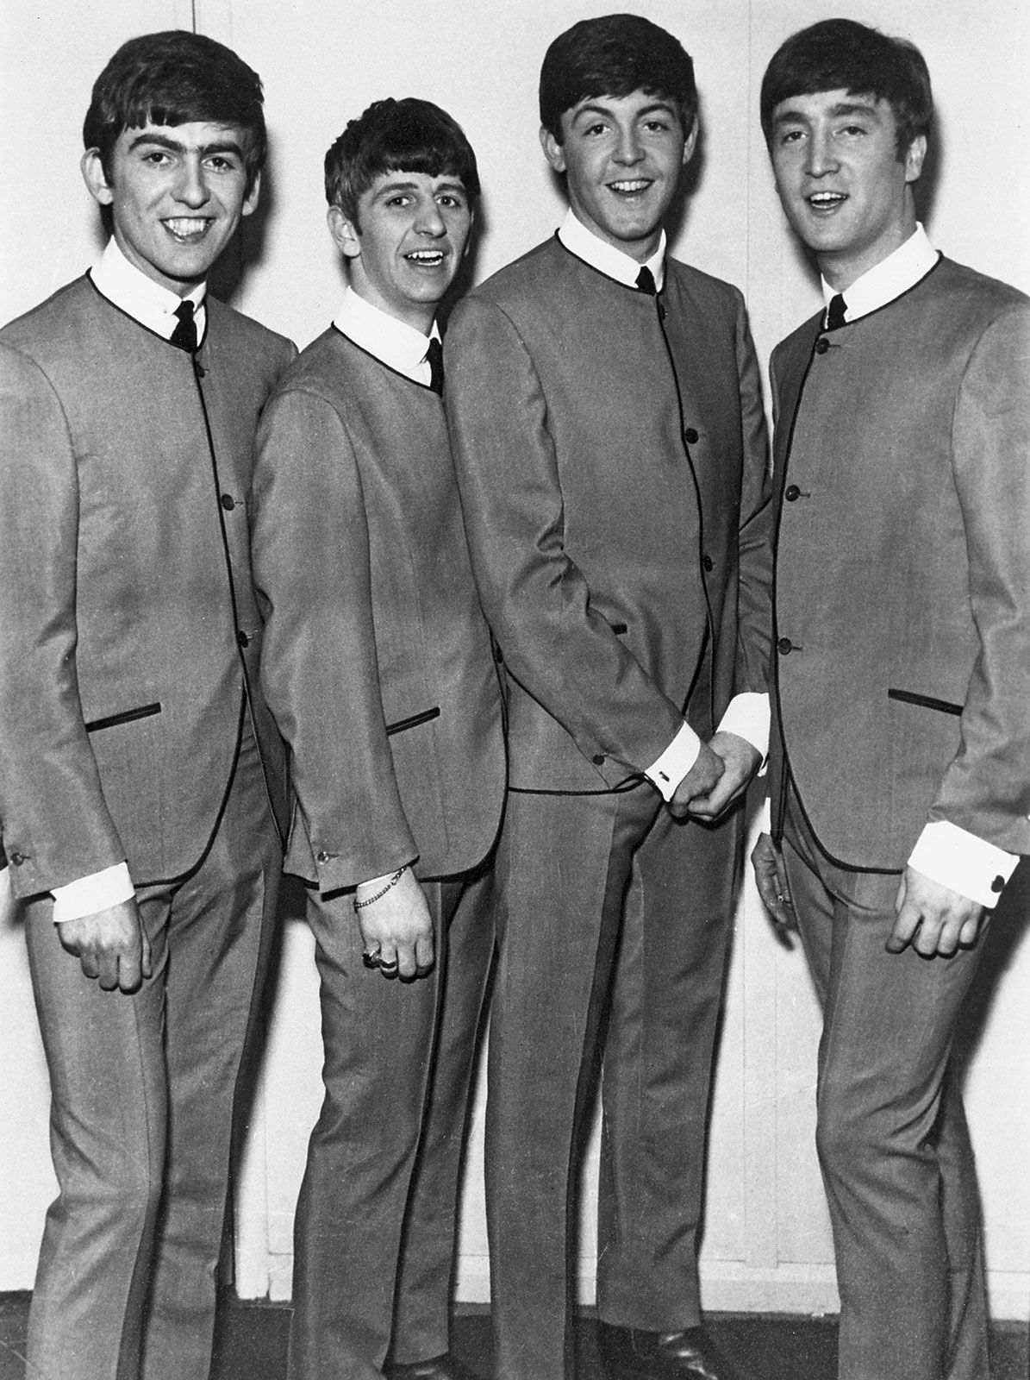
KS1 – E2 - Summer
The Beatles
Notes:
https://www.youtube.com/watch?v=IcfIjfq_3Tk

Slide 8
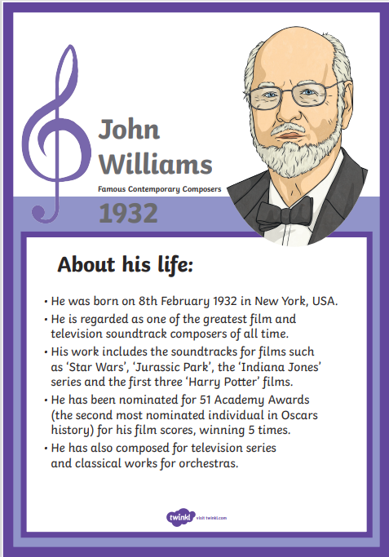
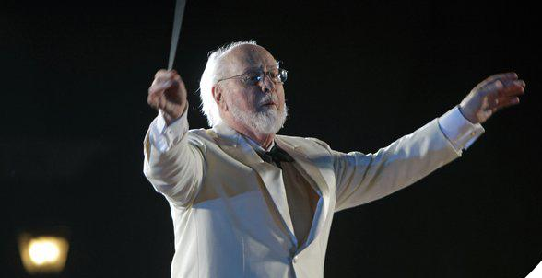
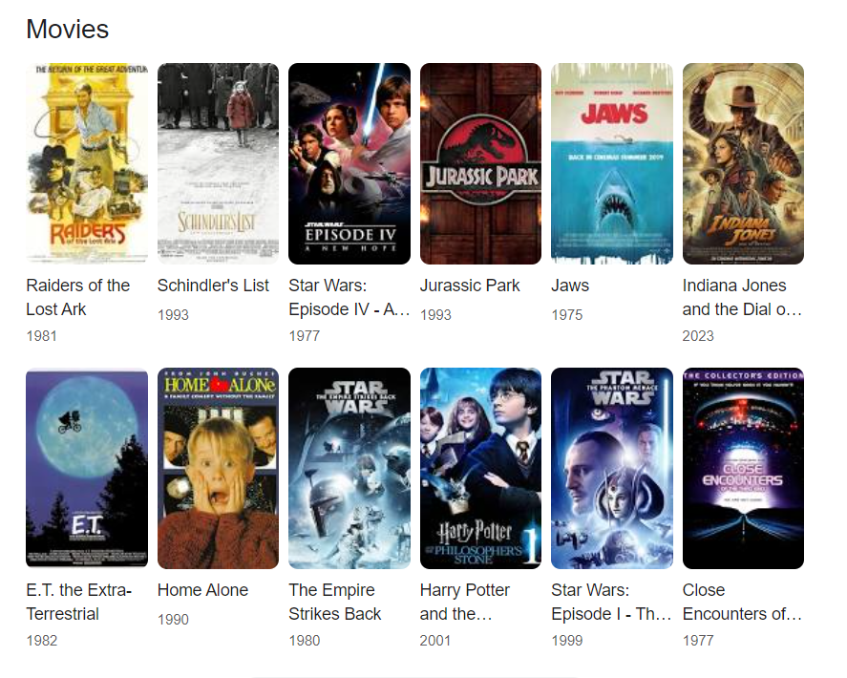
LKS2 – E1 - Autumn
John Williams
Notes:
https://www.youtube.com/watch?v=vsMWVW4xtwI (Stars Wars - Imperial March)

Slide 9
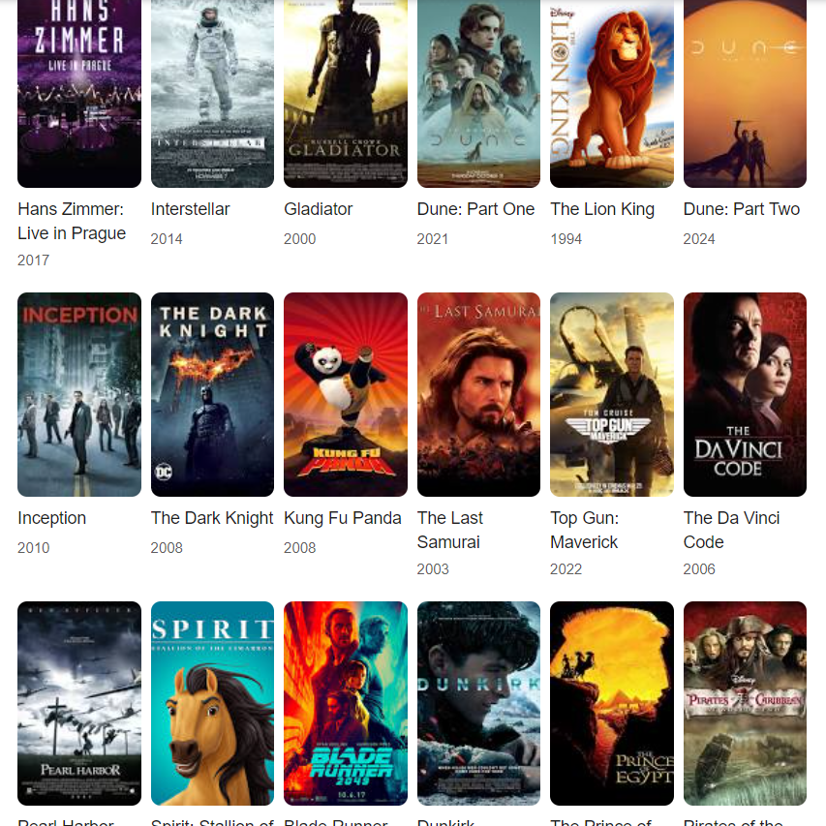
LKS2 – E2 - Autumn
Notes:
https://www.youtube.com/watch?v=P5JplB64m5U (pirates of the carribean medley)

Slide 10
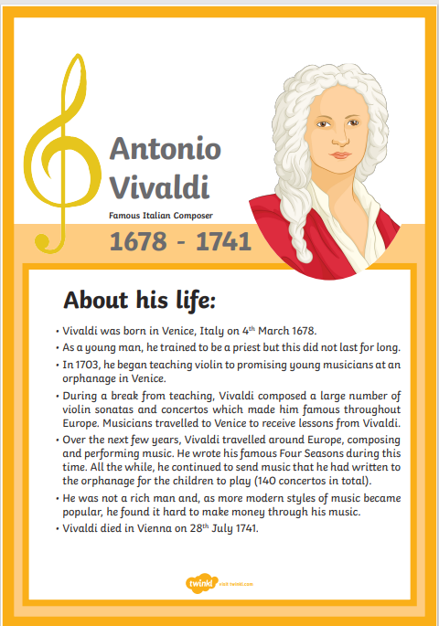
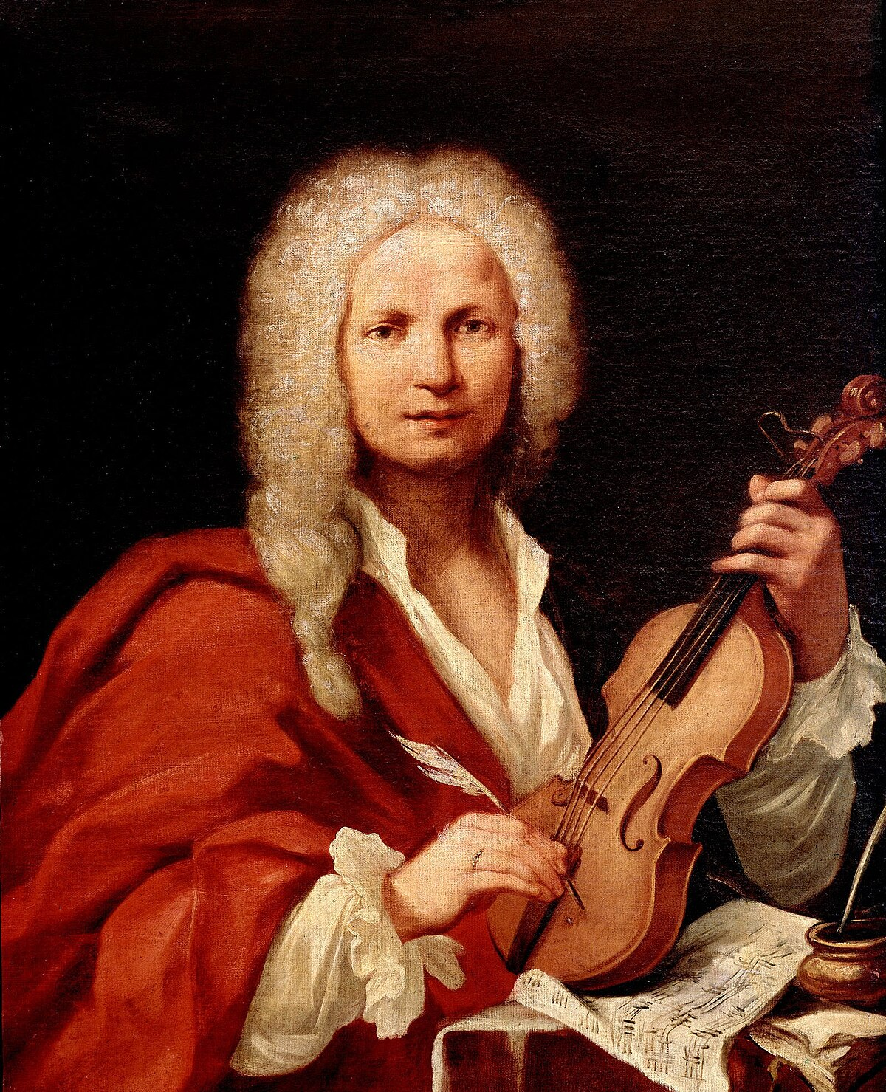
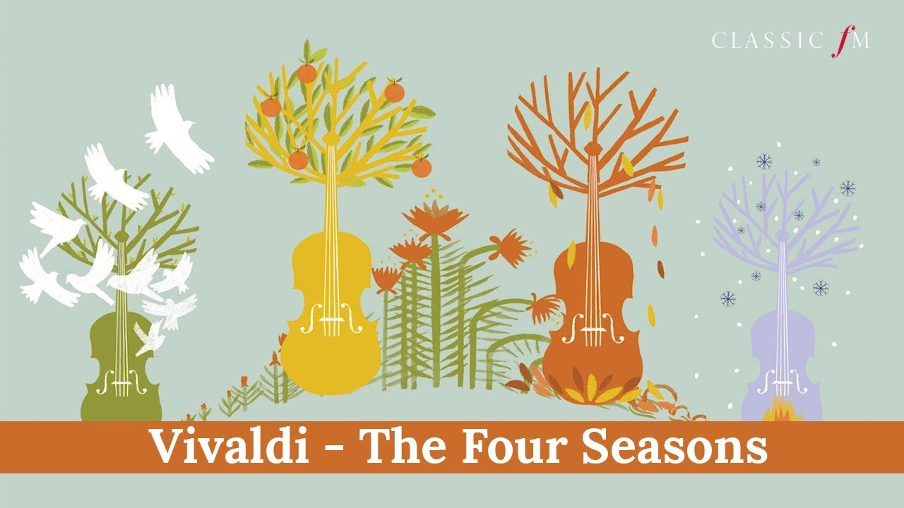
LKS2 – E1 - Spring
Vivaldi – The Four Seasons
Notes:
https://www.youtube.com/watch?v=GRxofEmo 3HA

Slide 11
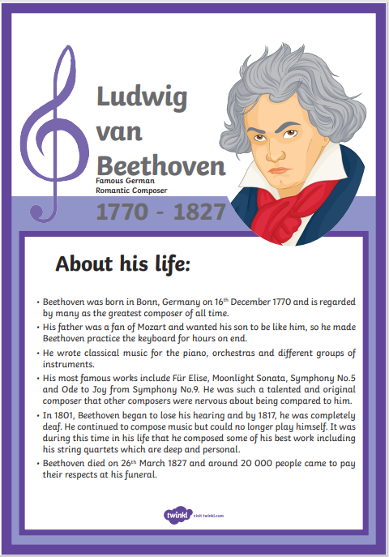
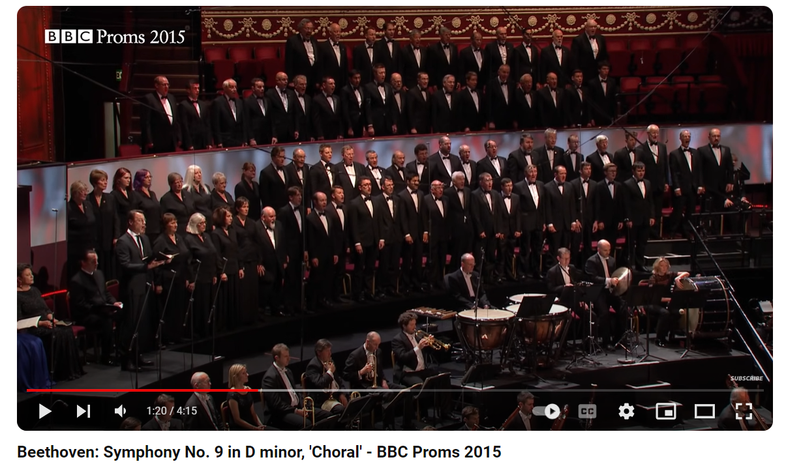
LKS2 – E2 - Spring
Beethoven – Fur Elise/ Moonlight Sonata
Or 9 symphonies
Notes:
https://www.youtube.com/watch?v=yf2rbcrZzDQ

Slide 12
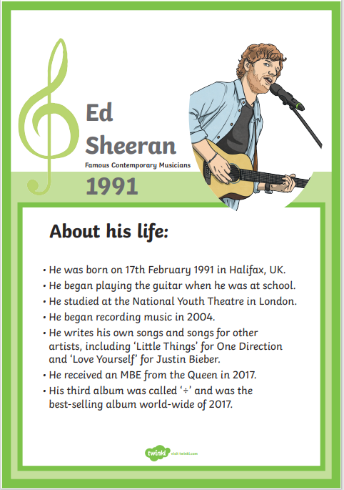


LKS2 – E1 - Summer
Notes:
https://www.youtube.com/watch?v=l11mUSu7aeA

Slide 13
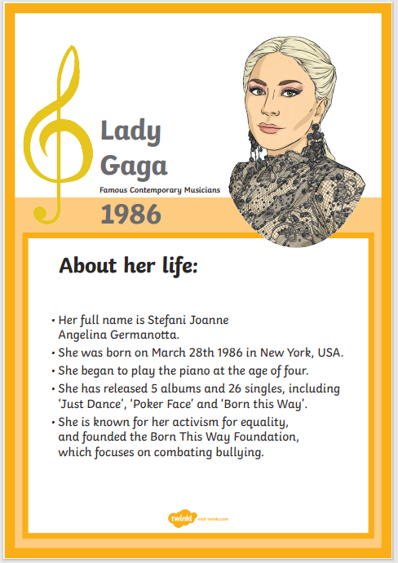
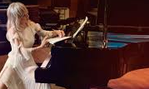
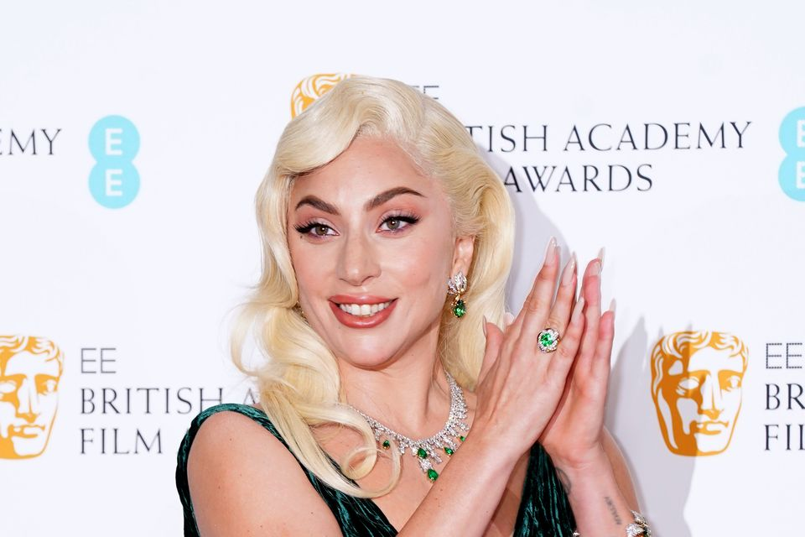
LKS2 – E2 - Summer

Slide 14
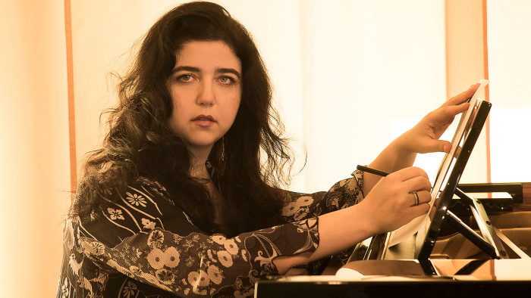
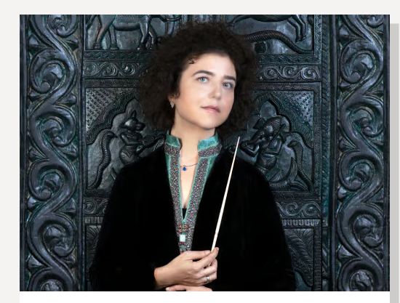
UKS2 – E1 - Autumn
Notes:
Interview - https://www.ft.com/content/b7dd1b38-4503-11e6-9b66-0712b3873ae1 , https://www.rsno.org.uk/people/lera-auerbach/
https://www.youtube.com/watch?v=Hb99fT14kUI&list=PLL4KNk6FHkB9_3vbf-LC9ZAZksOiRtKXe&index=3

Slide 15
UKS2 – E1 - Autumn
Notes:
https://www.youtube.com/watch
?v=4vbvhU22uAM
https://www.classicfm.com/composers/britten/guides/best-recordings-brittens-young-persons-guide-orche/

Slide 16
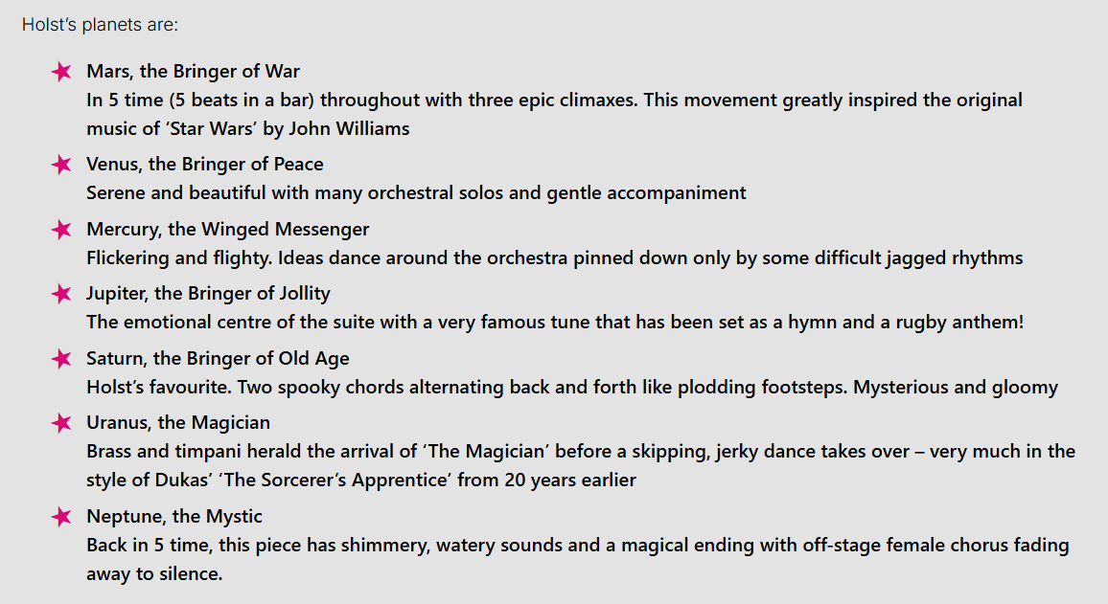
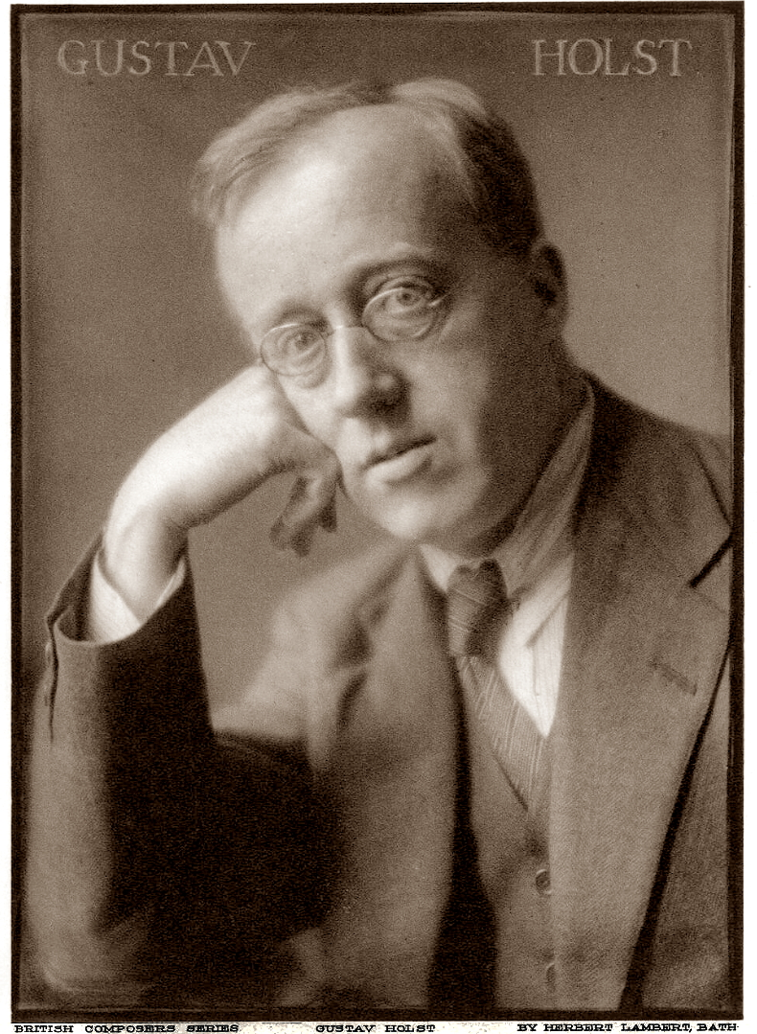
UKS2 – E1 - Spring
The Planets, Op. 32, is a seven-movement orchestral suite by the English composer Gustav Holst, written between 1914 and 1916. Each movement of the suite is named after a planet of the solar system and its corresponding astrological character as defined by Holst.
Holst – ‘The Planets’
Notes:
https://www.classicfm.com/composers/holst/pictures/holsts-planets-guide/saturn/
https://lpo.org.uk/digitalresource/gustav-holst-the-planets-project/
https://lpo.org.uk/wp-content/uploads/2022/11/LPO-KS2-resources_Gustav-Holst-The-Planets.pdf

Slide 17
UKS2 – E2 - Spring

Slide 18


UKS2 – E1 - Summer
Notes:
https://www.youtube.com/watch?v=XwkVVByRNUg

Slide 19
UKS2 – E2 - Summer

