Slide 1

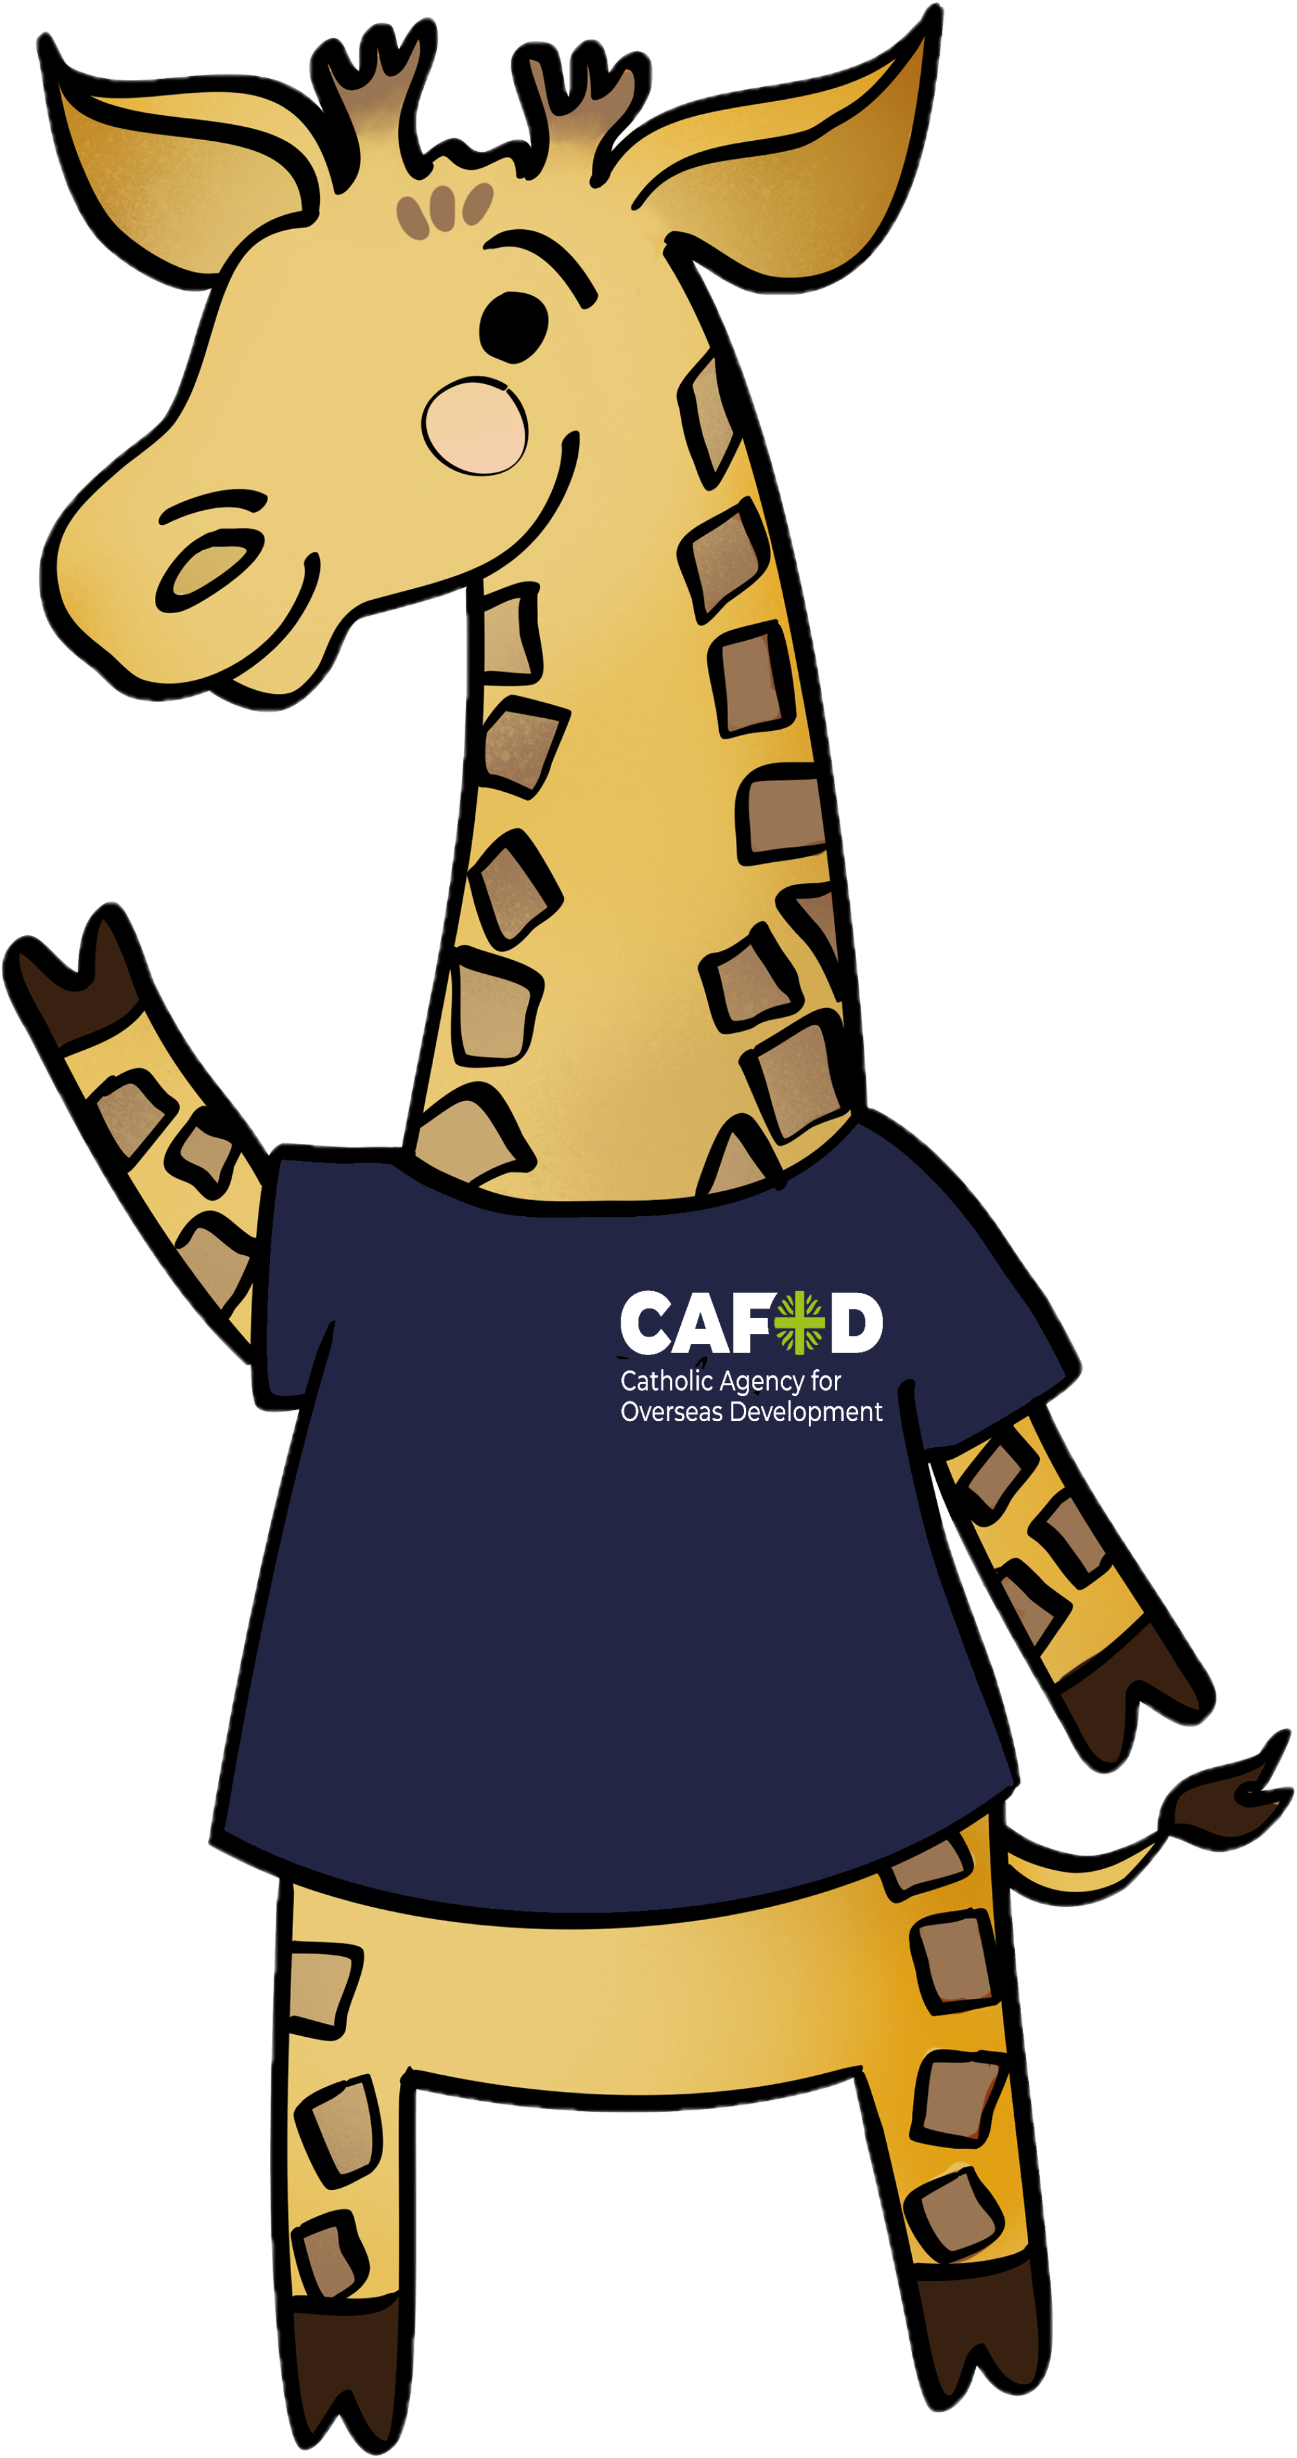

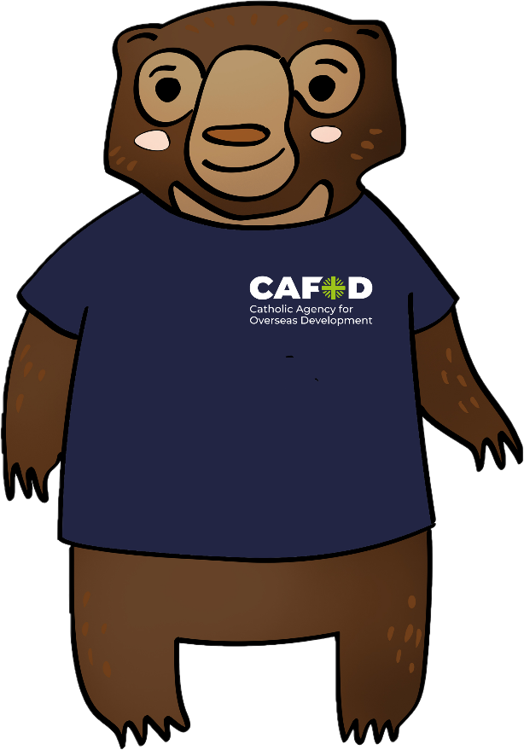
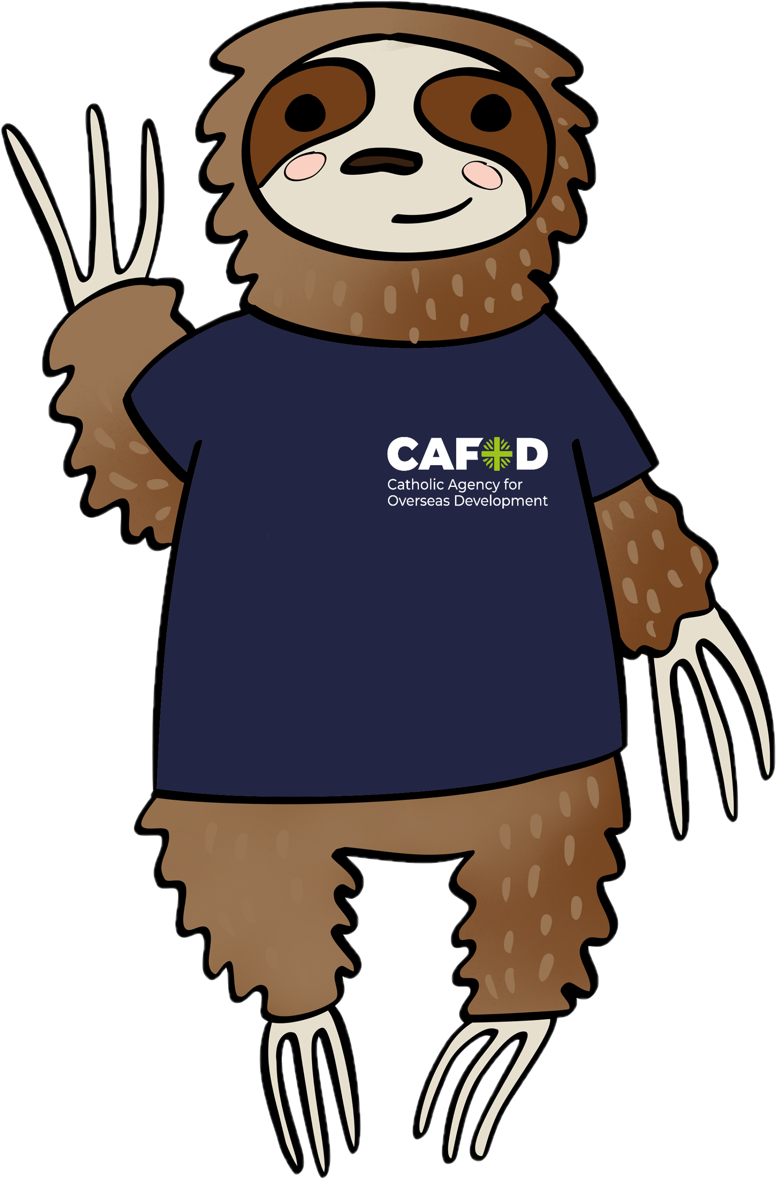


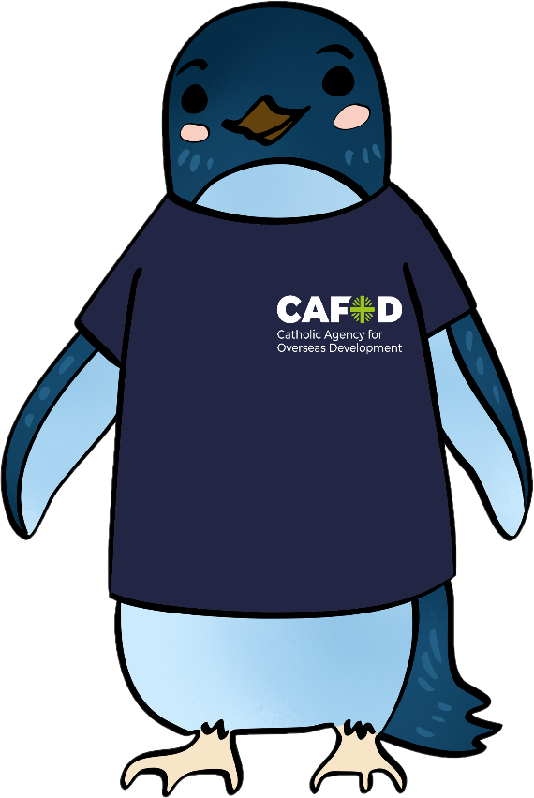
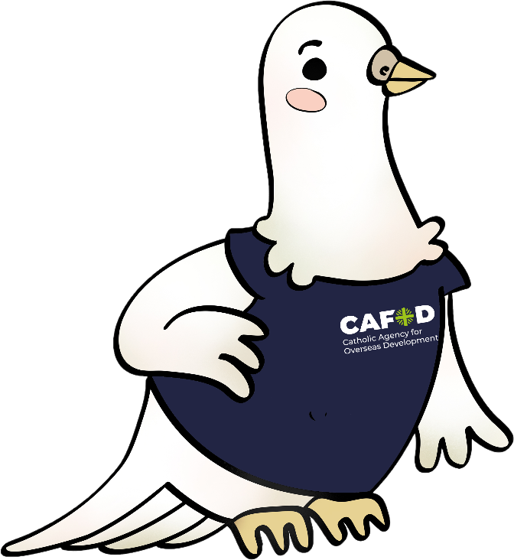
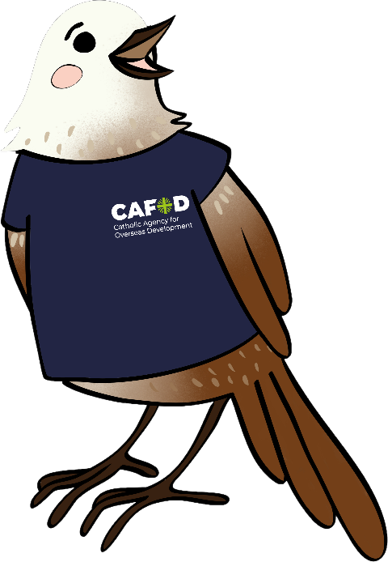
Catholic
Social
Teaching
As Easy as

Slide 2
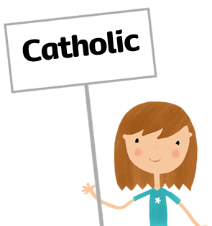


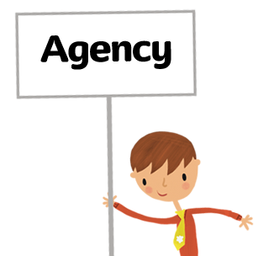


Slide 3







Clean water
Enough food
Safe home
School
Doctor or nurse
Live in peace
Notes:
This means a world where people have clean, safe water to drink. They have enough food to eat every day. Everyone has a safe home, children can go to school, and anyone who is sick can visit a doctor or nurse. One the reasons CAFOD does this work is because of something called Catholic Social Teaching. This is all the things the Catholic Church tells says we should do to make the world a better place where everyone can live life to the full and have everything they need.

Slide 4
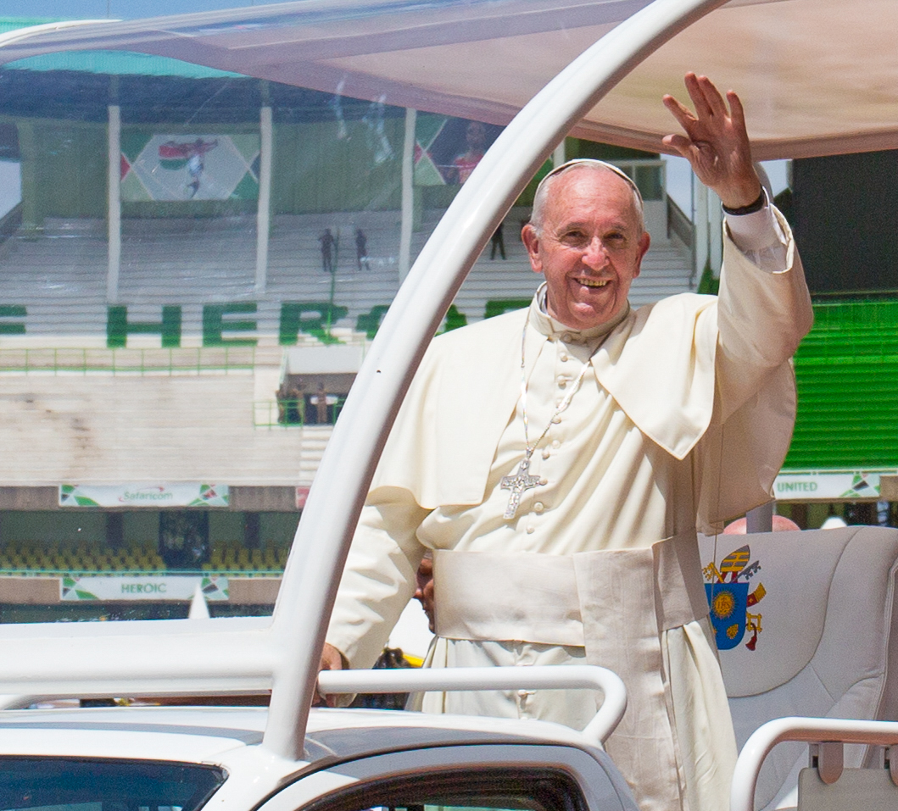
Notes:
Some of Catholic Social teaching is in the Bible, [Hold up a Bible] or is based on things that were said by Saints a long long time ago. But some of it is very new. Do you know who this is? Yes it’s Pope Francis. He has written letters to everyone in the world which explain how we can care for the Earth and for everyone in it. [Hold up large envelope with letter inside]
Photo Credit : David Mutua

Slide 6
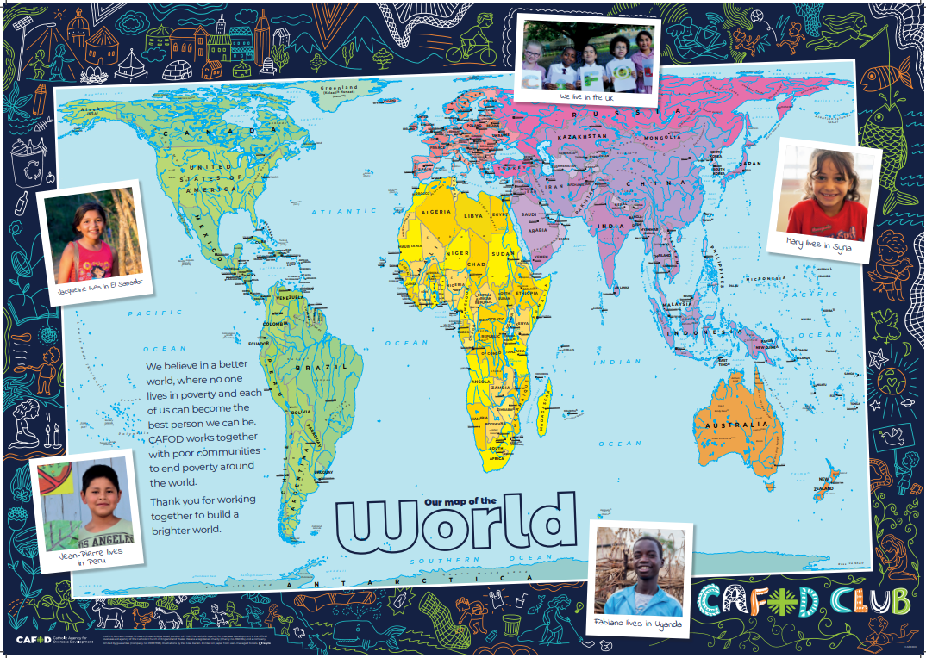
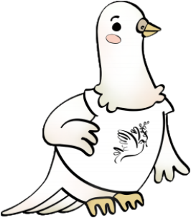

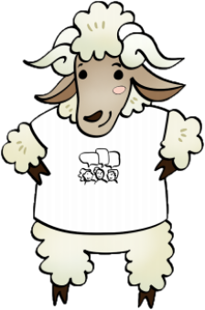
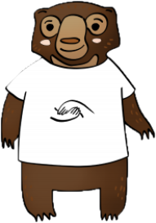

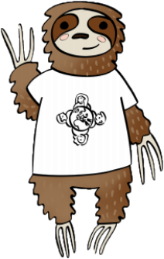

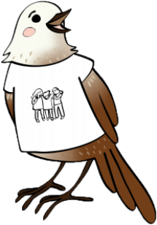
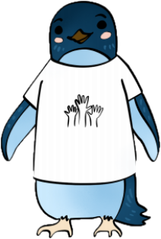
Sofia
the
sloth
Notes:
Sofia is from the continent of South America

Slide 7

Shristi
the
Sun Bear
Notes:
Shristi come from the Asian continent

Slide 8
Patariki
the
penguin
Notes:
Patariki lives on the coldest continent, Antarctica

Slide 9

Notes:
The animals have shown us what each bit of Catholic Social Teaching means. Now we need to show how we can put them into action. Each animal is going to give us one example of how we can do this in school and we are going to see if we can think of more.

Slide 10
Caring for God’s Gifts
(Stewardship)
Caring for the many gifts that God has given to us. These include our environment, our own talents and other resources.
Notes:
Sofia often sleeps in her favourite tree within a National Park forest.
One day big machine waker her up and start chopping down the tress. She joins some of the others who call the forest home, to stop the illegal logging.
She reminds the operators that these trees need to be cared for like the rest of God’s creation.

Slide 11



Slide 12
Showing we care
(Solidarity)
We must recognise others as our brothers and sisters and actively work for their good.
Notes:
Shristi is one of the biggest animals in her neck of the woods. However, she also has the kindest heart.
A fire destroyed part of her forest and many animals lost their homes and were injured and couldn’t live like they used to. Shrisiti was the first to visit them and shared time with them understanding what it was like to lose their home and their lives.
After becoming friends she made sure that they found new homes and are happy with their new lives. Her actions inspired lots of other animals to follow.

Slide 14
Taking Part
(Participation)
We live in community with others, growing together. It is important that we join in.
Notes:
Once every year the penguins come together to celebrate by having a sports festival. Patariki is in charge of making sure that everyone take part, so that they can celebrate their skills and also be part of an event that brings everyone together.
Different breeds of penguins join in, Little Blues, Fjorordland crested and Yellow eyed. They run all sorts of events including sprint races, diving, synchronised swimming, shark racing, sand digging, sailing and fish eating!
Patariki loves it when everyone takes part…there is nothing better than watching a crowd of penguins cheer for everyone and having fun all together. Those who feel they need support are always given the help they need to participate and enjoy themselves.

Slide 15
Caring for God’s Gifts
(Stewardship)
Planting trees and flowers around school

Slide 16
Showing we care
(Solidarity)
Choosing to sit with a friend who can’t play the game because of a bad leg

Slide 17
Taking Part
(Participation)
Everyone tidying the classroom together
Notes:
.

Slide 18
Sharing
Fairly
Promoting Peace
Caring for
God’s Gifts
Showing we care
Everyone is
Special
Thinking of
everyone
Taking
Part
Everyone should have a say
Putting people in most need first

Slide 19
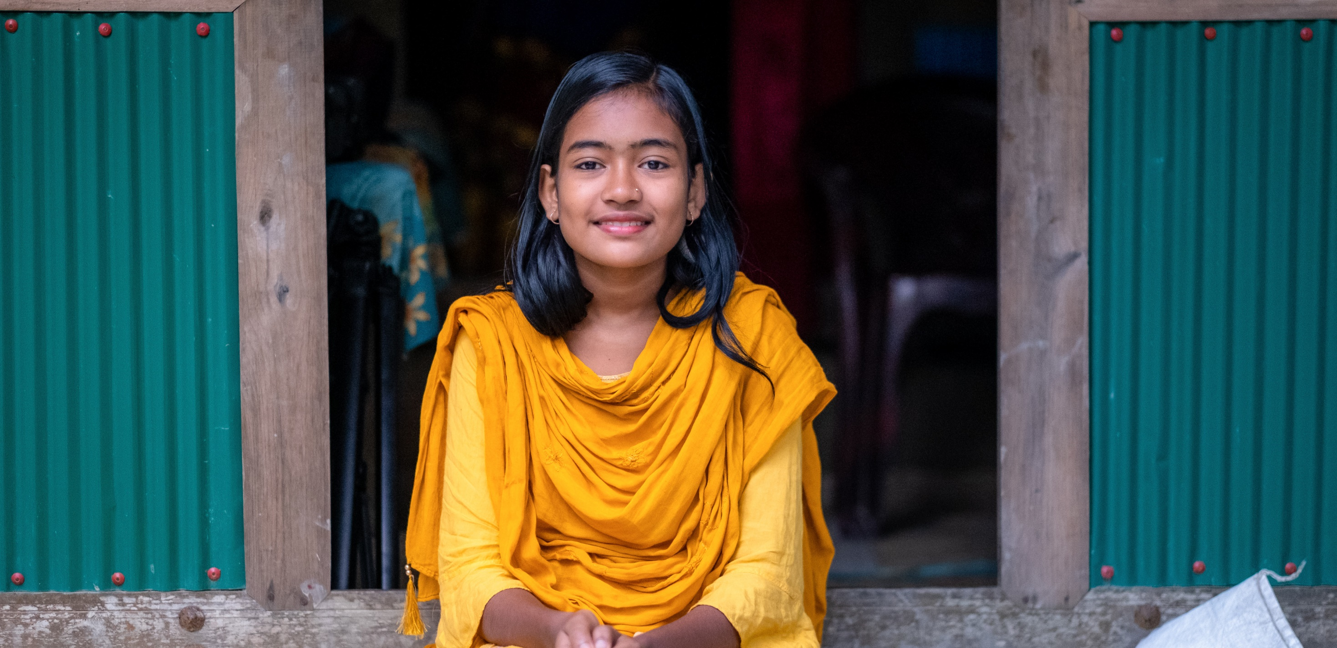
Dristy

Slide 20
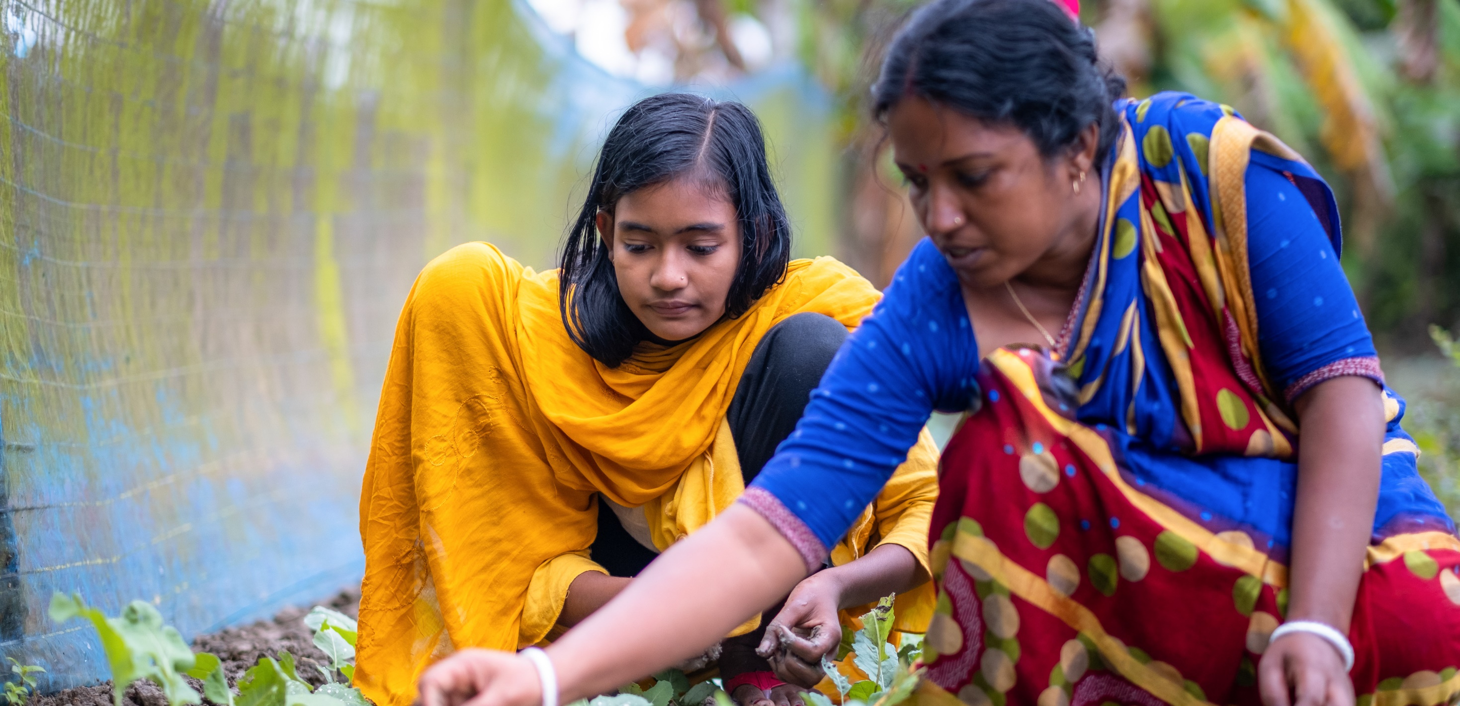
“We grow fruits and vegetables.”

Slide 21
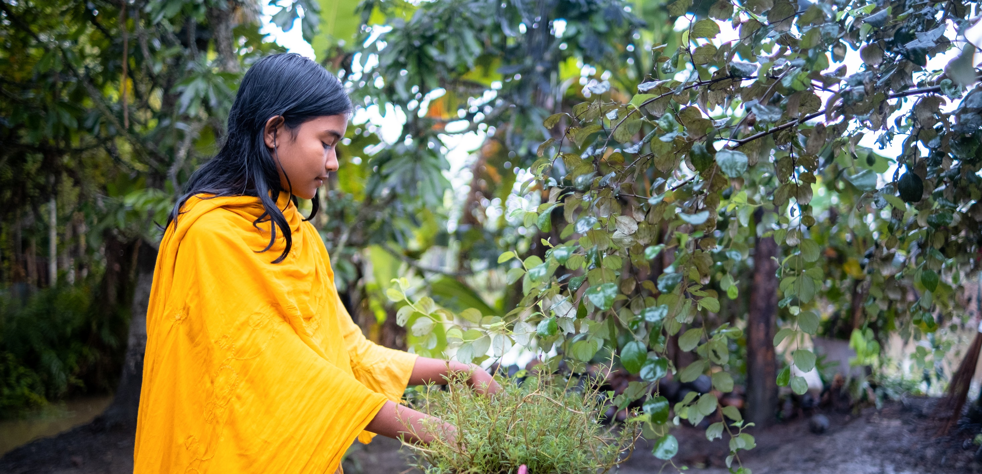

Slide 22
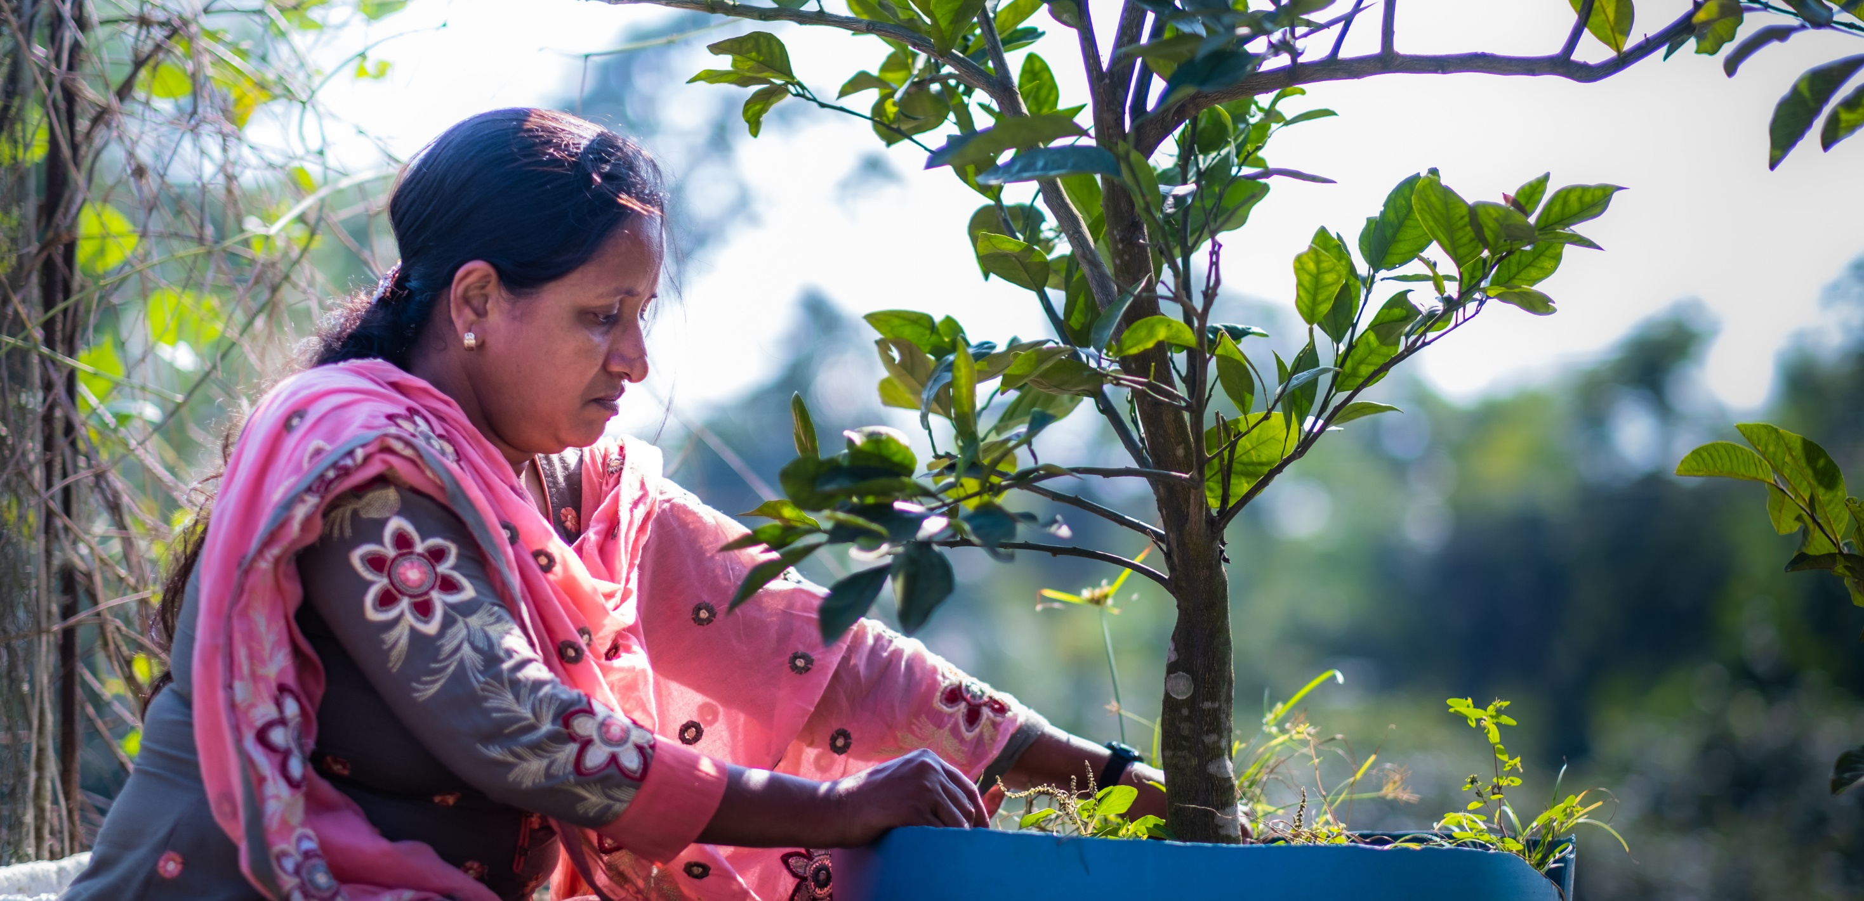
Stewardship

Slide 23
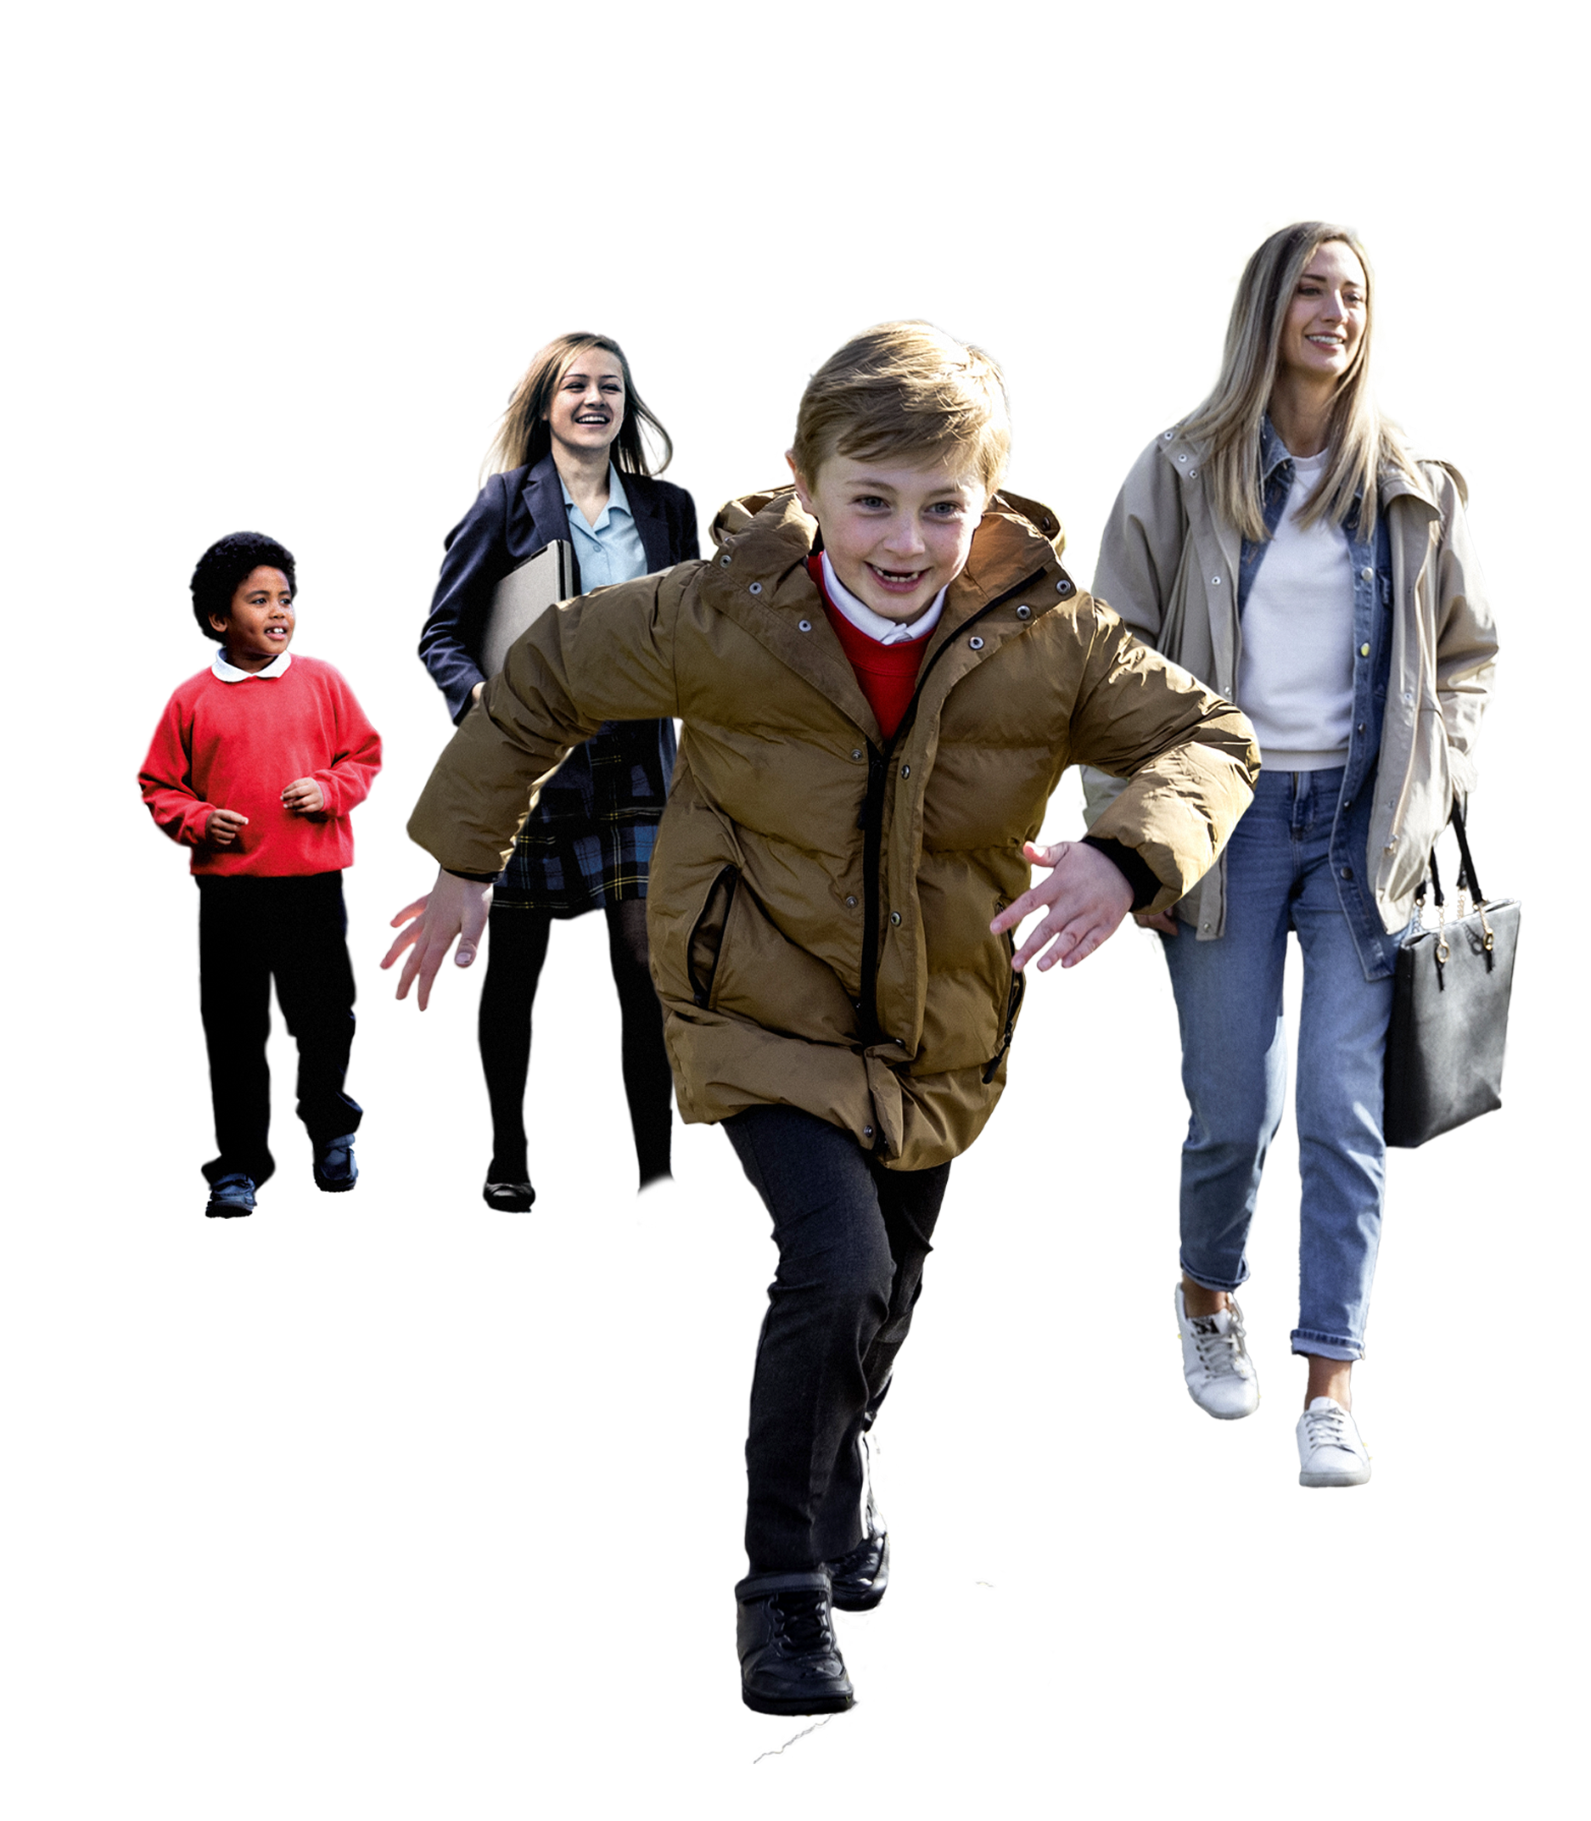

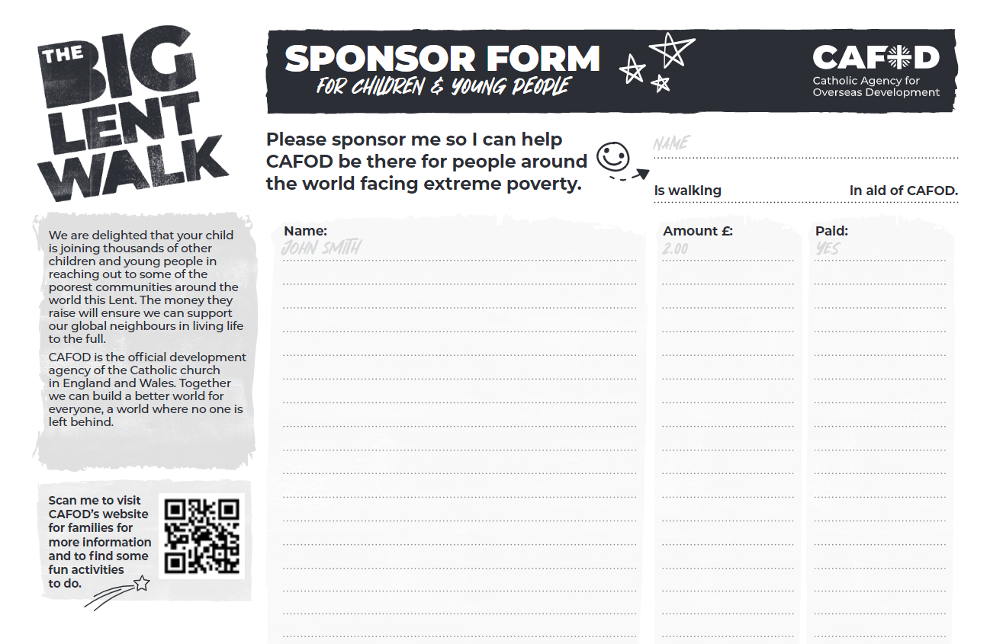

Slide 24



£10 can provide four palm trees to protect land from extreme weather
£26 can help to build raised beds that protect vegetables from floods
£185 can provide a place on a two-week training course on adapting to extreme weather
£300 can help bring essential healthcare services to the remotest communities

Slide 25
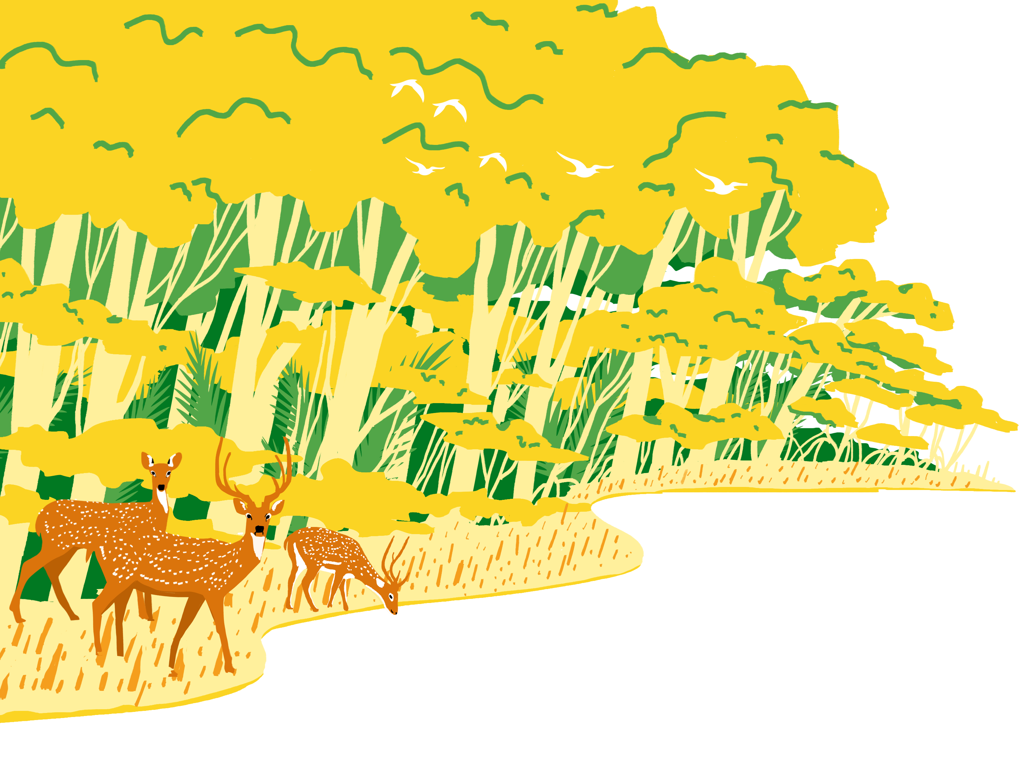
Loving God,
We think of our neighbours, near and far,
who are hardest hit by the climate crisis.
We pray we may share generously all you have given us.
Help us to work together to build a brighter world,
where each of us can be the best person we can be.
Amen.

Slide 26
Thank You
Adapted with permission from resources produced by
Caritas Aotearoa/New Zealand
Illustrations- Fran Denton, Sam Osbourne

