Slide 1
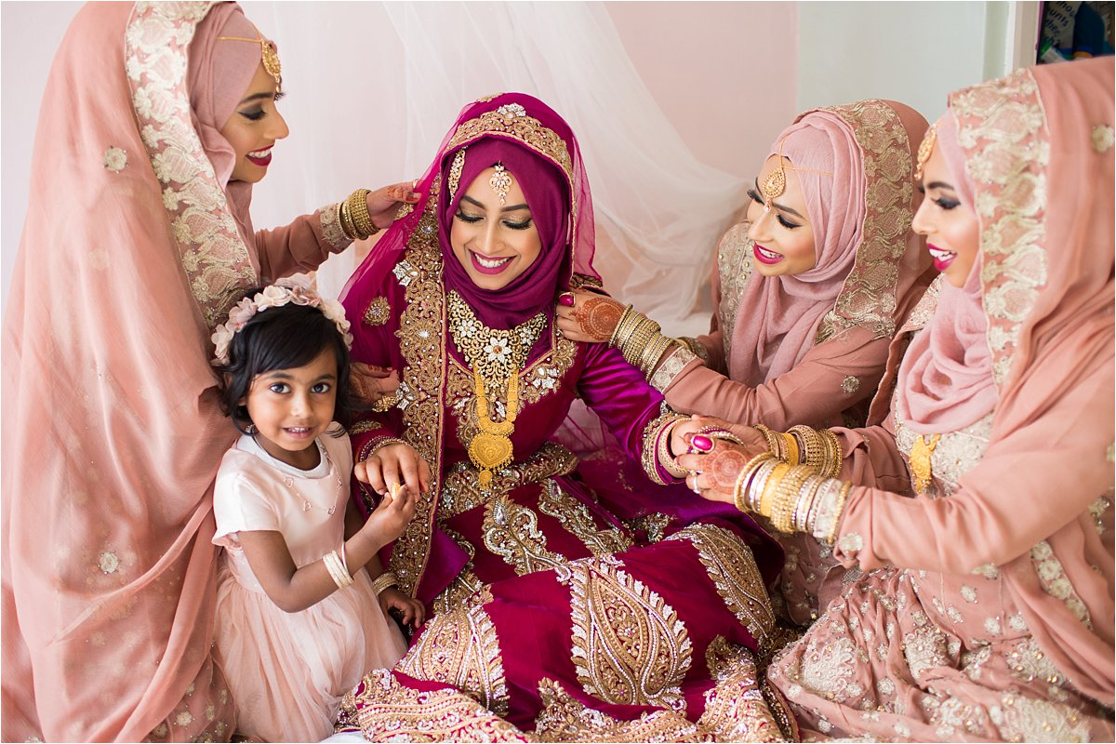
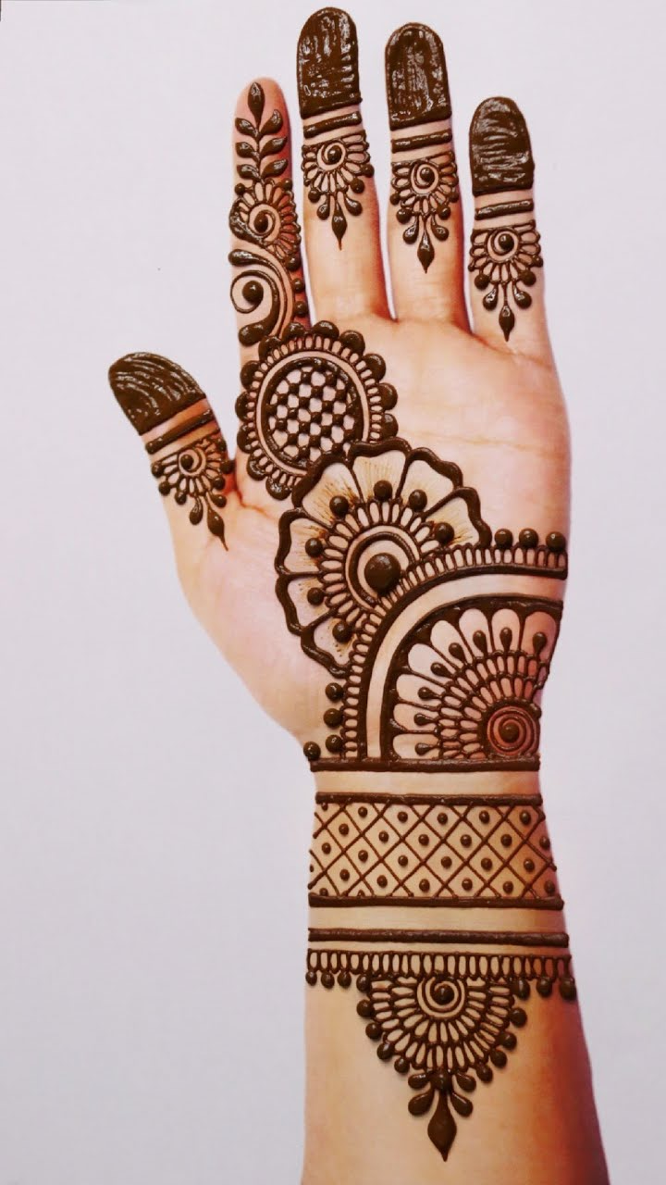
Cheshire West & Chester RE Knowledge Organiser
Islam Year 1
How do Muslims express new beginnings?
What do I already know?
I can explain Yasmin’s beliefs about Allah and can tell you about the Night of Power and Muhammad (PBUH). I can tell you some of the 99 names of Allah.
Key Artefacts and Symbols
Key Vocabulary | Definition
Qur’an | the Islamic sacred book
Wudu | a cleansing ritual or ablution that is an important part of purity and cleanliness in Islam before performing worship.
Creation | the action or process of bringing something into existence.
Shahadah | the Muslim profession of faith (‘there is no god but Allah, and Muhammad is the messenger of Allah’), one of the Five Pillars of Islam.
Wedding | a marriage ceremony
Muhammad | Religious islam leader
What will I know by the end of the unit?
I can tell you that the Qur’an is the sacred text for Muslims and can tell you about how Muslims use special words at the birth of a baby. That for a Muslim, there is one God called Allah and Muhammad (pbuh) was his messenger. I can show empathy with Yasmin and understands why her faith is important to her.
RE Skills to develop
I can talk about a practice from a religion.
I can ask ‘who’, ‘what’ and ‘when’ questions when exploring a religion.
I can see how I can work together with others even if we have differences.
I can show respect and empathy.

