Slide 1

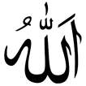
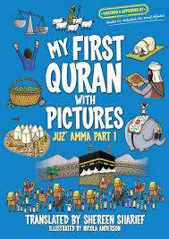

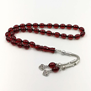
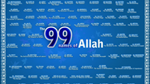



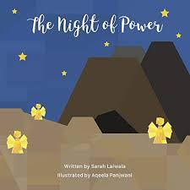
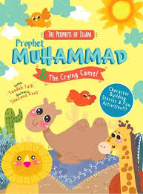
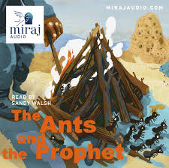
Cheshire West & Chester RE Knowledge Organiser
Islam Year 1
How and why are Allah and Muhammad (pbuh) important to Muslims?
What do I already know?
To belong means to be a part of something like a group or celebration Religion is the belief, faith and worship in the existence of God.
Key Artefacts and Symbols
Key Vocabulary | Definition
5 Fingers | Islam, Muslims, Qur’an, Arabic, Mosque
Allah | Allah is the Arabic word for God – whom Muslims worship,
Islam | The second most popular religion in the world.
Mohammad (pbuh) | The founder of Islam. Muslims say he is a messenger from God and is the last of the prophets.
Muslim | Someone who follows Islam. Muslims believe that there is only one God, Allah.
Prophethood | Muslims believe that Prophets are messengers sent from God, or Allah, to help Muslims follow the straight path.
Qur’an | The Qur’an is a book in the Arabic language that Muslims believe to be the actual words of Allah.
What will I know by the end of the unit?
What is a Muslim? | I can explain the Islam beliefs about Allah. I can tell you about the Night of Power and Muhammad (PBUH). I can tell you some of the 99 names of Allah.
Who was Muhammad? What happened to Muhammad on the Night of Power? | A religious leader important to Muslims was a man who was a prophet called Muhammad. Muslims follow Allah but they learn a lot about how to be a better Muslim from Muhammad. Muslims have a special book called the Qur’an
Who is Allah? | Muslims don’t draw God (Allah) or Muhammad because they are so special and perfect
How do Muslims describe Allah? | He is wise He has lots of names
What are some of the 99 names? | Inside a set of Muslim Prayer Beads, these are the 99 names of Allah and the prayer beads are called Subhas.
Key Stories
RE Skills to develop
I can retell a religious story using prompts and know that it is from a sacred text and is special to some people.
I can recognise some religious symbols and words
I can ask questions about me, and who I am, showing awe and wonder.
I can ask puzzling questions about Creation and God.

