Slide 1
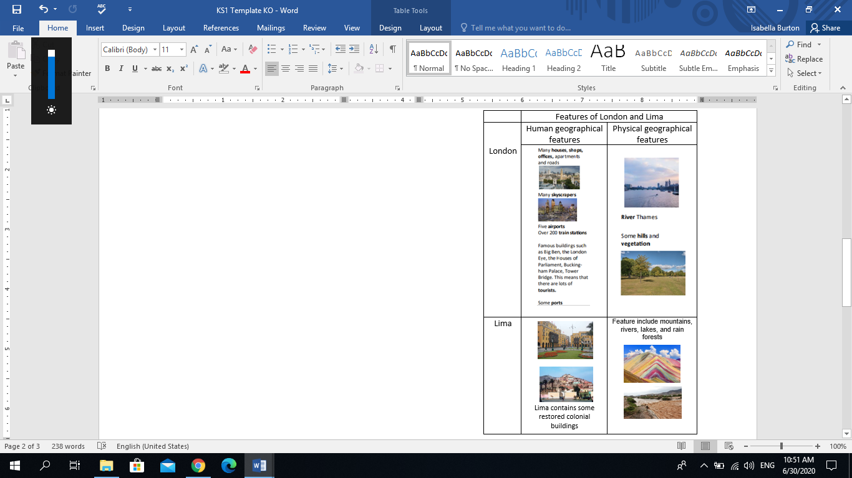
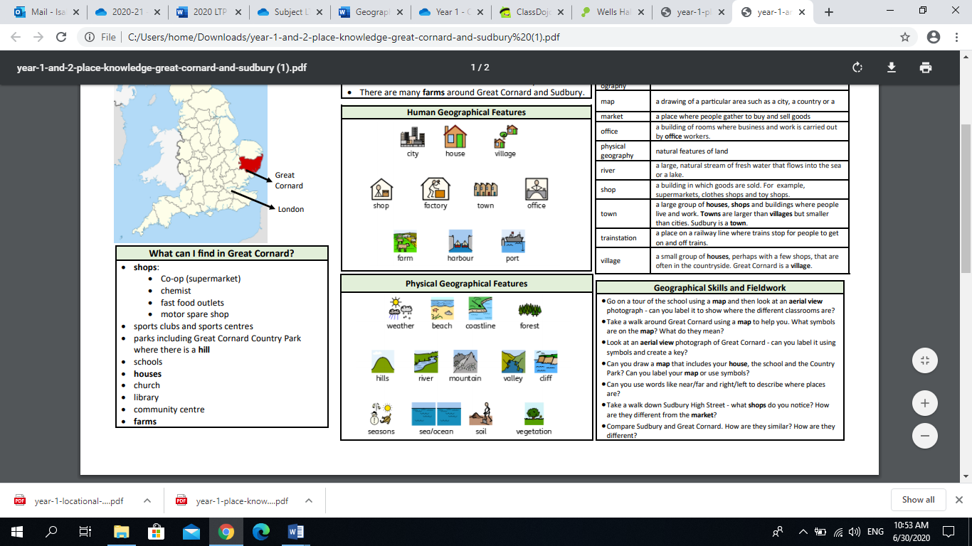
Over Hall Primary School - Geography
Topic: London and Lima | Year: 1 | Strand: Human and Physical Geography
What should I already know?
The town I live in is called Winsford. Winsford is in England, which is a country.
Vocabulary
Capital city | The city where the government sits. London is the capital city of England and the UK.
River | A large, natural stream of fresh water that flows into the sea or lake.
Skyscrapers | A very tall building with many floors.
Tourist | A person who is visiting a place for pleasure and interest, especially when they are on holiday.
Train station | A place on a railway line where trains stop for people to get on and off trains.
Airport | A place where aeroplanes land and take off.
Office | A set of rooms used for work.
Apartment | A living space usually in a tall building.
Vegetation belt | Plant life as a whole within a certain area.
River | A large natural stream of water flowing into the sea.
Lake | A large area of water surrounded by land.
Mountains | Higher and steeper than a hill.
Rain forest | A forest, found typically in tropical areas with heavy rainfall.
What will I know by the end of this unit?
Human and physical features of London and Lima Similarities between London and Lima Differences between London and Lima Understand the different weather patterns in London and Lima and how this can affect plant growth
Geographical Skills and Fieldwork
Use a map to find London and Lima Use aerial photographs to compare London and Lima to discuss what is the same and what is different in both cities

Slide 2
1. London and Lima are similar because… | Start of unit | End of unit
They both have rivers
They are both capital cities
They both have airports
All of the above
2. Some famous London landmarks include…. | Start of unit | End of unit
Tower Bridge
Asda
Big Ben
Buckingham Palace
Larco Museum
3. I can use a ____ to find where London and Lima are. | Start of unit | End of unit
Telescope
Television
Compass
Map
4. Match these rivers to where they belong.
Start of unit | End of unit
London Rimac River River Thames Lima | London Rimac River River Thames Lima
5. London and Lima are different because… | Start of unit | End of unit
London does not have mountains
Lima does not have a train station
Tourists do not visit London
All of the above

