Slide 1

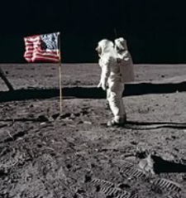
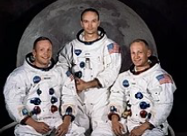
Year 1 History Knowledge Organiser
Space
What should I already know?
Things happened before I was born. That space exists and that we are able to travel there. Rockets can be used to travel into space. Life is different now to how it was many years ago. What the moon is.
What will I know by the end of the unit?
Before the Apollo 11 flight mission, people had been in space as part of the Space Race but had not yet been to the moon. On July 16th 1969, Saturn 5, was launched. There were three American astronauts on board; Neil Armstrong, Buzz Aldrin and Michael Collins. It took four days to reach the moon. Neil Armstrong was the first man on the moon - 19 minutes after Buzz Aldrin joined him. They gathered moon dirt and rocks to bring back to Earth; they also took photographs to show what the moon was like. The moon landing was important because it told us that people could travel there and back safely. It would also help us find out more about space and the moon.
Vocabulary
after | Later in time than, or behind in order
astronaut | A person trained to take part in space flight
before | At an earlier time; in the past
famous | Recognized or liked by the public
Flight | An act of passing through air or space by flying
gather | Collect things together
history | Everything that has happened in the past to people or things
launch | To put in motion
space | The area that contains the entire universe beyond the earth
tourist | A person who is visiting a place for pleasure and interest
travel | When you go from one place to another, often to a place that is far away
Key Dates
1969 Saturn 5 was launched 1972 Sir Tim Peake was born
Historical Skills
Place key events in the history of space travel on a timeline. Compare this timeline to the timeline of your family - where do key events in your family’s life cross over with key events in space travel? Choose two astronauts to compare. Where are they from? What were their achievements? What are their similarities and differences? Explain what caused the 1969 Moon Landing. Explain what effects the 1969 Moon Landing had on history. Use words such as before, after, past, present, then and now to describe the history of space travel.

Slide 2
Year 1 History Mini Assessment- Space
Question 1 | Start of unit: | End of unit:
The first man went in to space …………. you were born
before
after
Question 3 | Start of unit: | End of unit:
Place these things in the order in which they happened. Use the numbers 1-3.
Neil Armstrong was born.
You were born.
Neil Armstrong became the first man on the moon.
Question 2 | Start of unit: | End of unit:
Things that happen in the past are part of:
The future
The present
history
now
Question 4 Write one fact about the 1969 Moon landing.
Start of unit ___________________________________________________________________________________ ___________________________________________________________________________________
End of unit ______________________________________________________________________________________________________________________________________________________________________________________________

