Slide 1
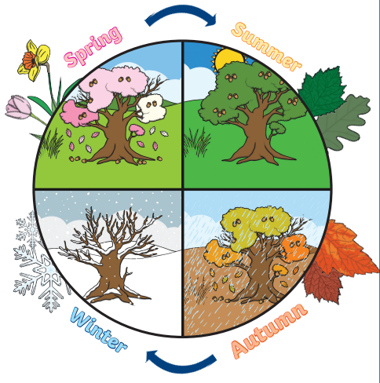
Over Hall Primary School - Geography
Topic: Seasonal Patterns | Year: 1 | Strand: Human and Physical Geography
What should I already know?
That there are four seasons. How the seasons affect the world around you. What changing seasons looks like.
Vocabulary
Season | The four different times during the year with different types of weather
Spring | The season when cold winter temperatures gradually rise to the warmth of summer
Summer | Summer is the warmest season of the year. It falls between spring and autumn
Autumn | Autumn is the season when warm summer temperatures gradually decrease to the cold of winter.
Winter | Winter is the coldest season of the year. It falls between autumn and spring.
Environment | Everything that is around us
Equator | An imaginary line around the Earth that goes exactly midway between the North Pole and the South Pole and divides it into two equal halves
Desert | A place that has very little rainfall
United Kingdom | It is made up of four parts: England, Scotland, Wales, and Northern Ireland.
What will I know by the end of this unit?
How weather conditions change throughout the year That counties are hotter if they are close to the equator That countries are colder if they are far away from the equator The different features of Summer are sun, warm weather, more daylight hours The different features of Autumn leaves change colour, colder weather, windy, less daylight hours. Where the UK is on a map
Geographical Skills and Fieldwork
Use globes to identify the United Kingdom Use simple compass directions (North, South, East and West) and locational and directional language [i.e. near and far; left and right], to describe the location of features and routes on a map

Slide 2
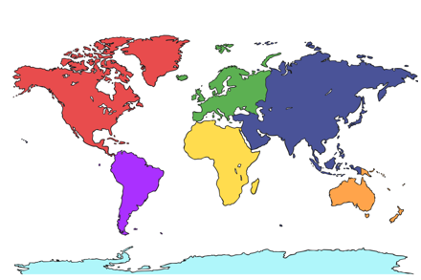
1. Tick all of the boxes that are features of Summer. | Start of unit | End of unit
Sunny weather
Warm weather
Long days
Leaves turn brown
2. Tick all of the boxes that are features of Winter. | Start of unit | End of unit
Cold temperatures
Snow
Lots of flowers start to grow
Short days
3. If a country is close to the equator it is… | Start of unit | End of unit
Warm
Cold
4. Can you draw an arrow to the UK?
Start of unit | End of unit

