Slide 1
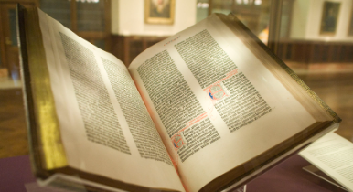
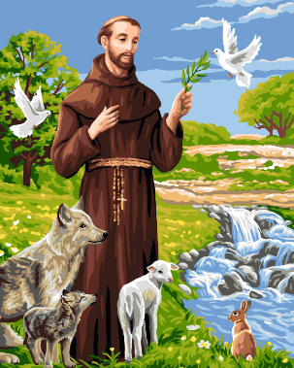
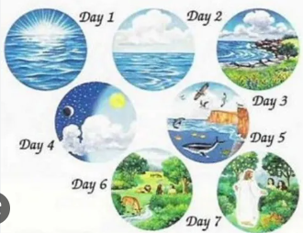
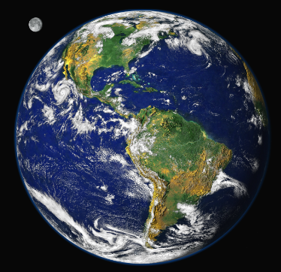
Over Hall Community School – Religious Education
Religion: Christianity | Phase: Year 1 | BIG Question: What do we think about how the world was made and how we should look after it?
What do I already know?
Religion is the belief, faith and worship in the existence of God. The Bible is the Christians Holy Book.
Religious Symbols
Skills and Enquiry Steps
I can retell a religious story using prompts and know that it is from a sacred text and is special to some people. I have started to share my opinions and say what is important to myself and to others. I can ask questions about me, and who I am, showing awe and wonder. I can ask puzzling questions about Creation and God.
Useful Links
The Creation Story https://www.learnreligions.com/the-creation-story-700209 https://www.bbc.co.uk/bitesize/guides/zv2fgwx/revision/10#:~:text=Put%20simply%2C%20the%20theory%20states,and%20continues%20to%20this%20day. https://www.ducksters.com/history/middle_ages/saint_francis_of_assisi.php
Books / Linked Text

Slide 2
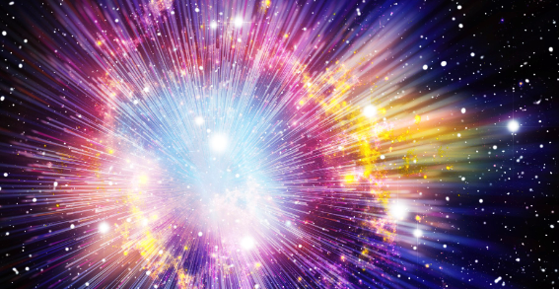
Over Hall Community School – Religious Education
Religion: Christianity | Phase: Year 1 | BIG Question: What do we think about how the world was made and how we should look after it?
What will I know by the end of the unit?
What does the Bible say about how the world was created? | Genesis is the first book in the bible The book of Genesis describes how God created heaven and earth, plants, animals, and people called The Creation Story -On the first day, God created light and dark. He separated the light from the dark and called the light ‘day’ and the dark ‘night’. -On the second day, God created the sky. He used the sky to separate the water. -On the third day, God created land. He gathered the water together to create the seas. The dry land was named “earth”. He also created trees and plants. -On the fourth day, God created the Sun, the Moon and the stars, to separate the light from the darkness. -On the fifth day, God created living creatures for the sky and sea. -On the sixth day, God created many different animals. He also created human beings in his image. He gave humans the responsibility of looking after all the animals. -God looked at all he had created and was pleased. On the seventh day, he rested. God blessed the seventh day and made it a holy day.
What other views are there about how the world began? | Some Christians hold the view that God was responsible for the Big Bang. The Big Bang was a massive heat explosion which led to how everything was made, including the stars, the planets, and everything that lives on those planets, like us! For a Humanist or people that are non-religious, God has never existed so they would talk about the Big Bang if they were asked how the world was made.
How did St Francis care for creation? | St Francis taught people to look after the world around them, especially animals.
Key Vocabulary and Concepts
Natural | From nature, not made or caused by people
Manmade | Made or caused by human beings
Landscape | An area of land
Bible | Christians holy book
Genesis | The first book of the bible
Creation | The making of the world by God
The Big Bang | A massive heat explosion that started the universe 13.7 billion years ago
Humanist | Humanists do not believe in a god. They believe it is possible to live a good and fulfilling life without following a traditional religion. They do not follow a holy book either. Instead, Humanists value traits like reason and rely on science to explain the way things are.
St Francis | Saint Francis of Assisi was a Catholic friar who gave up a life of wealth to live a life of poverty.

