Slide 1

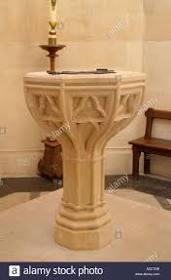
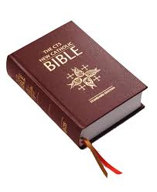
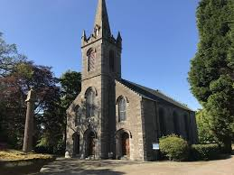
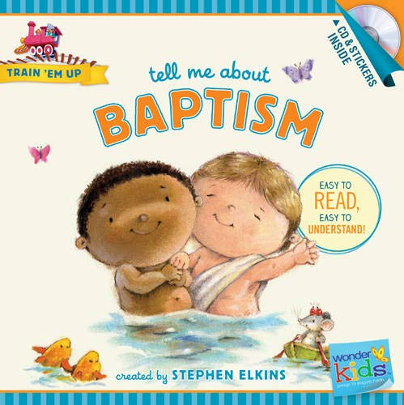
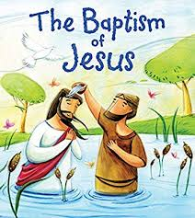

Cheshire West & Chester RE Knowledge Organiser
Christianity Year 1
What does it mean to belong?
What do I already know?
-The Christians believe in God and I have explored my views about God -That Jesus is a special person for Christians and can tell you about his birth -That the church is a special place for Christians where they can worship and there are people there who have special roles -Can tell you about special events including Christmas and Easter -The Bible is a special book for Christians -Can talk about values including care of one another, friendships, love, care of animals and environment and respect for all -What happens inside a church? -Why is water used at a Baptism? -What does it mean to belong to a church family who care for each other?
Key Artefacts and Symbols
Key Vocabulary | Definition
Belong | To be part of something like a group or celebration.
Similarities | Things we share that are the same
Differences | Aspects that are different
Church | A sacred place where Christian attend to worship, pray and get closer to God, also known as a chapel or cathedral
God | A supreme being
Special | A kind of different from others or other things
Baptism | The Christian rite of initiation, involving immersion in water or sprinkiling with water
Unique | Unusual, special
What will I know by the end of the unit?
How am I special? Why do Christians believe that people are special? | Some Christians believe that everyone is important/special to God. You can name ways that you are special.
What does it mean to belong? | Discuss the idea that many of the groups that we belong to often have a symbol
What different religions are there in the world? Which of the symbols are associated with Christianity? | Recognise that different religions might do or wear certain things to show that they belong. Name some examples such as wear a cross or fish badge to show they belong to a church
What symbols can I see in a baby’s baptism? | A font is used to hold baptisms. The cross that is made on a baby's head in the context of welcoming a child into the family of God in the church. I can talk about what a baptismal candle might symbolise.
How was Jesus baptised? | Recall key events from the story John the Baptist with links to Jesus.
Why do some adults choose to be baptised? What is special about belonging? | Explain very simply what happens during baptism and how the water symbolises a new start. I can recognise ways that belonging to a religion is special.
Key Stories
RE Skills to develop
I can talk about a practice from a religion.
I can talk about my own experiences and can link these to the communities to which I belong.
I can ask questions about me, and who I am, showing awe and wonder.
Useful links
http://www.primaryhomeworkhelp.co.uk/religion/christian.htm
http://www.primaryhomeworkhelp.co.uk/religion/islam.htm
http://www.bbc.co.uk/religion/religions/christianity/beliefs/basics_1.shtml
https://www.bbc.co.uk/education/clips/zr34wmn

