Slide 1

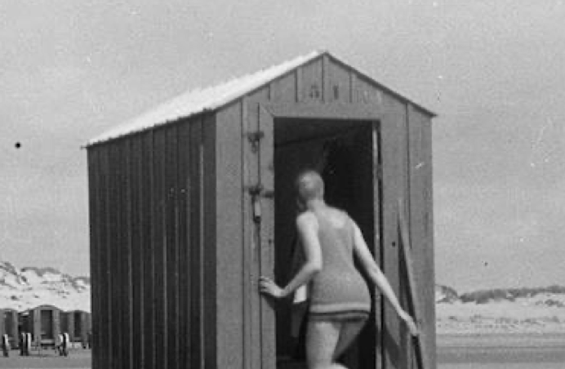
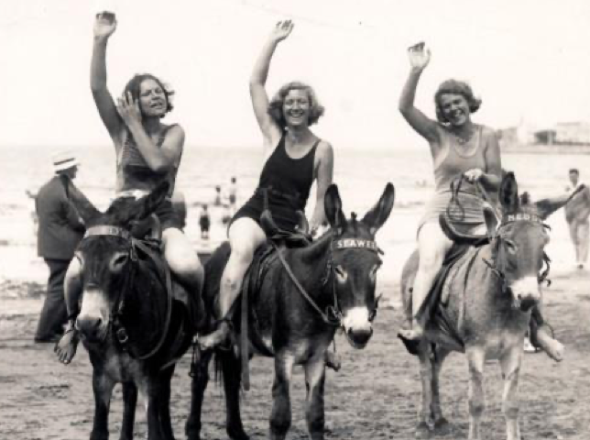
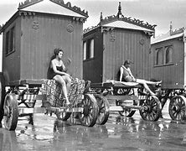
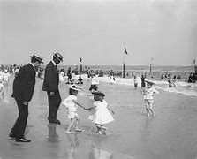
Year 1 History Knowledge Organiser
Now and then- Beaches
What should I already know?
Some knowledge of beaches and what they are like. Why people go to the beach now. What people do at the beach now. Things happened before I was born. Some knowledge about how to travel to the beach. Life is different now to how it was when my grandparents were children.
What will I know by the end of this unit?
There are differences between seaside holidays 100 years ago, 50 years ago and today e.g. different clothes and different entertainment. People got changed in special bathing machines. Some things are the same as today – children played with fishing nets, buckets and spades, ate ice-cream and watched Punch and Judy like today. We can find out about seaside holidays in the past from a range of sources including: photographs, film recordings, postcards, letters, diaries, paintings, books and first- hand accounts (talking to people). In Victorian times most people travelled by train to the seaside because during this time the railways expanded (grew) and went to more places. That people used to send postcards about their trips
Key Date
1840-Seasides officially became popular holiday destinations
Vocabulary
Lighthouse | A tower or other structure containing a beacon light to warn or guide ships at sea.
Harbour | a place on the coast where ships may moor in shelter.
Promenade | A paved public walk, typically one along the seafront at a resort.
Bathing machine | A wheeled hut drawn to the edge of the sea, used for changing in and bathing from.
Beach | A pebbly or sandy shore
Bay | An area of the sea that curves inwards.
Pier | A platform on pillars projecting from the shore into the sea, typically incorporating entertainment arcades and places to eat.
Amusements | An area with rides, games and other entertainments.
Tourist | A person who is visiting a place for pleasure and interest
Holiday | A period of leisure and recreation, one spent away from home or in travelling.
Historical Skills
I can put pictures, artefacts or events in chronological (time) order. I can use words and phrases such as old, new, a long time ago, before and after to describe the past. I can use stories to ask and answer questions about the past.

Slide 2
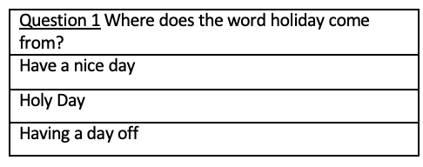
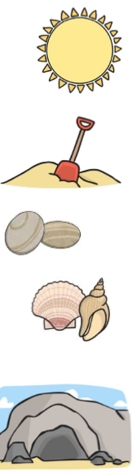
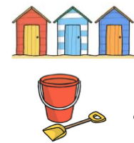
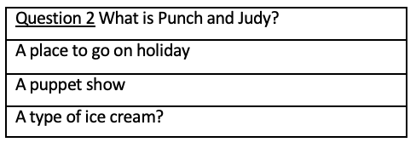

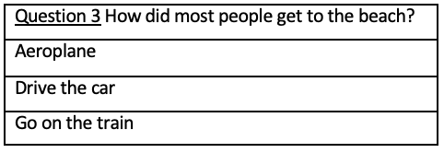

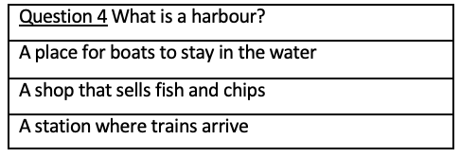
Year 1 History Mini Assessment
Now and then- Beaches
Describe a day at the beach during the Victorian period. What would you take and what would you do?
________________________________________________________________________________________________________________________________________________________________________________________________________________________________________________________________________________________________________________________________________________________________________________________________________

