Slide 1
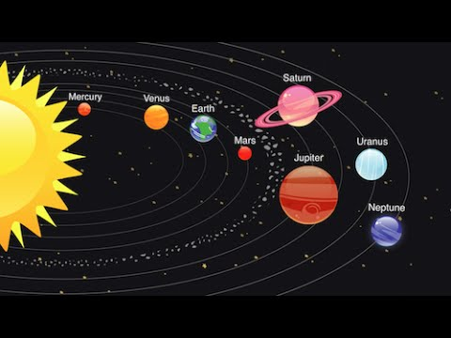

Year 5
Space
Science
Earth and Space
Describe the movement of the Earth and other planets relative to the sun in the solar system
Describe the movement of the moon relative to the Earth
Describe the sun, Earth and moon as approximately spherical bodies
Use the idea of the Earth’s rotation to explain day and night and the apparent movement of the sun across the sky
Vocabulary
Asteroid | A small rocky body orbiting the sun.
Axis | An imaginary line about which a body rotates.
Celestial | Positioned in or relating to the sky, or outer space as observed in the astronomy.
Day | A twenty-four hour period, from one midnight to the next, corresponding to a rotation of the earth on its axis.
Dwarf Planet | A celestial body resembling a small planet but lacking certain technical criteria to be classed as a planet e.g. Pluto.
Moon | A natural satellite of any planet.
Night | The period from sunset to sunrise in each twenty-four hours
Orbit | The regularly repeated oval course of a celestial object around a star or planet.
Planet | A celestial body moving in orbit round a star.
Rotation | The action of rotating about an axis or centre.
Solar System | The collection of eight planets and their moons in orbit round the sun.
Star | A fixed luminous point in the night sky which is a large, remote body like the sun.
Sun | The star round which planets orbit.
Art and Design
Digital Media
1. Record, collect and store visual information using digital cameras, video recorders
2. Present recorded visual images using software
3. Use a graphics package to create and manipulate new images
4. Be able to import an image (scanned, retrieved, taken) into a graphics package
5. Understand that a digital image is created by layering
6. Create layered images from original ideas (sketch books etc.)

Slide 2
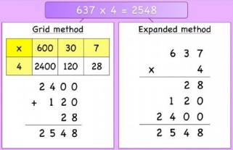
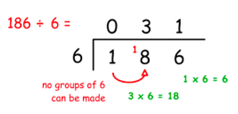
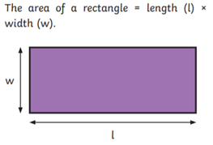
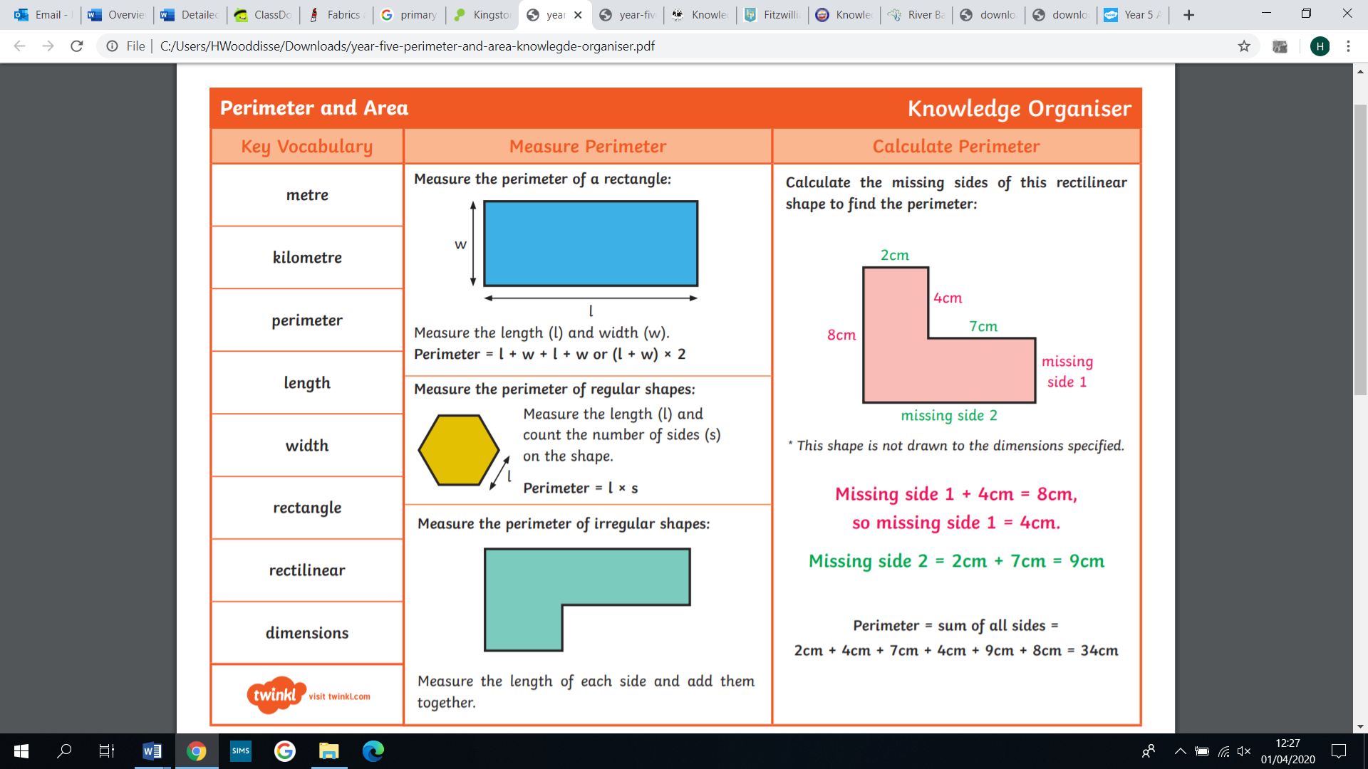
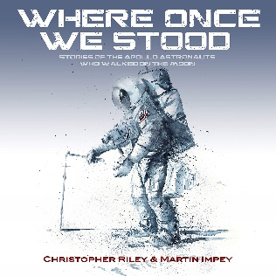
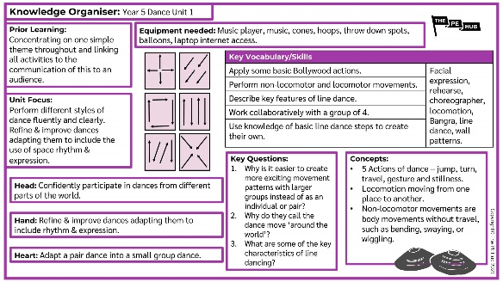
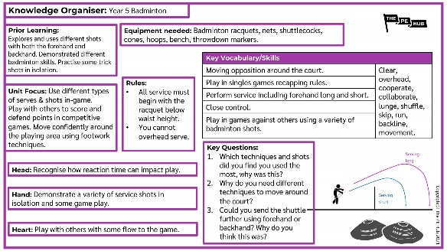
Maths
Multiplication, Division, Perimeter and Area
•Identify multiples and factors, including finding all factor pairs of a number, and common factors of two numbers.
•Know and use the vocabulary of prime numbers, prime factors and composite (non-prime) numbers.
•Multiply numbers up to 4 digits by a one- or two-digit number using a formal written method, including long multiplication for two-digit numbers.
•Divide numbers up to 4 digits by a one-digit number using the formal written method of short division and interpret remainders appropriately for the context.
•Multiply and divide whole numbers and those involving decimals by 10, 100 and 1,000.
•Recognise and use square numbers and cube numbers, and the notation for squared (2) and cubed (3).
•Measure and calculate the perimeter of composite rectilinear shapes in centimetres and metres.
•Calculate and compare the area of rectangles (including squares) including using standard units, square centimetres (cm2) and square metres (m2) and estimate the area of irregular shapes.
Key Vocabulary
Multiplication and Division
Multiplication, multiply, multiple, factor, groups of, times, product, repeated addition, division, divide, remainder, grouping, sharing, array, row, column, inverse square, squared, cube, cubed.
Perimeter and Area
Metre, kilometre, perimeter, length, width, rectangle, rectilinear, dimensions.
English
Exploration Narrative: Write a first-person Exploration Narrative.
Report: Write a formal report about a space mission.
SPaG Glossary
Adverb: A word that describes a verb, usually ending in –ly. For example, she ran quickly.
Apostrophe: ( ‘ ) An apostrophe is a mark used to show that a letter has been left out.
Example: he is can be written he’s. Apostrophes are also used to show ownership.
Examples: the cat’s bowl, the cats’ bowls.
Clause: A distinct part of a sentence including a verb. A main clause makes sense on its own.
A subordinate clause adds detail to the main clause but does not make sense on its own.
Compound sentence: A sentence consisting of two main clauses joined by a connective.
Complex sentence: A sentence consisting of a main clauses and one or more subordinate clause.
Dialogue: Speech between two or more people.
Ellipsis: … Used to create suspense or to show omission.
Embedded clauses: Adding extra information into the middle of a sentence using commas e.g. The man, who is tall, ran down the road.
Metaphor: A direct comparison without the use of like or as e.g. the clouds were cotton wool in the sky.
Personification: Giving human qualities to non-human objects e.g. the leaves danced in the wind.
Phrase: Two or more words that act as a unit and do not have a verb e.g. over the bridge.
Speech marks: Punctuation marks that go around the words that are actually spoken in a piece of writing “ “
PE
Dance/ Badminton

