Slide 1
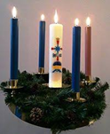
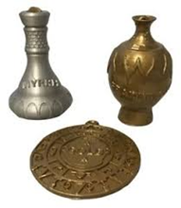
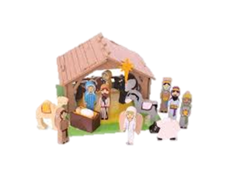

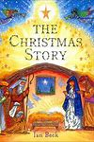
Over Hall Community School – Religious Education
Religion: Christianity | Year: 1 | BIG Question: Why is Christmas celebrated by Christians?
What do I already know?
Key Vocabulary
Nativity | A picture, carving, or model representing Jesus Christ's birth.
Gold | Gold is a precious metal and as such was a very valuable commodity.
Frankincense | Frankincense is a white resin or gum Frankincense was often used in worship, in the burning of incense, by the priests.
Myrrh | Myrrh is a spice which was commonly used in ancient times. It is made from sweet smelling sap which is obtained from several species of tree. The trees are found in parts of Africa and the Middle East, including Yemen and Ethiopia.
Angel | Angels are powerful, smart spirits that obey God's commands and praise him with singing. They sometimes appear to humans in human form
Religious Symbols/ Objects
Enquiry Steps
What is meant by the idea of something 'precious'? What happened before and after the birth of Jesus? What was special about the gifts that were given to Jesus? Which parts of the Christmas story are still good news for Christians today Why do Christians believe that Jesus was a gift from God? Can you discuss how the school nativity is different or similar to your understanding of the Christmas story?
Useful Websites
What will I know by the end of this unit?
Books / Linked Text

Slide 2
Over Hall Community School – Religious Education
Religion: Christianity | Year: 1 | BIG Question: Why is Christmas celebrated by Christians?
Which of these …… | Start of Unit | End of Unit
Which of these …… | Start of Unit | End of Unit
What have I enjoyed the most about this unit of work?
Which of these …… | Start of Unit | End of Unit
Which of these …… | Start of Unit | End of Unit
Which of these …… | Start of Unit | End of Unit
Which of these …… | Start of Unit | End of Unit

