Slide 1

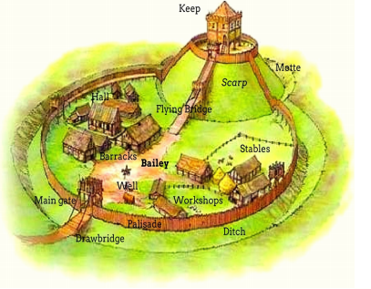
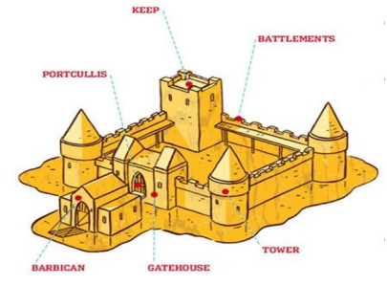
Year 1
Beeston Castle- Local History
What should I already know?
Basic knowledge of different fairy tales, being introduced to castles as story settings. Some features of a castle.
What will I know by the end of the unit?
A castle is a type of home that was built to protect the rich people inside. A long time ago, Kings and Lords lived in castles with their families. They were rich people who had lots of money. Castles were built to protect the rich people inside. Castles were often built on hilltops and by water to make them easier to defend. There were lots of jobs for people who lived in the castle. Castles had lots of protective features
Vocabulary
Battlements | A part at the top of a wall, of a castle, that has regularly spaced squared openings for shooting through.
Drawbridge | A type of movable bridge at the entrance to a castle or tower surrounded by a moat.
Portcullis | Is a heavy sliding gate found in castle, consisting of a latticed grille made of wood or metal.
Turret | A small tower on top of a larger tower or at the corner of a building of a castle.
Moat | A deep ditch surrounding a castle, filled with water and intended as a defence against attack.
Gatehouse | An entry control point that is usually at the front of the castle and houses the constable.
Ramparts | A defensive wall of a castle having a broad top with a walkway and typically a stone parapet.
Key Dates
1220’s- Beeston Castle Built 1644-1645- Beeston Castle destroyed
Historical Skills
Children will be able to sequence events/objects in chronological order; now/next, past/present, months Talk about their own life timelines. Use a range of sources to find out characteristics of the past. Describe similarities and differences between historical objects; artefact, compare, comparison

Slide 2
Year 1 History Mini-Assessment-Castles
Question 1 What is a drawbridge? | Start of unit: | End of unit:
A small tower on top of a larger tower or at the corner of a building or castle.
A type of movable bridge at the entrance to a castle or tower.
Question 3 What was a knight? | Start of unit: | End of unit:
Someone who made the meals
Someone who was in charge of the church
Someone who had shown themselves to be brave in battle
Question 2 What were castles built for? | Start of unit: | End of unit:
To protect people
To host big parties
To look nice
Question 4 Write one fact about Beeston Castle
Start of unit ___________________________________________________________________________________ ___________________________________________________________________________________
End of unit ______________________________________________________________________________________________________________________________________________________________________________________________

