Slide 1
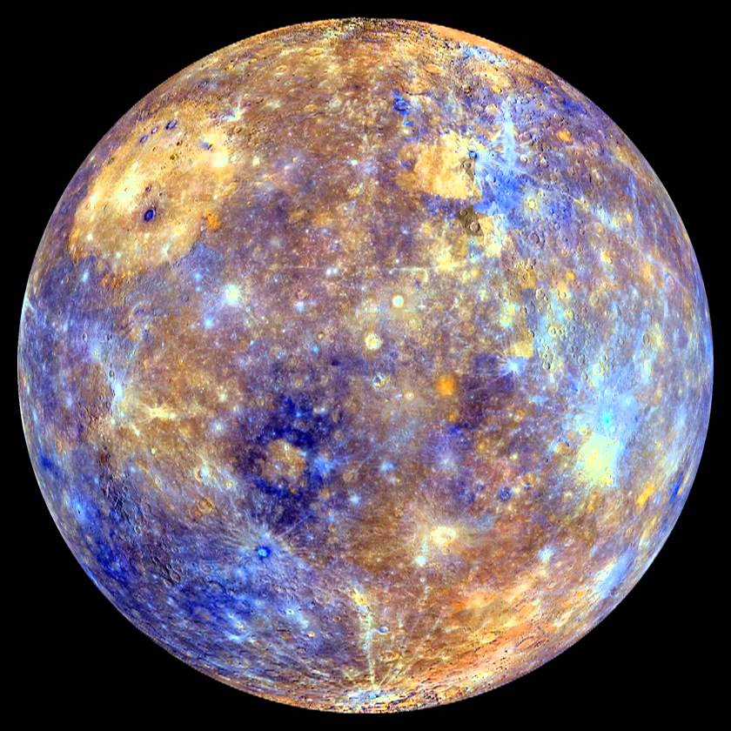
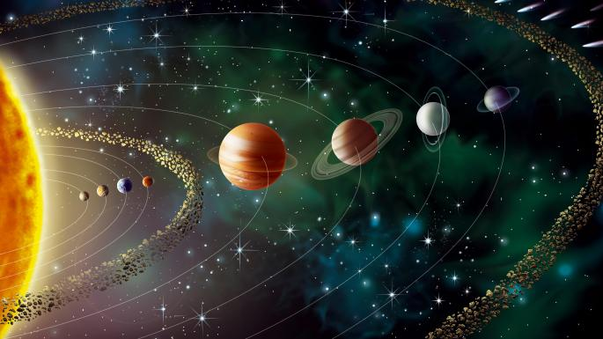
Mercury

Slide 2
Profile
It has no moons
The surface temperature is between minus 173 to 427°C
Mercury is 48 million miles from Earth
The polar diameter is 4,879 km
It was recorded by Assyrian Astronomers.

Slide 3
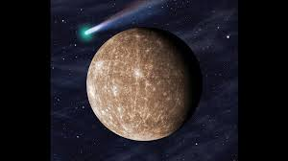
Fantastic Facts !!!
Mercury itself has been mentioned as early as the 2nd millennium BC by the Sumerians, and recorded by the Babylonians – they called the planet Nabu. The ancient Greeks associated Mercury with the god Hermes, who was thought to carry the Sun across the sky in his chariot.

Slide 4
Facts
Mercury is the smallest planet in the solar system. The diminutive planet is about 3,030 miles (4,876 kilometres) in diameter, making it about the size of the continental United States and only slightly bigger than Earth's moon
As a result, Mercury is made out of a large percentage of heavier elements, mainly iron. It is essentially a large metal ball of iron with a very thin silicate crust. Mercury's core makes up about 75% of the planet. Its thin mantle, or crust, is only about 300 to 400 miles thick (500 to 600 km)

