Slide 1
All about the Earth

Slide 2
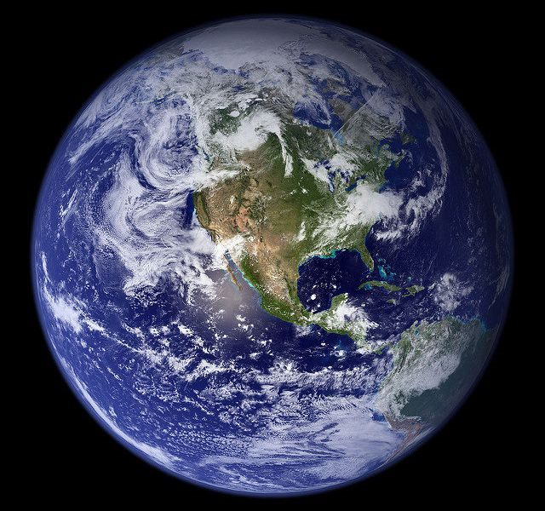
Earth
Earth is the third planet from the Sun and the only object in the Universe known to life.

Slide 3
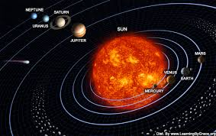
The Earth
This deceleration is happening almost imperceptibly, at approximately 17 milliseconds per hundred years, although the rate at which it occurs is not perfectly uniform .

Slide 4
Facts about the Earth.
Earth is the third planet from the Sun. The Earth is the only planet in our solar system not to be named after a Greek or Roman myths or legends. The earth was once believed to be the centre of the universe. The Earth is unlike every other planet in the Solar System in a number of different ways.
Earth doesn’t take 24 hours to rotate on its axis
It’s actually 23 hours, 56 minutes and 4 seconds.
70% of the Earth’s surface is covered in water.
Earth is the only planet not named after a god.

Slide 5
Earth’s profile
Orbit Period:365.24 days
Surface Temperature: -88 to 58°C
Moons:1.

Slide 6
The earth is 149.6 million km.
A hole Earth year is 365 days
The Earths atmosphere is 300 miles and 480 km thick, but most of it is within 10 miles.
The Earths gravity is 9.807 millisecond.
The earth’s diameter 12,742 km.

