Slide 1
All About Venus

Slide 2
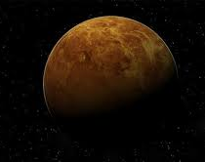
Venus
Venus is the second planet from the sun.
It was believed once to be a twin of Earth.
Venus is one of the easiest planets to see as it is the brightest object in the sky after the sun and moon.

Slide 3
How Big Is Venus?
Venus is 6,052Km in diameter.
Venus has more volcanoes than any other planet in the solar system with over 1600 volcanoes.
A day on the surface of Venus (solar day) would appear to take 117 Earth days.
Venus is nearly as big as the Earth with a diameter of 12,104 km.

Slide 4
Venus
The surface temperature on Venus can reach 471°C.
Venus is the hottest planet in our solar system.
It takes 225 Earth days to orbit the Sun.
Venus rotates the opposite direction as the sun.

