Slide 1


Reading and Phonics in Reception at Mickle Trafford Village School

Slide 2
Learning to read is the most important thing your child will learn at our school. Everything else depends on it, so we put as much energy as we possibly can into making sure that every single child learns to read as quickly as possible.
We want your child to love reading – and to want to read for themselves. This is why we put our efforts into making sure they develop a love of books as well as simply learning to read.

Slide 3
What is phonics?
Phonemes (sounds) and graphemes (letter combinations)
44 sounds
26 letters
Over 150+ graphemes (ay,ai, a-e)
We have one of the most complex alphabetic codes in the world!

Slide 4
Our phonics scheme
At Mickle Trafford Village School, we use
Phonics and reading happens daily in Reception, Year One and Year 2.
We have set sessions for phonics and reading during each morning and often use time in the afternoons for follow up teaching, if it is needed.
Phonics even happens in years 3, 4, 5 and 6. Children use their phonics knowledge every day to help them read and spell words.

Slide 5
Phonics in Reception
The children are immersed in phase 1 phonics as soon as they enter Reception through a range of listening games
We then introduce the single sounds first, we call these Set 1 speed sounds; m,a,s,d
The single sounds are… How to say the sounds - YouTube

Slide 6
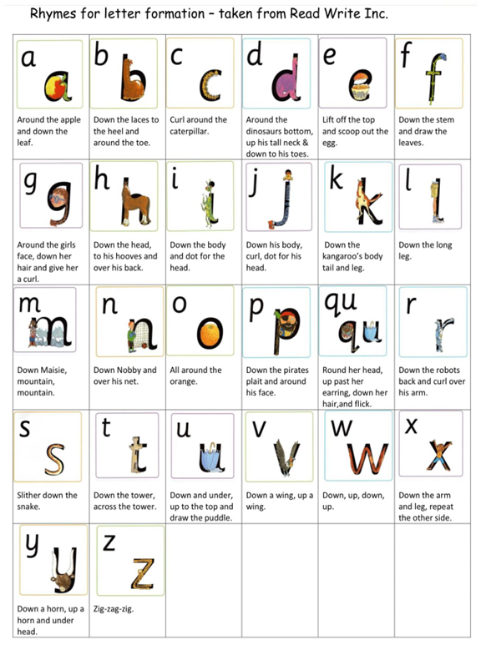
You will notice that there are some Special Friends in Set 1 too.
Special Friends are when two letters join together to create one sound.
We teach these at the end of Set 1, once the children are secure with single sounds.

Slide 7
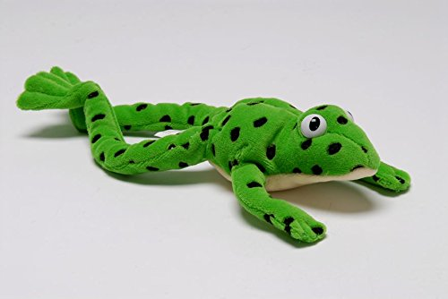

Fred Talk
This is Fred the frog.
Fred can only talk in sounds.
We use Fred and Fred Talk to teach and support blending, starting in Reception.
We play lots of games with Fred such as ‘Fred says’, ‘Fred’s adventures’ and ‘Fred’s house’.
We use ‘Fred Fingers’ to spell words

Slide 8

Will my child have a book to bring home?
Bedtime story
Sound blending book- CVC words
Ditty Photocopies
Red Ditty (3 in 1)
Please make sure you look after these books and keep them in the plastic wallet we have provided for your child. They are paper books and we don’t want them to get water damaged.

Slide 9
Reading diaries
A weekly note of focus sounds and any additional comments will be stuck in your child's reading diary each week.
Please use reading diaries at home to record any reading you have done together by making a short comment
Diaries are collected on a Thursday and returned to the children on a Friday

Slide 10
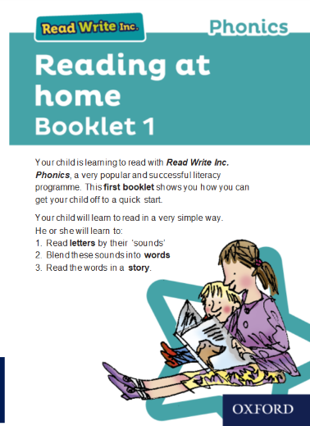
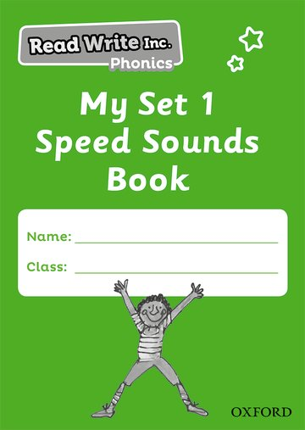
My first reading wallet

Slide 11
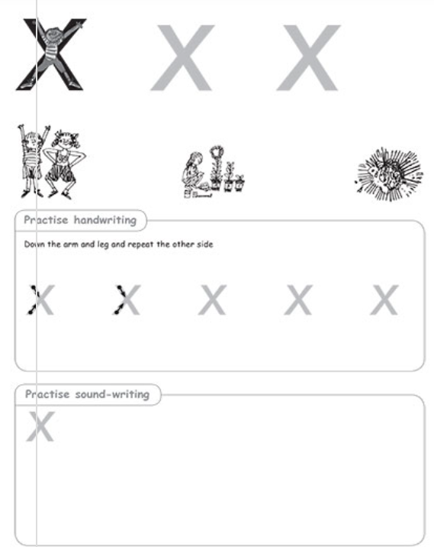
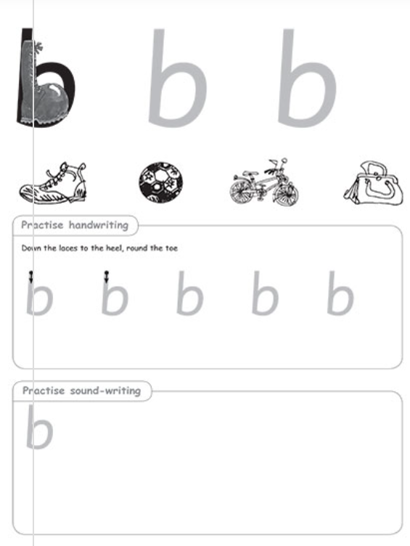
My first reading wallet

Slide 12
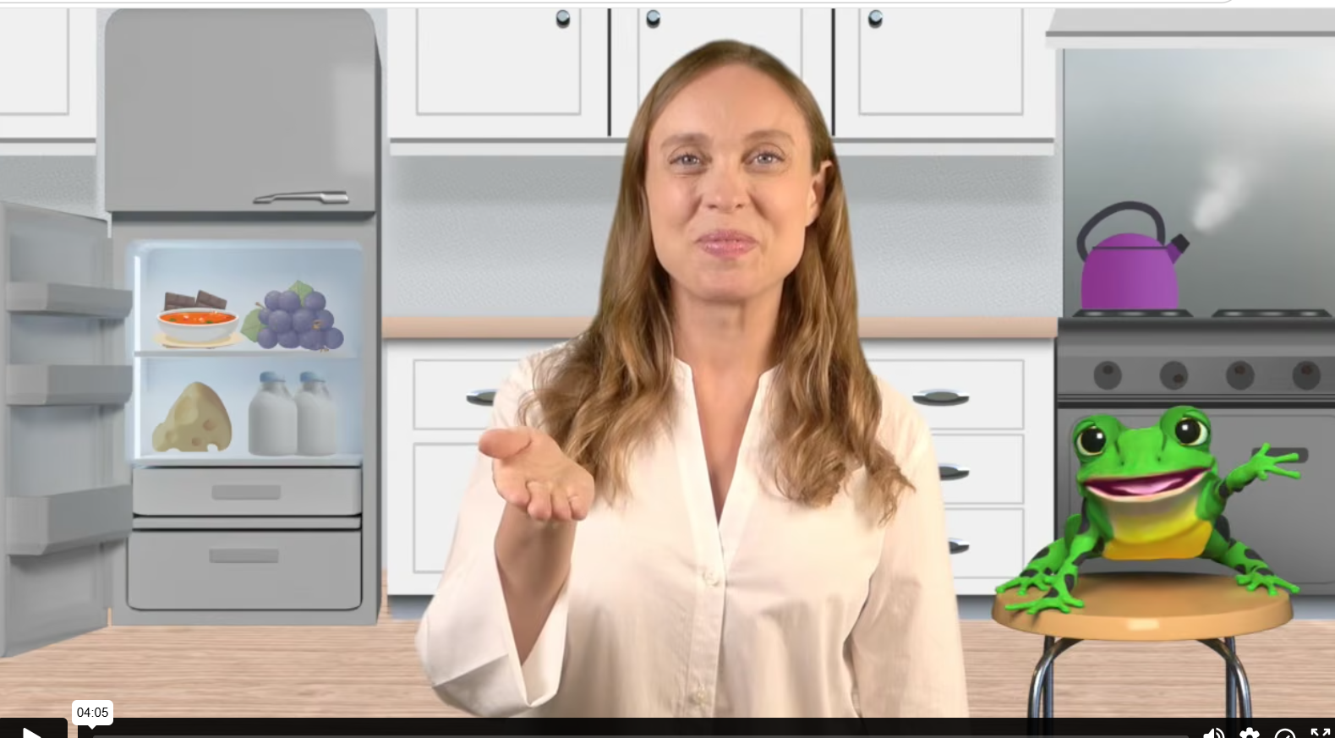
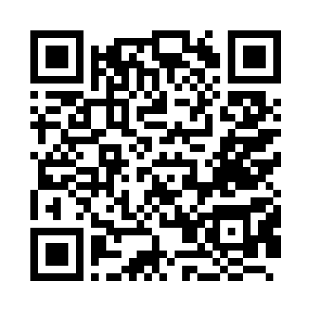
My first reading wallet

Slide 13
What can I do to help?
Reception- Focus on pre-writing skills (see website)
Use your child’s RWI speed sound booklet to continuously recap the sounds.
Please trust your child’s teacher to choose the book/s that will help them the most.
Please don’t say ‘this is too easy’ when you see the book your child is reading. They are supposed to be able to read it fluently and confidently. It shouldn’t be a struggle and children shouldn’t be getting stuck on every other word.
We know parents are very busy people! If you can find time to read to and with your child as much as possible, it really helps them to love reading. In school, we teach children to read, but we also need them to continue and practice at home.

Slide 14
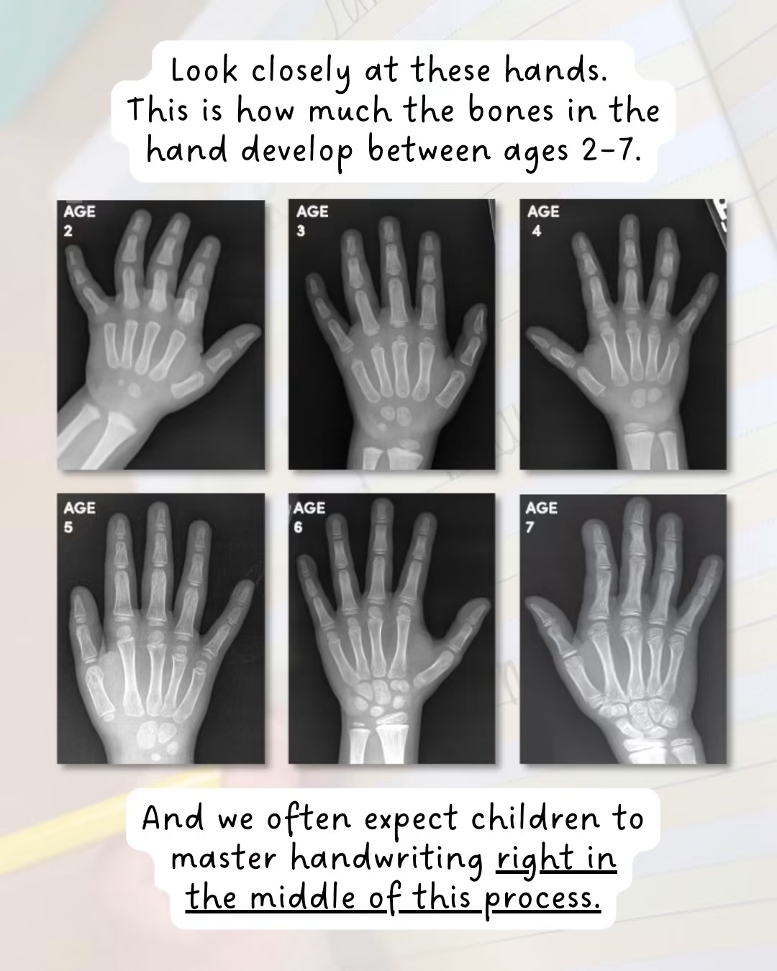
Importance of Fine Motor
Strong fingers make strong writers
Good pencil grip and hand strength support writing letters learned in phonics.
Fine motor development helps children form letters, use tools, and gain independence in learning.
Parents can support at home through simple, playful activities.

Slide 15

See you in the classroom…

