Slide 1

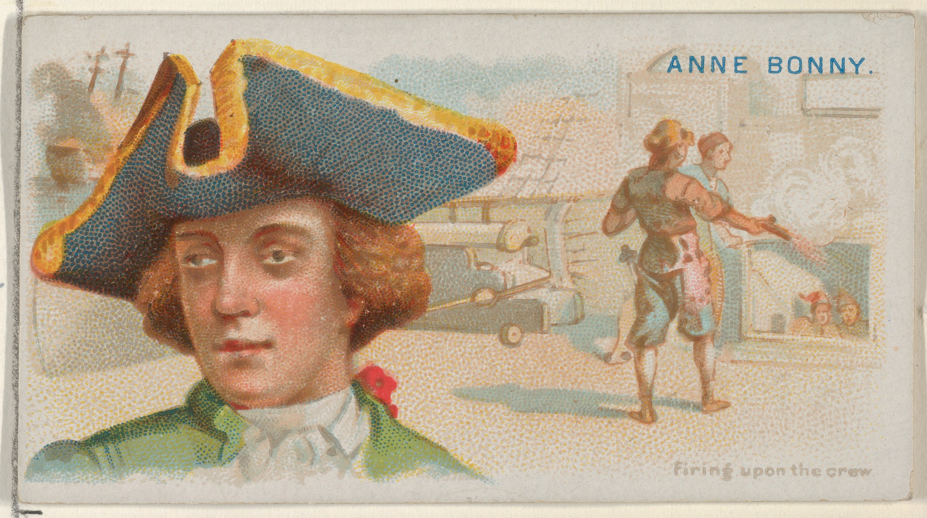
Anne Bonney was an Irish pirate operating in the Caribbean, and one of the most famous female pirates of all time.
Anne Bonney
Born: March 16th 1697, Cork, Ireland
Died: unknown, no sources after 1720
Anne married in 1715 and moved to Nassau in the Bahamas which was a sanctuary for pirates. Anne met Calico Jack Rackham there and they became pirate partners and her boyfriend.
In October 1720, Rackham and his crew were attacked by Jonathan Barnet and were taken to Jamaica where they were convicted and sentenced to be hanged by Governor Lawes.
Anne was pregnant at the time and asked for mercy which was granted and she remained in prison until she gave birth. There is no record of her release, execution or death.
Anne escaped prison, no one knows how Anne died.
Amelia Phillips

Slide 2
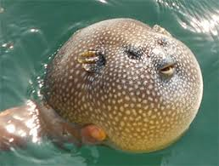
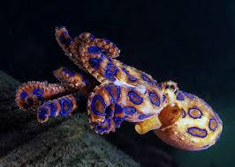
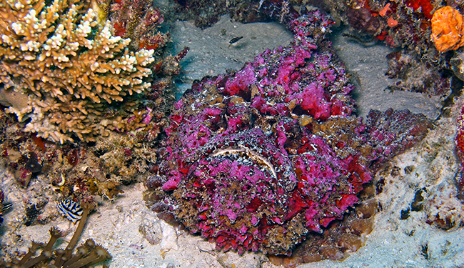
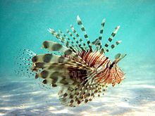
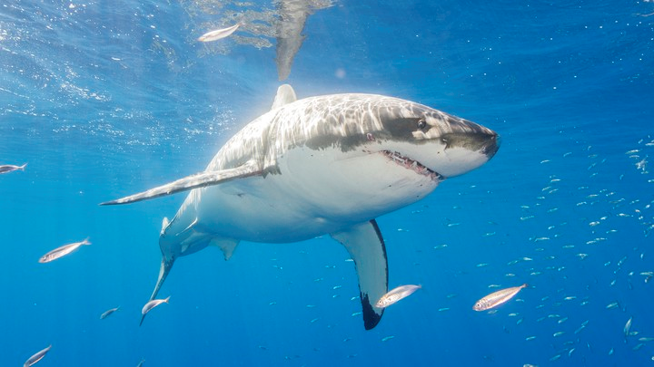
Puffer fish: Whilst pufferfish may look harmless, they’re actually pretty dangerous due to the amount of tetrodotoxin they contain.
Blue-ringed Octopus: Whilst it may be a dazzling sight, one bite can kill a human. The pufferfish has nothing on the blue-ringed octopus, as its venom is 10,000 more lethal than cyanide and there is no known antidote.
10 deadliest creatures
In the ocean
Stonefish: With venomous sacs on each of its 13 spines, if you come in close contact with a stonefish there’s no way of avoiding getting stung.
The lionfish: Is known for its many spiky fin rays, which also happen to be highly venomous.
The great white shark: Sits comfortably near the top of the food chain, where a single bite from their sharp teeth can be fatal.
Amelia Phillips

Slide 3
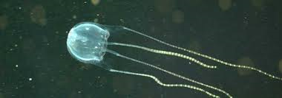
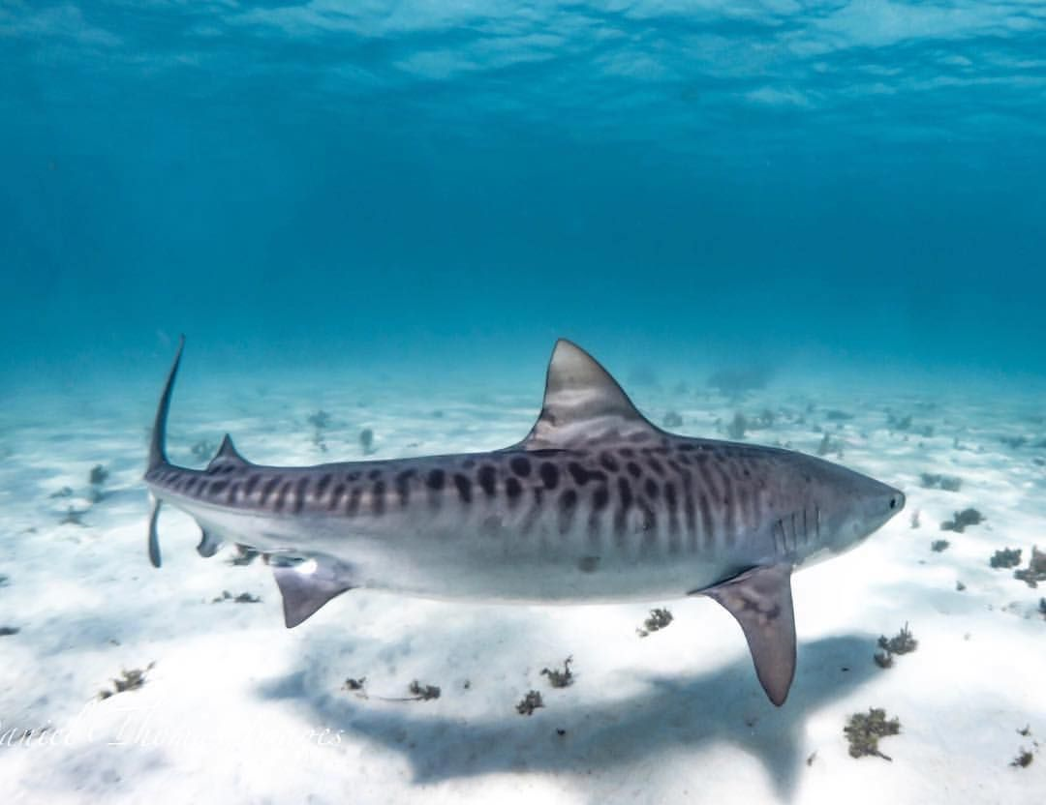
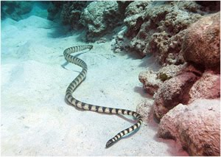
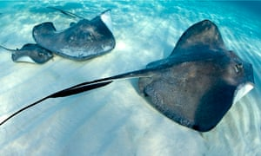
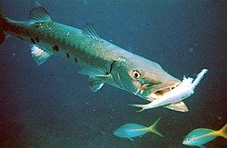
Tiger shark’s: They can reach a length of 5m, making it a relatively large predator of the seas.
Box Jellyfish: Accountable for more human fatalities on the Australian continent than sharks, the box jellyfish is one of the most ferocious creatures to roam the ocean.
10 deadliest creatures
In the ocean
Sea snakes:The most poisonous species is the beaked sea snake, whose venom is eight times as toxic as a cobra’s. Just 1.5 milligrams of its venom could kill up to eight humans. Luckily, they are not known to attack humans often – just don’t provoke them.
Stingrays: When threatened, the stinger in the stingray’s tail will whip up. Contact with the stinger will usually cause pain and possible infection. More serious attacks are rare, but can involve poisoning and even death.
Great barracuda’s: They have fang-like teeth are very similar to those of a piranha, and there have been reported cases of barracudas leaping out of water and injuring boaters.
Amelia Phillips

