Slide 1


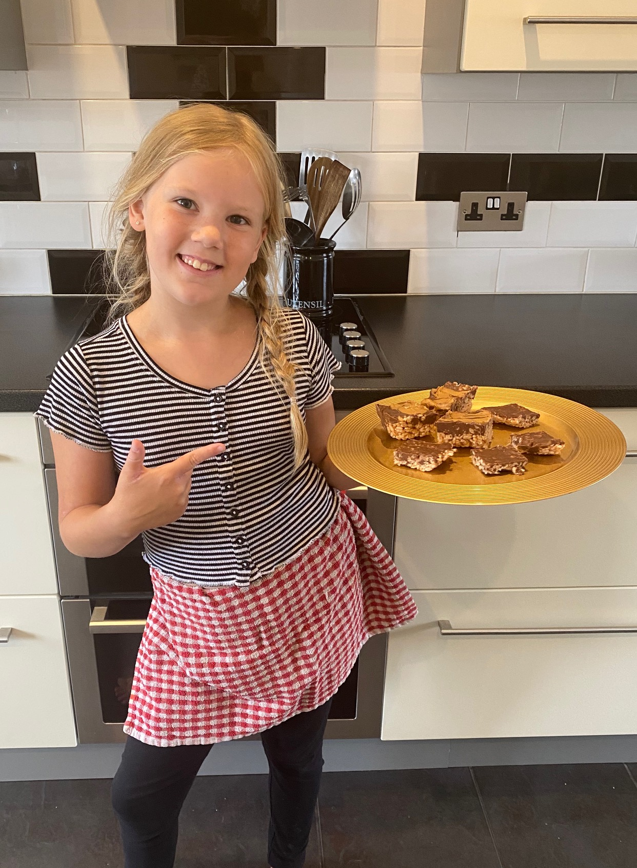

Los platos gourmet de Bella
Bella’s gourmet dishes

Slide 2

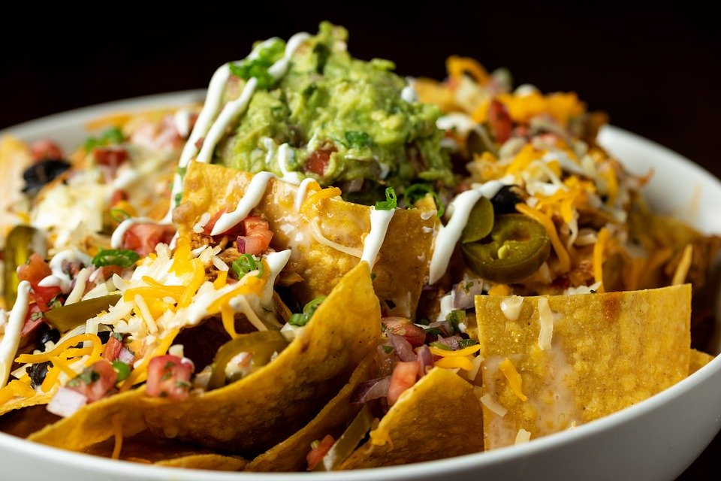

Entrantes Starters
Pan de ajo o pan de ajo con queso. €1.35
Garlic bread or cheesy garlic bread. £1.20
Sopa de tomate o sopa de calabaza. €2.81
Tomato soup or pumpkin soup. £2.50
Nachos. €4.49
Nachos. £3.99
Plato de queso. €5.61
Cheese platter. £4.99
Halloumi a la parrilla. €2.25
Grilled Halloumi. £2.00
Hummus y palitos de pan. €1.69
Hummus and breadsticks.£1.50
Panqueques salados, con tocino, salchichas o tomates. €5.20
Savoury pancakes, with bacon, sausage, or tomatoes. £4.59

Slide 3
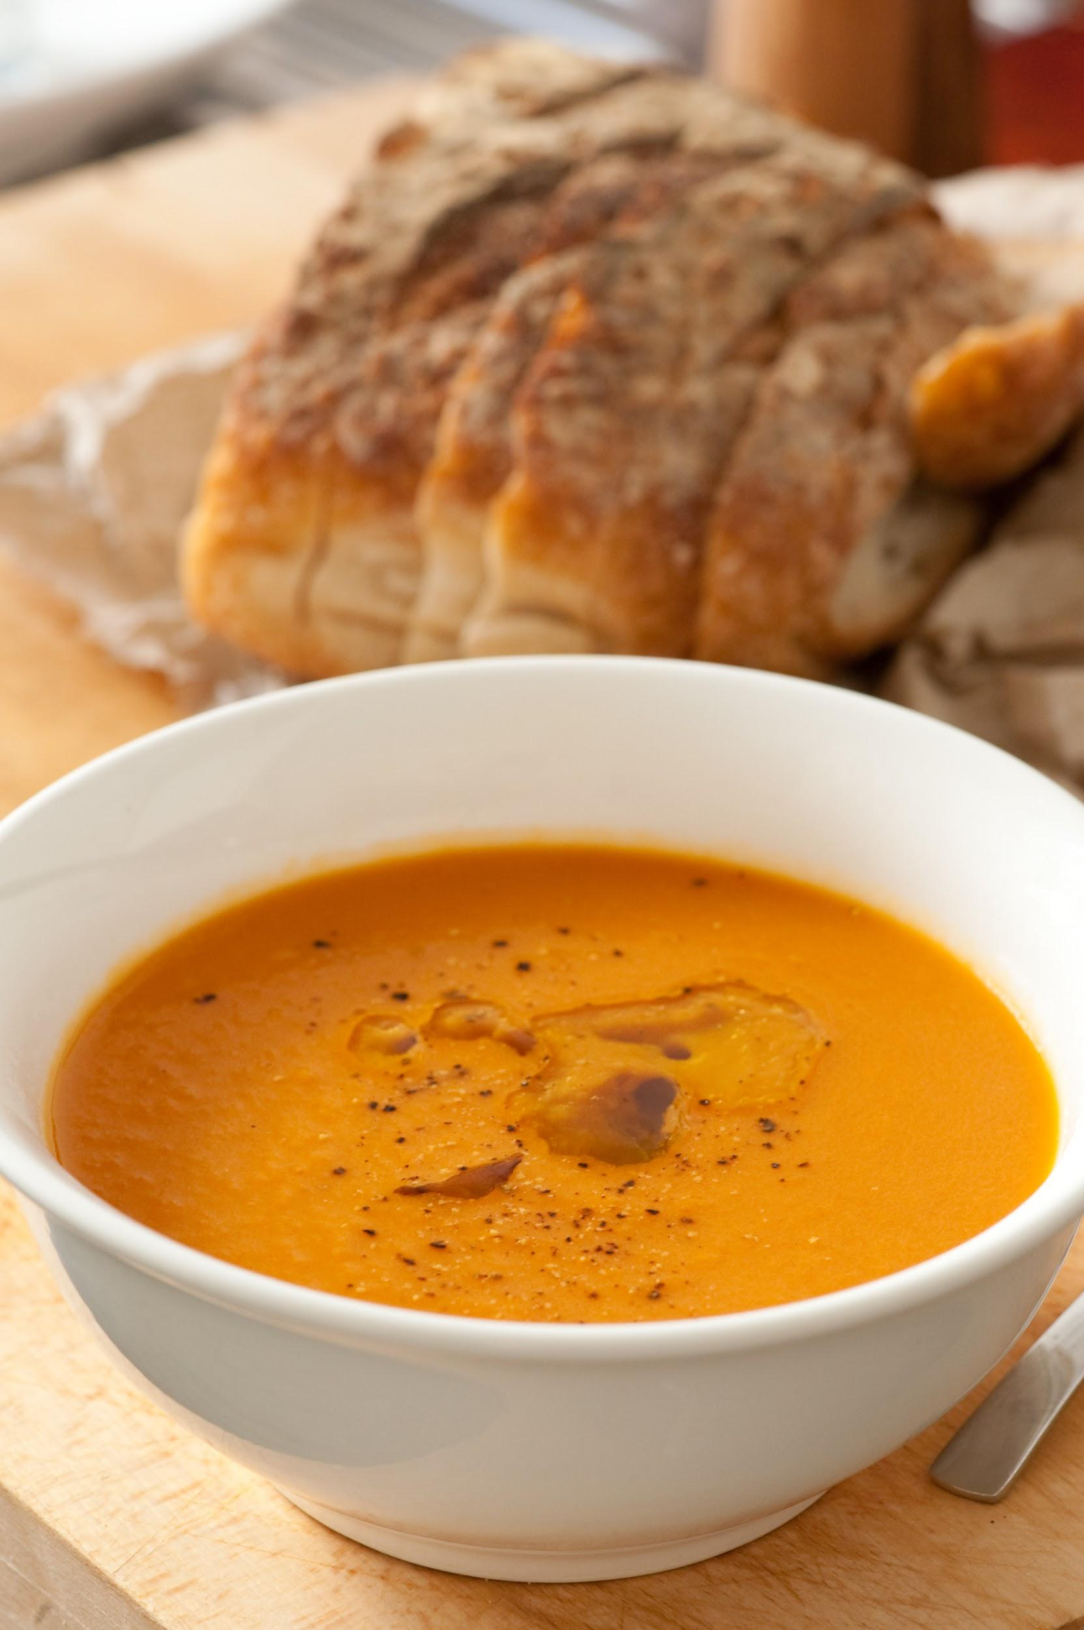
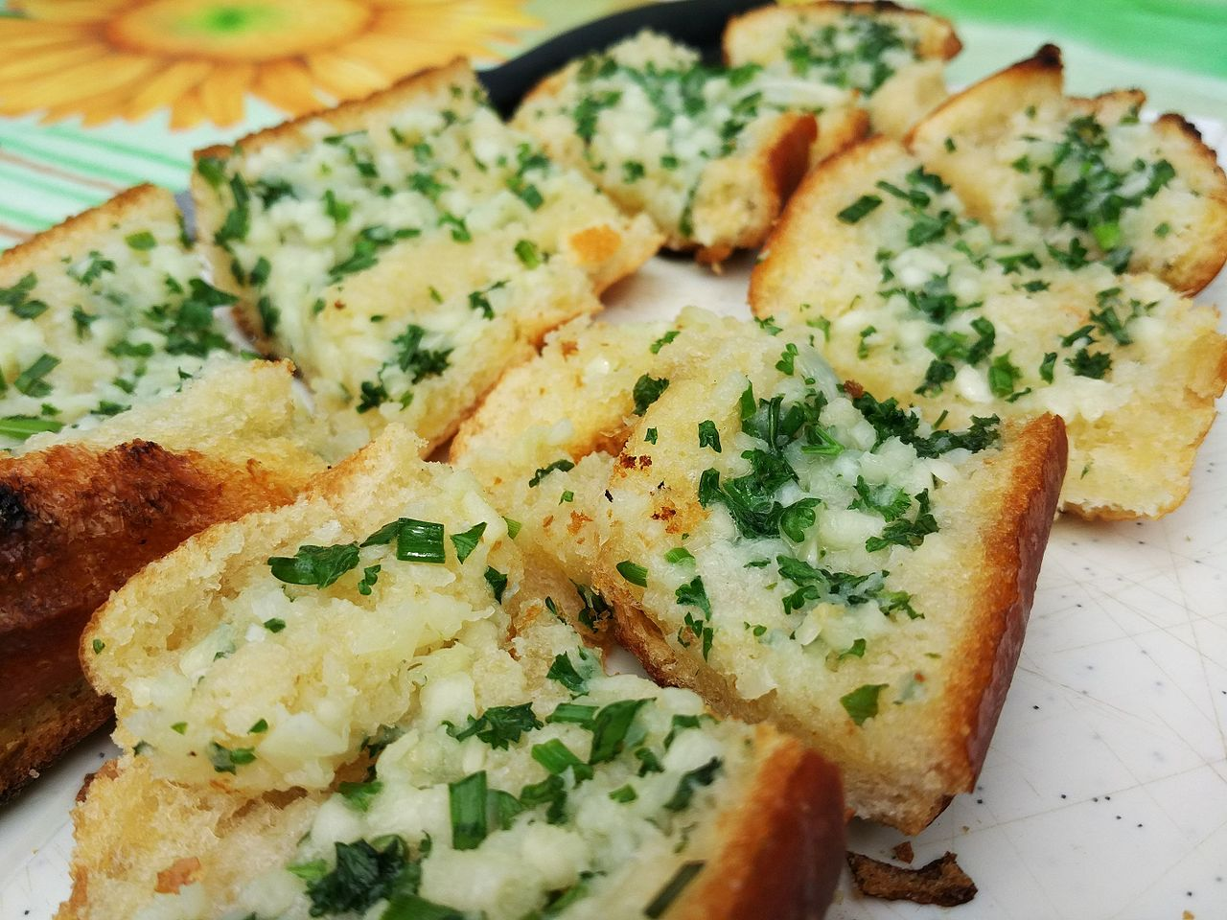

Slide 4
Comida principal Main meal
Cena de pavo asado con verduras de temporada. €8.53
Turkey roast dinner with seasonal vegetables. £7.59
Papa al horno con atún, queso o frijoles horneados. €5.28
Baked potato with tuna, cheese or baked beans. £4.70
Ensalada de hojas con queso tomate y cebolla. €3.37
Leafy salad with cheese tomatoes and onion. £3.00
Cinco hamburguesas con queso, tocino, tomate, lechuga y cebolla con mayonesa picante. €7.93
Five patty burgers with cheese, bacon, tomatoes, lettuce and onions with a spicy mayonnaise.£7.05
Pasta con papas nuevas, con salsa de pasta cremosa opcional. €3.24
Pasta with new potatoes, with optional pouring creamy pasta sauce. £2.88
Hamburguesa de pollo con salsas caseras opcionales, queso, lechuga, tomate y cebolla. €5.20
Chicken burger with optional home sauces, cheese, lettuce, tomatoes and onions. £4.63
Hamburguesa vegana de lentejas con queso vegano, lechuga, tomate y cebolla. €5.92
Vegan lentil burger with vegan cheese, lettuce, tomatoes and onions. £5.27
Rollo de salchicha vegana. €2.33
Vegan sausage roll £2.07
Nuggets de pollo y papas fritas. €5.17
Chicken nuggets and chips. £4.60
Salchicha, puré de papas y salsa. €5.64
Sausage, mash potato and gravy. £5.02

Slide 5

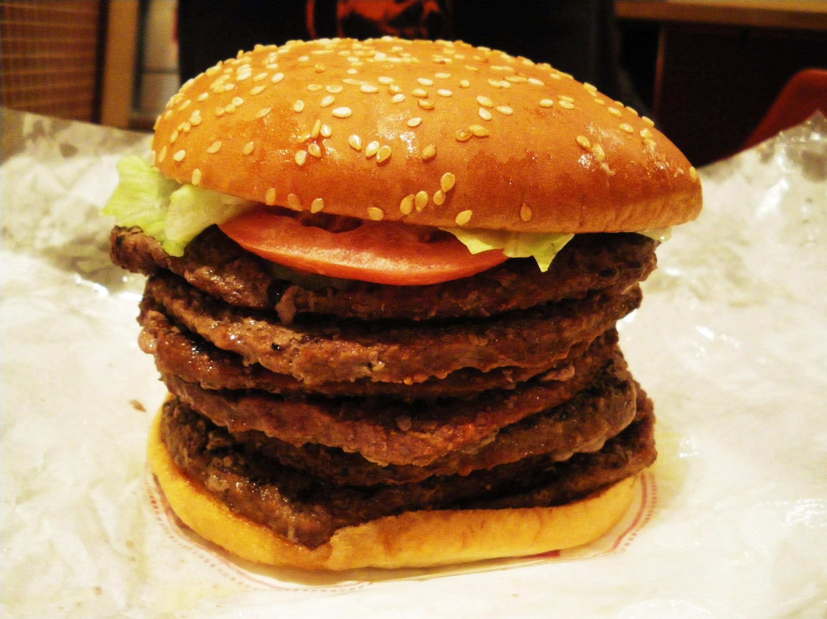
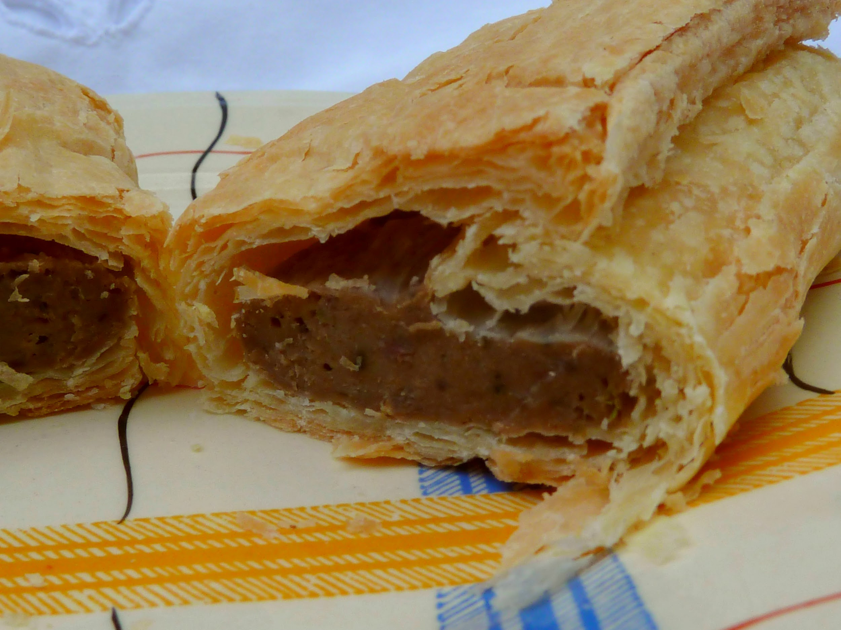
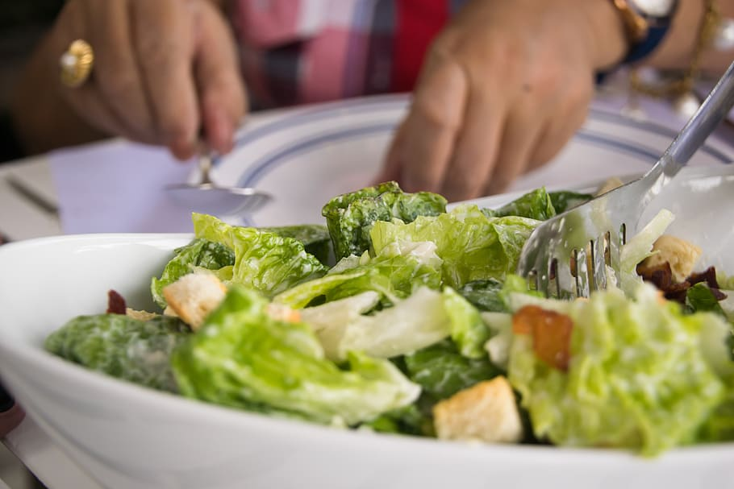
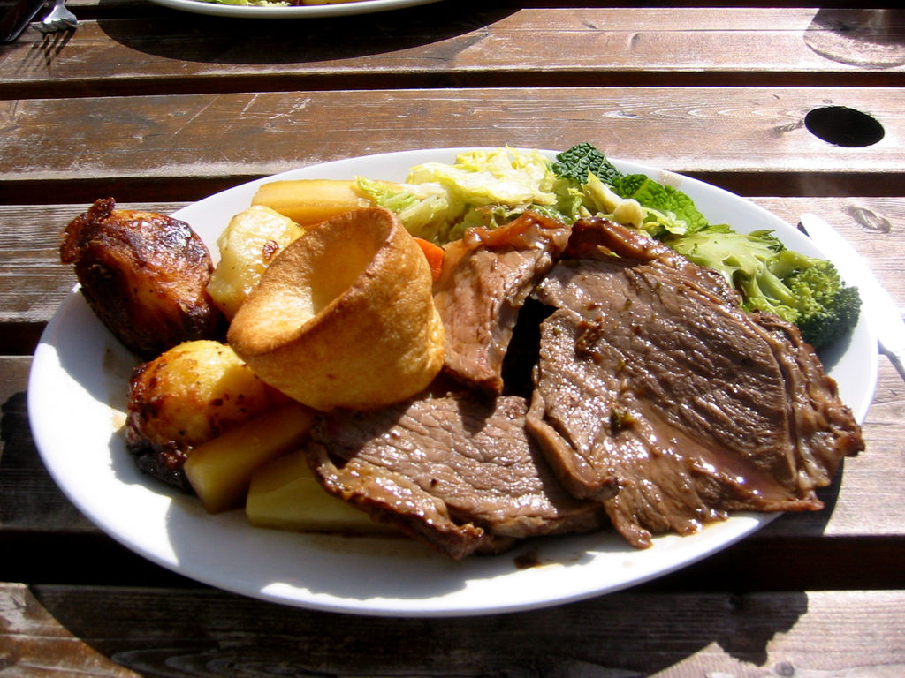
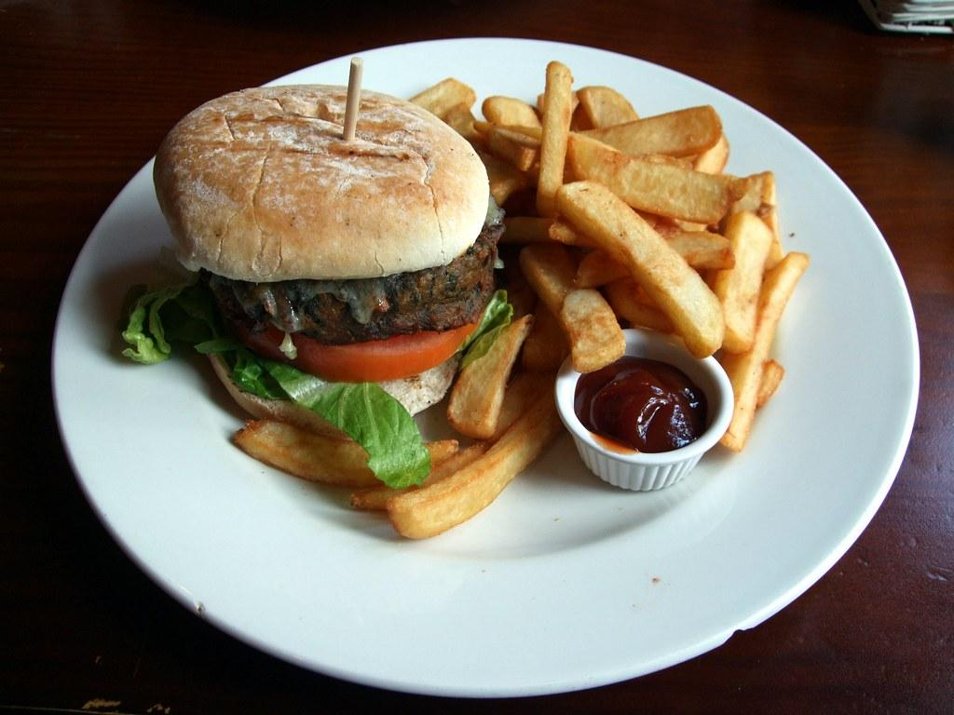
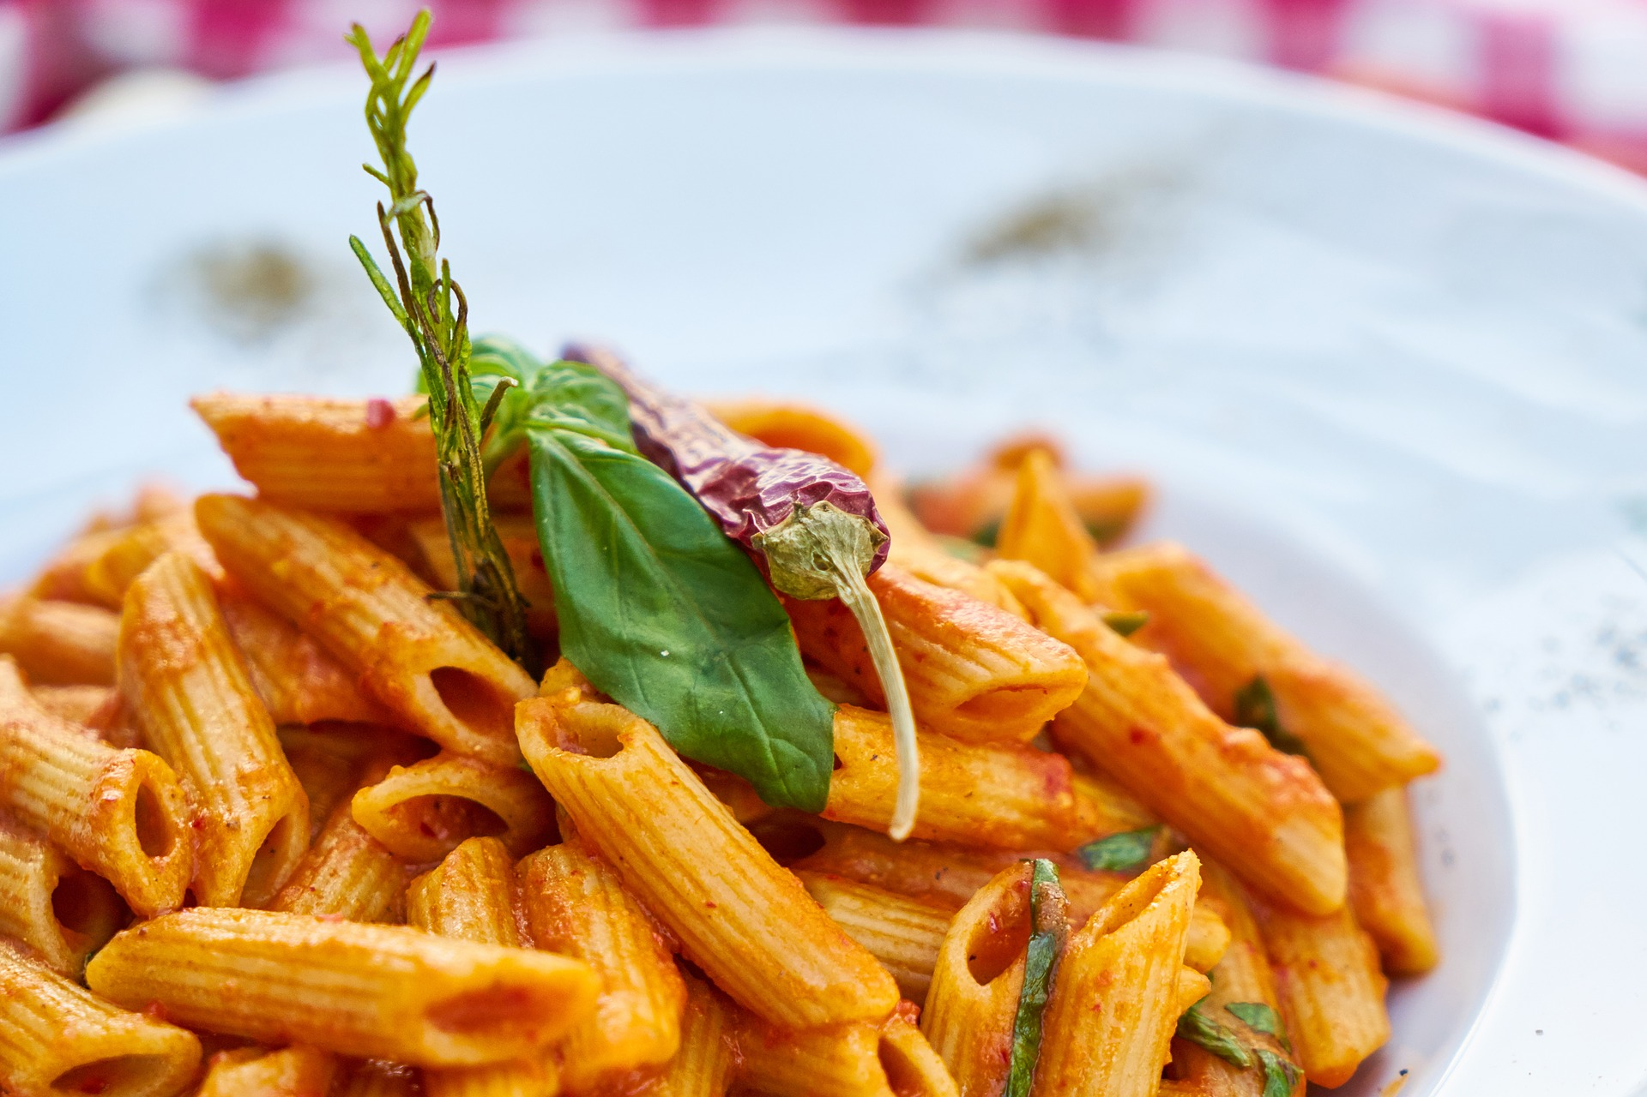

Slide 6
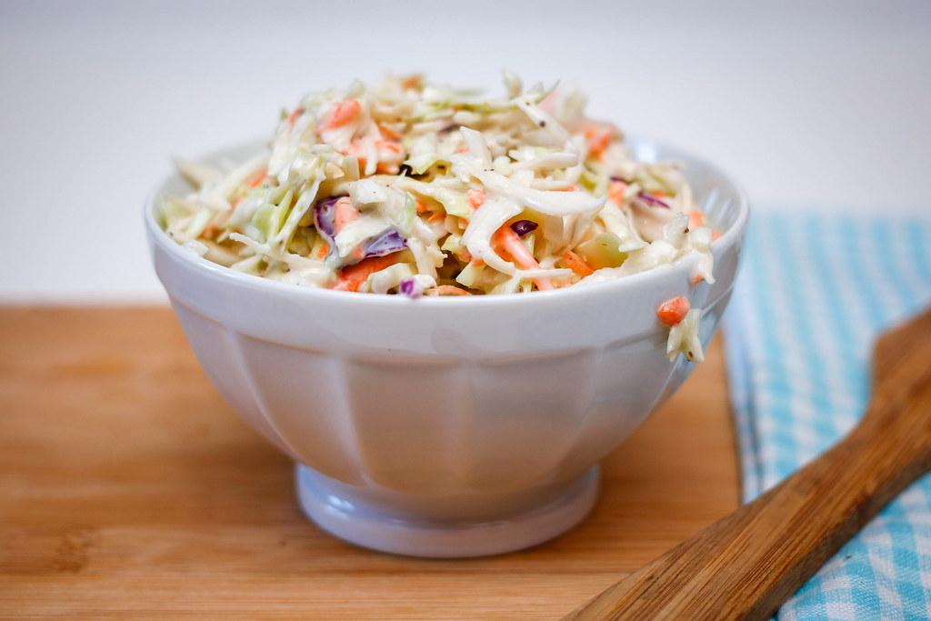
Maíz en la mazorca. €0.56
Corn on the cob.£0.50
Papas fritas. €1.12
Fries. £0.99
Ensalada de col. €0.56
Coleslaw. £0.50
Aros de cebolla fritos. €1.12
Deep fried Onion rings. £1.00
Patatas dulces fritas. €1.12
Sweet potato fries. £0.99
Panecillos con mantequilla. €0.34
Buttered bread rolls.£0.30
Puré de patatas. €0.56
Mashed potato. £0.50
Salsa. €0.11
Gravy. £0.10
Guarniciones Side dishes

Slide 7
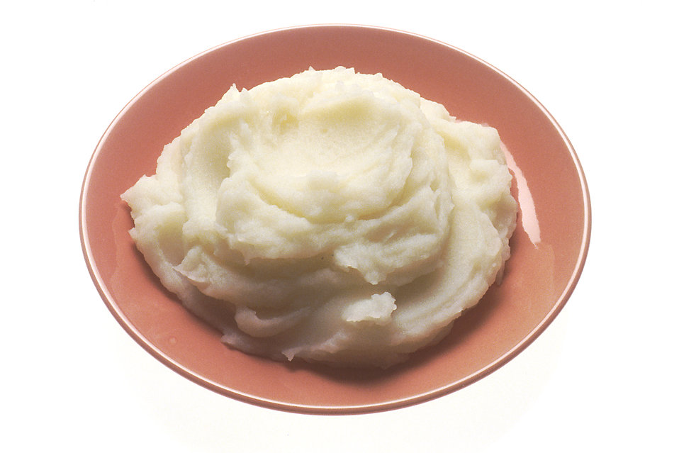
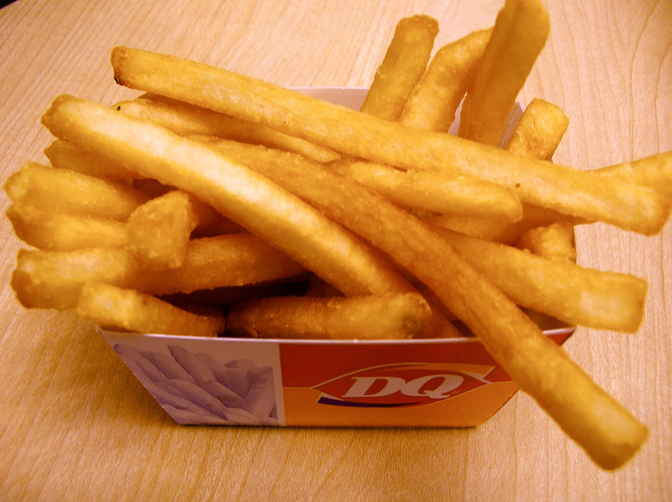
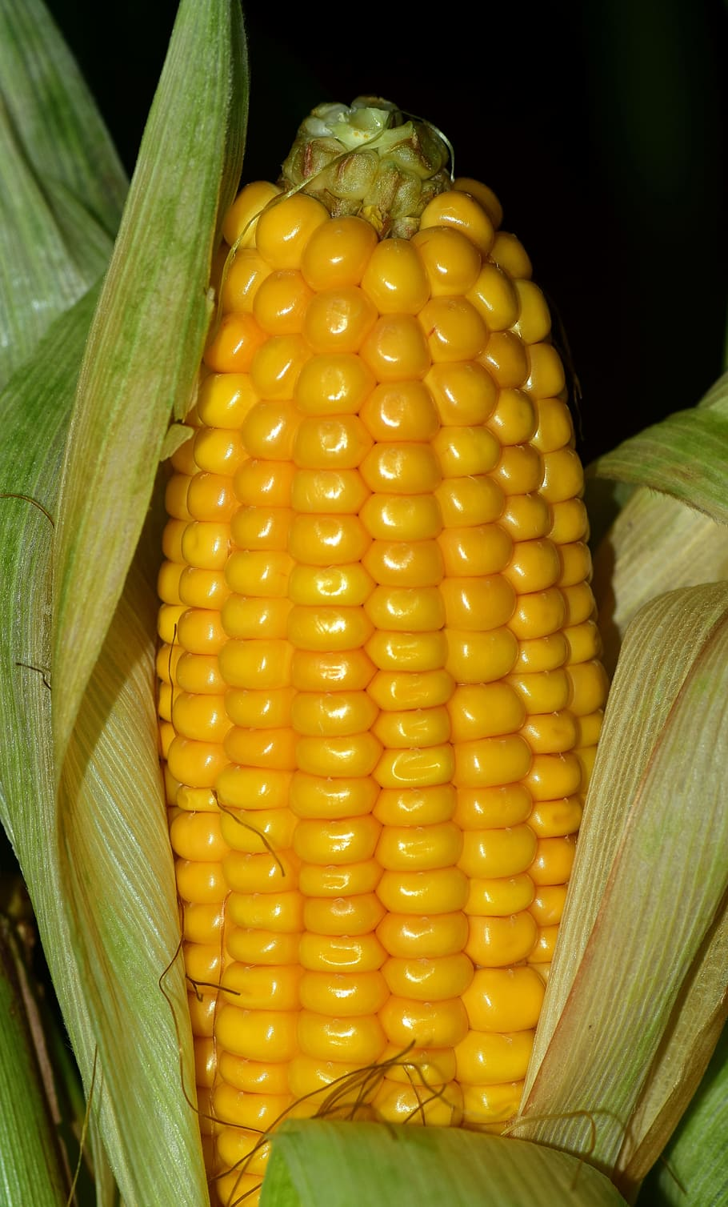
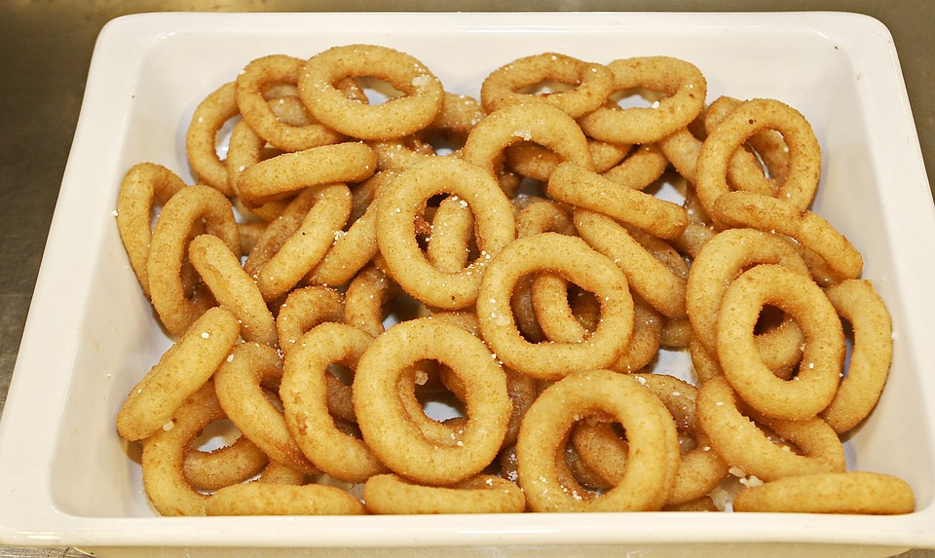
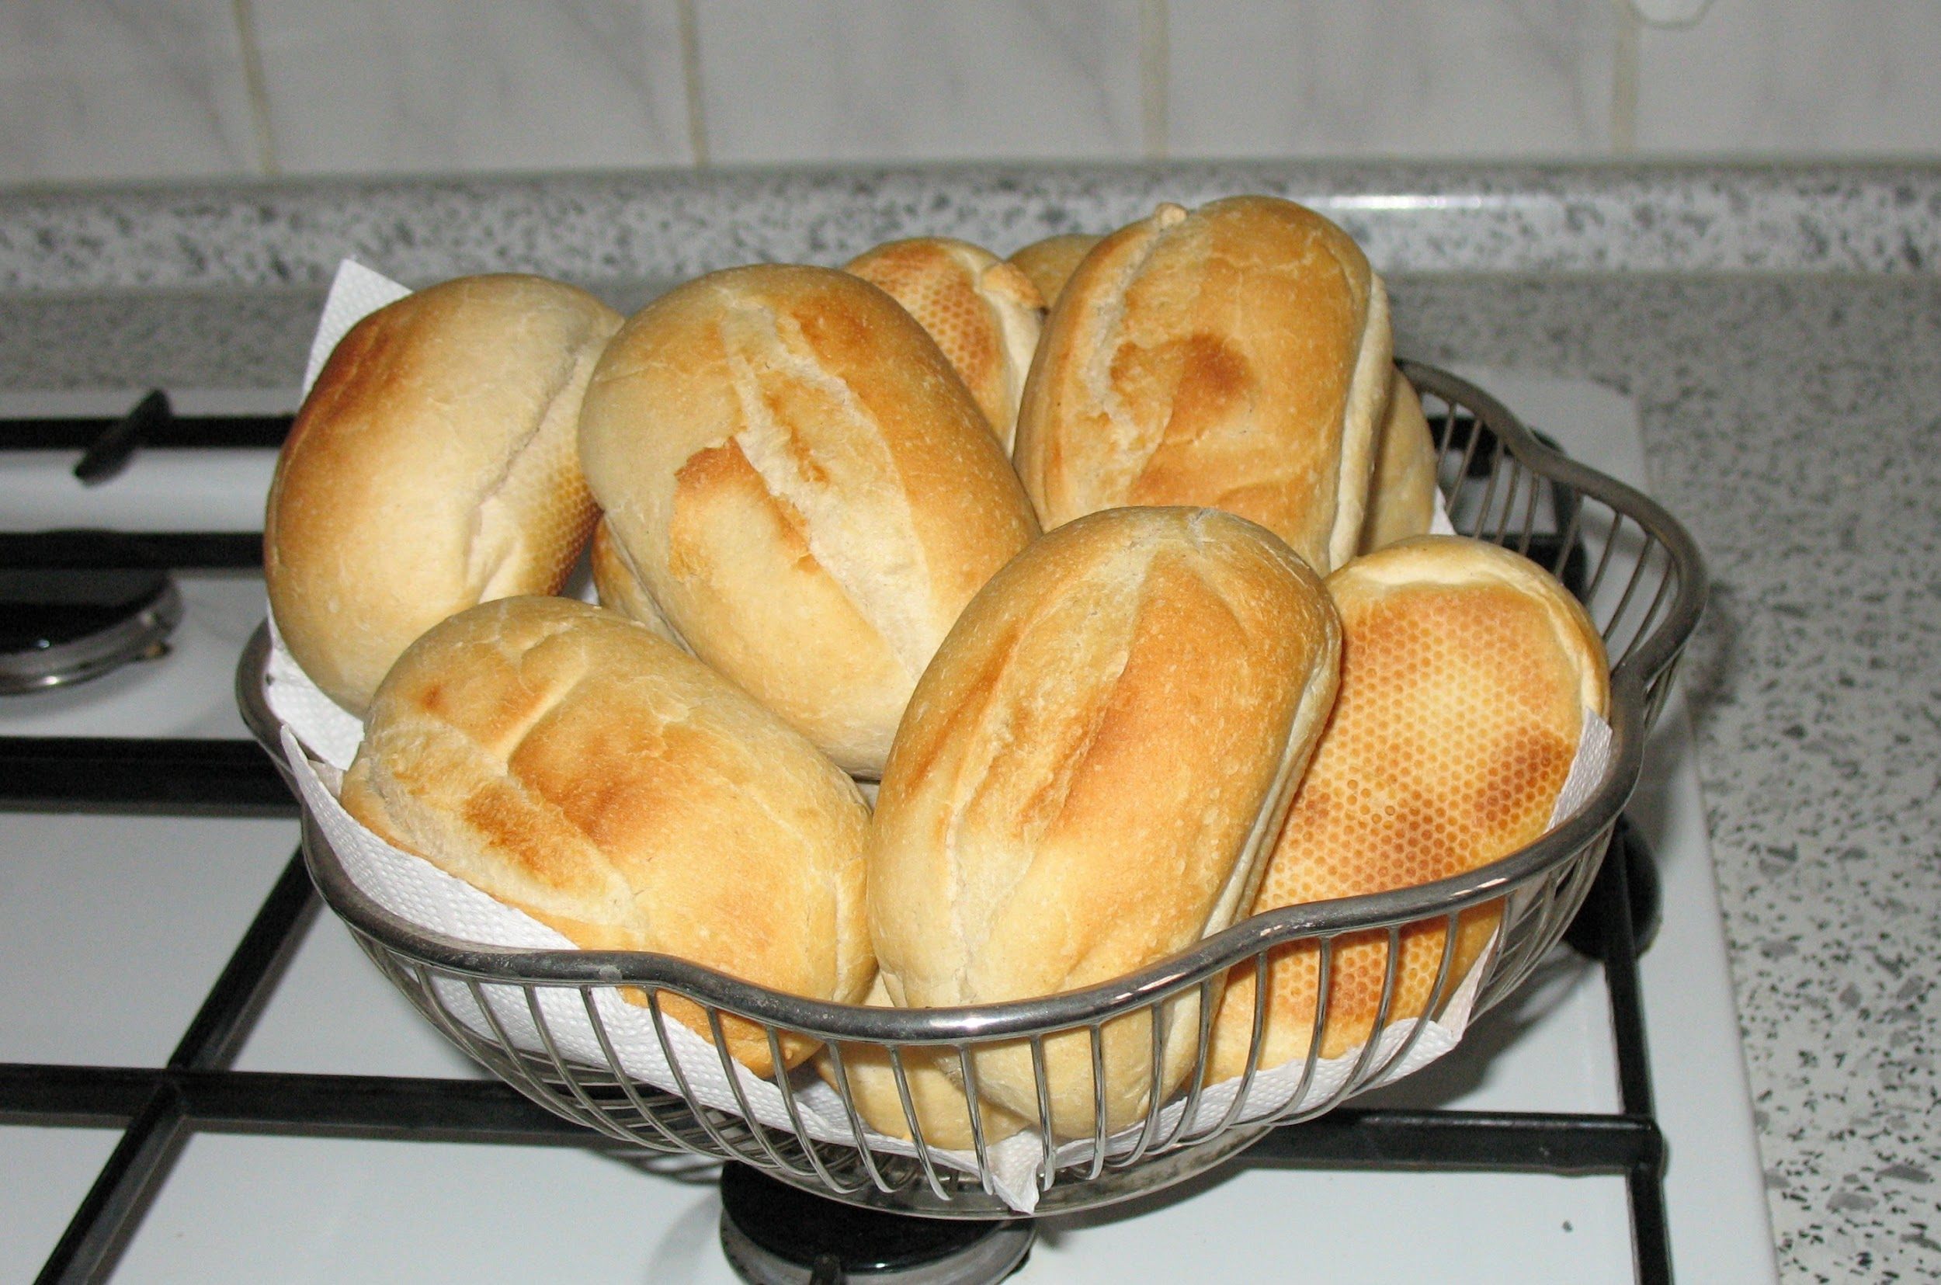

Slide 8
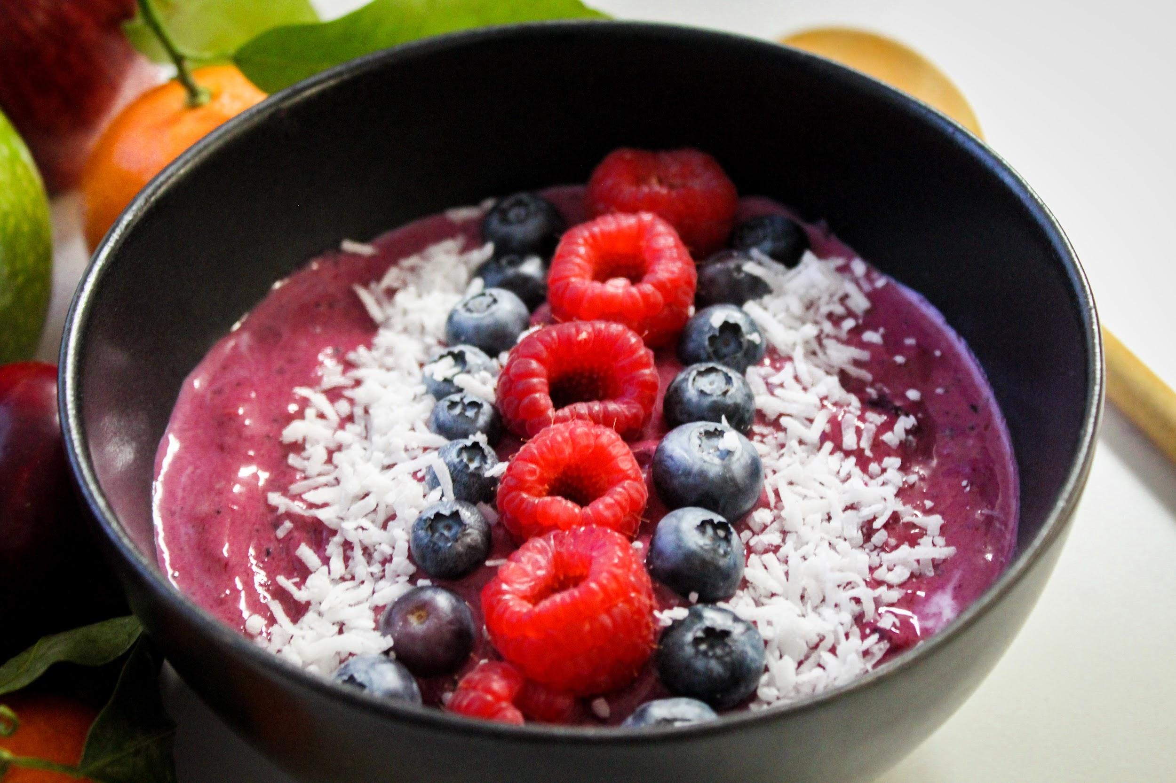
Postres Desserts
Brownie de chocolate caliente con helado de vainilla. €2.81
Warm fudge brownie with vanilla ice cream. £2.50
De 1 a 15 bolas de helado, consulte al camarero para conocer las opciones de helado. €0.56 por cucharada.
1 to 15 scoops of ice cream, please see the waiter for ice cream options. £0.50 per scoop.
Bizcocho de vainilla con crema fresca y fresas. €1.12
Vanilla sponge cake with fresh cream and strawberries. £1.00
Panqueques dulces con salsa de chocolate, mantequilla de maní y helado. €1.69
Sweet pancakes with chocolate sauce, peanut butter and ice cream. £1.50
Brochetas de frutas de temporada, con un trío de salsas. €0.56
Seasonal fruit kebabs, with a trio of dipping sauces. £0.50
Pizza de chocolate con malvaviscos, chocolate con leche y gotas de chocolate blanco. €3.93
Chocolate pizza with marshmallows, milk chocolate and white chocolate drops.£3.50
Tazón de acai, relleno con puré de bayas de acai y coberturas de frutas. €1.68
Acai bowl, filled with acai berry puree, and fruit toppings. £1.50

Slide 9
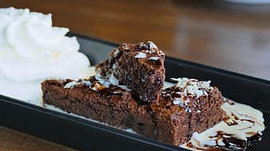
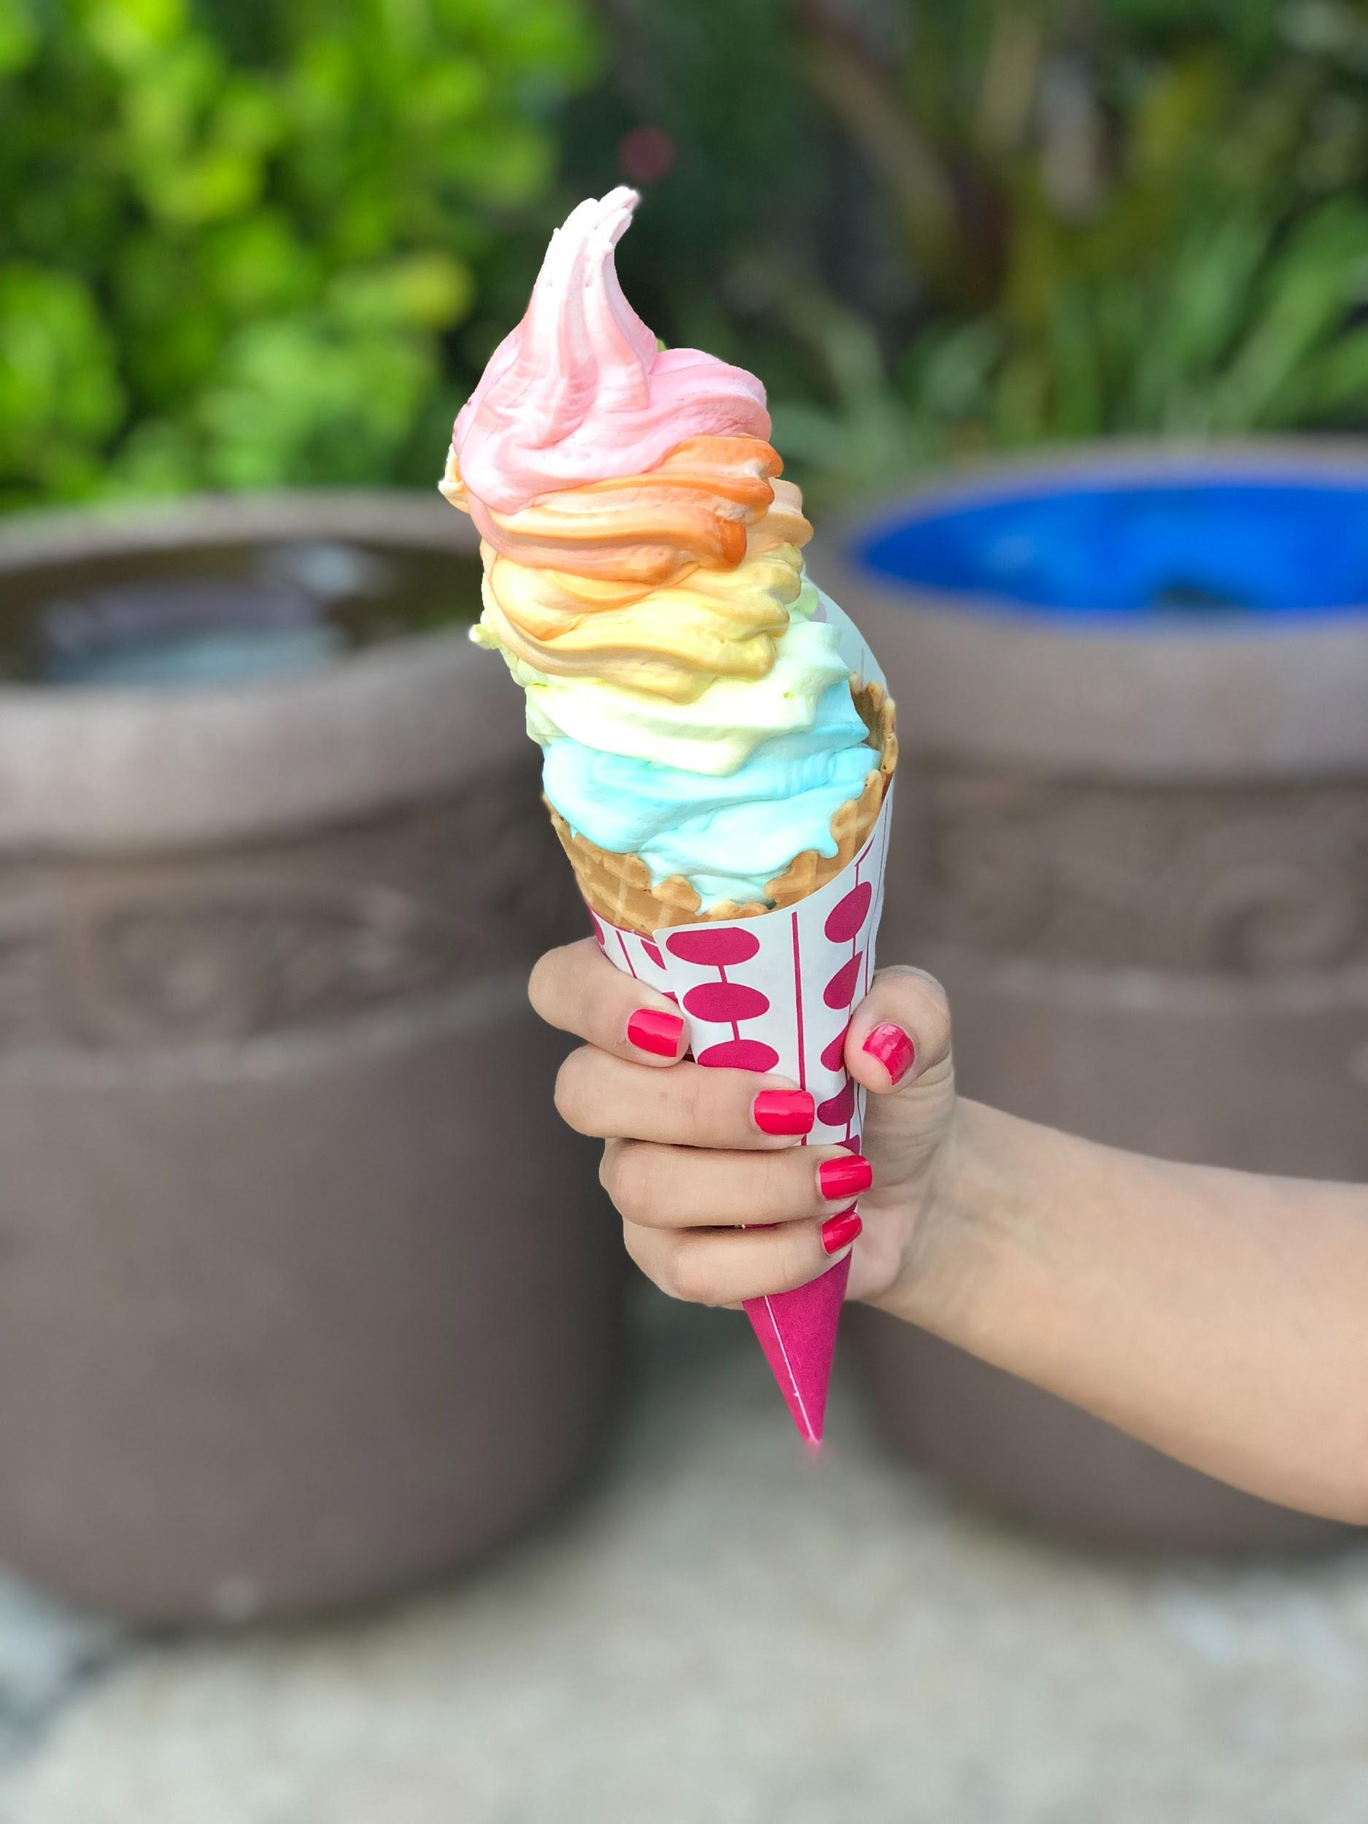
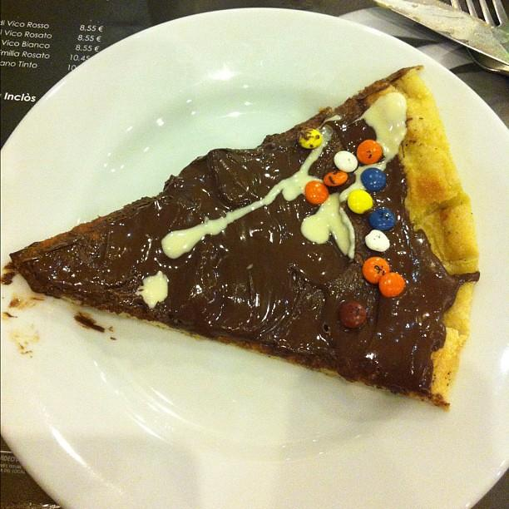
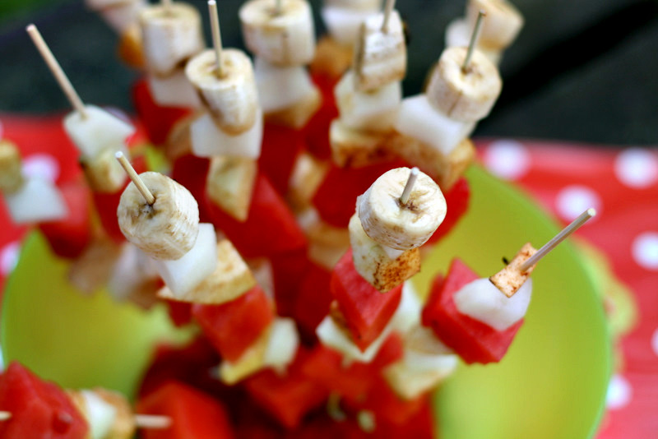

Slide 10
Menú de bebidas Drinks menu
Zumo de naranja pequeño €0.56 grande €1.12
Orange Juice small £0.50 Large £1.00
Zumo de grosella negra pequeño €0.56 grande €1.12
Blackcurrant Juice small £0.50 Large £1.00
Jugo de manzana pequeño €0.56 grande €1.12
Apple Juice small £0.50 Large £1.00
Pepsi pequeño €0.84 grande €1.41
Pepsi small £0.75 Large £1.25
Limonada pequeño €0.84 grande €1.41
Lemonade small £0.75 Large £1.25
Appletiser pequeño €0.84 grande €1.41
Appletiser small £0.75 Large £1.25
Niños pequeño €0.84 grande €1.41
Fanta small £0.75 Large £1.25
Granizados, Frambuesa azul, fresa, Piña,
naranja pequeño €0.56 grande €1.12
Slushies small £0.50 Large £1.00
Blue raspberry
Strawberry
Pineapple
Orange
Para bebidas alcohólicas, vaya al bar.
For alcoholic drinks, please go to the bar.

Slide 11
