Slide 1
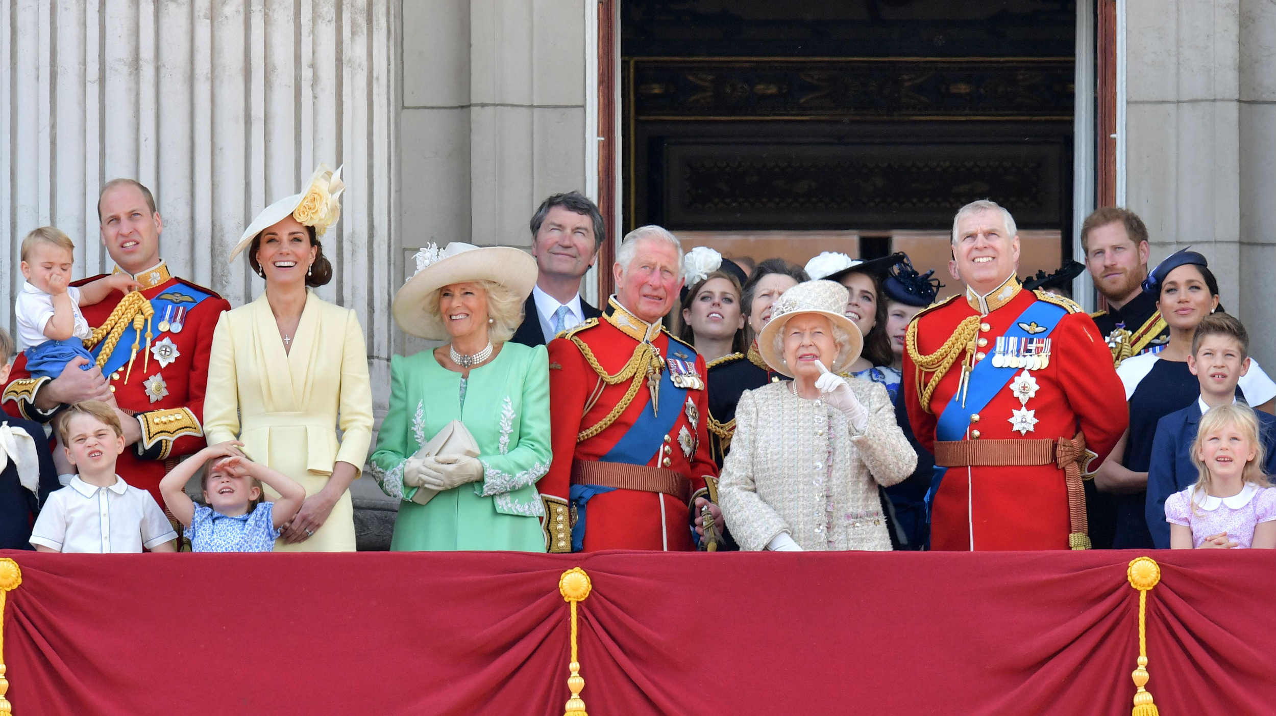
The Royal family

Slide 2
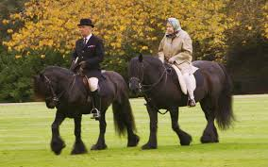
A day in the life of the Queen
This is the Queen and my
Great uncle Terry who is the queens head groomsman.
The Queen likes to go horse
Riding in her spare time.

Slide 3
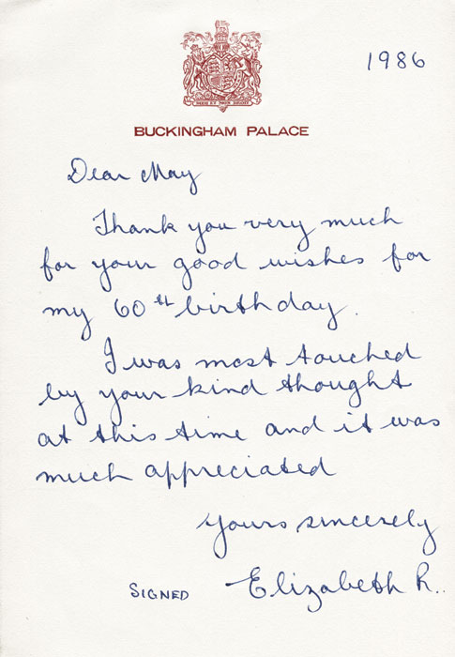
DID YOU KNOW
The Queen personally writes to people on their 100th birthday and some special occasions such as anniversaries. The Queen also writes thank you letters to the people that have given her generous gifts. Some gifts have included wild exoctic animals which she donates to London Zoo.

Slide 4
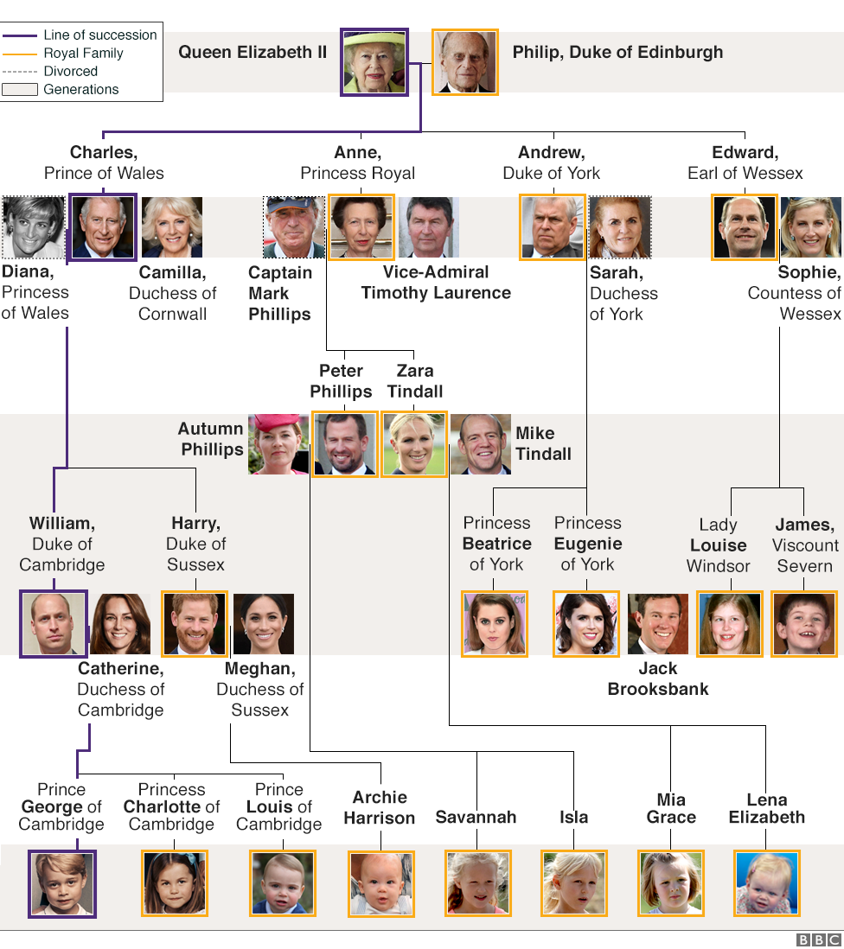
The royal family dates
Back hundreds of years.
This is todays royal
family

Slide 5
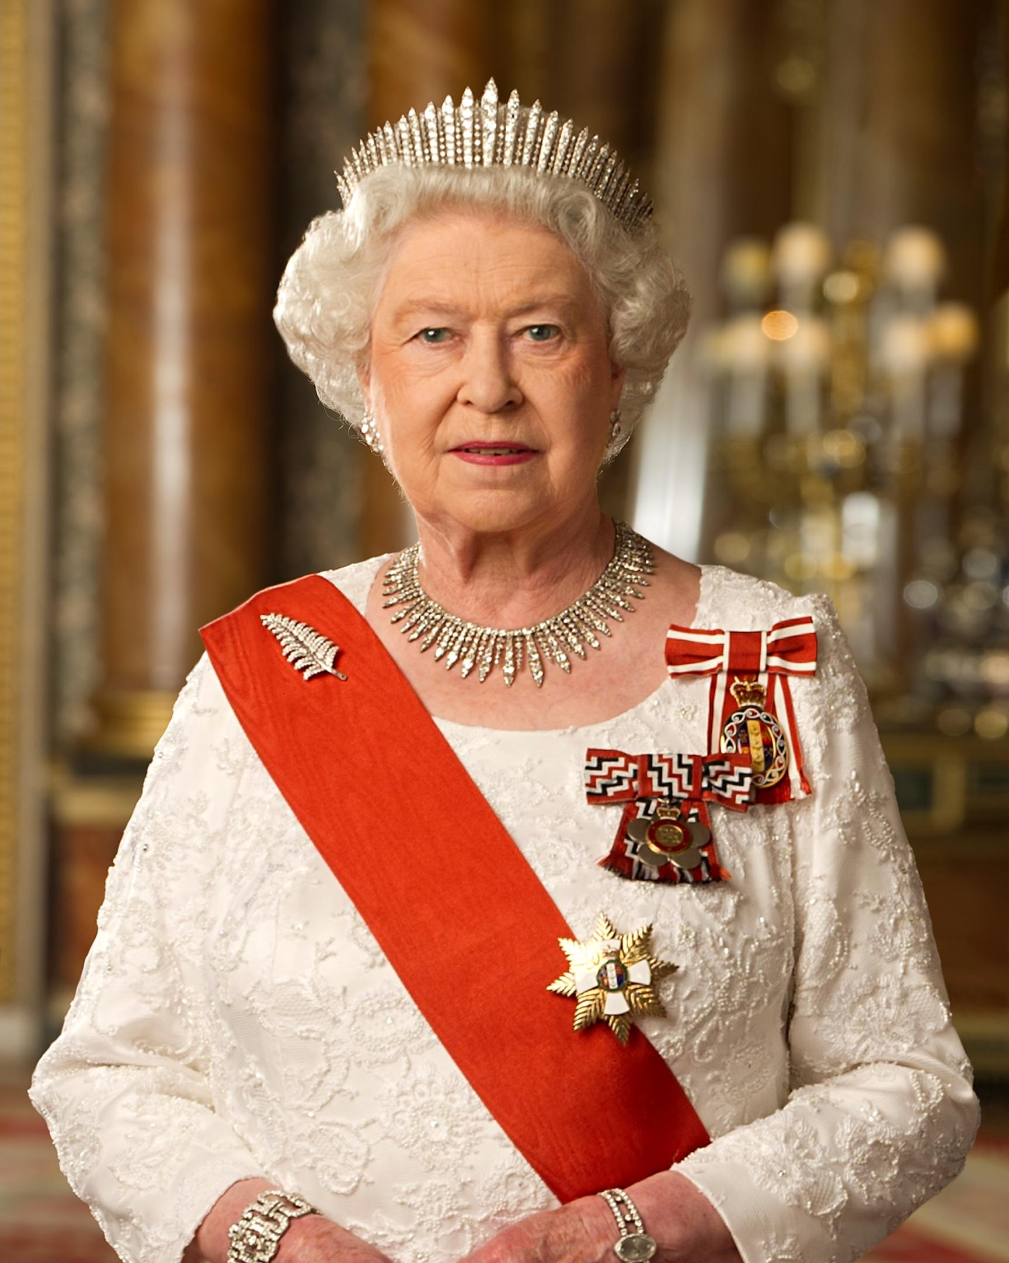

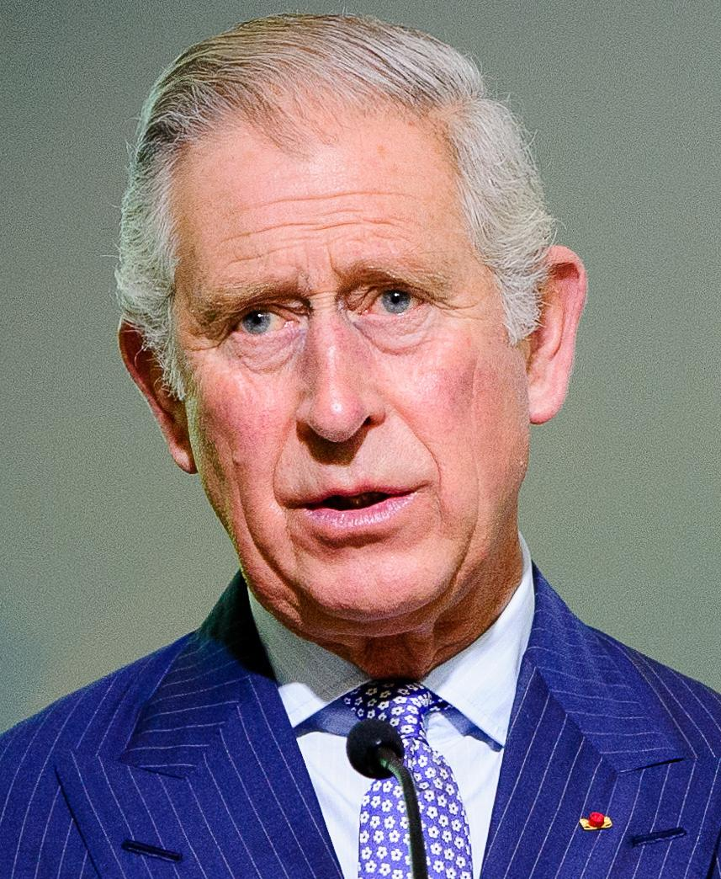
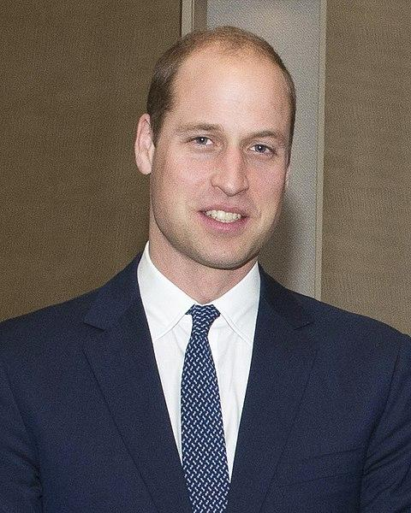
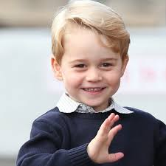
Queen Elizabeth the second
Is the longest reigning monarch
One day we will have a king, who will it be

Slide 6
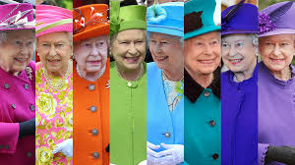
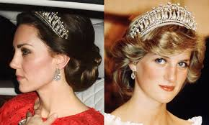
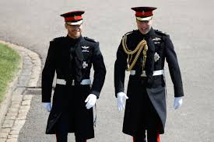
Here are some of the royal dress code rules
Bright colours are necessary for the Queen
Hats for women are a must
Women can only wear tiaras when they are married
Young princes have to wear shorts
Nails are to be kept plain
Always have black clothes ready
Coats must stay on
Wear gloves for protection
Ladies must wear tights
Denim is not preferred but not forbidden
Men wear military clothes to get married

Slide 7
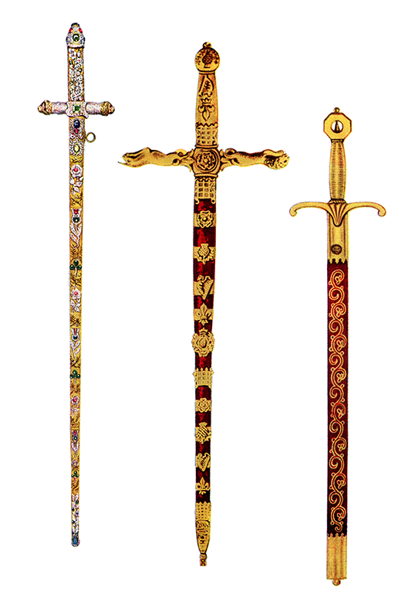
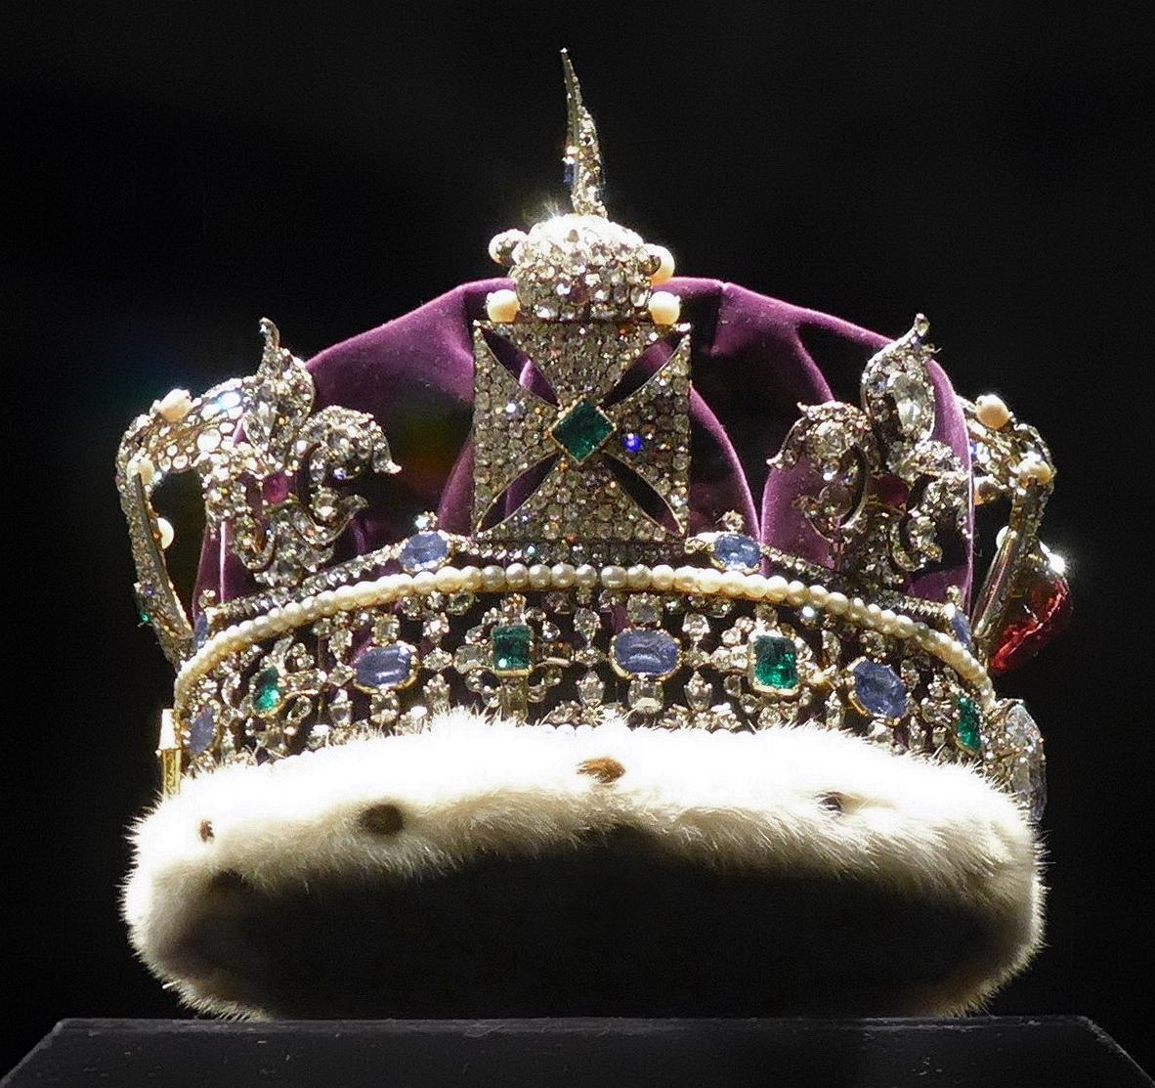
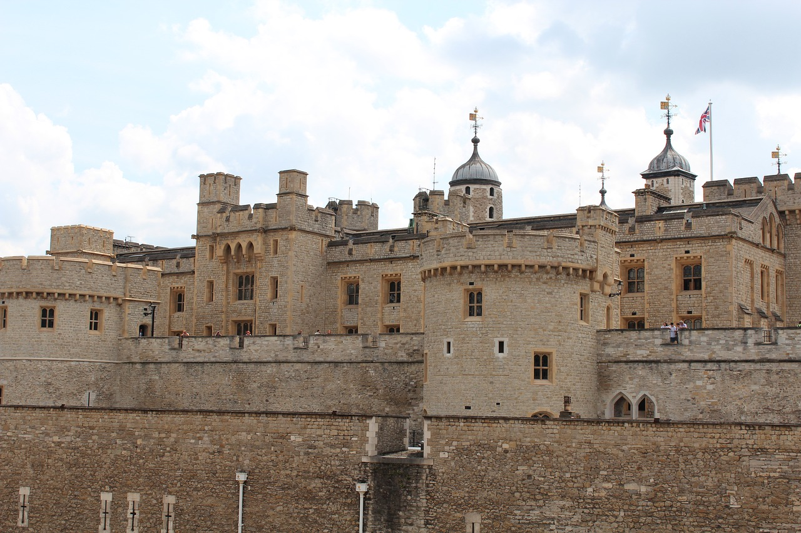
Crown jewels of UK
35 pieces of secular plate
31 pieces of altar plate
16 trumpets
13 maces
7 sovereign crowns
6 swords
6 sceptres
3 robes
3 rings
3 pieces of baptismal plate
3 prince of wales coronets
2 orbs
2 pairs of armills
1 pair of spurs
1 ampulla
1 spoon
1 walking stick
1 armlet
1 monde
There are 142 objects of the crown
Jewels in the tower of london.

Slide 8
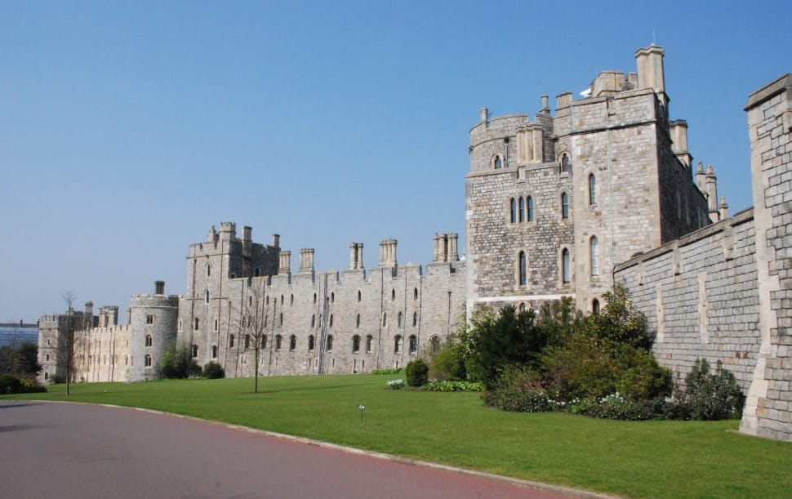
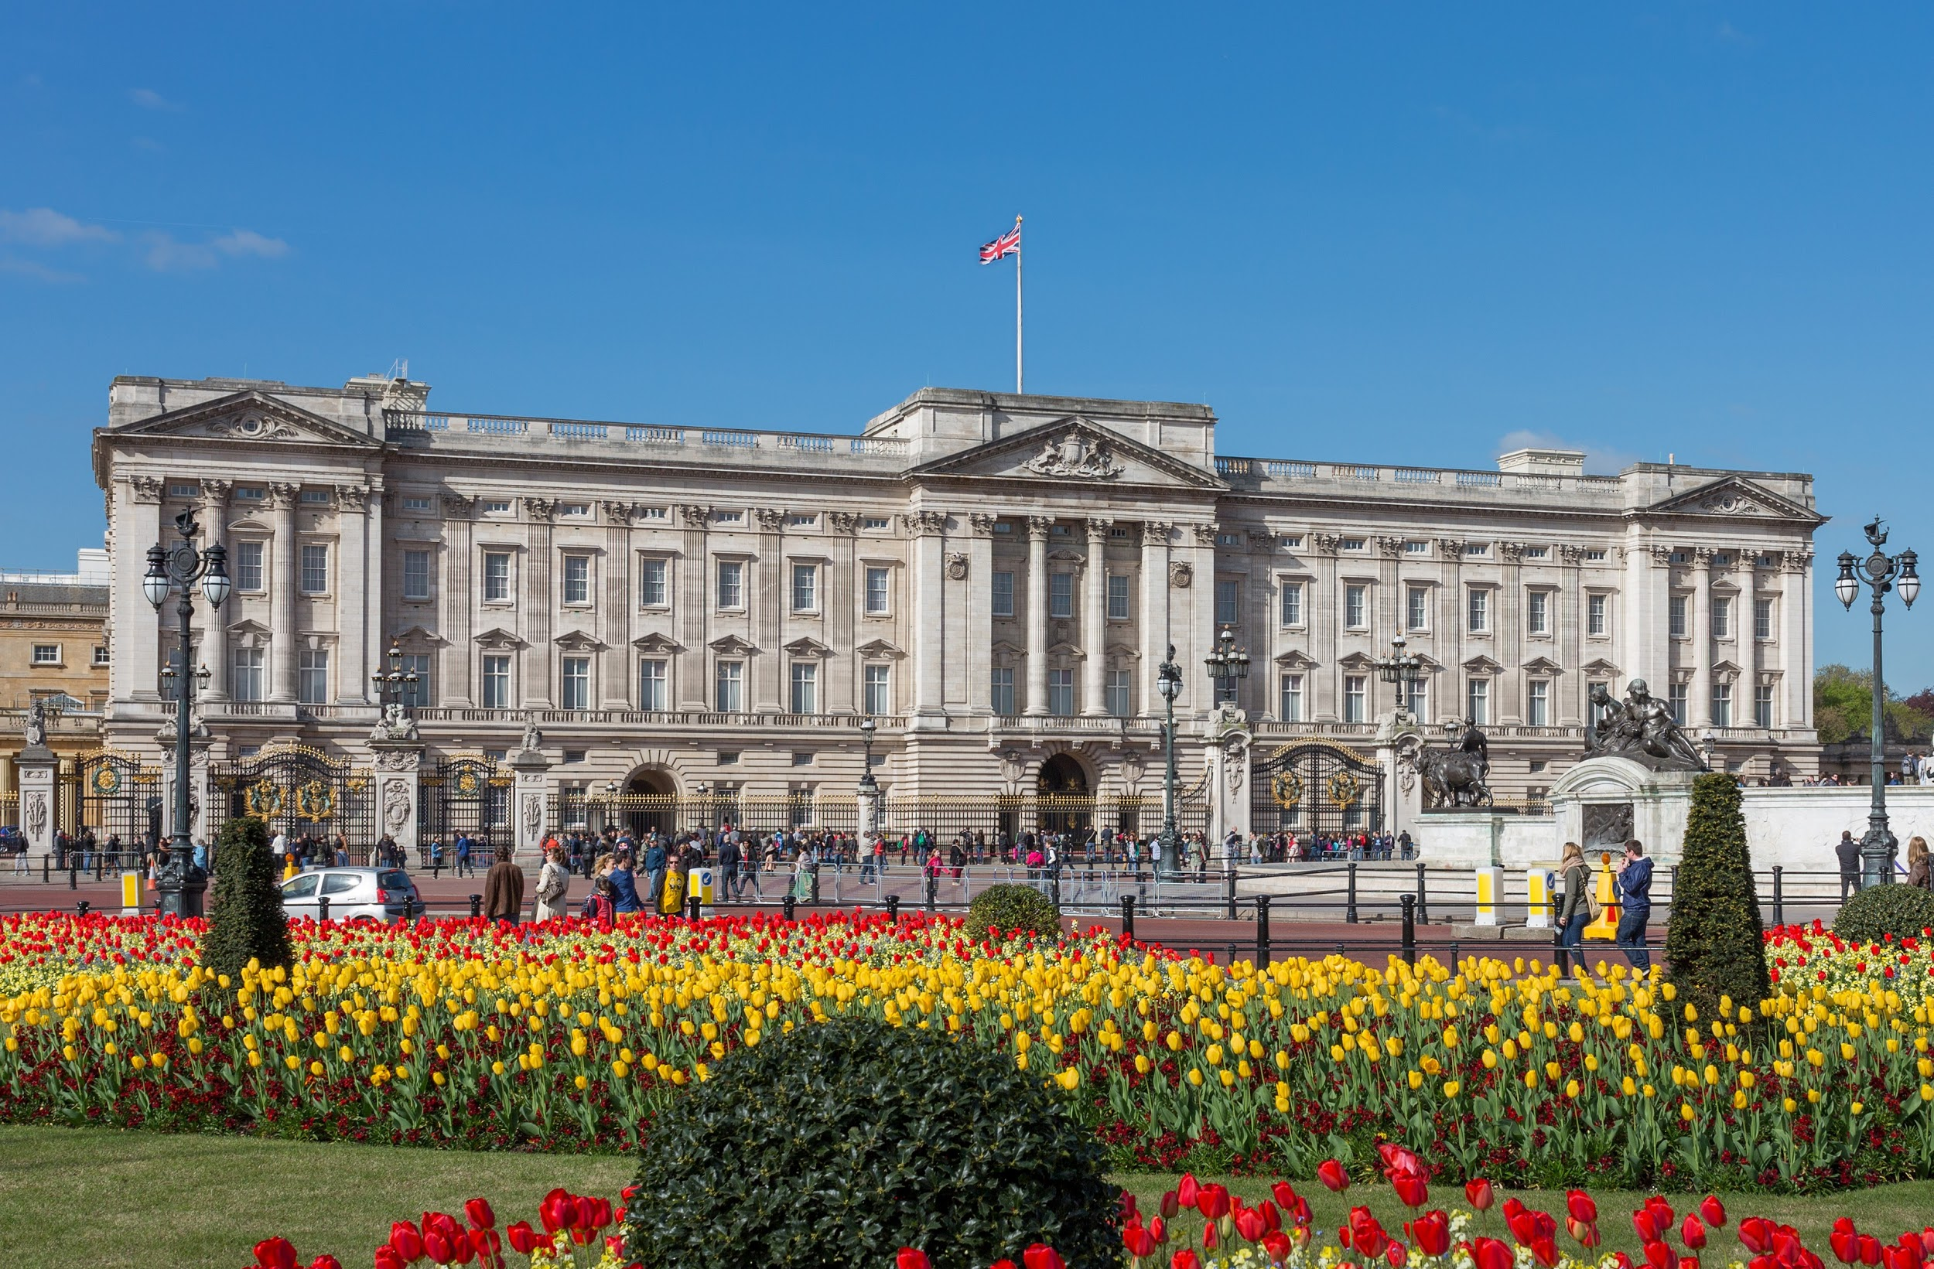
Royal family homes
There are many royal family homes in the UK, most are still lived in. The Queen lives in Buckingham palace and Windsor castle. You can tell when the Queen is home as the Union Jack is flying high.
Other royal homes are
Balmoral castle
Sandringham house
Clarence house
St James palace
Kensington palace
Osbourne house
Frogmore house
Palace of holyroodhouse

Slide 9
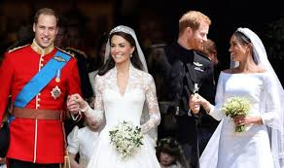
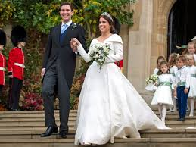
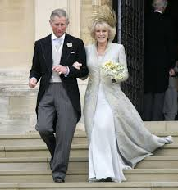
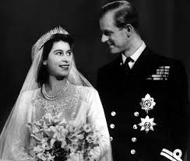
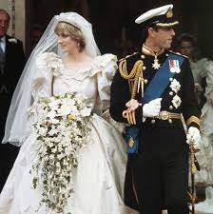
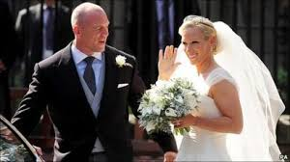
Royal weddings

Slide 10
My Royal menu
Starter
Carrot or tomato soup with a selection of breads.
Main
Steak with seasonal vegetables, with a choice of sauce, yorkshire puddings and roast potatoes, sprinkled with the finest gold flakes.
Desert
Chocolate pudding topped with a ferrero rocher and a biscuit coating.
Warm Chocolate cake with buttercream frosting and a warm caramel pouring sauce.

Slide 11
