Slide 1
PETS
A pet or a companion animal, is an animal primarily for a persons company or entertainment rather than a working animal , livestock or a laBatory animal . Popular pets are often considered to have attractive appearances , intelligence and relatable personalities , but some pets may be taken in on altruistic basis (such as a stray animal) and accepted by the owner regardless of these characteristics. The two most popular pets are cats and dogs ; the technical term for a cat lover is an ailurophile , and a dog lover cynophile.iam going to show you different kinds of pets and what kind of pet I would like when I am older.
The information above was researched at Wikipedia.

Slide 2

Tallest pet
Giant George: a 43 - inch great Dane (Arizona):
Giant George was a blue Great Dane previously recognised as the world's tallest living dog, and the tallest dog ever by Guinness World Records. There were originally conflicting media reports regarding his height, but the official measurement showed that he was three-quarters of an inch taller than the previous record holder, Titan (at 42.25 inches (107.3 cm) at the withers) and an inch shorter than the subsequent record holder, Zeus.[1] His records were announced as he appeared on The Oprah Winfrey Show in February 2010.
Researched at Wikipedia

Slide 3

Smallest pet
The smallest dog living, in terms of height, is a female Chihuahua called Milly, who measured 9.65 cm (3.8 in) tall on 21 February 2013 and is owned by Vanesa Semler of Dorado, Puerto Rico.
THE INFORMATION ABOVE
WAS REASERCHED AT
WIKAPEDIA.

Slide 4
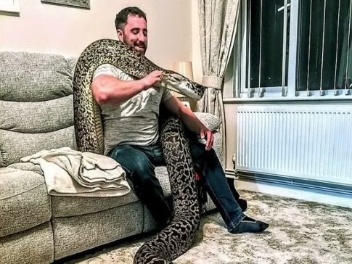
Dangerous pet
A Burmese python : a dad who bought an 8-inch snake has seen it grow into the worlds biggest Burmese python measuring over 18ft – and still keeps it in his three bed semI ! Marcus Hobbs, 31, who lives in Gloucestershire, purchased Hexxie from a pet shop eight years ago - and watched it become a 110kg (17 stone) whopper.
THE INFORMATION ABOVE WAS Researched AT website daily record.co.uk

Slide 5
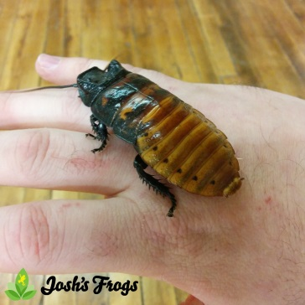
Weirdest Pet
The Hissing Cockroach: The Madagascar hissing cockroach, also known as the hissing cockroach or simply hisser, is one of the largest species of cockroach, reaching 2 to 3 inches (5.1–7.6 cm) at maturity. They are native to the island of Madagascar, which is off the African mainland, where they are known to be found inside of rotting logs. It is one of some 20 known species of large hissing roaches from Madagascar, many of which are kept as pets.
The information above was Researched at Wikipedia

