Slide 1

Year 6 Careers Week

Slide 2
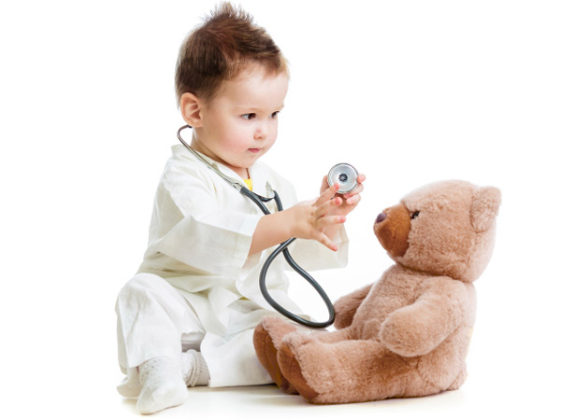
Doctor
I’m a paediatrician which is a Doctor specialising in Children’s health. I care for children from birth until their 18th birthday with a variety of medical problems.
How did I get here?
  GCSEs and Alevels: Need good grades in Sciences but can also do non-science subjects. I took Geography A-level.
  Studied Medicine at University: 5 or 6 year course with the chance to go abroad. I went to Australia for 3 months.
  Foundation Dr: 2 years of trying different medical specialties
  Paediatric training: 8 year programme to become a consultant paediatrician
What’s good about the job?
  Different every day
  Get to work with a team and meet lots of different people
  Working with children is fun- they always make you smile
  Flexible career- can take time out to travel, do research or teach.
  Well respected
  Good pay
What’s not so good?
  Work shifts including nights and weekends
  Can be quite sad when things don’t go well
Tasks:
1: Doctors need to be good at handwashing: put on a pair of rubber gloves and use paint as handwash- can you cover the gloves in 20 seconds? Which bits did you miss?
2: Doctors need to be good at communicating. Imagine you have found someone unwell in the street and practice having to “call an ambulance” with a friend or parent. You need to be able to tell the operator you want an ambulance, where you are (as clearly as possible- look for landmarks or street signs) and what has happened to the person.
See https://www.youtube.com/user/stjohnambulance to learn more about first aid

Slide 3
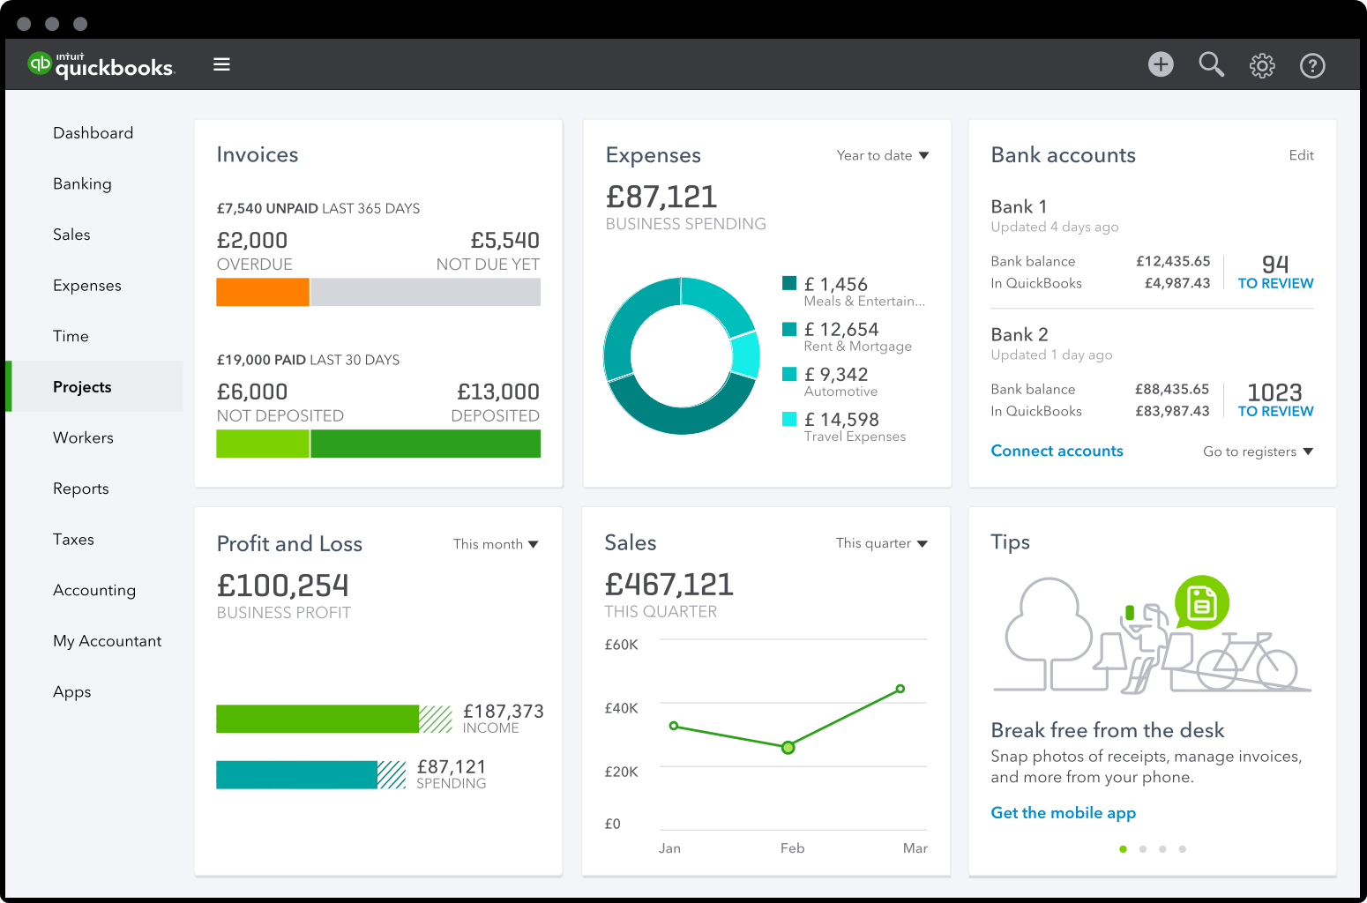


Trainee Accountant
What is an Accountant and what do duties include?
Accountant job duties include providing tax advice, helping companies report their financial situation, bookkeeping and data analysis. In an accountancy firm (or ‘a practice’), you will work with other companies and individuals to help them pay the right tax, compile their accounts, and then use that information to help them grow and make more money.
What do I do in my role as a Trainee Accountant?
The jobs I do in my role are similar to the description above but on a more basic level as I am training & still learning. I process Payroll (People’s wages), VAT Returns (Companies & Non companies Value Added Tax returns) to advise them of how much VAT they owe to the Government (HMRC), I also process accounts for self employed (sole traders & partnerships).
What do I most enjoy about my job?
I enjoy problem solving and constantly working out calculations which keeps my brain active allowing days to go quickly. I also enjoy that no day is the same and I get to meet clients/ business owners on a regular basis
Activity- Due to accounting being like Maths. Give this a try.
You have been given a bank account. Can you work out, after the incoming and outgoings, how much money is left?
How did I get to where I am? How do I get to where I want to be? Are there other routes to the same result? Lastly what made me want to be an accountant?
I got to where I am now by working hard at school, especially in maths by practicing all the time and challenging myself to learn. After school I decided to carry on my studies by continuing to learn as I studied Accounting levels 2&3 with AAT which is an accounting exam body. I am currently studying AAT level 4 and all being well I shall go on studying to qualify as a Chartered Accountant. Alternative routes in the accounting industry include going to University then on to Chartered Accounting.
I decided I want to be an accountant because I have always enjoyed maths, finance & business. If you like: Maths, problem solving and have an analytical brain then accounting could be for you.

Slide 4




Lawyer
A lawyer is a professional who is qualified to offer advice about the law. Lawyers help people in everyday life across many different areas.
Types of law
The most recognised is a criminal
lawyer which is often seen on tv.
This lawyer defends people accused
of crimes.
Family lawyers help people who are getting divorced, or sometimes they help children who are mistreated to find better homes
Real estate lawyers help people
buy and sell houses.
Corporate lawyers help inventors protect their inventions from other people stealing their ideas as well as buying and selling businesses.
This is only a small sampling of the types of jobs lawyers do.
Becoming a lawyer
Good GCSEs and A levels are needed as well as a university degree and you need to pass law school. Once you have done your GCSEs, it takes a minimum of 8 years to become a qualified lawyer. Being a lawyer takes hard work, dedication and many years in education.
Why become a lawyer?
Lawyers spend a lot of their day in meetings or on the phone, therefore it is very sociable.
The law changes yearly so lawyers are always learning!
Lawyers do a lot of good in the world. Sometimes lawyers help parents adopt children from other countries so they can have loving homes or a lawyer might help bring someone to justice who has harmed an animal.
And the best bit - lawyers often get paid well too!

Slide 5

Garment Technologist
I have a very exciting job working in fashion for a company that makes clothes for New Look, so you might have some of our designs in your wardrobe! I make sure clothes fit properly and check they have been made to a great standard - no one wants a pair of jeans with a hole in!
I’ve had amazing experiences travelling all over the world to visit the garment factories so I’ve seen how clothes are made from start to finish! This includes dyeing fabric, pattern cutting, sewing all the pieces together, pressing the garment so it’s neat and packing the goods so they can be sent to the U.K. to be sold in our shops.
I went to college to study for my A Levels so that I could go university and complete a degree in Fashion Design - you need to try and get as much experience as possible to get a job in fashion as it’s very competitive but a very exciting environment to be part of!
ACTIVITY
From your wardrobe, choose out 5 items of clothing. There should be a white label inside which tells you what the garment is made from. Research where each of these fibres come from e.g.a jumper might be 100% wool, wool comes from sheep!

Slide 6
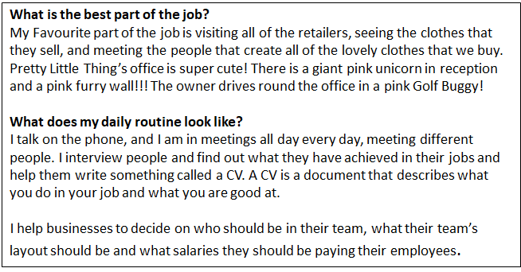
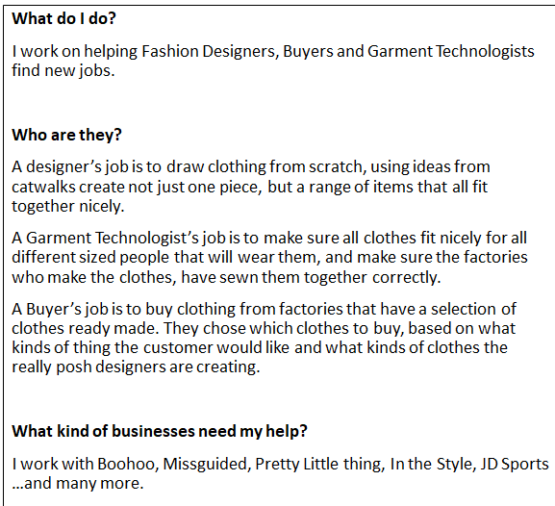
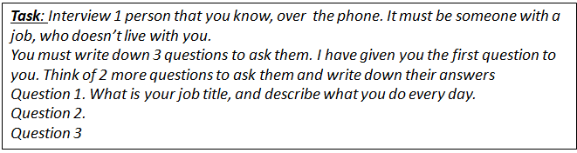
Recruitment Consultant

Slide 7
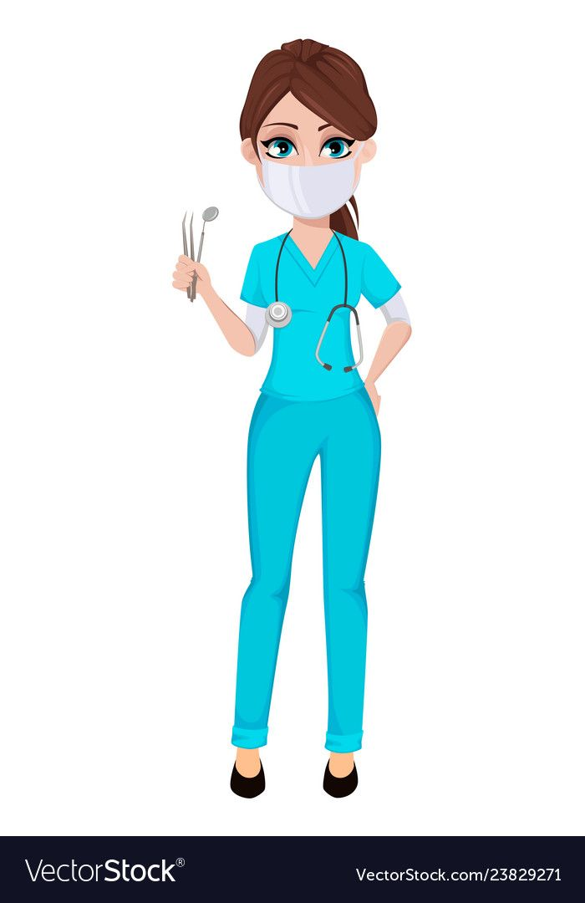
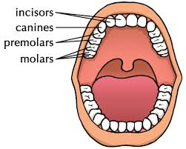
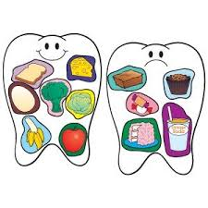
Do you want to be a dentist?
What do we do?
Improve the health of teeth and gums.
Fillings, removal of teeth, cleaning teeth.
Give advice on healthy foods and drinks.
Take X-rays.
Straighten teeth with braces.
I would suit this job if I…
Enjoy working with people.
Am a caring person who likes to help others.
Am good at working as part of a team which includes dental nurses, receptionists, hygienists.
Enjoy ‘hands on’ practical activities.
Enjoy science subjects at school.
Am not too squeamish!!!
Good foods/Bad foods
How do I become a dentist?
*GCSE’s
*Work experience at a dental
practice during school holidays.
*A Levels in Chemistry and Biology/Physics
*Dental Degree (5 years)

Slide 8
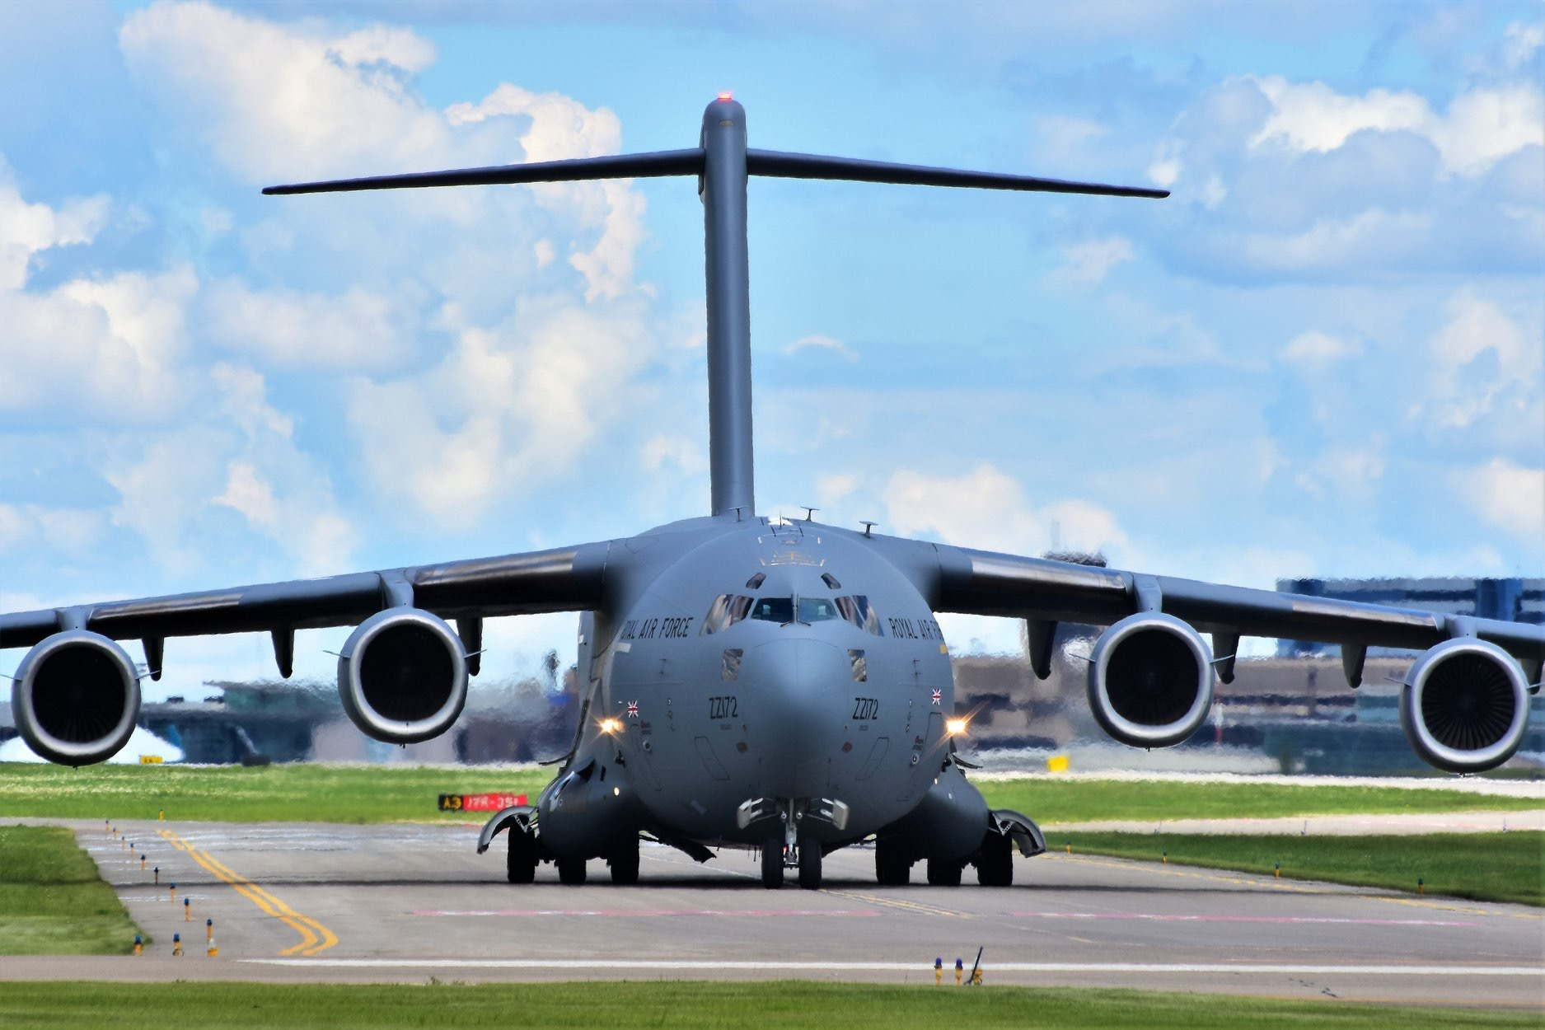
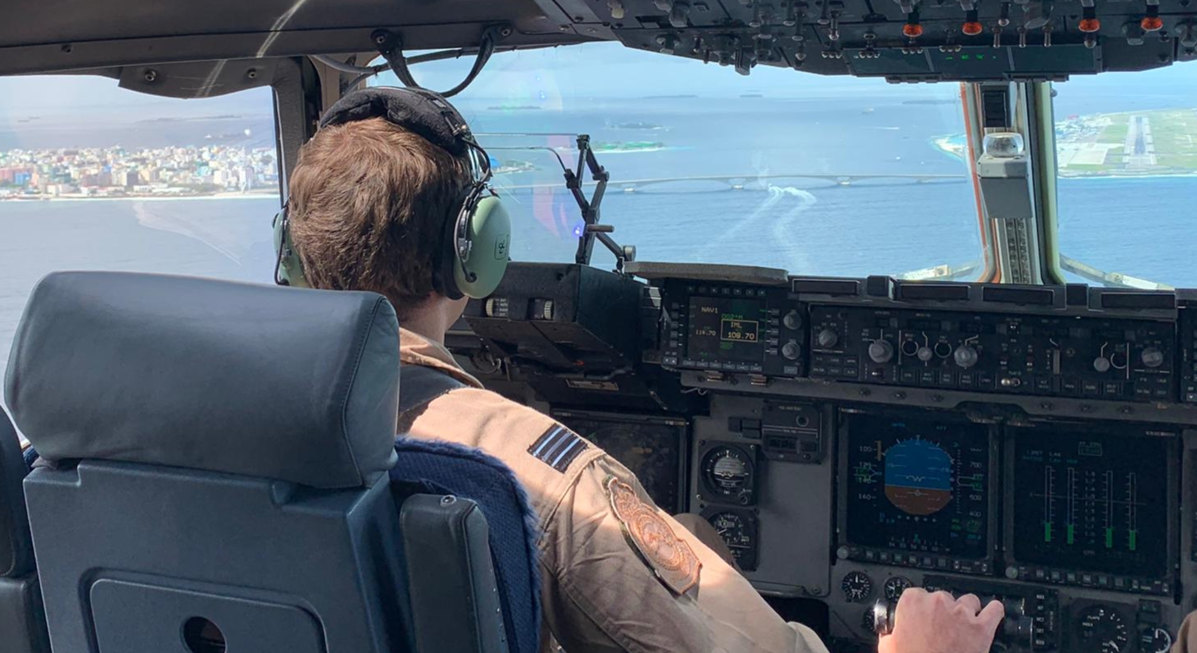
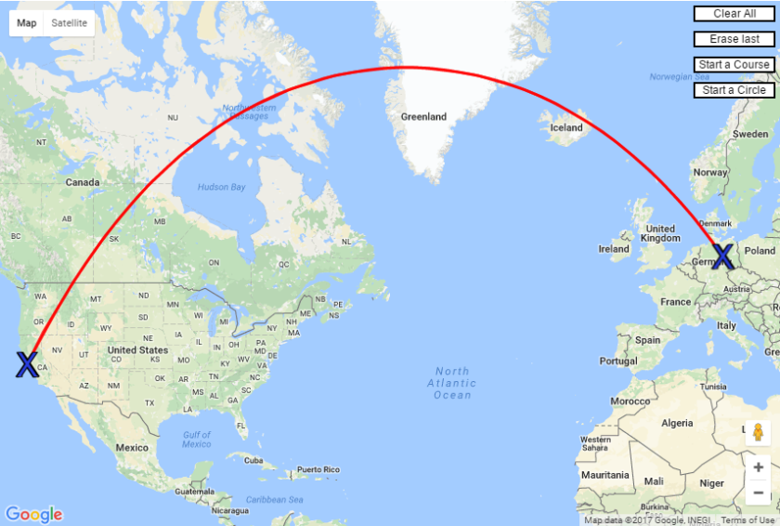
Pilot
I’m a C-17 Pilot in the RAF. The C-17 is the largest cargo aircraft in the RAF. When fully loaded, it weighs more than 265 tonnes. The C-17 can carry cargo, passengers, helicopters and even tanks!
After my A-levels, I studied Maths at University before starting Pilot training that takes 5 years.
What’s the best part of my job?
Every day is different and brings a new challenge! The job takes me all over the world, from Afghanistan to Las Vegas! The most rewarding part of the job for me is flying medical supplies into places where they have no other way of getting them.
Task
If you want to save time and fuel, which route would you fly? Red or black, and why?

Slide 9


Vicky - Direct Marketing Manager
What is Direct Marketing?
This is a method of advertising where we pre-select our ‘target group’ (chosen customers) to talk to them about a product or service that is relevant for them - this is otherwise known as a Direct Marketing Campaign, and usually we are trying to persuade customers to do something by incentivising them (for example, by giving a discount to buy something or a prize for a customer survey).
We talk to our customers through different channels of communication, such as mail, email, mobile apps and telephone. We would usually pick a channel that is most relevant to our customers, so for example we might use mobile app messaging for young adults, and instead use mail for an older generation that prefer post.
Direct marketing can be used to increase the number of new customers for a business, or it could be used to speak to existing customers which helps to keep a relationship with them (and hopefully encourage existing customers to buy again!)
What are the best bits about my job?
Personally I love bringing every aspect of a campaign together. This includes deciding the ‘target group’, organising our creative (what the campaign will visually look like), project managing the launch of the campaign and finally reviewing performance, so we can always look to improve future communications with our customers.
My journey to becoming a Direct Marketing Manager
I studied Business & Economics at GCSE and A Level, and went on to do a degree in Marketing as my chosen area of Business. This is what interested me the most as I found it quite creative. After completing my degree, I spent time working in Marketing agencies supporting companies with their campaigns which was fun and fast paced. I now work for Nationwide Building Society and I am responsible for getting key messages to customers through their Internet Bank and Mobile Banking app.
Your activity
Please create a direct marketing campaign using a poster - you can choose a product of your choice that you would like to advertise.
For the poster, think about the following:
Tell us about your product
Who do you want to target / speak to, and why?
What channel of communication will you use?
What will be your key message for the campaign and will there be an incentive for the customers you are speaking to?

Slide 10
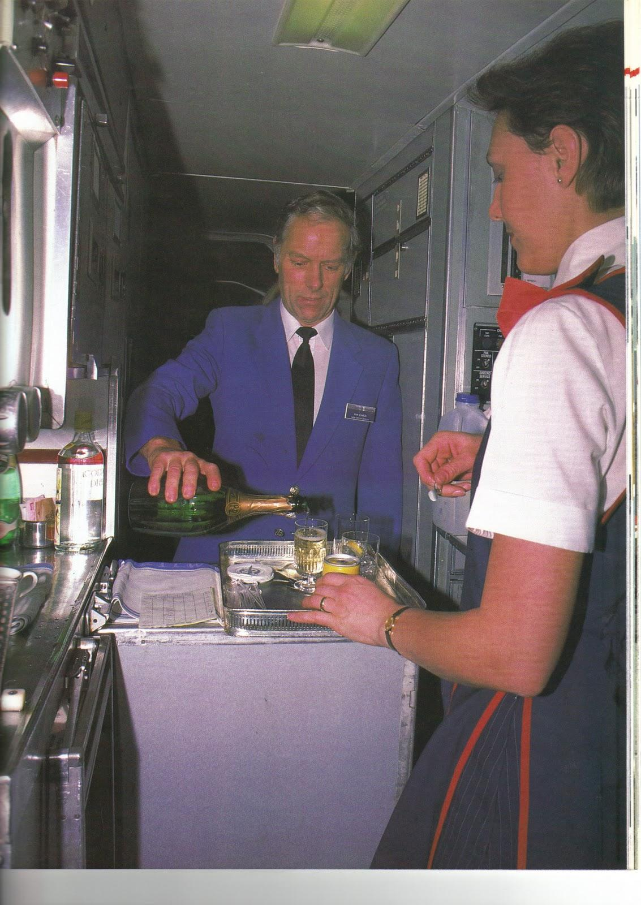
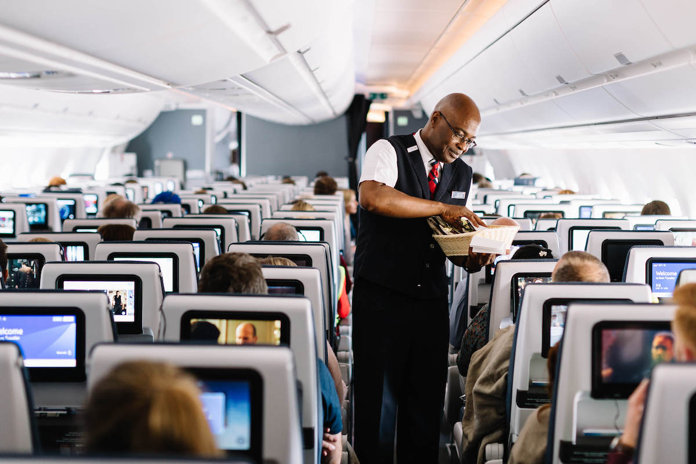
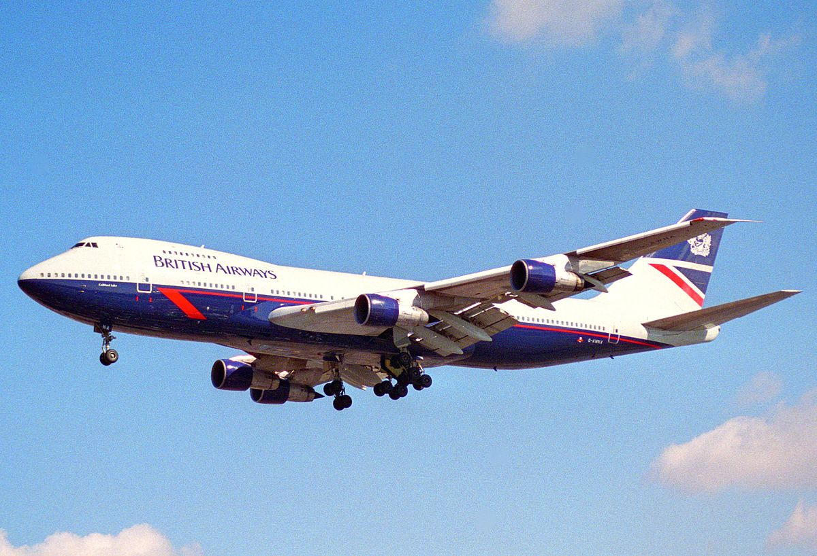
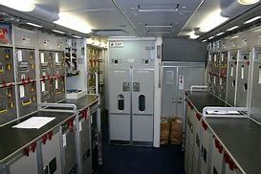
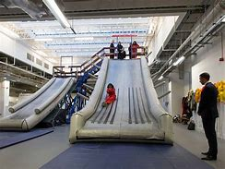
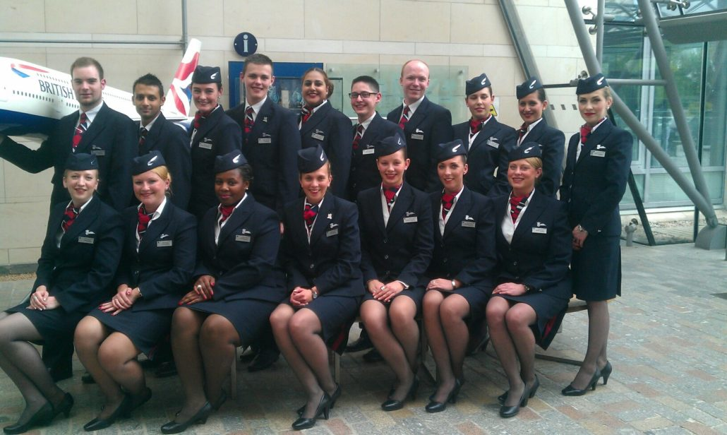
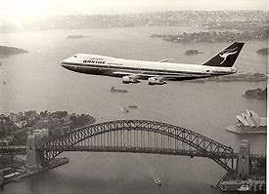
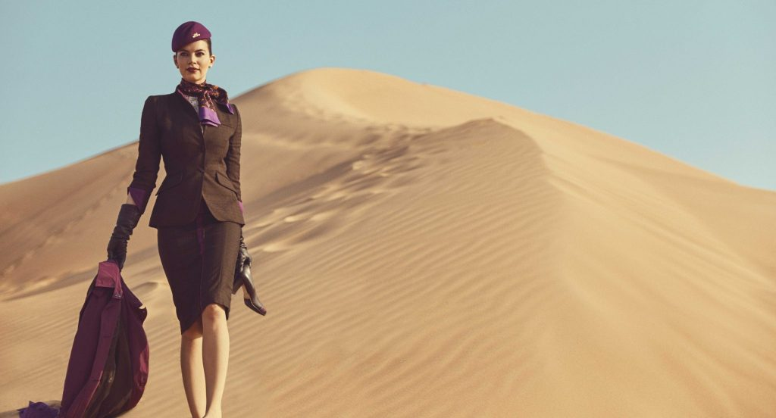
Cabin Crew
I was Cabin Crew for British Airways on 747 Jumbo jets
The best bits were travelling to far off places with a great team, being paid to sit on an exotic beach or visit the sights for a few days then returning home. I mixed with lots of different passengers such as ships crews, Royalty and celebrities. I got to fly with Paul McCartney (The Beatles!) which was a highlight. The major part of the job was safety, followed by keeping passengers happy.
To get there, after passing A levels, I studied Business studies through BA while I worked in their head office. I much prefer being cabin crew rather than an office so asked to transfer...and never looked back!

Slide 11
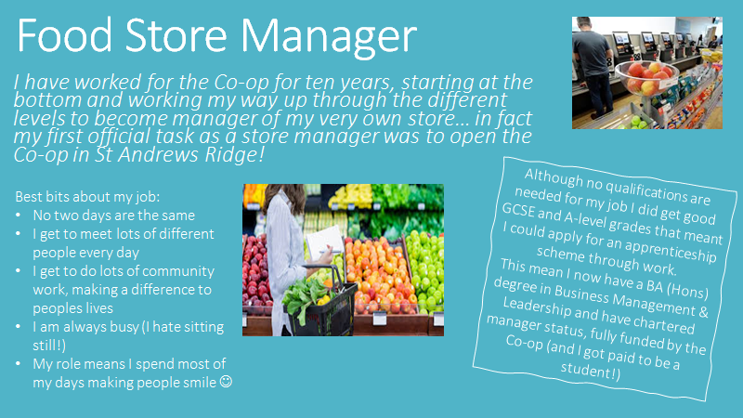

Slide 12
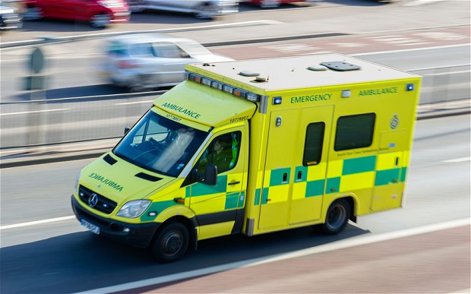
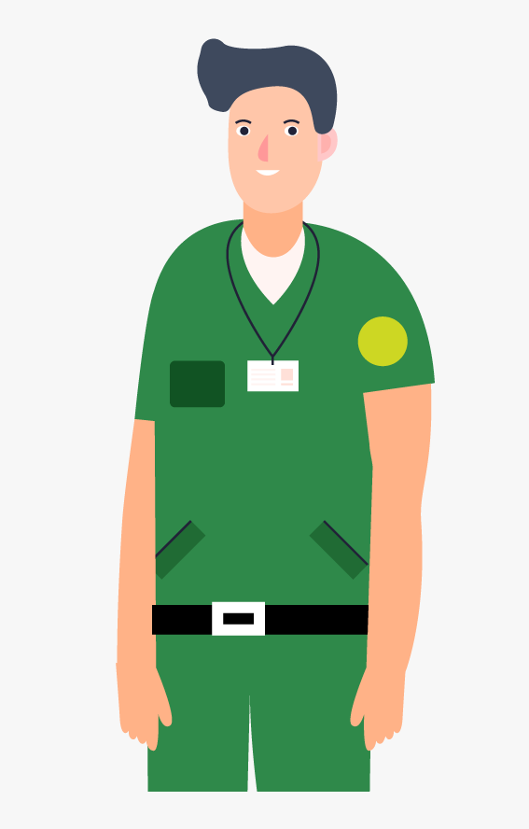
Ambulance Service
Currently I am a software developer and data analyst working with the Ambulance Service helping them forecast their demand which assists with deciding how many ambulances they put out ‘on the road’ every day.
I started out with very few ‘O’ levels (GCSE) and joined the ambulance service many years ago as a Technician. I then qualified as a Paramedic and moved up through the ranks, eventually becoming a Divisional Commander responsible for the operational management of three ambulance stations.
Being a clinician in the ambulance service was a very rewarding role, helping people at times of crisis and treating injuries and illness. It is a job where you can see the best and worst of people in all levels of society. You end up working closely with the police, fire brigade and hospitals. Level-headedness and problem solving are things that help you in the clinical role.
I discovered late in my career that I rather enjoyed dealing with data and statistics and writing computer code which is why I do what I do now. It is never too late to change direction and you will be amazed at the number of opportunities there are out there doing jobs you never dreamt about. Be interested, apply yourself and good things will happen.

Slide 13

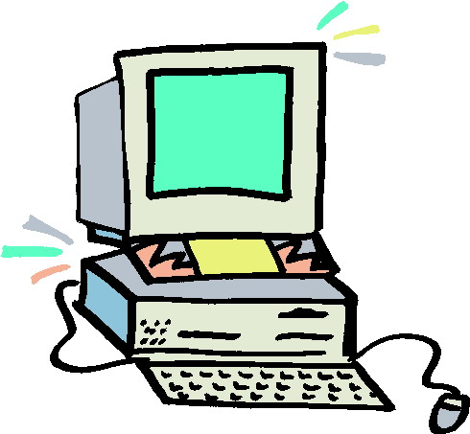
Software Sales
After leaving school with only a few qualifications, I had a sales career selling software to large corporations.
I travelled around the country meeting a large range of people. I helped them make decisions on which software they should purchase.
Some days I was office based while other days I had to drive across the country - I got to see lots of different places! Whilst on visits I would often need to drive 400 miles - listening to music helped the hours pass by!
There were highs and lows, I had a great feeling of success when someone bought (if they did, I earned extra money). I saved the extra money and bought some properties that I now rent out.

Slide 14
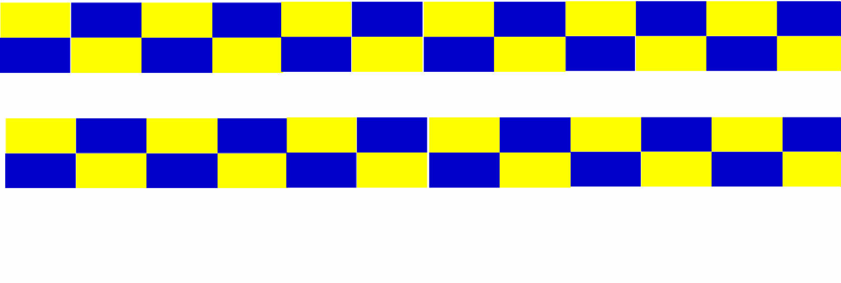

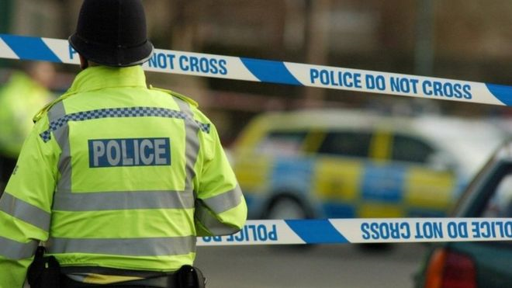
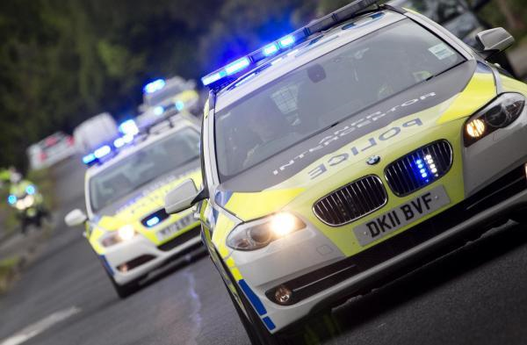
Police Officer
My name is Sam, I am a Police Officer with Wiltshire Police and I patrol the Swindon area. It was always my dream to be a Police Officer, ever since I was 3 yrs old!!
What does a Police Officer do?
Protect the public from violence
Provide a reassuring presence in the community
Support victims of crime and those that have witnessed a crime
Investigate crime
Being a Police Officer is a very interesting and varied job. Every day is different and you never know what you’ll be doing from one day to another. You could be arresting and interviewing a suspect, directing traffic around a crash, or taking a statement from a someone who has had their house broken into. It is very rewarding because you help people and protect them from harm.
My background…I studied Public Services at college and went on to study Police Studies at University too. After University I worked in the Police Control Room answering 999 and 101 telephone calls, and taking crime reports from members of the public.
TASK - make a list of the different types of crimes and incidents that a Police Officer would attend and investigate….

Slide 15
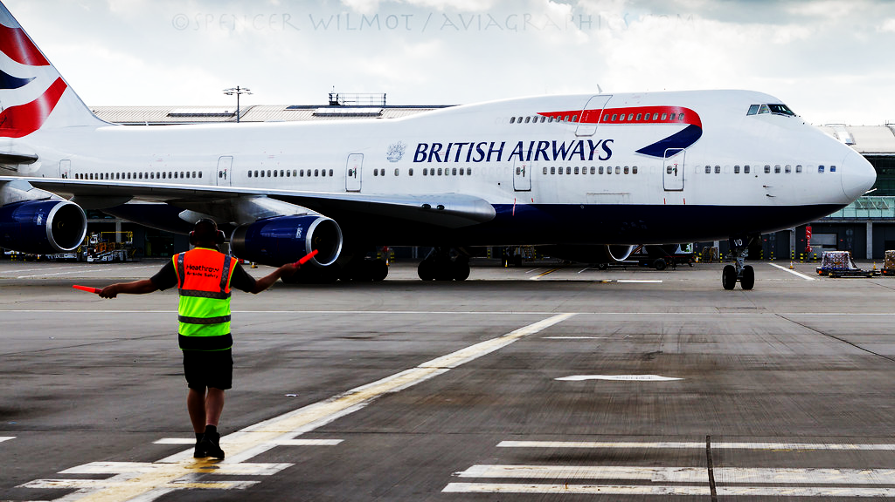
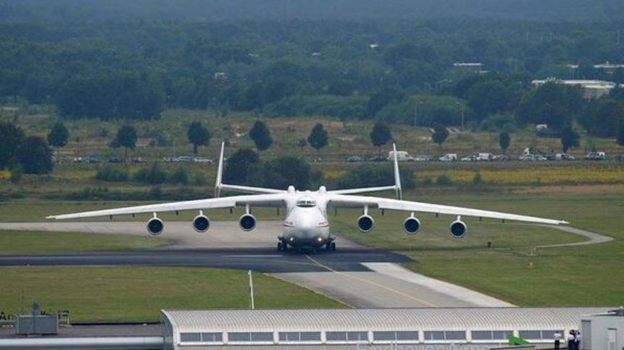
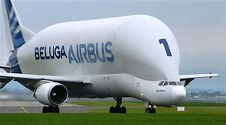
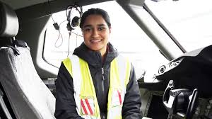
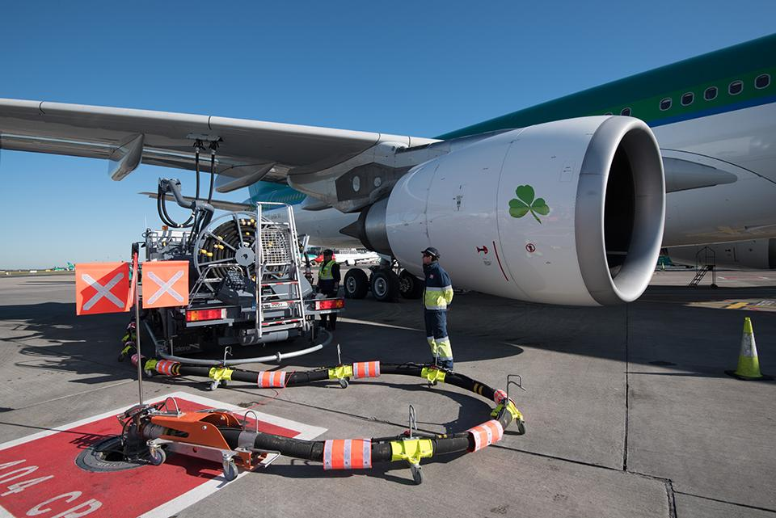
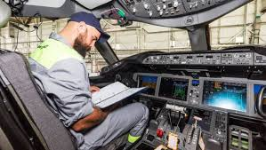
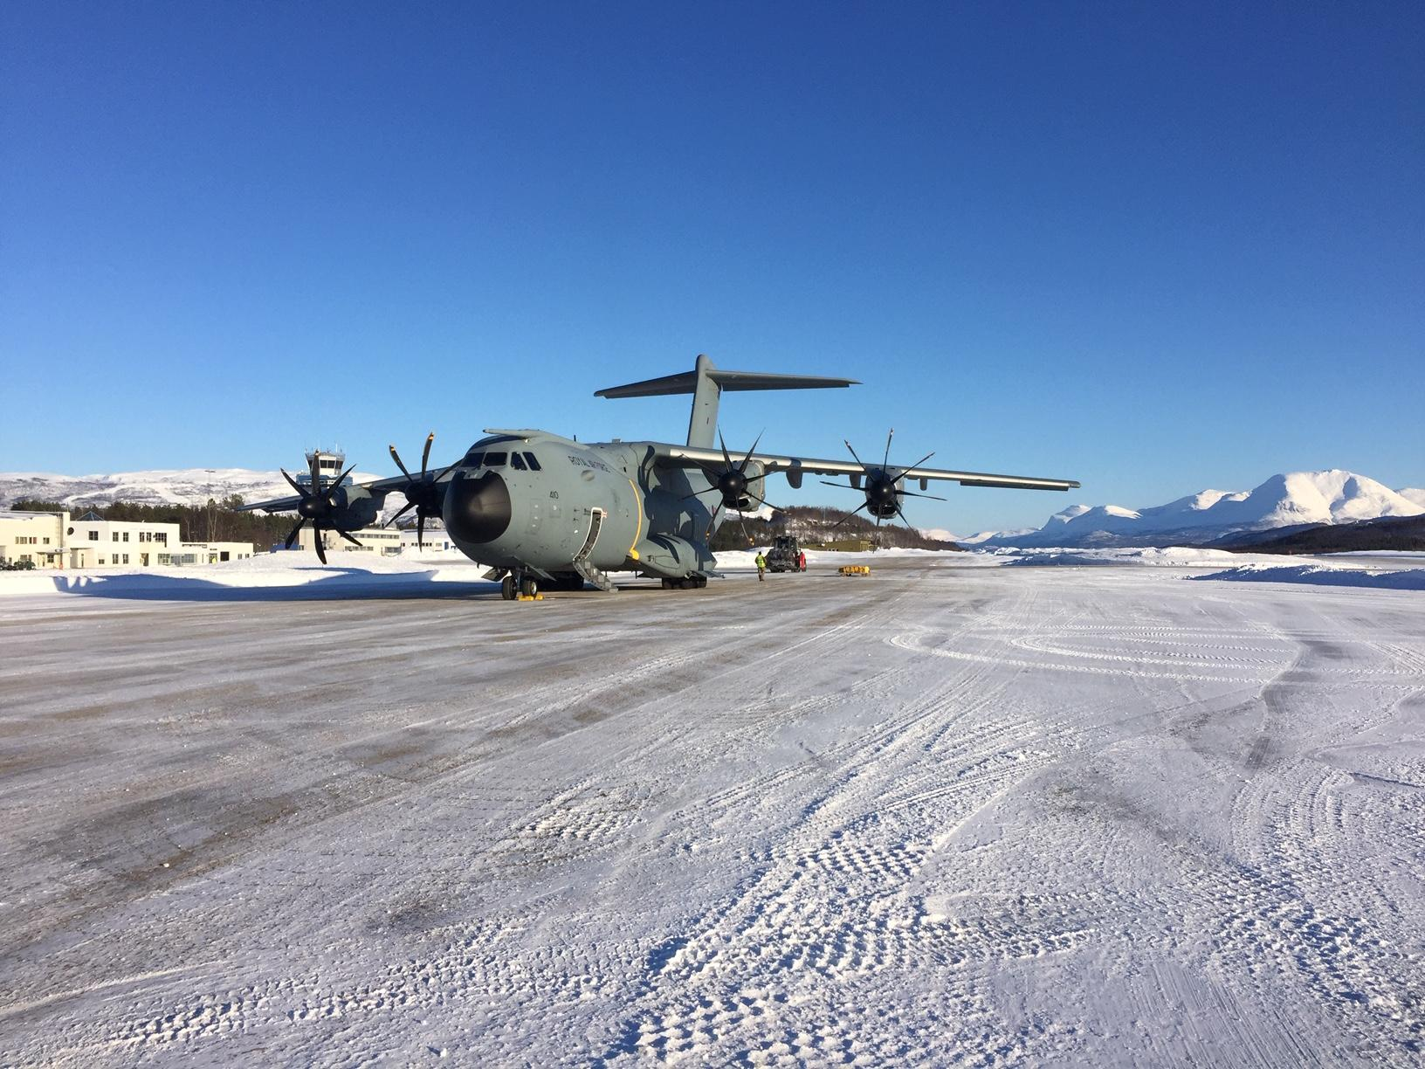
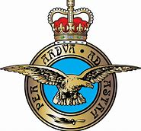
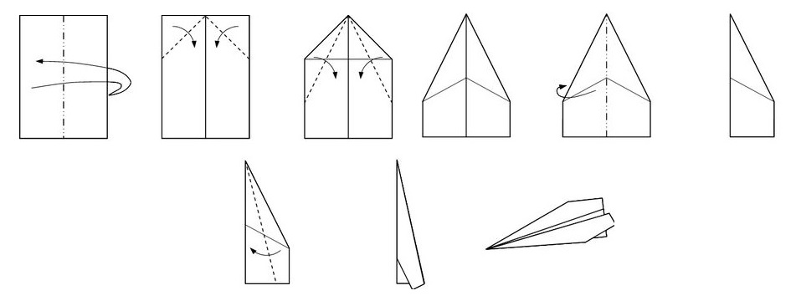
Aircraft Maintenance Engineer
We get aircraft ready to go on their next flight, this could be as simple as refueling to major repairs that takes months to complete.
We fly around the world fixing the aircraft wherever they land; staying in great hotels and enjoying the local culture.
You’ll need:
GCSEs
A Levels
Degree or Aircraft Maintenance licence issued by the Civil Aviation Authority (CAA).
Have a go!
Can you make a plane?
How far will it fly?

Slide 16
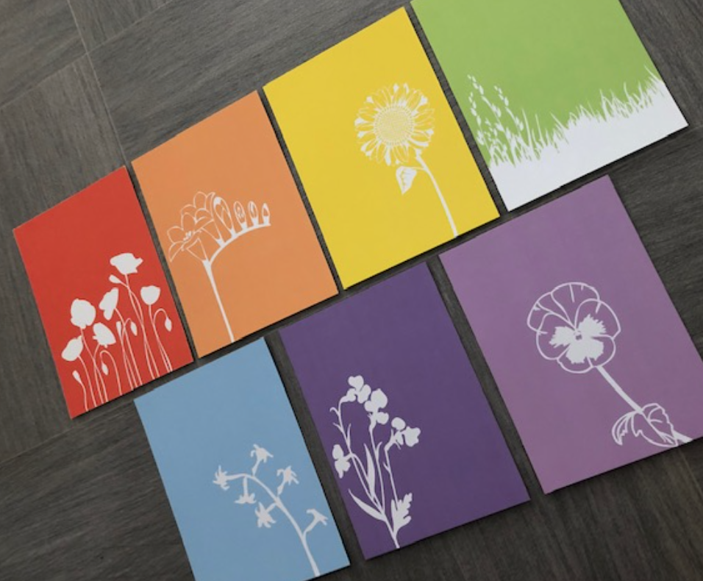
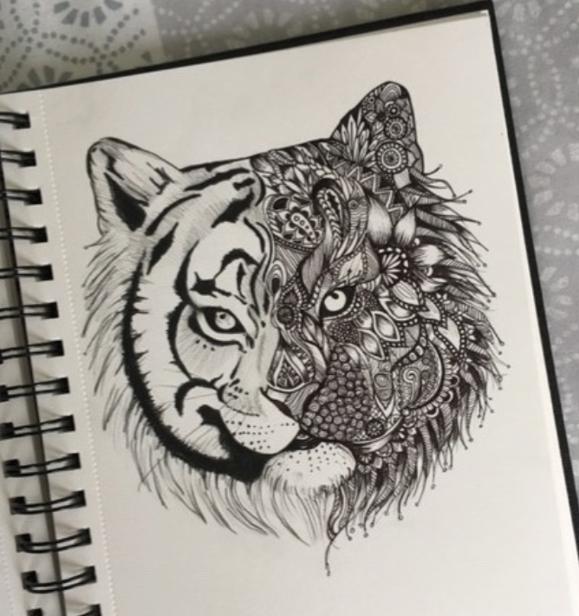

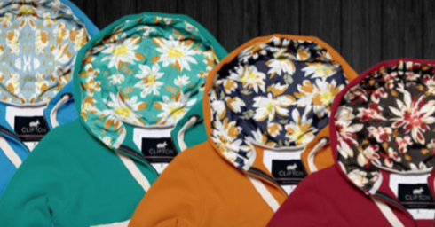
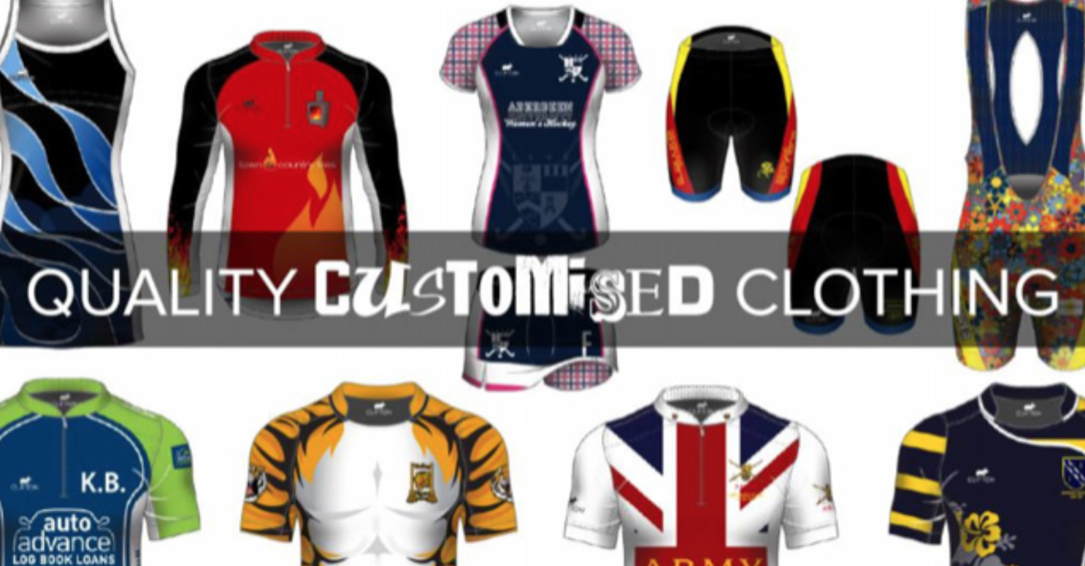


Graphic Design
The thing I love most about Graphic Design and Art is being able to be creative. In my spare time I enjoy drawing, and I am often commissioned by people to create Artwork. I have added some images of the work I have created.
After school/sixth form I went to college for a year to do a Foundation course in Art and Design. This allowed me to try lots of different options within Art, these included Graphic Design, Photography, Ceramics, Illustration and Fine Art. Once I sampled all of these I had to pick which one I wanted to do my Diploma in. I picked Graphic Design, as this interested me the most. I then went to University and got a degree in Graphic Design, where I learnt lots of different skills.
I worked in London for a Design company who make custom clothing and accessories. I used software such as Indesign, Illustrator and Photoshop to create unique one off pieces for customers. They would give me an idea of the things they would like, for example a colour scheme, any images they wanted on the clothing. Then I would create this for them.
My role included tasks such as-
Designing logos
Picking Fabrics and colours for the clothing
Creating layouts for the company website
Taking photos of the clothing
Drawing art work (either by hand or on the computer)
Task- Redesign your school logo, come up with a new and exciting design. I have added your current logo for reference.
Your design can look however you want, but you must use this colour scheme/palette

Slide 17
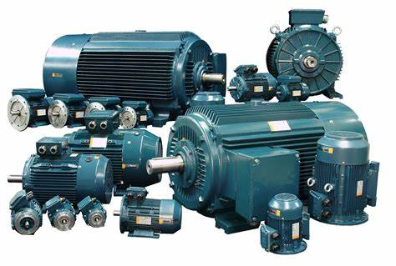
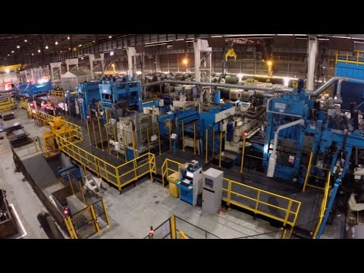
Electrical Engineer
What is it?
Electrical engineering is the design, building and maintenance of electrical control systems, machinery and equipment.
What makes it enjoyable?
It presents a different challenge every day.
It provides a sense of satisfaction when repairing or installing machinery and returning the customers plant back to working operation.
Activity:
Create a list of food companies that might use machinery that may need fixing.
https://www.youtube.com/watch?v=LAtPHANEfQo
What do we do?
We provide on site technical support at sites such as nuclear power stations, steel works, within the chemical industry and also provide technical support to food and beverage companies. We are instrumental in ensuring their production lines function correctly.
What does it take?
You will need GCSES in maths, science and English.
You can then complete an apprenticeship which is four years. Also working on site and attending college. This provides you with the technical qualifications.

Slide 18

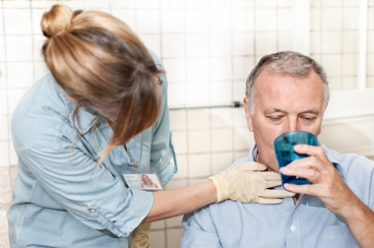
Speech and Language Therapist
What do speech and language therapists do?
Speech and language therapists diagnose, assess and treat babies, children and adults with communication and/or swallowing difficulties.
Our patients range from toddlers whose speech is slow to develop to older people who lose their ability to speak or swallow due to illness or injury.
Where we work:
Mostly within the NHS.
Settings include nurseries, schools, health centres, hospitals, prisons, youth offending institutes, visiting patients’ homes, charities.
How do you become a speech and language therapist?
GCSEs & A levels, preferably in related subjects (eg English, science, psychology)
4 year undergraduate degree or a 2 year postgraduate degree in Speech and Language Therapy
You would make a great Speech Therapist:
If you want to help people
If you are a good listener and communicator
If you enjoy English & science
If you enjoy working as part of a team
If you like a challenge
If you want a flexible job with lots of different opportunities
Task:
Try and communicate a message to someone without using any spoken words- experiment with all of the other ways you can
get your message across!

Slide 19
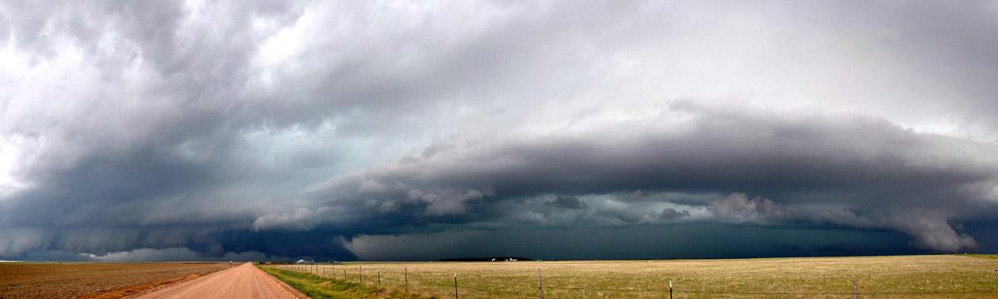
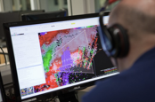
Research Meteorologist
Scientist Dr. Katie Wilson at the CIMMS / NOAA National Severe Storms Laboratory
What do I do?
Conduct experiments to test the impact of new technology on weather forecasters’ predictions of severe weather (e.g., tornadoes, giant hail, extreme flooding)
Explore research questions that have never been asked before
Attend conferences and workshops to learn about lots of other research happening in weather and climate
What qualifications do I have?
Maths (required), physics (required), and psychology (not required) A-levels
Highest degree is Doctor of Philosophy in Meteorology (and you oftentimes are PAID while completing this degree!)
What skills do I need?
Creative thinking and problem solving
Writing (for publications)
Computer programming/coding
Ability to communicate complex ideas in simple language to non-experts
Work well independently as well as in teams
A passion for discovering something new
What other professions can meteorologists work in?
Weather forecasting
Broadcast (TV)
Policy advisor
Insurance industry
Energy industry
Agricultural industry
Teaching
HUNDREDS of research areas (including storm chasing!)
And many more...
Click to watch this video about the National Severe Storms Laboratory: https://www.nssl.noaa.gov/about/
Links to Weather Activity Ideas: http://www.weatherwizkids.com/weather-experiments.htm and https://www.nssl.noaa.gov/education/students/

Slide 20

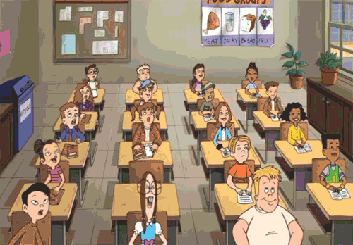
Teacher
To be a teacher you need to have either a teaching degree, or an undergraduate degree with a teaching top up (either through university - PGCE - or school based - SCITT).
This means you need to work hard at school to have GCSEs in Maths, English and Science as well as A-Levels...no matter what subject you want to teach!
The best parts of the job are:
The children!
It’s different every day
Chance to be creative
Working as a team
Make a real difference

Slide 21
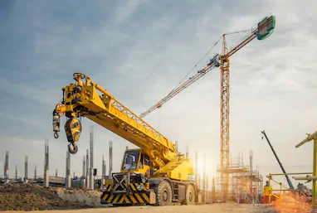
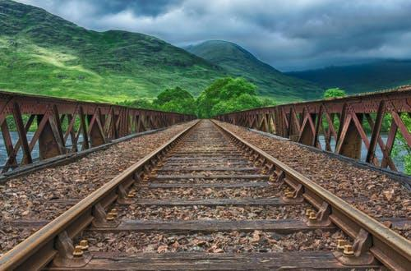
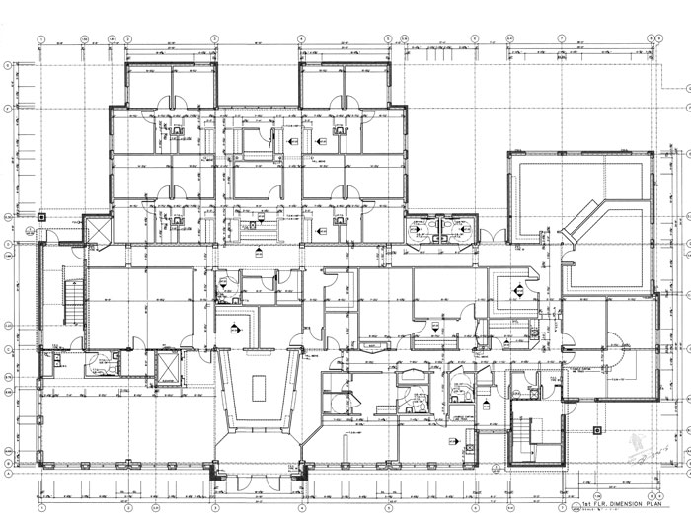
Quantity Surveyor
Best part about being a Quantity Surveyor is you don’t have to spend all day sat at a desk, there are opportunities to work on site, outside watching all the action whilst doing your job.
What is a Quantity Surveyor?
Quantity Surveyors are responsible for calculating and managing the costs of a project to keep it under budget and not over spend. We deal with construction companies, public, train operating companies, housing developers...the list is endless.
How can you become a QS
Work hard at school
Do your A Levels - maths is useful
You can either go on to an apprenticeship scheme with an employer or go to uni and study for 3 years.

Slide 22
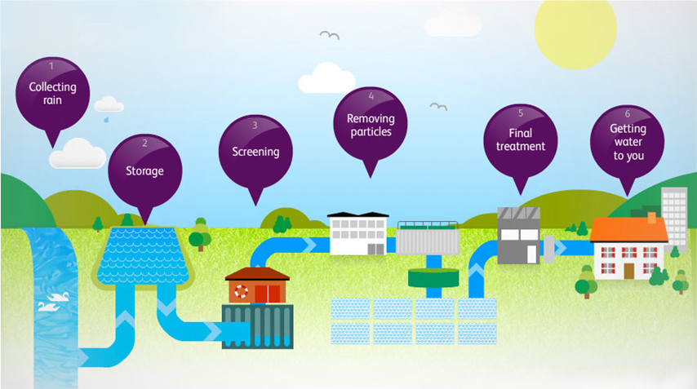
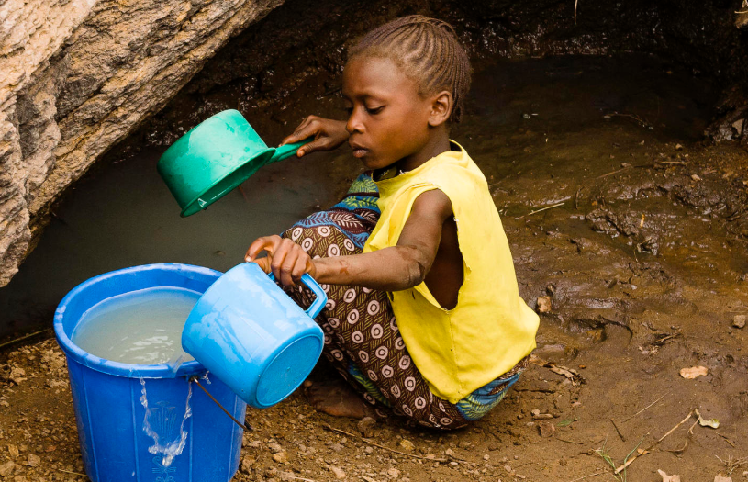








Water and Sewage Industry
Would you do this everyday before school?
So you could drink this?
So you could drink this?
Or would you rather turn this on?
Jobs you could do - or try different ones during your career!
Office Teams
Speak to customers
Plan out work for field teams
Design new pipes for new housing projects
Move water remotely using automatic systems
Be a People Manager!
Field Technician
Problem solving
Stopping leaks
Civil Engineer
Fix broken pipes
Or build huge tunnels under the River Thames!
Scientist
Doing experiments to check water is always safe to drink
Start with good GCSEs in a wide range of subjects and see what you can do.
We also offer programmes for graduates.

Slide 23



High Speed Train Driver
As a train driver with CrossCountry, I drive long distance passenger trains around the country at speeds of up to 125 mph. Train drivers for other companies might drive freight trains or commuter trains so there’s plenty of variety.
My first job on the railway was as an office clerk and then I moved on to train driving. Many train drivers started off this way, or as catering staff, guards or working on stations; most companies choose their trainee drivers internally.
The training took 15 months. You have to learn all the rules, the routes and some technical knowledge about the trains in case they break down so you can do the job safely,
Everyday is different
Working with great people.
Best Bits.
Having a job I don’t take home with me.
Seeing the countryside in all weathers and seasons.
Worst Bit
Shift work - 3am alarm calls aren’t for everyone
,

Slide 24

Environmental Health Practitioner (Officer)
What's good about the job?
You use science and legal skills. You give advice, do inspections and also take prosecution if laws we enforce are broken.
You work out of the office a lot!
You can work for a Local Authority, The Government, a private business, a charity and even in another country like Australia ,
What’s not so good ?- you won't make a fortune in public service.
You do a specific degree at university to be registered as an EHP with practical training placement too
https://www.cieh.org/what-is-environmental-health/
This is an old job - it started in 1844 when the country was in the middle of a pandemic of a disease called Cholera.
Our name has changed over the years but a lot of the job is the same.
We have lots of different special knowledge some people work in just one area.
We do: Food Hygiene +standards,Health & Safety at work, Pollution + Noise & other nuisances, Housing standards, Infectious disease control with public Health Doctors

Slide 25

Working Adult in Social Care
I work as a Case Co-ordinator alongside Social Workers for the local Council. My role is simply to find out if people are able to live their day to day lives independently and safely. If a person is unable to manage my job is really about finding out why they are unable to cope with certain tasks by themselves and see if we can help them
My job is very interesting because we meet all sorts of people and they all have different problems, the trick is to help them to regain their independence. So what do you need to do my job? Good GCSE grades, as report writing and budgeting is involved, as well as enjoying being with people and having a desire to help them.

Slide 26




Biomedical Scientist
My job is really interesting, and working in transfusion can be very exciting when there is an emergency!
My favourite thing about the job is knowing that I am playing an important role in patient care, and helping save lives.
Working at night can be tiring, but I enjoy the variety of working different shifts.
There are lots of different types of biomedical scientist, but I work in haematology and transfusion.
I work in a hospital laboratory, running tests on patient blood samples to help find out what is wrong with them. We use machines and microscopes to count the different types of blood cells, and we can do tests to see if blood is clotting properly, too.
In the transfusion lab we do tests to find out what blood group people are, so we can match them with the right blood.
Our lab operates 24/7, so sometimes I have to work evenings, nights, and weekends.
My background:
I always enjoyed science at school and chose to study Biomedical Science at university. My degree included a training placement in a hospital, where I collected the evidence I needed to complete my registration.
Task:
Can you find out what the main blood groups are?
What type of blood can be given to anyone?

Slide 27


Loadmaster
My job was part of the Royal Air Force (RAF). I had to ensure the aircraft was loaded safely to enable it to fly in a balanced condition. The cargo we carried also had to be checked that it met safety regulations. My job took me all around the world! Once, I went round the whole world in one trip which took 10 days!
We carried cargo like:
Vehicles
People
Explosives
Spare parts
The two types of plane I flew on were a Hercules and VC10.
We also did air-to-air refueling (putting aviation fuel into another plane WHILE WE FLEW!) as well as carrying out Fighter AFIL. This was where fighter jets had to pretend to attack us and we had to evade them! A bit like role play.
You’d like this job if you:
Enjoy solving problems
Like visiting different places
Can work well as part of a team
Must enjoy flying!

Slide 28

HR Advisor
To become a HR Advisor, you need to do a CIPD to make sure you have the right skill set. There are different routes into the job but it helps if you work hard at school as you will need some qualifications (it helps to have maths and English). You also need to communicate really well!
I work as a HR Advisor within the NHS. My job role has lots of different responsibilities to help the company run well, but the main ones are:
Employee relations (such as disciplinaries, grievances and performance management).
Sickness Absence Management
Monitor Recruitment
Create reports for who leaves, staff numbers etc.
I really enjoy dealing with people at all levels within the organisation.
Activity:
We have to write letters! Could you write a formal letter inviting an employee to an important meeting with their manager?
Remember, it needs to use formal language, include a date and time as well as sound professional.

Slide 29


Play therapist
What training would I need?
Play therapists are specifically trained with a postgraduate course in play therapy. During this training, a play therapist is taught about children’s development.
What is it?
In a safe, caring and confidential environment, the child is able to choose whether or not to play with as little or as many of the toys available as he/she wants to. There are few opportunities for children to have real freedom to play without constraint. Play is a vital part of a child’s life, it is essential for them to develop physically, emotionally and socially. Children also often express themselves or their feelings better through play as it fosters imagination and creativity whilst encouraging their concentration and confidence. Play helps a child to learn that ‘feeling’ is OK and helps them to cope with these feelings.
Tool kit
Role play
Puppets and masks
Sand tray
Art materials
Music
Dance and movement
Clay
What makes it enjoyable?
Building therapeutic relationships with children
Seeing children become more aware of their feelings/emotions, learning to accept them and developing successful strategies to deal with them in the ‘real world’

Slide 30

Hairstylist
How do I become a Hairstylist?
To become a hairstylist you need good GCSE’s, strong legs to be able to stand up all day, a steady hand and good people skills.
Hair qualifications can be achieved at college or as an apprenticeship in a hair salon, where you will achieve a level 2 or 3 NVQ in hairdressing.
What do I do?
My job is to make people feel good about themselves! In a normal day I am usually cutting hair, colouring hair as well as adding different types of hair extensions to make my clients look like a real life princess. Every now I then I get to do hair for weddings or special occasions, which I love to do!
Hair extensions can be applied using little beads, a needle and thread, glue or sticky tape. Everyone needs different methods depending on their hair types.
Where can I work as a hairstylist?
As a hairstylist you are able to work in salons, open your own salon or work as a freelance hairstylist, where you are able to travel to studios or people’s homes in order to do their hair.

Slide 31

Plumbing and Heating Engineer
What is this?
This role is a fundamental part of everyday life. Engineers install boilers to heat the home and provide hot water. Once this is done, they must be checked according to safety guidelines yearly for any defects. Alongside this, they can design and fit new bathroom suites, fix leaks within the home and install gas hobs and fires.
How do you become one?
To get started, you need to complete an NVQ Level 2 in Core Plumbing which leads to an NVQ Level 3 at a more advanced level. During this time, you will be employed by a relevant company who will support you with an apprenticeship - this is invaluable as you will learn many practical skills in a variety of environments.
Once you have qualified, you can work for different companies that range from small family run businesses to larger companies which provide heating for new housing estates. Heating engineers are always in demand so you may even want to set up your own business!
Reasons to consider this job:
Job stability
Opportunities to master the craft and work your up
Job satisfaction - knowing you’ve helped someone in need
Social interaction - being around others and offering good customer service with a friendly smile!
Other opportunities it can lead to:
I have been a heating engineer since leaving school and I am now a Site Manager for a new housing estate. This means I no longer do as much practical work, but I inspect the work of others and manage a team to ensure things are completed correctly and on time.

Slide 32





Jane and Patty - We Are Scientists!
Jane: After school I went to university to study Neuroscience. This is a special type of Biology where you learn about the brain.
Afterwards, I did another degree called a PhD where I did research in a laboratory. My research was about pain. Pain is important for humans because if we hurt ourselves, it reminds us to be careful and protect the area which is hurt. You wouldn’t want to walk around with a broken leg! Sometimes however, pain isn’t helpful and we need to take medicine to make it better. My job was trying to find a way to make new painkillers to help this!
Task: A few people in the world are born with a very rare problem – they cannot feel pain! Scientists work with them to understand why this has happened and
to understand more about pain. Can you
think of what might happen if you couldn’t
feel pain?
The best bits about my job:
Knowing that one day, my work will help people!
Working with scientists from all around the world.
Learning new things all the time.
Getting to invent exciting new experiments.
What else can scientists do?
Scientists work on all sorts of topics, such as Alzheimer’s disease, diabetes or cancer. Being a scientist requires hard work but it is great fun! It’s especially interesting if you are curious about how the body works or want to know more about science topics you might see in the news.
Patty: I’m a Cancer Researcher
Why do I enjoy my job?
* I can do something different everyday
* I learn new skills and experiments
* I don’t have to sit at a desk all day
* I work with people from all around the world
* I think it’s exciting that we can make new discoveries
* We make discoveries that can lead to new treatments
*
What do I do?
My job is to understand how faults in our genes can cause cancers to grow.
I look at how we can target these genetic faults to find new treatments to cure patients with the disease

Slide 33


Alex - Corporate Parenting Coordinator
What I do in my role?
A big part of my role is working with organisations, businesses and groups to create partnerships to support children, young people and adults in Birmingham.
This can be very exciting as we work with organisations such as Aston Villa FC, Birmingham City FC, Edgbaston Cricket, Ice Skate Birmingham, Birmingham Airport and Barclays to name a few. We get to meet great people and visit great places!
Best bits
One of my highlights was as a team, organising and running an event for over 1,000 children, young people and families to go and ice skate, ride the big wheel and socialise around Christmas time!
How I got here?
After A Levels, I studied Sport and Leisure, Psychology and Education at University for 3 years; after this I knew I wanted to work in education and more importantly, with young people. Although my university degree wasn’t in this field, it encouraged me to work hard to reach my goals. I went from being a learning mentor to working in the local authority at Birmingham Children’s Trust and I am proud to be part of #bhamsbiggestfamily.
To get here you need your GCSEs and experience with young people; whether this is through college or university degrees. You will also need an understanding of the local authority, policies and procedures.
Task - Think of an organisation/business in a certain sector i.e. sports, food, technology; what do they offer/sale? What skills might their staff have? How could this benefit young people i.e. work experience, activity sessions, life skills.
Design 6 activities with your chosen organisation that would directly benefit young people and/or give them a memorable experience!

