Slide 1
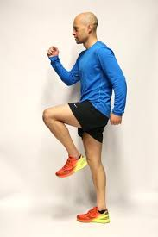
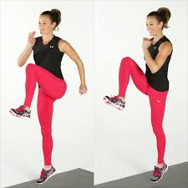
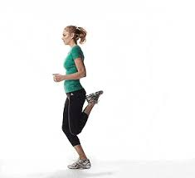
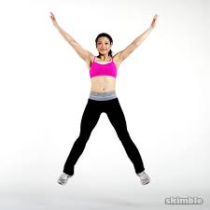
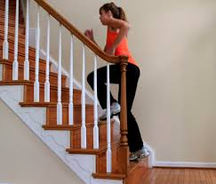
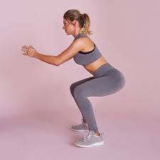
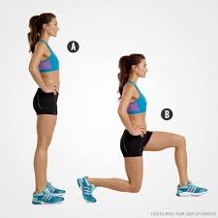
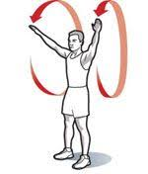
Home workouts – warm up
Task: Complete this 5 minute warm up:
30 seconds marching on the spot.
30 seconds high knees.
30 seconds heel flicks
30 seconds star jumps
1 minute up and down the stairs
30 seconds squats
30 seconds lunges
30 seconds arm swings forwards
30 seconds arm swings backwards

Slide 2
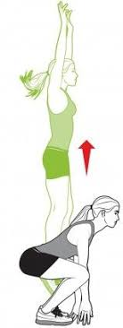
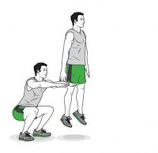
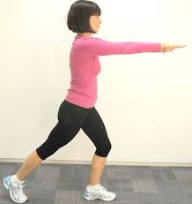
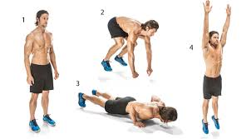
10-minute home workouts
Do Now: Warm up routine
Rocket jumps (2 sets of 20 repetitions) – feet hip-width apart, jump up and drive hands above head, land softly.
Recovery – jog on the spot for 45 seconds.
Squat jumps (2 sets of 20 repetitions) – feet hip-width apart, squat down with head up and heels on the floor, jump up and drive hands above head, land softly.
Recovery – jog on the spot for 45 seconds.
Tap backs (2 sets of 20 repetitions) – step back with right leg and swing both arms forward then repeat in a continuous rhythmic movement.
Recovery – jog on the spot for 45 seconds.
Burpees (2 sets of 20 repetitions) – start in a standing position, drop into a squat with hands on the ground, kick feet back into push up position, jump back into squat and jump up.
Cool down with the stretch routine.
AEROBIC ENDURANCE
Or stamina, is the ability to exercise continuously for extended periods without tiring.
1
3
5
7

Slide 3
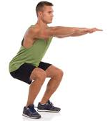
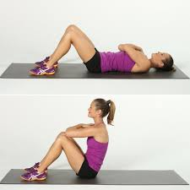
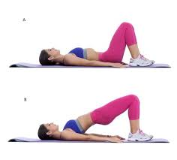
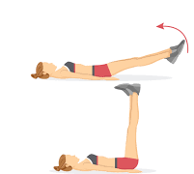
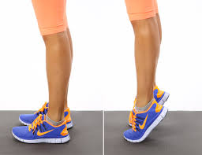
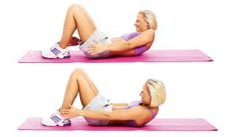
10-minute home workouts
MUSCULAR ENDURANCE
Ability of a muscle or group of muscles to sustain repeated contractions against a resistance for an extended period of time.
Do Now: Warm up routine
Squats (2 x 20 repetitions) – Keep your back straight, don’t let your knees extend over your toes.
Sit ups (2 x 20 repetitions) – Keep your feet on the ground, cross your arms over your chest.
Lunges (2 x 20 repetitions) – stand in a split stance, keep your head up, bend until leg is at a right angle.
Leg raises (2 x 20 repetitions) – lie on your back, hands under your bottom, raise legs up, keep legs straight, lower back down until just off the ground and repeat.
Calf raises (2 x 20 repetitions) – slowly lift onto your tip toes, hold for 3 seconds and then slowly lower your heels down.
Bridges ( 2 x 20 repetitions) – lie on your back, knees bent and heels close to bottom, raise your hips upwards and tighten your abdominals, gently lower.
Ankle touches (2 x 20 repetitions) – lie on your back, keep your head and neck stable, plant your feet on the floor and try to touch your ankles.
Cool down with the stretch routine.
1
2
3
4
5
6
7

Slide 4
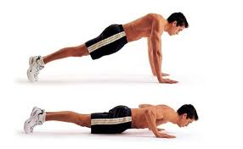
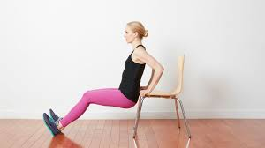
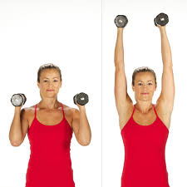
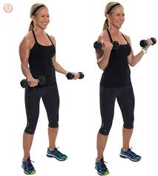
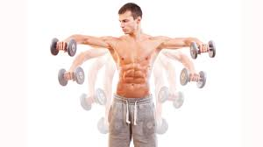
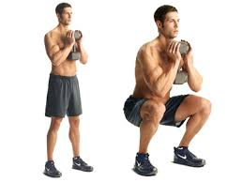
10-minute home workouts
MUSCULAR STRENGTH
The amount of force a muscle can produce with a single maximal effort.
Do Now: Warm up routine
Press-ups (2 x 20 repetitions) – Bend at your elbows, lower your chest and push back up.
Tricep dips with chair (2 x 20 repetitions) – Lift your hips off the floor, bend your elbows and lower your body down.
Shoulder press (with weights/tins/water bottles) (2 x 20 repetitions) – Slowly extend arms above head then lower to shoulder height and repeat.
Bicep curls (with weights/tins/water bottles (2 x 20 repetitions) – slowly bend at the elbows keeping them tucked into your sides, raising the weights to your shoulders.
Lateral raises (with weights/tins/water bottles) (2 x 20 repetitions) – Slowly raise both arms, keeping them straight up to shoulder height with palms facing down.
Goblet squats (with weights/tins/water bottles) ( 2 x 20 repetitions) – Keep your back straight don’t extend your knees over your toes.
Cool down with the stretch routine.
1
2
3
5
6
4

Slide 5
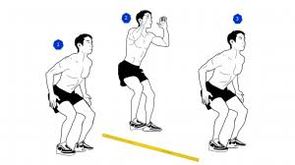
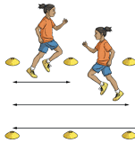
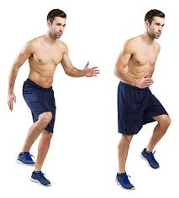
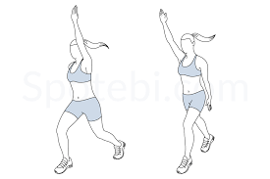
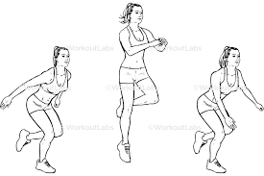
10-minute home workouts
SPEED and AGILITY
Speed is the distance travelled per unit of time.
Agility is the ability to change direction at speed without losing balance.
Do Now: Warm up routine
Stair runs (2 x 10 repetitions) – Running up and down the stairs as quickly as you can.
Speed bounces (2 x 20 repetitions) – Quick jumps from side to side, landing softly.
High knees (2 x 20 repetitions) – Knees lifted to waist high, balls of your feet.
Shuttle runs (wall to wall) (2 x 20 repetitions) – head up and quick turns.
Football sprints (2 x 10 repetitions) – Starting in press up position, jump up and sprint for 10 seconds then repeat.
Scissor steps ( 2 x 20 repetitions) – Quick feet alternating from front to back, head up.
Single leg hops (2 x 20 repetitions) - hopping two to the left and two to the right then repeat. Don’t forget to switch legs.
Cool down with the stretch routine.
1
2
3
5
6
4
7

Slide 6
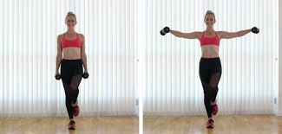
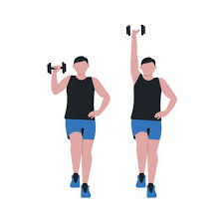
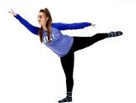
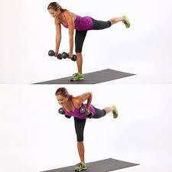
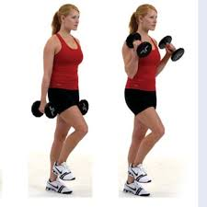
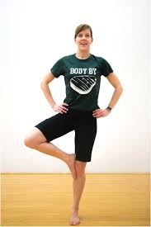
10-minute home workouts
COORDINATION and BALANCE
Coordination is the ability to control two or more limbs to create movement.
Balance is the ability to hold your centre of mass over a base of support.
Do Now: Warm up routine
Single leg lateral raises (with weights/tins/water bottles) (2 x 10 repetitions on each leg)
Single leg shoulder press (with weights/tins/water bottles) (2 x 10 repetitions on each leg)
Arabesque hold for 10seconds (5 repetitions on each leg)
Single leg bicep curl (with weights/tins/water bottles) (2 x 10 repetitions on each leg)
Standing stork hold for 10 seconds (5 repetitions on each leg)
Single leg upright row (with weights/tins/water bottles) (2 x 10 repetitions on each leg)
Cool down with the stretch routine.
1
2
3
5
6
4

Slide 7
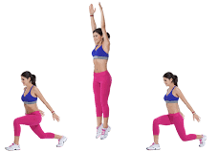
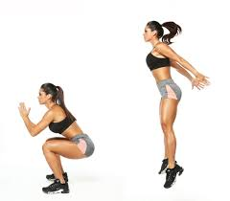
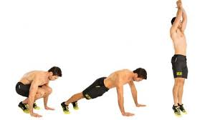
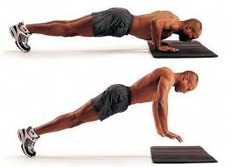
10-minute home workouts
POWER
Power is the ability to exert a maximal force in as short a time as possible.
Do Now: Warm up routine
Starjumps (2 x 20 repetitions) make sure you bring your hands together above your head.
Jogging on the spot
Jumping lunges (2 x 20 repetitions) Start standing with your feet hip-width apart, bend your knees then jump up into the air bringing your right leg forward, and left leg goes back so that you land in a lunge position.
Jogging on the spot
Burpees (2 x 20 repetitions) start in a standing position, drop into a squat with hands on the ground, kick feet back into push up position, jump back into squat and jump up.
Jogging on the spot
Squat jumps (2 x 20 repetitions) Lower down into a squat position then jump up into the air as high as you can and straighten out your legs.
Jogging on the spot
Plyometric push ups (2 x 20 repetitions) Start in high plank position. Bend arms and lower your chest to the floor. As you press yourself back up, push off the floor bringing your hands off the floor, then land back on the floor with soft elbows.
Cool down with the stretch routine.
1
3
5
7
5
9

Slide 8
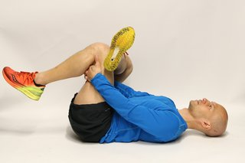
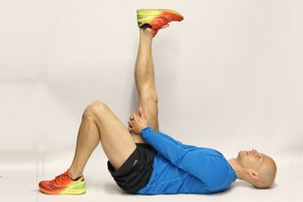
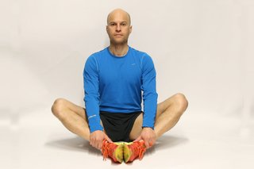
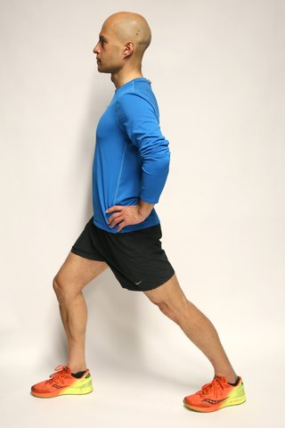
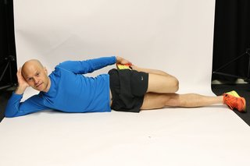
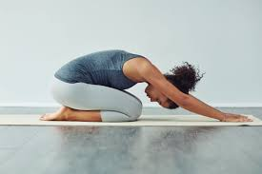
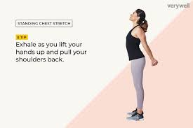

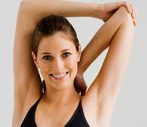
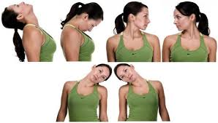
Home workouts – cool down stretch routine
Task: Complete this 5 minute stretch routine:
Each stretch should be held for at least 20 seconds
Gluteus maximus (bottom) stretch
Hamstring (back of leg) stretch
Inner thigh stretch
Calf stretch
Quadriceps (thigh) stretch
Latissimus dorsi (back) stretch
Pectorals (chest) stretch
Biceps (front of arms) stretch
Triceps (back of arms) stretch
Trapezius (neck) stretch

Slide 9
Other ways of staying active
Just Dance (Youtube)
Go Noodle (www.gonoodle.com)
Youtube exercise sessions
Adaptiv (mobile app)
Asana Rebel – yoga (mobile app)
Whatever you do to remain active at home take a #healthyselfie and share your physical activities with @OAWSport on their twitter page! We look forward to hearing from you!

