Slide 1

Meet The Teacher
Reception Acorns
Pre-School Squirrels

Slide 2
Staff
Mrs Williams is the class teacher who teaches Monday – Thursday.
Miss Rodgers will unfortunately not be in school at the moment whilst she recovers from her broken ankle. We are lucky that Mrs Edwards has kindly agreed to return to school and she will teach Fridays, as well as supporting on Thursday afternoons.
Mrs Heath and Mrs Mason are our fabulous teaching assistants who will be in school all week.

Slide 3
Reception Baseline
During the first few weeks of term, each child in Reception will complete the statutory Reception Baseline Assessment with Mrs Williams. This is a short, practical assessment. More information on this can be found in the leaflet on our class page.

Slide 4
PE
We will have PE on Thursdays.
Children in Reception need to come to school in uniform and bring their PE kit into school. We will get them changed here and back in to uniform
Children in Pre-School can come to school ready dressed in PE kit.

Slide 5
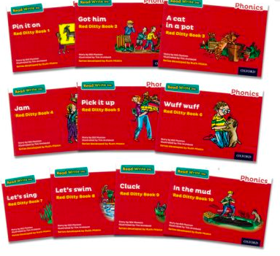


Reading and phonics in Reception
At the start of the year, the children will be sent home with a story book for you to share with them. Please write a comment in your child’s reading journal as this helps us to understand the types of books and themes your child enjoys.
As they learn more sounds in phonics, we will start to send home 1 phonics reading book based off your child’s phonic knowledge
Please read this at least 3 times per week with your child at home. Decoding -> fluency
Books will be changed on a Friday
The children will begin to learn single letter sounds in short phonics lessons. As the year progresses these sessions will become longer as the children learn to blend sounds to read word independently.
We follow the Read Write Inc phonics scheme.
Reading is key to all areas of the curriculum and needs practicing regularly to keep skills sharp and developed.
Sharing stories at home, with adults modelling reading skills is still hugely important. Please read story books regularly at home with your child.

Slide 6
Reception Parents Phonics Evening
We will hold a phonics information evening for Reception parents on Tuesday 22nd September at 5:30pm.

Slide 7
Reading and Phonics in Pre-School
Pre-School children will be sent home with a story book to share at home with a parent.
Phonics in Pre-School will include group activities focusing on some of the following activities
Storytime
Nursery rhymes
Environmental sounds
Listening skills
Rhyming games
Initial sound games
Segmenting and blending games- Fred Talk Games
Later in the year the children will learn the picture cards related to each sound and begin to be exposed to the written sound

Slide 8


Maths
We follow the White Rose Scheme
We will also be starting Mastering Number to embed key number skills and fluency
Reception Parents Maths Information Evening
Tuesday 13th October at 5:30pm

Slide 9
Curriculum
We will teach the rest of the curriculum through a mixture of adult led carpet times and group work, as well as through continuous provision and play.
Our topic this term is ‘Once Upon A Time’ where we will explore the themes
Starting school
My family
Friendships
Favourite stories and Traditional Tales
I will add the curriculum map for this term to the website

Slide 10
Communication
Tapestry- we will upload photos of learning to tapestry
Please feel free to add photos of any learning or events from home to tapestry that we can share in class
I will also do class specific communication via Tapestry
Notice board by the sliding doors

Slide 11
Stay and Play and Library Time
I will confirm Stay and play dates ASAP
We will also run library times, which will be 2:45-3:15 where you can come in to class and share a story with your child and then we will have a class story at the end of the day

Slide 12
Dates for your diary
Tuesday 22nd September, 5:30pm- Reception Parents Phonics Information Evening
Tuesday 13th October, 5:30pm- Reception Parents Maths Information Evening
Friday 23rd October- Break up for half term
Wednesday 11th and Thursday 12th November, 3:30-6- Parents’ Evening
Thursday 19th November- Flu Vaccines
Friday 20th November- Children in Need
Tuesday 24th November- Individual Tempest Photographs
Monday 7th December, 2pm- Nativity performance
Wednesday 8th December, 9:30am- Nativity performance
Friday 11th December- Christmas jumper day and Christmas lunch
Thursday 17th December- EYFS &KS1 Christmas Party
Friday 18th December- Break up for Christmas Holidays

