Slide 1
Meet the Teacher
Year 3 – Kingfishers
2026/27

Slide 2
Meet the Year 3 Team!
Class Teacher – Miss Turner
TA – Mrs Gibson
Phases 3 team – Miss Holland

Slide 3
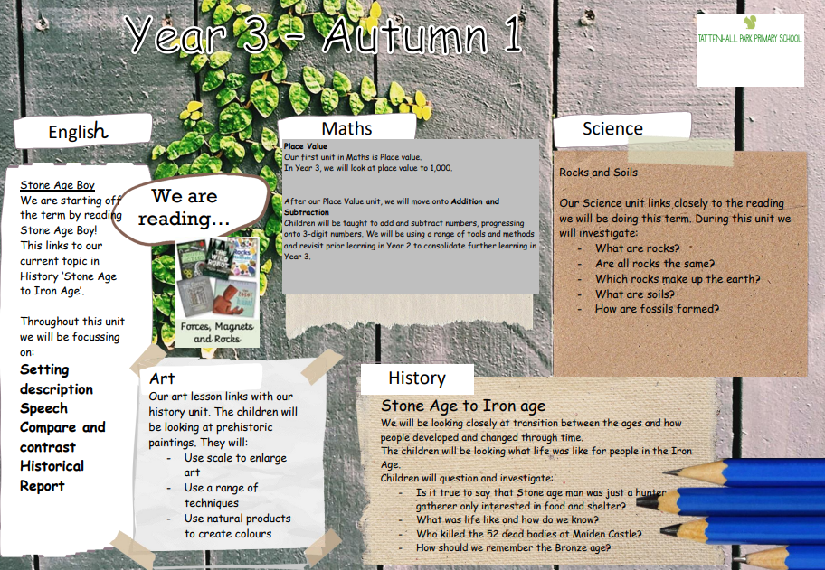

Slide 4
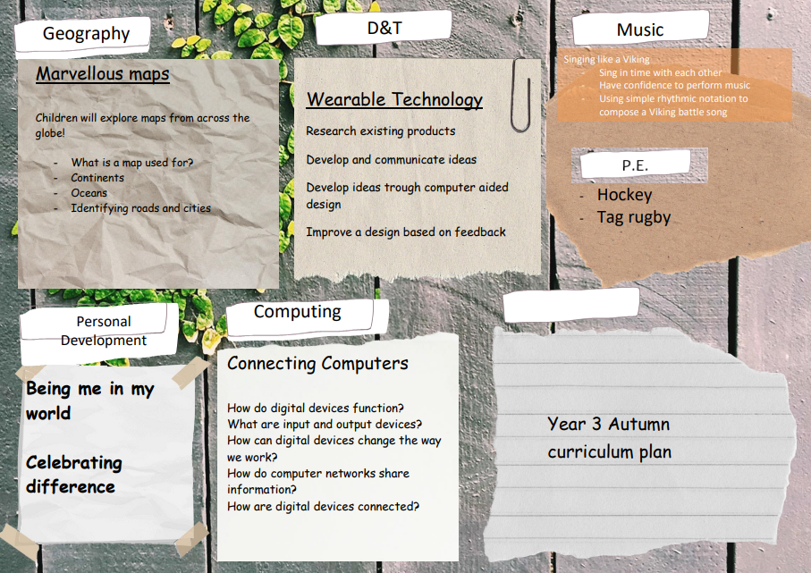

Slide 5
Class Timetable
 | Monday | Tuesday | Wednesday | Thursday | Friday
9-9:30 | Reading Lesson | Reading Lesson | Reading Lesson | Reading Lesson | Assembly
9:30-10:15 | English | English | English | English | Spelling/handwriting/ readers
10:15-10:30 | Break | Break | Break | Break | Break
10:30-11:00 | Arithmetic | Arithmetic | Arithmetic | Arithmetic | Arithmetic
11:00-12 | Maths | Maths | Maths | Maths | Maths
12-1 | Lunch | Lunch | Lunch | Lunch | Lunch
1 – 1:30 | Handwriting Spanish or Music | Spelling History or Science | Computing with Mr Cragg | Spelling History or Science | Homework Art
1:30-2:40 | PE with Mrs Gibcon | History or Science | PE with a sports coach | Art (2-2:40)
2:40 – 3:15 | Assembly | Assembly or RE | PE | Singing Assembly | PSHE

Slide 6
Reading
The children will have daily 30-minute reading lessons throughout the week. There will be a focus on comprehension skills to help improve understanding of the texts given to them, enhance critical thinking and increase vocabulary and language skills.
Additionally, I would really encourage home reading to develop richer vocabulary, understand sentence structure and story telling and help with reading fluency. They can log this in their reading diaries which Mrs Hughes and I can will check.
Reading is key to all areas of the curriculum and needs to be practised regularly to ensure that skills are sharp and developed.

Slide 7
Maths
In Maths lessons we will start with looking mastering number each lessons. This is to help build children's confidence with numbers and number concepts.
We then do daily Arithmetic practice. Followed by a Math lesson starting off with fluency and then going onto reasoning and problem solving questions to develop their skills further.
Math homework will also be sent out on a Friday.
Times Table Rockstars should be practiced at home where possible. Any problems with logins please contact me.

Slide 8
PE
PE will taught on a Monday and Wednesday afternoon.
Both outdoor and indoor PE kit must be in school everyday.
Hair should be tied back.
Monday: Mrs Gibson
Wednesday: External coach

Slide 9
Spelling
Spellings will be set on a Friday. It is important the children are practicing these throughout the week. The spellings set for the children consist if spelling pattern rules for the Year 3 curriculum but we will also recap spellings from year 2 when required. Spellings are to be practiced in homework books to support children in applying these correctly in their writing aside from learning them in a test. There are lots of fun and creative ideas to help you learn your spellings on our class page!

Slide 10
Homework
Homework will be stuck into homework books and sent out each Friday. These will be due back in the following Thursday.
Homework will consist of SPaG and maths. Both will be based on what the children have been learning that week.
If addition support is needed with the homework please contact me so I can arrange time to go through the work during the following week.
If homework is not completed, it will be done in school on the Friday.

Slide 11
Key dates
Wednesday 11th November – Parents’ Evening
Thursday 12th November – Parents’ Evening
Friday 20th November – Children in Need (More details to follow)
Tuesday 24th November - individual photos
Friday 11th December – Christmas Jumper & Christmas Dinner Day
Monday 14th December – Year 3 & 4 Christmas Performance, 6 pm
Tuesday 15th December – Year 3 & 4 Christmas Performance, 9.30am
Friday 18th December – KS2 Silent Disco / End of Term

Slide 12
If you have any questions, please don’t hesitate to contact me with any concerns I am always here to help.
Email:
aturner@tattenhallpark.cheshire.sch.uk

