Slide 1


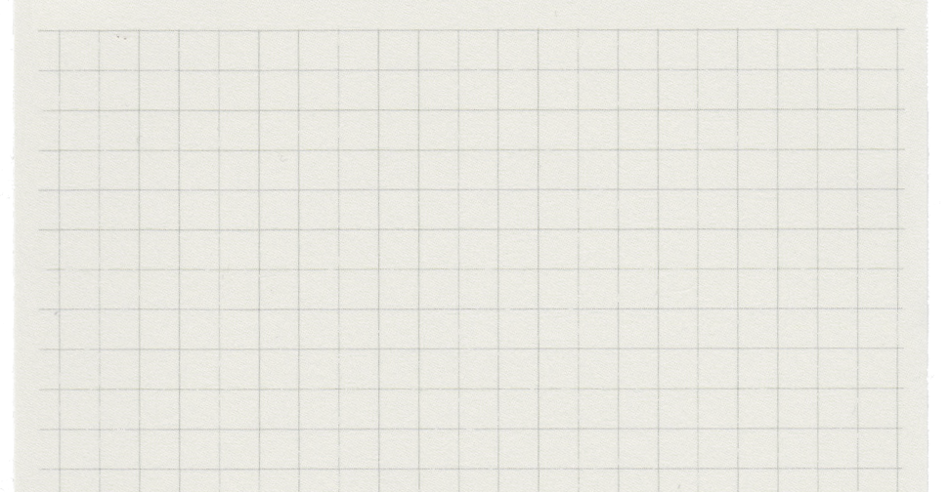
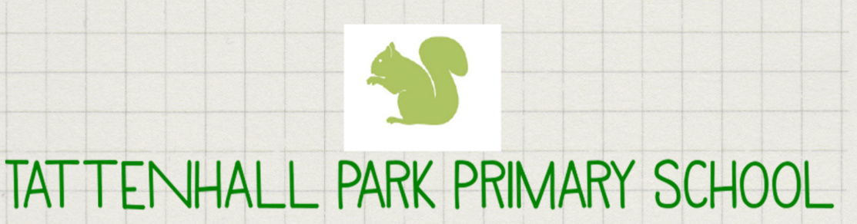
Oak Class
Year 6

Slide 2



Meet the team…
Miss Comish – Class Teacher
Miss Rodgers- Class Teacher Thursday PM
Mrs Roberts- Teaching Assistant

Slide 3

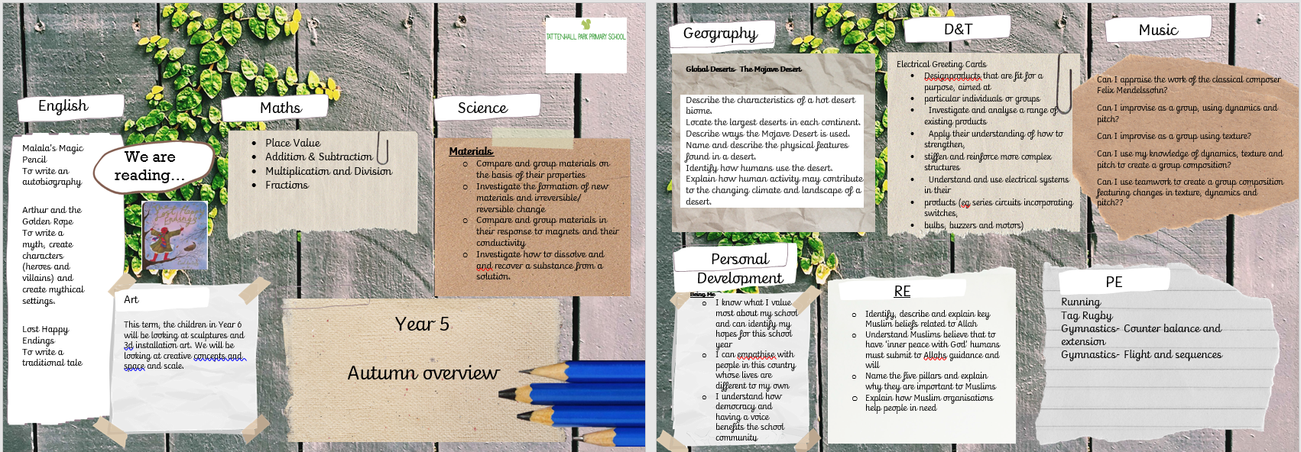
Autumn Term Overview
Important Dates
Parents Evening- 11th and 12th November
Christmas Carol service- 16th December at 2pm and 6pm
Residential and SATS information evening- Tuesday 5th January at 5pm
Ghyll Head Residential- 13th- 15th January
Topics- World War 2 and Windrush
Population, Migration, World development
Crime & Punishment throughout history
Coasts
Evolution, change and moving on

Slide 4
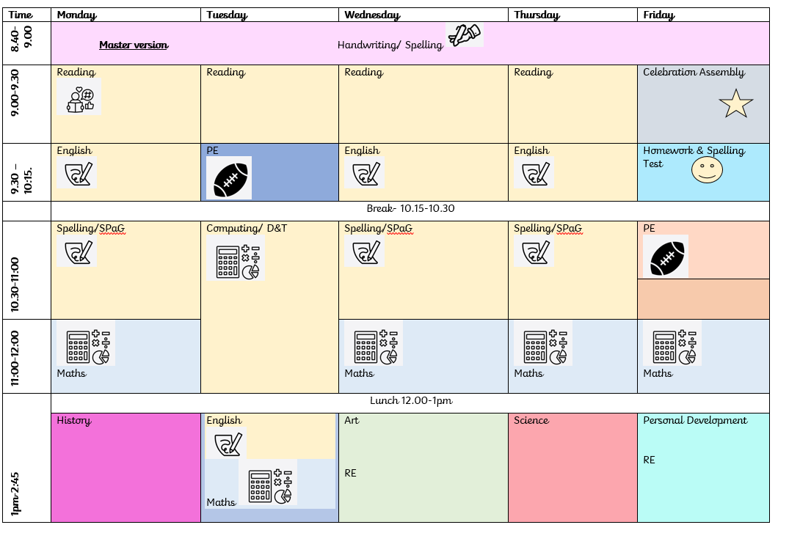
Our Timetable
PE- Tuesday morning and a Friday morning
.

Slide 5



We love reading…
Reading Diaries are monitored in Year 6 on a Monday, Wednesday and Friday.
Children are encouraged to read each day at home and to log this reading in their personal reading diary. They should note down any effective words or phrases that they are inspired by and would like to use in their own writing.
Children experience a 30-minute daily reading lesson Monday-Friday.
Children are encouraged to read newspapers, websites (information sites/ higher level vocabulary/ subject specific terminology) kindles, audiobooks etc.
Notes:
Ask them to share their definitions so as a class you bring a picture of evolution together.

Slide 6

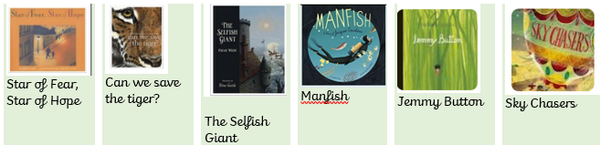
We really love writing…
These high quality texts are the drivers behind our writing.
Across the year we will be:
Re-telling a myth
Writing our own traditional tale
Writing biographies
Writing a recount
Writing persuasively to make a difference

Slide 7
These high quality texts are the drivers behind our writing.
Across the year we will be:
Writing a war inspired narrative.
Writing classic archaic traditional tales
Writing biographies
Writing a recount
Writing persuasively to make a difference
Our English lessons are structured in the following way:
Session 1-
Children unpick the features of high quality modelled texts
`Shared writing is created by a collaboration of ideas from children and teachers.
Children then write independently.
Session 2-
Teachers support the children to address misconceptions, correct spellings and up-level/ edit their work from the previous day.
This piece of writing is then improved and contributes to the final writing outcome after a few weeks.

Slide 8
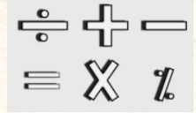
We really really love maths…
Lessons are structured with a 20 minute arithmetic lesson around the four operations & fractions, decimals & percentages.
Each Friday, there will be a short arithmetic assessment. This is to consolidate our arithmetic learning from the week or to revisit prior knowledge.

Slide 9
Homework
Homework consists of:
SPaG
Maths
If there is a reason why homework cannot be completed then please just let us know as we completely understand that evenings & weekends can be really busy.

Slide 10
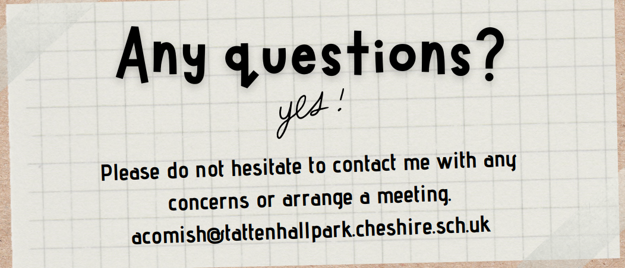
acomish@tattenhallpark.cheshire.sch.uk
krodgers@tattenhallpark.cheshire.sch.uk

