Slide 1










A warm welcome to
YEAR ONE
Primrose Class

Slide 2




Our Team
Mrs Ellam - Class Teacher - Monday, Tuesday, Wednesday morning
Mrs Downes - Class Teacher - Wednesday, Thursday, Friday
Miss Cross - Student Teacher - will be with us for most of the year
Teaching Assistants working with year one at various points throughout the week:
Mrs Roberts, Mrs Harding and Mrs Gibson

Slide 3

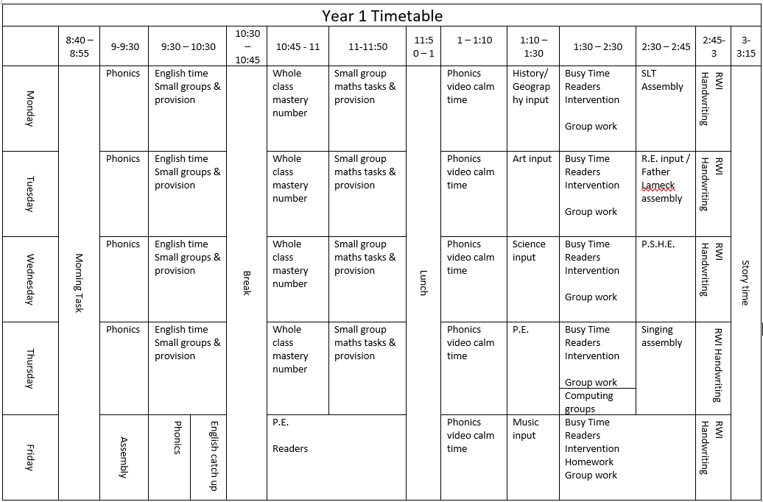
Timetable

Slide 4

Timetable
Our timetable is likely to change throughout the year as the children become able to sit and concentrate for longer periods of time.
Curriculum Areas
  English, including phonics, reading, writing and SPaG (spelling, punctuation and grammar)
  Maths, including mental arithmetic
  Science
  Computing
  History and Geography (alternating each half term)
  Art and Design Technology
  PE
  RE
  Music
  PSHE (Personal, Social, Health and Economic Education)

Slide 5


Transition
We are very fortunate to have two areas within our classroom. We have a dedicated space where children can access continuous provision, similar to what they have been used to in Reception. The provision has been carefully tailored to challenge the children in line with the Year 1 curriculum, while also maintaining a familiar feel and reflecting the style in which they have been learning.
As time progresses, the amount of time children spend accessing continuous provision may gradually decrease as the expectations of their learning and independence increase.

Slide 6
Reading
Reading with your child is one of the most valuable things you can do to support their learning and development. Even just 10 minutes of reading together each day can help to build their vocabulary, comprehension, confidence and love of books. It is also a wonderful opportunity to talk, ask questions and share time together. Most importantly, reading should be enjoyable — whether you are reading a story, sharing a favourite book or listening to your child read, your encouragement and enthusiasm can make a lasting difference.
  How often and when?
  In school
  New books
We read as part of our phonics lessons. Reading skills are also practised during group sessions using our Favourite Five books, where children develop their comprehension skills through high-quality questioning.
Children will also read their books with an adult throughout the week.
Books will be changed on a Friday. We encourage your child to read their book multiple times to develop fluency.
Children can also enjoy books from home to support their reading and listening skills.
We encourage you to read with your child at least three times a week and make a note of it in their diary.
Please choose a time that suits your child best, when they are not too tired, so that reading can be an enjoyable experience.
Reading is key to all areas of the curriculum.

Slide 7




  Hair
Children with longer hair to tie their hair back.
Uniform
As the children are representing the school, it is important that they look smart when coming to school. This includes ensuring that T-shirts are tucked in.
We do not require uniform to be branded.
Please speak to us if you require any help with uniform, and we will be more than happy to support you.
Please support us in keeping our classroom clean by encouraging the children to wipe their feet on the mat as they come into the classroom.
Thank you!
  Jewellery
Children may wear small stud earrings that must be removed or covered for PE. Children may wear a watch. No other jewellery should be worn.
  Wellies
We would be grateful if you could leave a pair of wellies in school. This ensures that we can access outdoor learning come rain or shine!
Please label EVERYTHING so we can return items back to their rightful owners.

Slide 8
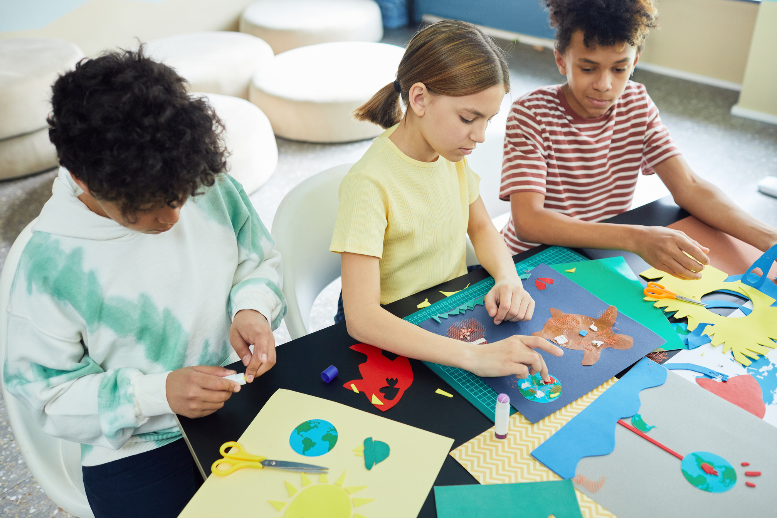
PE
PE will take place on a Wednesday and Friday.
We ask that PE kits are brought into school at the start of each term. They will be sent home at the end of each half term, or sooner if we feel they need to be washed.
Trainers, tracksuit bottoms and tops are needed for cold and wet weather, as we aim to do PE outside whenever possible.
Please ensure that your child’s PE kit adheres to our school uniform policy.

Slide 9

Homework
•Homework alternates weekly between Maths and English.
• English – Read Write Inc., spellings based on Red Words, and handwriting.
• Maths – Basic number facts, number formation and learning for the week.
Homework will go out on a Friday and should be returned by Wednesday.
If you have any questions about the homework, please ask straight away so that we can support your child’s learning at home.

Slide 10
  Healthy minds
• Water bottles – children have access to their water bottles throughout the day. Please, no juice!
• Morning snack – free fruit or vegetables are provided daily, or children can bring a healthy snack from home. Please note that we are a nut-free school.
• Healthy lunchboxes
• School meals – free for children in Year 1.
• Sleep is very important too! A good night’s sleep helps children to feel happy, focused and ready to learn.
  Developing independence
• Encourage independent learning
• Responsibilities – children will be encouraged to take care of their own belongings, including water bottles, letters, homework and PE/Games kits.
• Looking after their property – ensuring that they have everything they need and that their kit is ready for the day.
  Behaviour
A new behaviour policy has been put in place for the start of the year. Please see further information from Mrs Bolton regarding how we support your child with their behaviour.
Children will be reminded that their behaviour should align with our three core values: ‘Ready, Respectful, Safe’.

Slide 11
Drop off/Pick up
• The gates open at 8:40am. Children will complete a morning task until 9am.
• The gates close at 8:55am. Registration is taken promptly at 9am.
• Please enter through the gate closest to our classroom.
• The school day ends at 3:15pm.
• It is essential that you tell us if a different person will be collecting your child. Please let us know at drop-off or by contacting the school office. Please do not email teaching staff regarding a change of collection arrangements, as we will be unable to access emails during teaching hours.

Slide 12
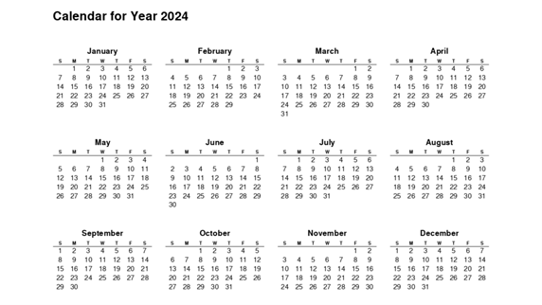
Important Dates
Parents Evenings:
Wednesday 11th November
Thursday 12th November
Phonics Screening Check:
The phonics screening check is a short, one-to-one reading assessment for Year 1 children to ensure they can decode words using phonics, helping teachers identify who may need extra support.
Schools must administer the phonics screening check within the 1-week period from Monday 14 June 2027.

Slide 13
A BIG THANKS!
If you have any questions, please do get in touch. Our door is always open!
Alternatively, you can email us:
Mrs Ellam - aellam@tattenhallpark.cheshire.sch.uk
Mrs Downes - edownes@tattenhallpark.cheshire.sch.uk
Please note that emails will only be checked outside of teaching hours and during our working days:
Mrs Ellam: Monday–Wednesday
Mrs Downes: Wednesday–Friday
You can also email the admin team, who will monitor emails throughout the day, at:
admin@tattenhallpark.cheshire.sch.uk

