Slide 1

Welcome to Year 4

Slide 2
Meet the team!
Class Teacher: Miss Holland
Learning Support: Mrs Gibson

Slide 3
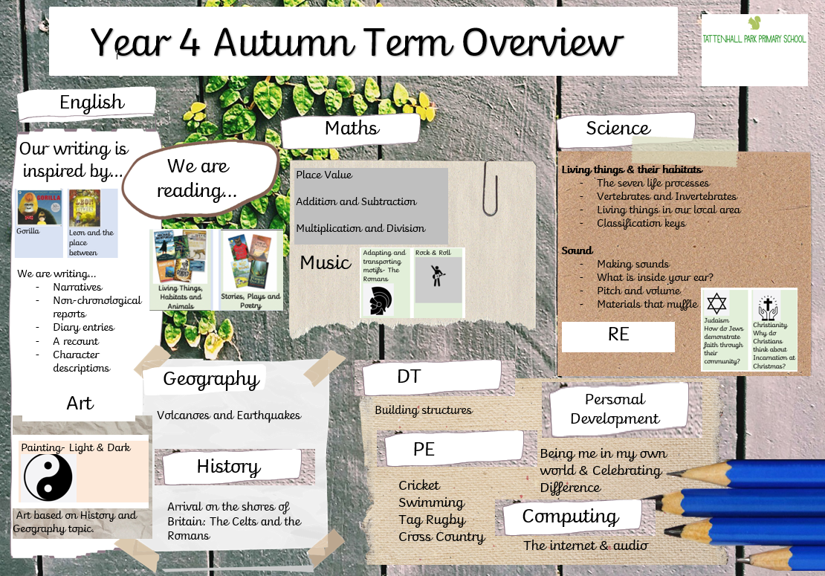

Slide 4
Key Dates
Swimming: Fortnightly from 9th September
Romans trip: November – date tbc
Residential PGL: 28th-30th April

Slide 5

Reading
We encourage the children to read each day at home and log this in their diaries.
Children will all take part in a 30 minute reading lesson 4 times a week.
Reading is key to all areas of the curriculum and needs to be practised regularly to ensure that skills are sharp and developed.

Slide 6


Writing
This term, we are writing…
Narratives
Non-chronological reports
Diary entries
A recount
Character descriptions

Slide 7

Spelling
Each Friday, 10 spellings will be sent home for children to practise and these will be tested the following Friday. Spellings will also be tested at various points throughout the week to build confidence.
Children are encouraged to practise the spellings in their homework books to understand and revise the spelling rules whilst practising good handwriting.

Slide 8

Mathematics
Each maths lesson begins with a 15 minute Mastering Number session and is followed by a 15 minute Arithmetic Lesson.
Each objective in the Year 4 curriculum will be explored over 2 lessons. Lesson 1 involves all children focusing on fluency. In lesson 2, children who have mastered the fluency will move on to reasoning and problem solving questions. Children who struggled with the fluency will have a chance to revisit this before moving on.
Please continue to encourage children to use times table rock stars – we will be sitting our Multiplication Check in Spring, so practise is essential for progress.

Slide 9

PE
PE will be taught on a Wednesday and Thursday afternoon
Both outdoor and indoor PE kit must be in school every day.
Hair should be tied back and any earrings should be covered or taken out for the sessions.
Wednesday’s PE lesson will be taught by a Sports Coach.

Slide 10


PE Kit
Summer:
-Plain white
T-shirt
-Black shorts
-Black trainers
Winter:
-Plain tracksuit – no
football strip
-A waterproof jacket
-Hat/Gloves if need be
This half-term, we are doing Tag Rugby and Athletics.

Slide 11

Homework
Maths, SPAG and Spelling homework will be set weekly on Friday and should be returned to school the following Wednesday.
If there are any issues completing homework, please let us know before the Wednesday, so that we can help to get this completed.
Homework not completed by the Wednesday, without a reason why, will be completed in the children’s lunchtime.
As we prepare for the Multiplication Check (statutory assessment in June), it is vital that all children regularly engage in times tables games on TTRS.

Slide 12

Healthy Minds
Water bottles – these are in the classroom and children have access to these throughout the day.
Morning snack – healthy snack or money for a hot snack.
Nut Free School!
No food items that contain sesame please!
We have regular brain breaks throughout the day.

Slide 13
Uniform
Correct uniform must be worn and our school uniform policy must be followed.
Shirts and t-shirts should always be tucked in and children should strive to look smart.
If there are any issues, please always send in a letter/mention to this to myself at the beginning of the day.

Slide 14

Any Questions?
Any questions, please don’t hesitate to contact me:
rholland@tattenhallpark.cheshire.sch.uk

