Slide 1

Welcome to Reception
Acorns class

Slide 2
Early Years Team
Teachers
Teaching Assistants
Mrs Williams (Mon-Thurs)
Miss Rodgers (Thursday am & Friday)
Mrs Heath
Mrs Mason
Both Mon-Fri

Slide 3
How will the class be run?
The two year groups will run as one class.
There will be 17 Reception children and 9 Pre-School children each day, with 3 members of staff (1 teacher and 2 TAs)
This is well within ratio of 1:13
There will be times of the day when the children are all together and times when they are separate in their year group. This will change and develop as the year goes on.
Children will be taught the objectives for their year group through effective provision, adult support and guided teaching times.

Slide 4
The EYFS Curriculum
The Early Years Foundation Stage is a play-based curriculum that is based around 7 areas of learning.
Prime Areas
Communication & Language
Personal Social & Emotional Development
Physical Development
Specific Areas
Literacy
Mathematics
Understanding the World
Expressive Arts & Design.
These areas are developed through adult-led activities, structured play and child-initiated activities, following the children’s interests and embodying topic led themes.

Slide 5
The EYFS Curriculum cont…
Each of these areas then has objectives for
3-4 year olds, which the pre-school children will work towards
4-5 year olds, which the Reception children will work towards. They will then work towards Early Learning Goals, which are end of year assessment statements that show if they have met a good level of development.
All areas of learning, inputs and provision in the classroom will consider objectives for both ages, and clear progression and differentiation will be planned for.
We will also develop the effective characteristics of learning…

Slide 6
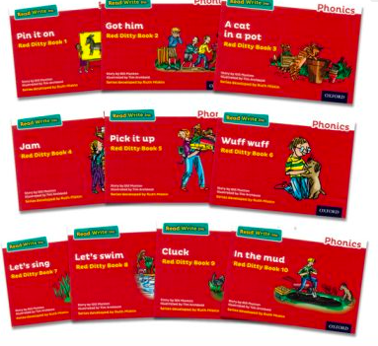


Reading and phonics
At the start of the year, the children will be sent home with a story book for you to share with them. Please write a comment in your child’s reading journal as this helps us to understand the types of books and themes your child enjoys.
As they learn more sounds in phonics, we will start to send home 1 phonics reading book based off your child’s phonic knowledge
Please read this at least 3 times per week with your child at home. Decoding -> fluency
Books will be changed on a Monday.
The children will begin to learn single letter sounds in short phonics lessons. As the year progresses these sessions will become longer as the children learn to blend sounds to read word independently.
We follow the Read Write Inc phonics scheme.
Reading is key to all areas of the curriculum and needs practicing regularly to keep skills sharp and developed.
Sharing stories at home, with adults modelling reading skills is still hugely important. Please read story books regularly at home with your child.

Slide 7

Tapestry
We will continue to share learning on Tapestry
Please also feel free to upload pictures, videos and information of things you have done at home, days out or special events or achievements. The children love showing these to their friends and it contributes to their learning.
If you are a new starter, then please complete the Tapestry permission form in your pack
My Special Book- Photos of family, loved ones and pets. Summer holidays/ through the year. The children will leave this in the book corner in school to share with friends.

Slide 8
Timetable
This is a current rough timetable for September. This will change and adapt in response to children’s needs and as the year progresses

Slide 9
Time | Activity | Further info
8:40-8:50 | Gates open | Arrive. Coats and bags away. Self-registration and lunches. Morning task
9:15 | Carpet time 1 | All together to begin with- Welcome, rules and provision outline As the weeks progress, this will be split between 2 or 3 groups depending on task and age related objectives
9:30 | Continuous provision starts | Free flow between the two rooms (sometimes outdoor as well) Adults will be between the two rooms, playing with children, getting to know them and building relationships, as well as working on skills we are learning
10 | Snack opens | This will happen in Squirrels classroom. Up to 10 children at a time. 2 adults will be supervising this at all times
 | Adult led tasks | For reception children, adult led tasks will start to happen now, in small groups in the Acorns classroom, working on Reception objectives
10:30 | Open outdoor provision | Children can choose between indoor or outdoor provision. Staff in all areas
11:15 | Carpet time 2 | May be altogether, may be split into 2/3 groups If maths- then reception will be together working on Reception objectives and P-S will be in Squirrels room for their carpet time
11:30 | Lunch prep | Wash hands, toilet etc
11:45 | Lunch | Reception will go to the hall with Mrs Williams/ Miss Rodgers & a midday assistant When they have finished eating they will play in our outdoor area. Reception will eventually go to play on the main playground
1 | Carpet time 3 | May be altogether, may be split into 2/3 groups
1:15-2:30 | Continuous provision | Children can choose between indoor and outdoor provision. Staff in all areas
2:30 | Tidy up
2:45-3 | Carpet time 4 | Snack/ drinks. Story time, nursery rhymes etc
3-3:15 | Home time prep

Slide 10
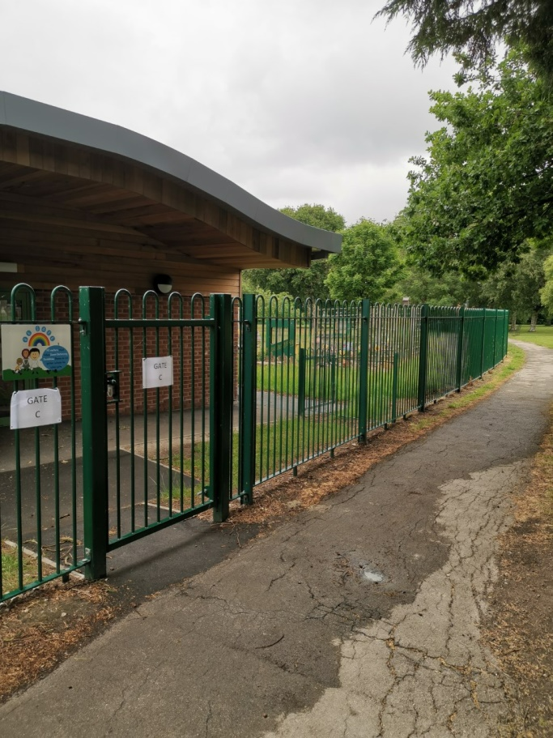
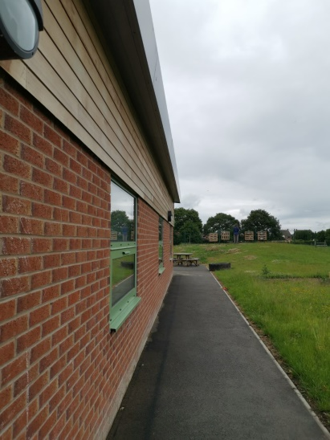
Drop off and Pick Up
The gates open at 8:40am.
Please come to the Squirrels sliding door and put coats, bags etc on pegs in that room.
Reception parents please leave children at the door.
Gates close at 8.50am.
The school day ends at 3:15pm.
We will dismiss through 2 doors
Reception through the Acorns’ classroom door
Pre-School through the Squirrels classroom door
It is essential that you tell us if a different person will be collecting your child. Please let us know at drop off or by contacting the office.

Slide 11
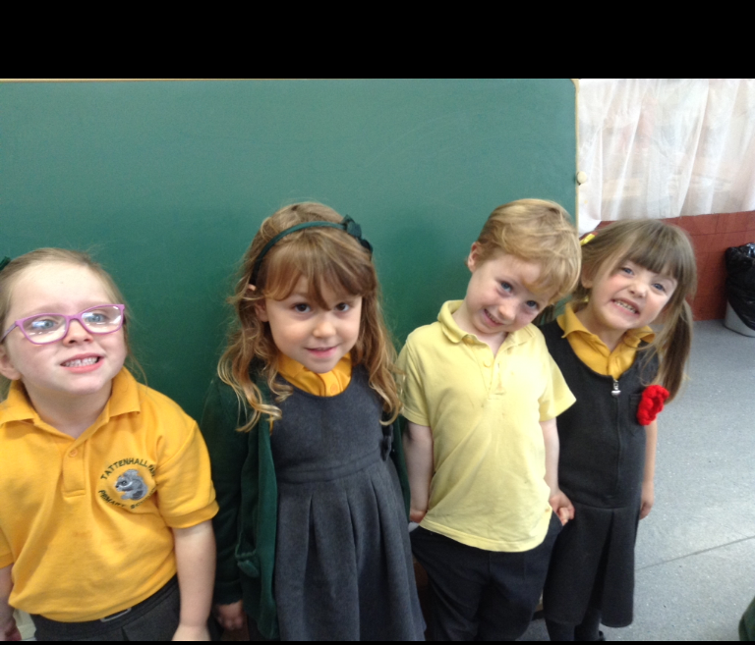
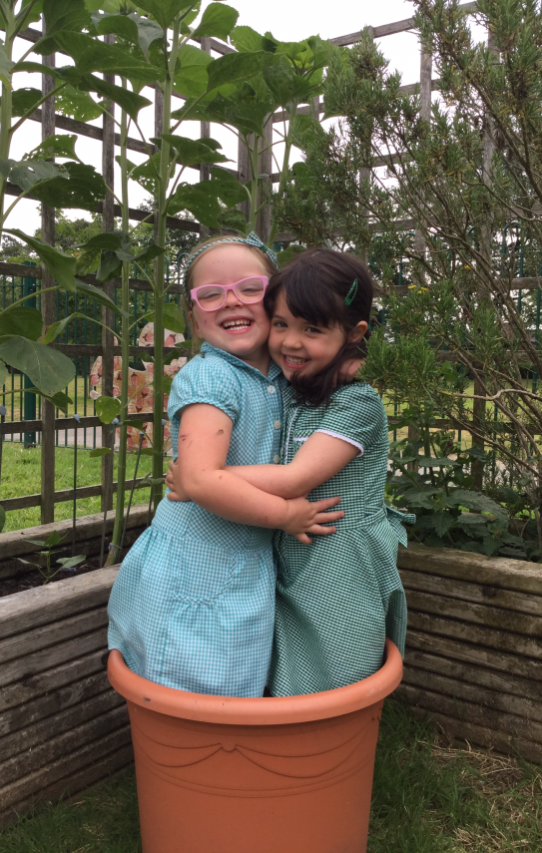
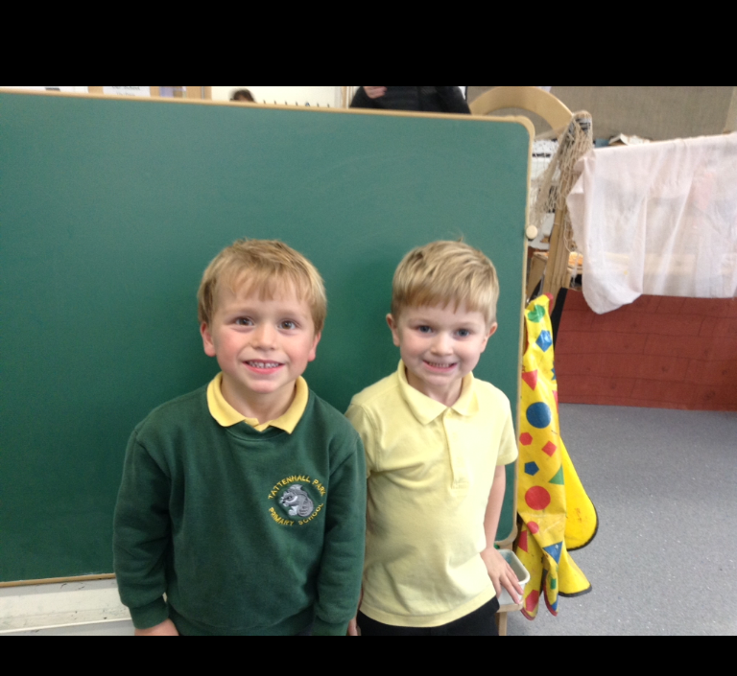
Uniform
Green sweatshirt/ cardigan
Yellow polo shirt
Grey trousers/ shorts/ pinafore/ skirt
Green gingham dress/ jumpsuit for summer
Smart black shoes/ sandals
Grey, black or white socks or grey tights
Coat
PLEASE NAME EVERYTHING including shoes!
In your packs is an information sheet on where to order your uniform from if you want a school logo- 26th June is last order date for free delivery into school, 31st July for home delivery for September
Otherwise you can get plain items from places like M&S, Sainsbury’s, Tesco etc

Slide 12
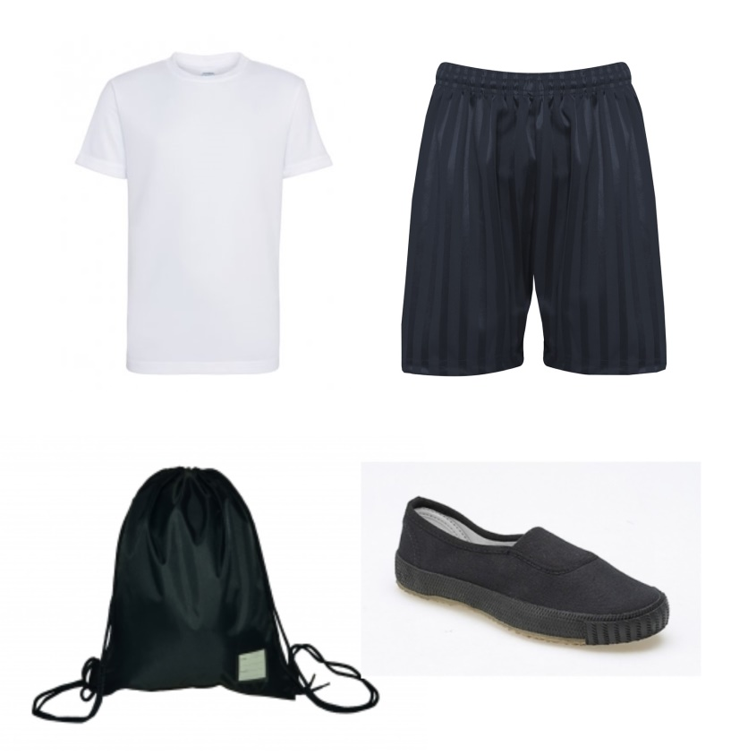
PE kit
We will have PE once per week.
Please bring PE kits in at the beginning of the week. We will then change the children for PE. We will send the children home in their PE kit, with uniform in their PE bag.
Please return the PE kit on a Monday morning.
White T-shirt
Black shorts or tracksuit bottoms/ leggings- plain
Trainers or black pumps
Black hoodie
Remember socks if your child is wearing tights to school
Please put all of these in a small drawstring bag (please no large rucksacks)
PLEASE NAME EVERYTHING including shoes!
If your child wears earrings, please make sure that they can take these out or have something to cover them up (tape/plasters).

Slide 13

Lunches, snack and drinks
Water bottles – Please send in each day. The children have access all day and we encourage that the children have water only in the bottles
Morning snack- fruit/ veg is provided each day by school. You do not need to provide a snack.
Lunch
Children in Reception get free school meals- see examples of menus and info in your pack
If you wish to provide a packed lunch then you are welcome to. Please ensure this is a healthy packed lunch and is nut free.
We will go to the hall for lunch at 11:45
Please name waterbottles with a name sticker rather than pen, as it rubs off easily.
Please name lunchboxes

Slide 14
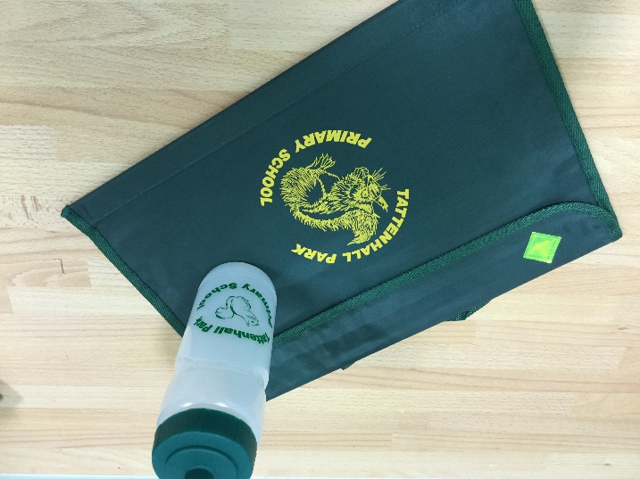
Book Bag and Water bottles
If you were in Pre-School, you already have a book bag. New starters, you will get one tonight
This will need to come to school each day in case there are any important letters or drawings from our day! We will also send home a story book to begin with, then phonics reading books
Please ensure that these books are looked after and returned to school each week as they belong to school or sometimes come from staff’s own book collection.
You will not get a new book if the one you have isn’t returned
You will be given a school water bottle tonight- please label this with a name sticker not pen, as this washes off easily. See PTFA name label order.

Slide 15
Things to bring to school
Book bag and reading book
Water bottles
PE bag in small drawstring bag
Lunchbox if having packed lunch
Coat / hat etc for the weather
Puddle suit and wellies- these can stay in school as we will go out in all weathers
SMALL change bag or carrier bag that will stay in school- change of clothes, underwear and socks just in case

Slide 16
PLEASE
NAME
EVERYTHING!
Thank you!!

Slide 17
What NOT to bring to school please
Please ensure that you do not send your child in to school with
Toys from home
Jewellery
Make up
Phones
Rucksacks- you only need book bag, PE drawstring bag and a small bag that stays on peg with a change of clothes.

Slide 18
School Readiness and independence
Supporting your child to get ready for school, and throughout their time in school is essential for their learning and development.

Slide 19
Physical Skills, including self care
An estimated 1.4 hours of teaching time is lost a day due to a lack of toilet training and independent dressing
Toilet independently (wipe, manage clothes, get there in time)
Use a fork, then knife and fork (cutting skills)
Navigate stairs or climb without help- developing core strength and gross motor skills
Put on coat independently- pull out sleeves that are inside out, begin to do up zips
Put on shoes independently- remind them to use their hands!
Dress and undress independently

Slide 20
Attention and Boundaries
Can sit and listen for a short time
Follow two step instructions
Accept no without arguing back or expectation of negotiation
Respect- toys and others
Can tidy away what they have finished playing with

Slide 21
Social and emotional
Can take turns and share
Can wait to play with a toy
Can start to name their feelings
Begin to understand how others are feeling

Slide 22
Communication and language
Can use words and short sentences to ask for help, explain what they need or what is happening (not just holding something out at you and expecting help)
Can talk about a favourite book, recalling story language
Use please and thank you and pardon
Most importantly
Play, have fun, talk and read together

Slide 23

Key dates
Tuesday 1st and Wednesday 2nd September- INSET Days
Thursday 3rd September- Children’s first day in school
Transition day Tuesday 14th July
We will hold Phonics and Maths information evenings in the Autumn term. Dates TBC.

Slide 24
We are looking forward to having a wonderful year with your children, watching them grow and flourish.
If you have any questions then please do not hesitate to contact us.; catch any member of the team on the door or email
Mrs Williams lwilliams@tattenhallpark.cheshire.sch.uk
Miss Rodgers krodgers@tattenhallpark.cheshire.sch.uk

