Slide 1
Year 3 & 4
Digital Leader lesson
Online identity

Slide 2
What does identity mean?
being who or what a person or thing is.
Are you the same person online as you are in real life? Discuss

Slide 3
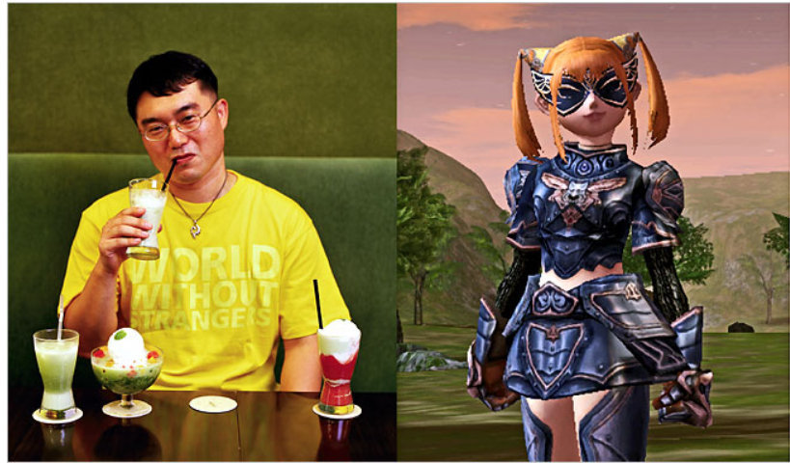
People can be who they want online
We need to make sure we are also safe and don’t trust anyone online that we don't know in person.
We should keep our identity personal.

Slide 4
Sharing your online identity
It is important to keep your identity safe online but also it is important to be a positive online citizen (helping people and being kind)
Only share information which is safe to do so.
Have an online avatar/profile that shows part of you but not your personal information.
Remember if somebody is being bullied online you can help by being a caring online citizen.

Slide 5
What would you share?
What is your name?
How old are you?
Where do you live?
Where do you go to school?
Who is your best friend?
What are your hobbies?
What is your phone number?
What is your email address?
What is your dream?

Slide 6
Task
Write down how you want to be online.
Are you kind, caring, energetic, happy, emotional, friendly, jubilant, giving, generous, strong, weak, interesting, educational, secretive?
You are going to put these as a wordle.
Your name will go in the middle BIG Then other around it put all your online characteristics.
Make it colourful and interesting.

Slide 7


Slide 8
Promise
Every child in the school is going to write a promise- something they will do to be a good online citizen.
It could be:
I will keep my personal information private.
I will be kind to people who are being cyberbullied.
I will only go on websites that are appropriate for me.
I will follow the advice from the Digital Leaders.
I will only add people I know to my profiles.

