Slide 1
ONLINE IDENTITY
DIGITAL LEADERS

Slide 2
What does online identity mean?
Online identity is how you portray yourself online, how people will see your profile.
Does

Slide 3
Here is a quick test to get you ready for the lesson
Alfie just got a friend request from a stranger what should he do?
Accept it
Ignore it
Accept it and ask who they are.

Slide 4
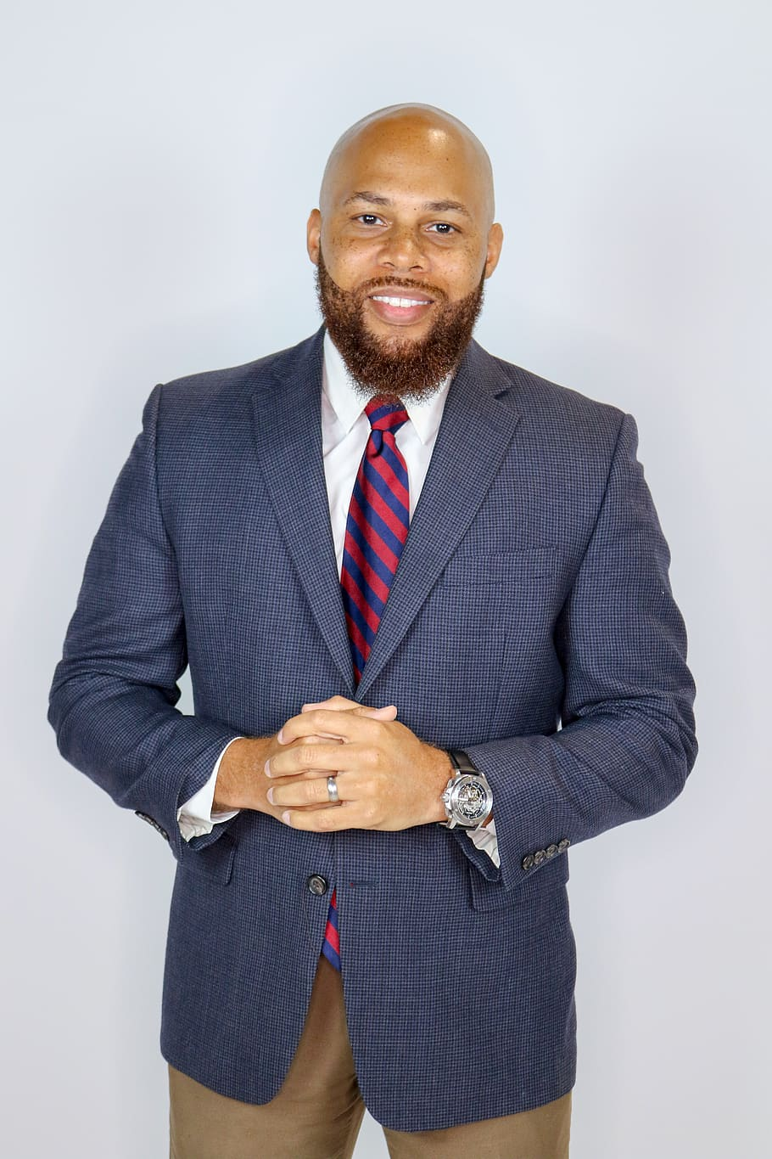
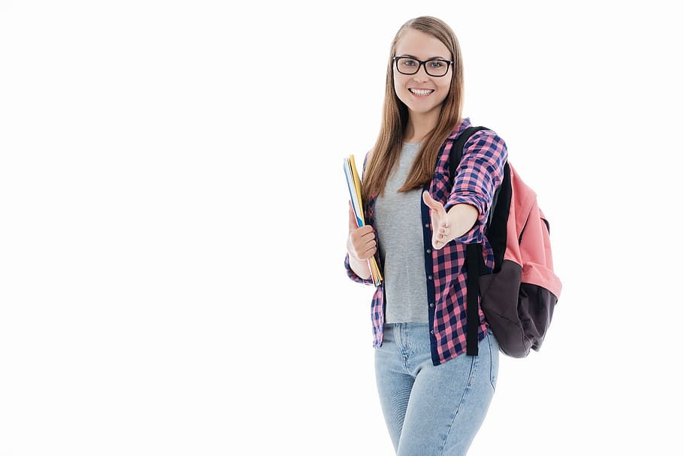
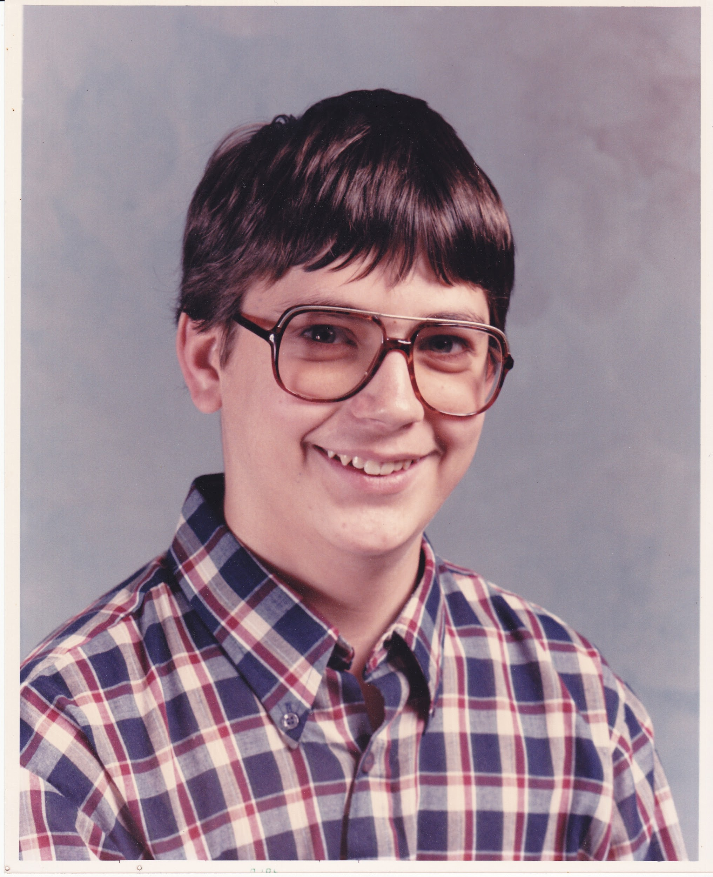
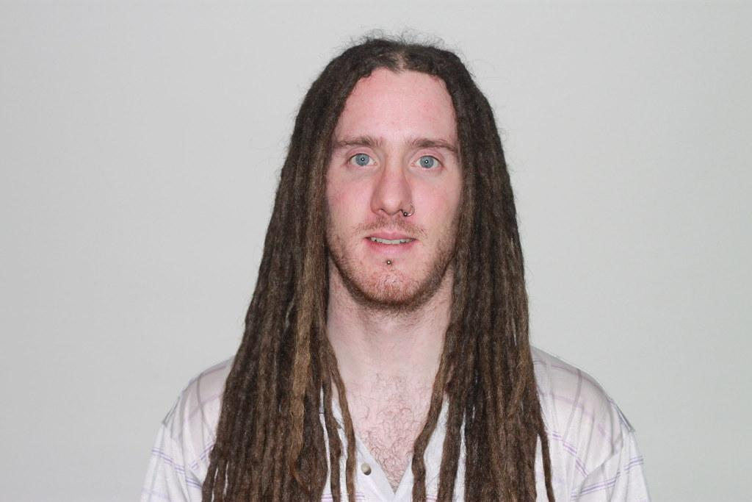
Guess who?
Which of these people would you assign these qualities to; Accountable, clever, free, decent, friendly, modest, conscientious, confident, hardworking, serious

Slide 5
Guess who ?
This person works as a presenter on television presenting a news show and is hardworking friendly and honest.

Slide 6
Guess who?
This person is on a football team where They play in goal. They are honest, serious and confident.

Slide 7
Guess who
THis person likes watching music and travelling they also care about the environment, they are friendly, free and accountable.

Slide 8
Guess who
This person is studying to become a teacher they are clever, hardworking and serious

Slide 9
Discussion
Were your first impressions correct?
What impressions do these images convey?
Do the pictures give a full impression of who these peopl are?

Slide 10
Your TAsk
Today you will create on online profile with all the information that you would share online for others to see;
Think about;
Name
Date of birth/ Age
School/Address
Hobbies
Family members.
Photographs

Slide 11
Example
I used this picture because...
I included this because….
Profile
------------------------------------------------------------------------------------------------
I didnt include this because...

Slide 12
Promise
Every child in the school is going to write a promise- something they will do to be a good online citizen.
It could be:
I will keep my personal information private.
I will be kind to people who are being cyberbullied.
I will only go on websites that are appropriate for me.
I will follow the advice from the Digital Leaders.
I will only add people I know to my profiles.

